Slide 1
Business & License Tax Division Almost One Year Later: The Motor Fuel Single Point Filing System Ashley Moon, Revenue Manager

Slide 2
Almost One Year Later: The Motor Fuel Single Point Filing System
Motor Fuel Single Point
Act 2018-469, Codified under Title 40, Chapter 17, Article 13
Established that the Department of Revenue would develop and maintain a Single Point filing system that allows taxpayers to timely file and pay county or municipal motor fuel taxes electronically through a single point at no charge to the taxpayer or local taxing jurisdiction
11/1/2019 - Taxpayers began filing returns using the MFSP System
This system is voluntary for taxpayers
Currently 91 taxpayers utilize the MFSP system

Slide 3
Local Requirements
Almost One Year Later: The Motor Fuel Single Point Filing System
Must provide ADOR with a 60-day notice prior to any additional or amended rates being available on the single point system
For reporting access, the locality must provide the Motor Fuels Section with a Nonemployee Confidentiality and Disclosure Statement for all employees and third-party administrators requiring access
A separate disclosure form for each tax type is required to be completed for access to confidential information

Slide 4
Local Reporting
Almost One Year Later: The Motor Fuel Single Point Filing System
Localities have the ability to query and export reports from disbursements
Using the same site as One-Spot, WRAP, and Local Tax Reports
Daily File Download
Returns: Detail data for daily disbursement
Payments: Detail data for daily confirmed payments
Debits: Detail data for returned payments
Query Data
Taxpayer data
Detail data for each end user/store

Slide 5
Taxpayer Requirements
Almost One Year Later: The Motor Fuel Single Point Filing System
Taxpayers must submit both the return and payment at the same time
Must submit return by the 20th of the month succeeding the month of activity
No late returns or amended returns will be accepted via the system
Late returns and payments must be made directly to the local taxing jurisdiction or designated agency
No refunds may be processed via the system
Return must include:
Name of store
Physical address of store
Sales tax number of store
Number of taxable gallons received
Local excise tax paid
Other information as required

Slide 6
Almost One Year Later: The Motor Fuel Single Point Filing System
FILING PERIOD | GALLONS | TOTAL TAX REMITTED
31-Oct-2019 | 60,145,655 | 1,476,398.24
30-Nov-2019 | 60,069,299 | 1,445,921.72
31-Dec-2019 | 76,731,924 | 1,859,755.40
31-Jan-2020 | 86,065,179 | 2,072,547.84
29-Feb-2020 | 84,482,442 | 2,031,120.49
31-Mar-2020 | 86,745,691 | 2,096,296.27
30-Apr-2020 | 63,204,376 | 1,498,475.98
31-May-2020 | 83,527,163 | 2,068,364.50
30-Jun-2020 | 89,874,248 | 2,232,848.01
31-Jul-2020 | 93,215,136 | 2,310,251.12
31-Aug-2020 | 93,307,264 | 2,302,749.07
11 Rows | 877,368,377 | $21,394,728.64

Slide 9
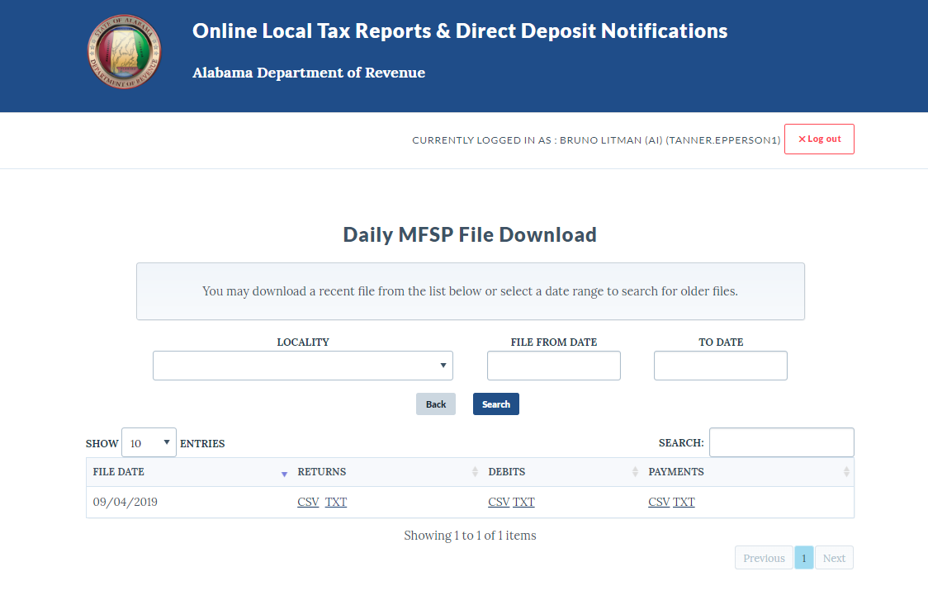
Local Reporting – Daily Download
Almost One Year Later: The Motor Fuel Single Point Filing System

Slide 10
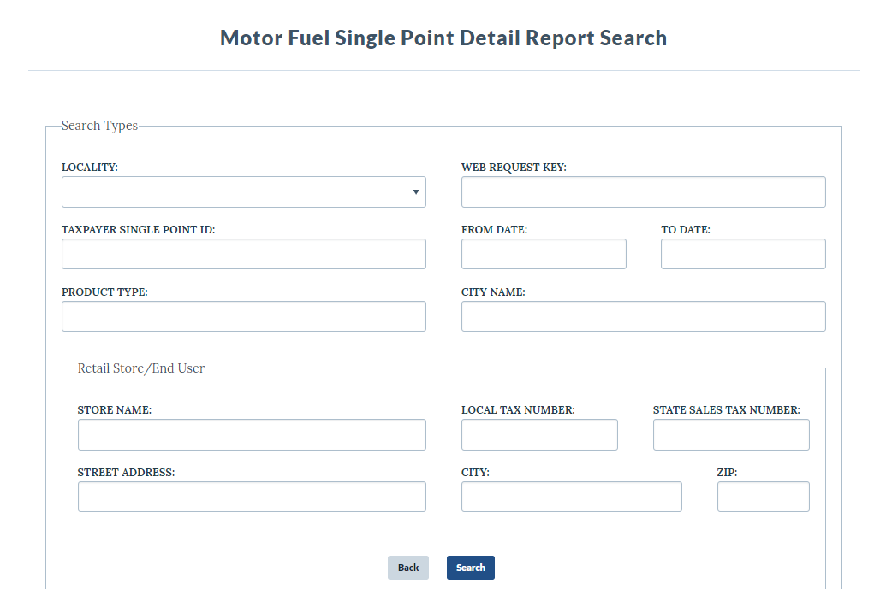
Local Reporting – Detail Report Search
Almost One Year Later: The Motor Fuel Single Point Filing System

Slide 11
Taxpayer Resources
Almost One Year Later: The Motor Fuel Single Point Filing System
https://revenue.alabama.gov/business-license/motor-fuels/
By visiting the above website, taxpayers can find a report listing all local motor fuel rates reported to the department, as well as information relating to Single Point and video tutorials on how to acquire an account and file a return.

Slide 12
Contact Information
Business & License Tax Division
Motor Fuels Section
P O Box 327540
Montgomery, AL 36132-7540
Telephone: (334) 242-9608
Fax: (334) 242-1199
E-mail: mft@revenue.alabama.gov

