Slide 1

Alabama Department of Revenue
Individual & Corporate Tax Division
CPE Training
January, 2016
Lynn Schoener, CPA, FAS II
(334) 353-8045
lynn.schoener@revenue.alabama.gov
Andrea Wyatt, Revenue Examiner III
(334) 353-9447
andrea.wyatt@revenue.alabama.gov
Notes:
1

Slide 2
Act 2015-027 (HB58)
Alabama Jobs Act
Notes:
1 of 5 bills described as the most significant overhaul of Alabama economic development since Mercedes-Benz

Slide 3
Act 2015-027 (HB 58)
Creates two credits that are available to qualifying projects on a discretionary basis: Jobs Credit and Investment Credit
Department of Commerce is the administrative agency
Jobs Credit –3% of previous year’s annual wages of eligible employees
Capital Investment Credit – up to 1.5% of qualified annual investment
Incentive period for each credit is 10 years. Qualifying projects can claim both credits.
Notes:
Capital Investment credit replaces the current capital credit and is transferrable

Slide 4
Act 2015-027 (HB 58)
Requirements
  1. Project must be qualifying project
    Must fall within certain NAICS codes. The act adds several additions
  2. Qualifying project must create a minimum of 50 jobs (certain activities are exempt from requirement) filled by Alabama residents
  3. Qualifying companies must be deemed an approved company by the Governor and the Department of Commerce
    Cost benefit analysis must show the anticipated tax benefit exceeds the cost and that the project would NOT decrease Alabama exports directly or indirectly.
Notes:
5 requirements. Additions include national security, electric power, pipeline and related industries, motion pictures and record production to name a few

Slide 5
Act 2015-027 (HB 58)
  Requirements cont’d
  4. Must be a project agreement with the Governor and the approved company
    Incentives to be granted and the order in which they will be claimed
    Capital investment to be made & time period in which it will be made
    Number of eligible employees
    Dates or conditions that start the incentive
    Length of the incentive period(s) for the project
    Annual and/or aggregate limitations on the credit amount(s)
    Recapture provisions
    Whether the project agreement is assignable

Slide 6
Act 2015-027 (HB 58)
  5. Proof of wages paid or investment made when claiming credit(s):
    Submit annual certifications of jobs created
    Wages paid
    Capital investment made
    The filings will be treated as tax returns subject to enforcements of ADOR

Slide 7
Act 2015-027 (HB 58)
Jobs Credit-2 methods available to claim credit and the method used must be spelled out in the agreement.
Credit claimed against the company’s utility taxes actually paid
  Any amounts exceeding the actual taxes paid can be carried forward for up to 5 years if allowed by the project agreement
  -or-
  Paid to the company as a refund out of the utility taxes (regardless of the amount of utility taxes paid)
Notes:
Assuming that the method is irrevocable unless the agreement is amended.

Slide 8
Act 2015-027 (HB 58)
Capital Investment Credit
Credit can be claimed to offset: 1) Income taxes including estimated taxes
            2) Financial Institution Excise Tax
            3) Insurance premiums tax including estimated taxes
            4) Utility taxes or a combination
Notes:
Or some combination of these taxes

Slide 9
Act 2015-027 (HB 58)
Capital Investment Credit cont’d
The credit is transferrable in the first 3 years of the project. It must be sold at a minimum of 85% of face value. The transferee is free of recapture unless the transfer is fraudulent.
Replaces the existing capital credit, the Made in Alabama credit, and the Tariff credit. These credits can be claimed until Jan 2, 2016 by filing form INT-1 and foregoing the incentives under the new act.

Slide 10
Act 2015-027 (HB 58)
Capital Investment Credit cont’d
Allow the credit to a pass through entity as long as the project provides for:
  The credit to be applied against 1) Employee stock owners
                2) Mutual Funds
                3) Real Estate Investment Trusts

Slide 11
Act 2015-041 (HB57)
Alabama Veterans &
Targeted Counties Act

Slide 12
Act 2015-041(HB 57)
Adds provisions to the Alabama Jobs Act
Defines “Targeted County”
  County that has a population of 25,000 or less
Jobs Credit Incentive
4% of previous year’s annual wages of eligible employees
Incentive period is 15 years if the project provides goods or services to another qualifying activity within 50 miles of the project site
Additional .5% of wages is allowed for employers that employed in the prior year 12% of its eligible employees as veterans
Establishes the Accelerate Alabama Fund which can make loans up to $2 mil to the projects
Notes:
Commissioner of Labor determines that the county qualifies as a ‘Targeted County’. Secretary of Commerce determines that the project has economic benefit to the targeted county. Dept of Labor will periodically verify the actual number & Wages of veterans employed by the company

Slide 13
Act 2015-041 (HB 57)
Fun facts
  67 Counties in Alabama
  12 have over 100,000 people
  29 have < 100,000 but > 25,000 people
  26 have < 25,000 people
  Largest County is Jefferson County with 660,793
  Smallest County is Greene County with 8,553
  Montgomery is 4th Largest County and 2nd Largest City in Alabama
Notes:
2010 Census data. Approximately 39% of Alabama counties qualify as targeted counties

Slide 14
Act 2015-291 (HB210)
Administrative Procedures Act Revisions

Slide 15
Act 2015-291 (HB 210)
The disapproval of a rule (a Departmental regulation) may be appealed to the Lt. Governor
Lt. Governor may review the rule and hold public hearings if necessary within 15 days after the disapproval of the rule
If the Lt. Governor sustains the disapproval, he or she shall notify the committee and return the rule to the agency
If the Lt. Governor approves the rule, he or she shall notify the chair of the committee and the rule will become effective upon adjournment of the next special session

Slide 16
Act 2015-291 (HB 210)
If the Lt. Governor fails to approve or disapprove the rule within the 15 day period:
  The rule will be deemed approved and will become effective upon adjournment of the next regular session
  Unless if prior to that time, the Legislature adopts a joint resolution that overrides the deemed approval of the Lt. Governor and sustains the action of the committee
  Extends the time of rules to become effective from 35 days after filing the certified rule to 45 days after filing
  Allows the committee to extend that period to 60 days if it determines a business economic impact is required

Slide 17
Act 2015-382 (HB243)
Removes
Certificate of Good Standing
Notes:
Part of the taxpayers bill of rights. Relating to confidentiality, disclosure, and exchange of tax information.

Slide 18
Act 2015-382 (SB 243)
Amends 40-2A-10; removes the Certificate of Good Standing; provides for a Certificate of Compliance
Certifies an entity is in compliance with ALL state taxes administered by ADOR
Taxpayer makes request on-line
There will be a fee of $10 for each certificate and a $4 processing fee is charged by Alabama Interactive

Slide 19
Act 2015-382 (SB 243) Continued
New Certificate of Compliance Section
Manager is Tamera Harrell
If contacted by taxpayers, refer all questions to (334) 242-1189
In the event that your taxpayer provides delinquent returns in order to come into compliance, NOTES should be made in RITS at the taxpayer level referring to what was received and when. This will help ensure that there are no unnecessary delays in providing the certificate to the taxpayer.

Slide 20
Act 2015-434 (SB 71)
Amendments to the Alabama Accountability Act of 2013

Slide 21
Act 2015-434 (S71)
Amends the Alabama Accountability Act of 2013
Increases cumulative amount of tax credits to from $25M to $30M
Allows for owners/members of partnerships and S-Corps to take pro-rata income tax credits for donations made to SGOs by the partnerships and S-Corps
Increases tax credit limitation for individuals making SGO contributions from $7,500 to $50,000
Notes:
SGO Scholarship Granting Organization

Slide 22
Act 2015-434 (S71)
Individual taxpayers making contributions to a SGO can offset up to 50% of tax liability
Changes who is eligible for a scholarship, based on income
Clarifies and confirms that once an eligible student receives an educational scholarship, the student remains eligible to receive the scholarship until he or she graduates or reaches age 19; regardless of whether or not he or she is zoned for a failing school

Slide 23
Act 2015-434 (SB 71)
Allows SGO to retain up to 5% donations for administrative costs
Lists various reports that SGOs are required to submit to the Department of Revenue quarterly and annually
Changes the release date for unaccounted scholarship funds from September 15 to July 31
Effectively “detaches” the failing school requirement” by allowing eligible students attending a non failing school to be awarded the scholarship funds that remain available after May 15 of each year

Slide 24
Act 2015-442 (SB226)
Creates the Achieving a Better Life Experience (ABLE) Act

Slide 25
Act 2015-442 (SB226)
Amends Sections 16-33C-1, 16-33C-2, 16-33C-2.1, 16-33C-3, 16-33C4, 16-33C-5, 16-33C-10, 16-33C-11, 16-33C-12 and 40-18-19
Renames the Wallace-Folsom College Savings Investment Plan Wallace-Folsom Savings Investment Plan
Adds the Achieving a Better Life Experience (ABLE) Act

Slide 26
Act 2015-442 (SB 226)
ABLE Program
  Follow under the guidelines of IRC section 529
  Will encourage Alabamians to save private funds for the purpose of supporting Alabama citizens with disabilities to maintain health, independence & a quality of life
  Beginning January 1, 2016, all income, interest, dividends, gains or benefits received from ABLE savings accounts are exempt from income taxation by the state
Notes:
§ 529 is the qualified college tuition programs

Slide 27
Act 2015-443 (SB287)
Income Tax Refund Check-Off
USS Battleship

Slide 28
Act 2015-447 (SB388)
Income Tax Refund Check-Off
Children First Trust Fund

Slide 29
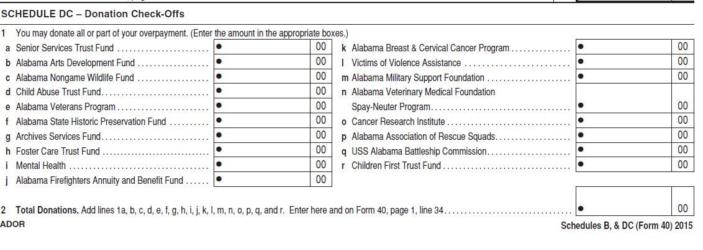
Act 2015-447 (SB 338)
Provides an income tax check-off for contribution to the Children First Trust Fund
Contributions will begin with the 2015 tax year
Notes:
Q and R

Slide 30
First Special Session 2015

Slide 31
Act 2015-502 (HB 18)
Automated Sales Suppression Device or Phantom-Ware Now a Class C Felony

Slide 32
Act 2015-502 (HB 18)
Makes the possession or use of an automated sales suppression device, or phantom-ware a Class C felony
Fine: Not more than $100,000 per person or $500,000 for a corporation
The person is also liable for lost revenue due the state and any locality
Illegal activity includes: Knowingly selling, purchasing, installing, transferring or being in possession of any automated sales suppression device or phantom-ware

Slide 33
Act 2015-504
Alabama Taxpayer and Fraud Prevention Act

Slide 34
Act 2015-504 (HB42)
Act 2015-504 passed in the First Special Session of the legislature is part of the State’s ongoing effort to combat income tax fraud. The Alabama Taxpayer and Fraud Prevention Act amends code section 40-18-73 to remove the ability of an employee to stop state tax withholdings from their wages.

Slide 35
Act 2015-504 (HB42)
This change was necessary as the Department’s research determined that an increasing number of employees were claiming the exemption from withholding and had ceased filing their income tax returns.
Notes:
Form A-4E

Slide 36
NEW WITHOLDING REQUIREMENTS
Departmental Business Rule 810-3-75-.03 has been amended to now require employers to submit their end of year reconciliation (W2’s/Form A3) to the Department on or before January 31.

Slide 37
NEW WITHOLDING REQUIREMENTS
Departmental Business Rule 810-3-75-.03 has been amended further to now require employers who currently file their monthly and quarterly withholding tax returns and payments online during the year to also submit their end of year wage and tax information (W2’s/Form A3) electronically with the Department as well.

Slide 38
Act 2015-505 (HB 49)
Factor Presence Nexus Standard

Slide 39
Act 2015-505 (HB 49)
Factor Presence Nexus Standard
Adds 40-18-31.2 which establishes a minimum factor presence nexus standard for nonresident individuals and business entities organized outside of Alabama.
Substantial nexus is establish if ANY of the following thresholds are exceeded
  1. $50,000 in Alabama property
  2. $50,000 in Alabama payroll
  3. $500,000 in Alabama sales
  4. 25% of total property, total payroll, or total sales

Slide 40
Act 2015-505 (HB 49)
Taxpayers whose business activities do not exceed the minimum thresholds are not required to file returns or pay the related business privilege tax, income tax, or excise tax
Does not negate PL 86-272
Effective for tax years beginning after December 31, 2014 (yes 2014)

Slide 41
Act 2015-527 (SB46)
Alabama Administrative Act

Slide 42
Act 2015-527 (SB 46)
Amends section 4 of Act 2015-291 (The Administrative Procedures Act)
  To specify that the Act would be prospective in operation to rulemaking commenced on or after October 1, 2105
  Provides for the review by the Lt. Governor of rules disapproved by the Joint Committee on Administrative Regulation Review under certain conditions
  Specifies that an agency may appeal the disapproval of a rule to the Lt. Governor within 15 days of the disapproval & the Lt. Governor will have an additional 15 days to review the disapproved rule

Slide 43
Act 2015-527 (SB 46)
States that the appeal must be in the form of a written letter
Specifies if the Office of Lieutenant Governor is vacant, the rule would be suspended until adjournment of next regular legislative session & would be reinstated at that time unless the Legislature sustains the disapproval by Joint Resolution

Slide 44
Second Special Session 2015

Slide 45
Act 2015-555 (SB20)
Alabama Tax Delinquency Amnesty Act

Slide 46
Act 2015-555 (SB 20)
Requires the Department of Revenue establish a Tax Amnesty Program
Program shall be effective at least two months in 2016 occurring prior to August 31, 2016
Program shall apply to ALL taxes administered by the Department EXCEPT for:
    Motor fuel taxes
    Penalties imposed by section 40-29-73
    Penalties for failure to submit information reports that are not based on an underpayment of tax
Notes:
Local sales, use, gross receipts, motor fuels taxes, utility taxes, personal property tax-generally taxes collected by others on behalf of the state or local governments

Slide 47
Act 2015-555 (SB 20)
Eligible: Taxpayers that have not been contacted by the Department of Revenue
Ineligible: 1) Taxpayers that have been contacted by the Department of Revenue or
2) Taxpayers who are parties to any criminal investigation or criminal litigations in any court of the United States or the State of Alabama

Slide 48
Act 2015-555 (SB 20)
    A 3-year look-back period will apply to tax types qualifying for the amnesty program
Tax periods eligible for the amnesty include: 1) Taxes due prior to January 1, 2015; or 2) Taxes for taxable periods that began before January 1, 2015
Taxpayers who want to take advantage of the program have to apply for amnesty and pay all tax due for those periods
If amnesty application is approved, all penalties and ½ of interest will be waived. Must agree to waive right to protest or initiate proceedings

Slide 49
NEW MAT REQUIREMENTS
The Departments online filing system My Alabama Taxes has undergone a change to the log in process to further protect our taxpayers and to help in the fight against the rise of identity theft and fraud. In addition to a user name and password, the system will now require an authentication code that can be either emailed or sent via text message to the user.

Slide 50
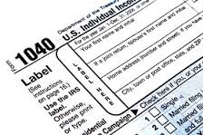
2015 FORMS

Slide 51
MAILED FORMS
The Department will mail income tax booklets (40/40NR) to Libraries and TPSC’s this year.
E-file most tax forms from our website.
Download and print all tax forms from our website.

Slide 52
Individual Income Tax Forms
Schedule AJA- Alabama Jobs Act-Investment Credit.
Schedule DEC-Career Technical Dual Enrollment Credit.
Schedule HTC- Historic Tax Rehabilitation Credit.

Slide 53
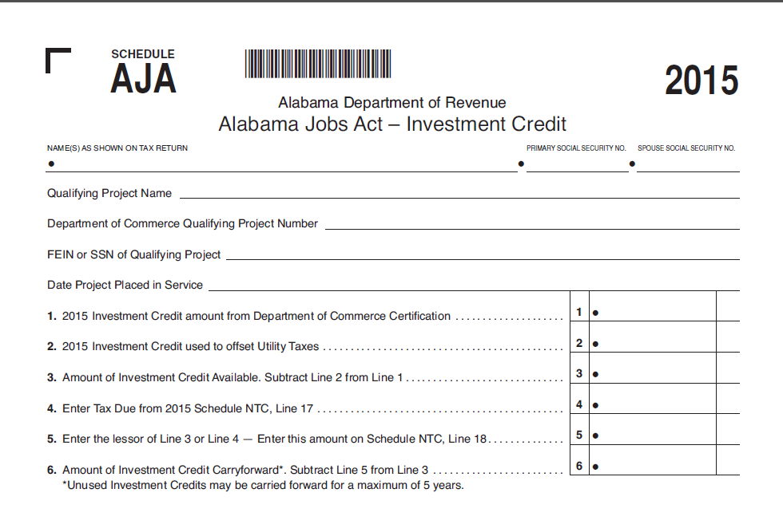
Notes:
Certificate will be issued by the Department of Commerce to the taxpayer.
Credits may be carried forward for up to (5) years.

Slide 54
Notes:
Dept of Post Secondary Education will issue tax credit certificate. Max Credit Allowable is 500,000. Credit may be carried forward for maximum of 3 years.

Slide 55
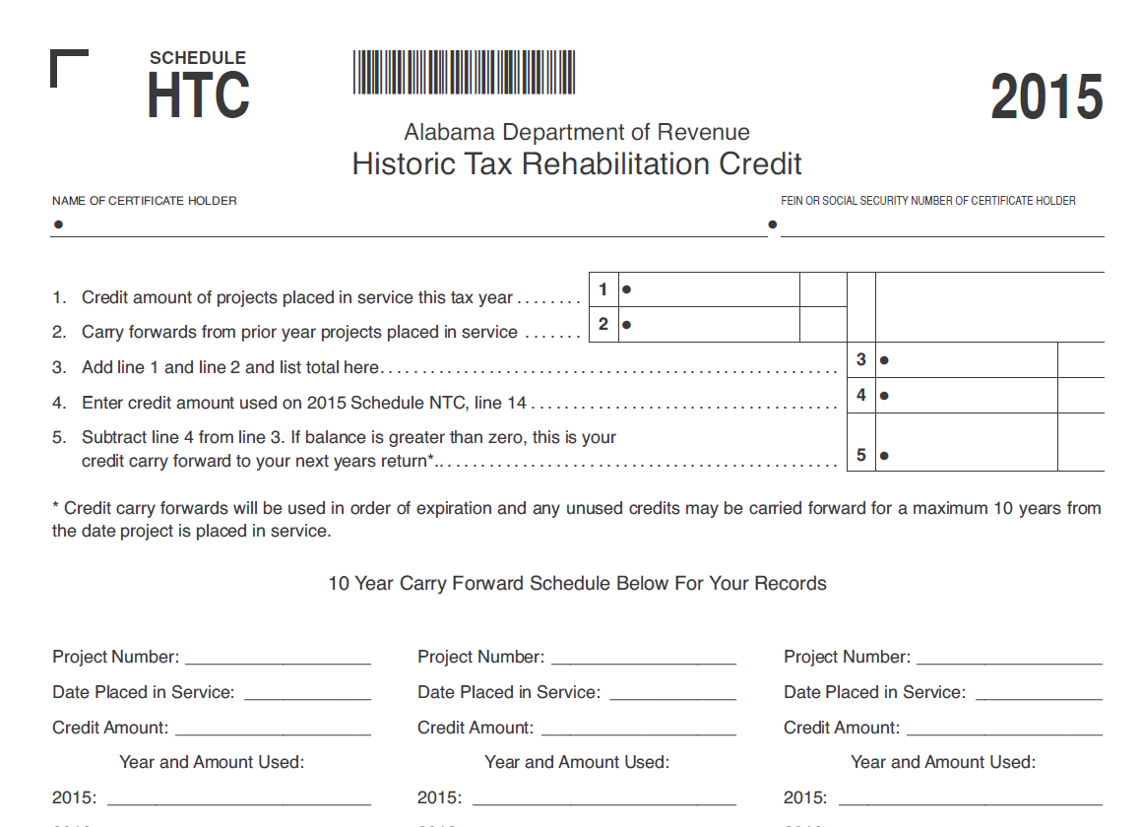
Notes:
Taxpayer’s can carry this credit forward for up to 10 years.

Slide 56
Individual Income Tax Forms
Schedule AATC- Credit increased to $50,000.
Schedule DC- 2 new check offs.
Form 40-Line 35 box added to check for direct deposit

Slide 57
Refund Calls
ADOR Website- “Where’s My Refund”
Phone: 1-855-894-7391(voice/ keyed response )
Call Center: (334)353-0944 or 1-800-535-9410

Slide 58
Pass Through Forms
Schedule D and E- identical to Individual Schedule D/E.
Schedule PC-Pass Through Credits for Forms 20S and 65.
Schedule FC- Fiduciary Credits for Form 41.

Slide 59
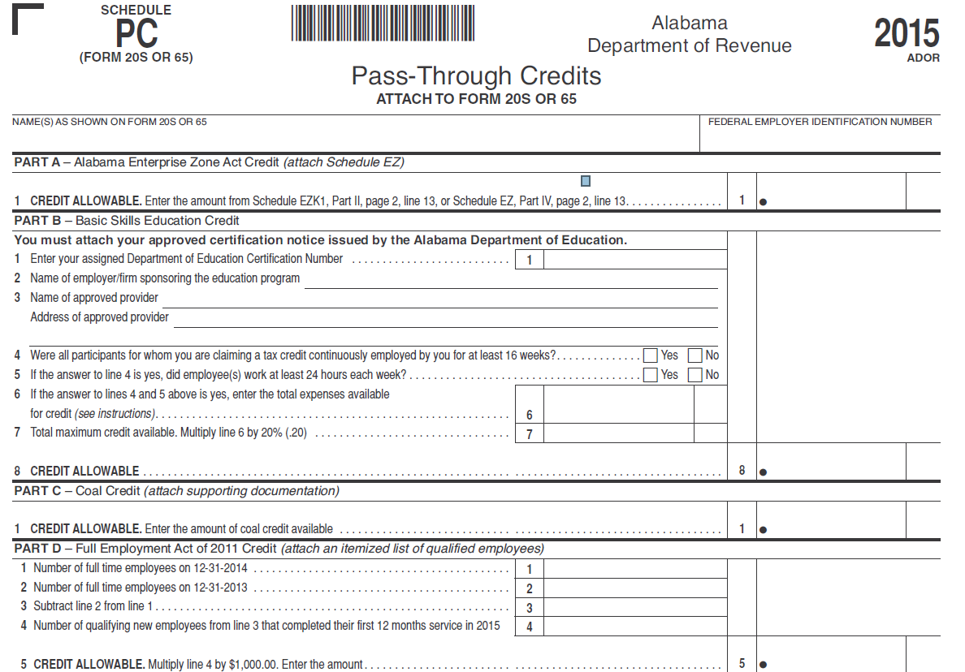

Slide 60
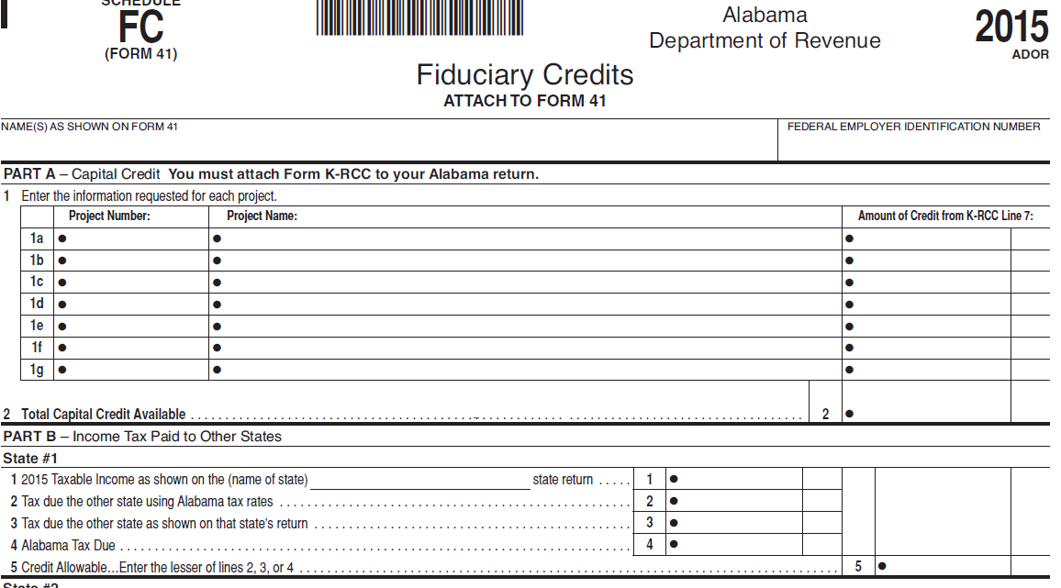

Slide 61
Pass Through Forms
Schedule PTE-R- Added Schedule NRA-R
Added 52/53 Week Check Box for forms 65/20S.
Notes:
The only entities that should use the NRA-R is those who are requesting relief from composite payments, those who are filing the Form 65.
There is already an option for this on the Form 20S.

Slide 62
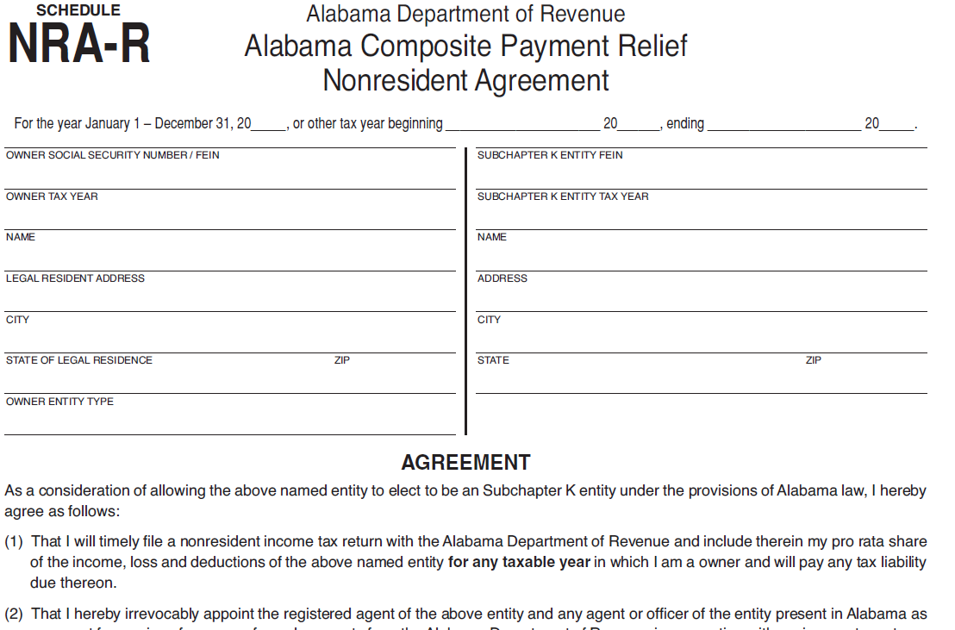

Slide 63
Business Privilege Tax Forms
Added 52/53 Week Check Telephone Number (334) 242-1200.
Schedule BPT-NWI (available for paper filers).
Schedule BPT-NW(available for MEF filers).
Notes:
BPT-NWI – Balance Sheet for Disregarded entities with individual and single members.
BPT-NW-Balance Sheer for those who are filing forms CPT and PPT.

Slide 64
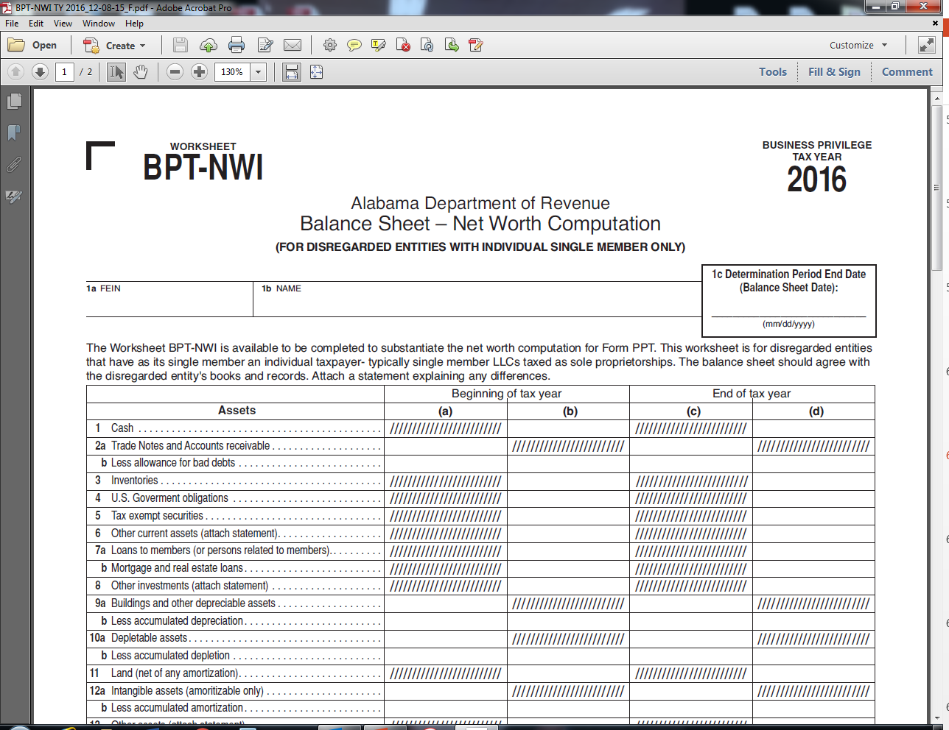

Slide 65
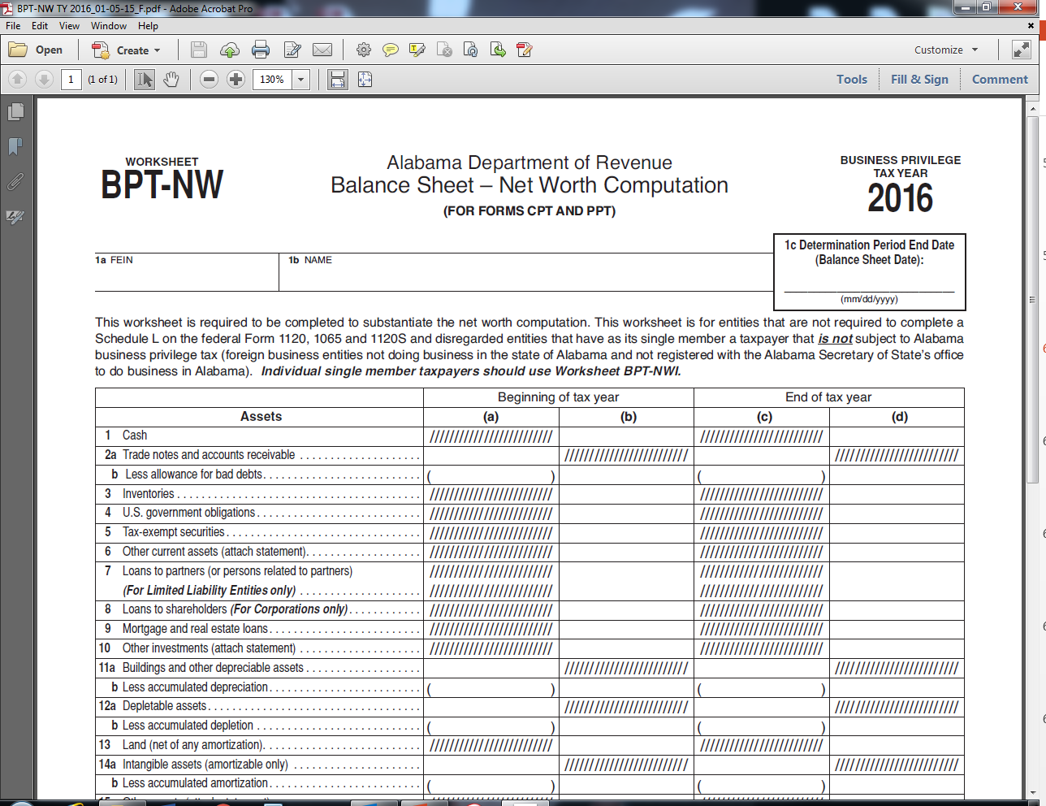

Slide 66
Corporate Income Tax Forms
Schedule EC- Excise Credits for Form ET-1.
Telephone Number (334) 242-1200.
Added 52/53 Week Check Box.
Major revisions to Schedule BC.
Notes:
ET-TC worksheet no longer utilized. Modified and Changed to Schedule EC.

Slide 67
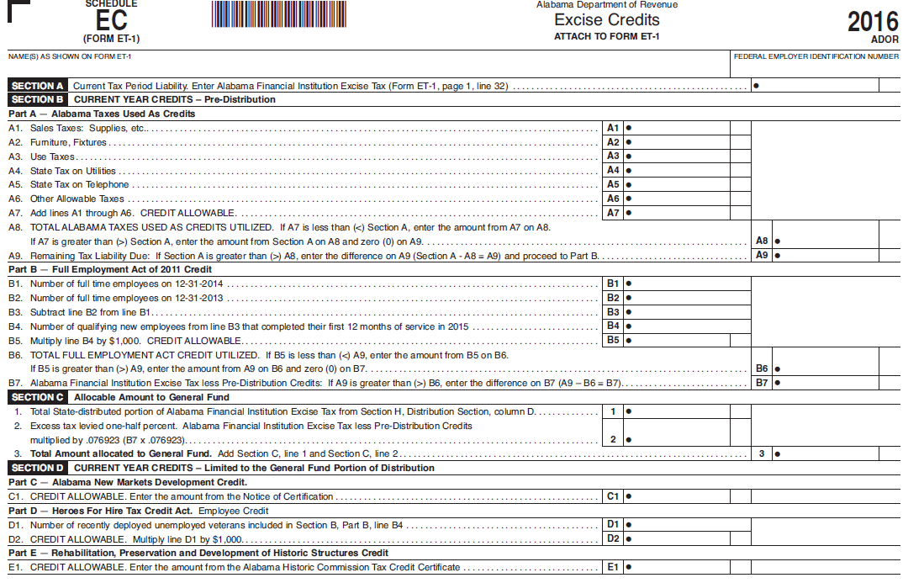
Notes:
ET-TC worksheet no longer utilized. Modified and Changed to Schedule EC.

Slide 68
Questions?
Lynn Schoener
lynn.schoener@revenue.alabama.gov
(334) 353-8045
Andrea Wyatt
andrea.wyatt@revenue.alabama.gov
(334) 353-9447
Notes:
Take Name Cards with us.

