Slide 1

Alabama Department of Revenue
Individual & Corporate Tax Division
2016 CPE Training
January, 2017
Lynn Schoener, CPA, FAS II
(334) 353-8045
lynn.schoener@revenue.alabama.gov
Andrea Wyatt, Revenue Examiner III
(334) 353-9447
andrea.wyatt@revenue.alabama.gov
Notes:
1

Slide 2

What’s New In
I.D. Theft Prevention
State partners with MorphoTrust USA to use a selfie to authenticate your identity when filing your 2016 returns.
Steps to participate:
Users will download the free app to their smartphone.
Take a photo of the bar code on the rear of their drivers license.
Scan the front of their drivers license to authenticate it is actually issued by AL DMV.
Take a selfie and submit.
The information submitted is compared to the drivers license information on file and if there is a match, the user will be registered for the service.
Each log in attempt or tax return submission requires a new selfie in lieu of a password to verify it is the actual taxpayer rather than a cyber criminal. Without an ID match the user cannot log in.

Slide 3

What’s New from the 2016 Regular Session of the Alabama Legislature

Slide 4
Act 2016-102 (HB34)
Alabama Renewal Act

Slide 5
Act 2016-102 (HB 34)
Alabama Renewal Act
The Alabama Renewal Act establishes two new income tax credits for the growth of business and industry in Alabama: The Port Credit and the Growing Alabama Act Credit.
The Port Credit is awarded to a company engaged in manufacturing, warehousing, or distribution which uses the state’s water, air, or rail ports and is based on the users increased cargo volume through such facilities.
The Act establishes the Alabama Renewal Commission in order to award the Port Credit.
The Port Credit is awarded based on the Commission's determination as to whether granting a Port Credit will increase the use of the state’s port facilities leading to the creation of new, high paying jobs in the state, bringing in substantial capital to the state, and further promoting the economic development efforts of the state.
The Alabama Renewal Act will sunset after the 2020 fiscal year, but Port Credits awarded prior to or in effect on this date will remain.

Slide 6
Act 2016-102 (HB 34)
Alabama Renewal Act
Requirements for awarding a Port Credit.
  An application which is available from the Alabama Renewal Commission must be filed by the port facility user with the Commission.
  An application fee determined by the Commission must be paid by the applicant to offset the costs of the program.
  The Port Credit may be conditioned on whatever requirements the Commission shall impose.
  The Commission may approve Port Credit Applications so as not to exceed $12,000,000 in awards over the life of the program.
  The Commission may approve Port Credit Applications so as not to exceed $5,000,000 in awards in any fiscal year.
  A company may assign and convey a Port Credit that has been awarded them to another company if substantially all of the assets of the company are assigned and conveyed in the same transaction.
  No deduction for the related expenses are allowed.

Slide 7
Act 2016-102 (HB 34)
Alabama Renewal Act
  Requirements for claiming a Port Credit.
  Port facility user must submit a certification to the Department of Commerce containing information adequate to prove the user is entitled to the Port Credit and have met the requirements set forth by the Commission.
  Must contain information as deemed necessary to verify that the port facility user shipped more than 105% of its cargo volume for the 12 month period immediately preceding the port facility users application to the Commission.
  Once the Department of Commerce verifies the required information, they will certify the information and report to the Department of Revenue that the user is entitled to the awarded Port Credit amount.
  Port Credit may be used to offset taxes levied by Chapter 18, but may not lower taxes to below zero.
  May also offset estimated tax payments levied by Chapter 18, but not below zero.
  Port Credit’s in excess of a users tax liability may be carried forward for up to 5 years.
  The Port Credit may be utilized on a pro rata basis for entities taxes under Subchapter S or Subchapter K since the Act is silent on the issue.

Slide 8
Act 2016-102 (HB 34)
Alabama Renewal Act
  Additional Port Credit Allocation Requirements.
  Port Credits which have not been awarded to a facility user may be allocated to any company which has entered into an economic development project agreement with the state.
  These Port Credit allocations shall be made by the Governor and approved by the Alabama Renewal Commission.
  Allocations may only be granted for a new warehouse or distribution facility which commits to investing at least $20,000,000 at a single site and which creates 75 new jobs in Alabama.
  Allocations for such projects shall not exceed $3,000,000.
  Port Credits allocated may not be utilized until the Department of Commerce has received satisfactory proof that the capital investment and job creation requirements have been met.
  Any Port Credit granted by allocation shall not be granted for more than 3 years.
  Obligations not met in the project agreement provides for the recapture of all or part of the allotted Port Credit.

Slide 9

Act 2016-102 (HB 34)
Alabama Renewal Act
The Growing Alabama Act Income Tax Credit was established to generate funding to help local economic development organizations develop building sites in order to attract business or industry to an area.
Allows taxpayers to make cash contributions to a local economic development organizations which has been approved by the Renewal of Alabama Commission and receive a credit which can be applied against Chapter 18 taxes.
Taxpayers will reserve their portion of any remaining available tax credit using an online portal system (M.A.T.) administered by the Alabama Department of Revenue similar to the SGO credit reservation system.

Slide 10
Act 2016-102 (HB 34)
Alabama Renewal Act
Requirements for Growing Alabama Credit.
In order to be eligible to receive funding, a local economic development organization must first apply to the Department of Commerce for funding.
The application must include confirmation that there has been expressed interest from industry in a building site and a description of the infrastructure work needed to make the site acceptable to the industry or business.
Application should also include quotes for the completion of such site preparation work.
Application should include an estimate of the number of jobs created, the average wages paid, and the capital
investment undertaken by the interested industry or business if the potential site were utilized.
3. If approved, the Department of Commerce will forward the application to the Alabama Renewal Commission. The Renewal Commission will consider the application further and if approved, shall specify the amount of money a local economic development agency may receive for completing the necessary site work in order to attract an interested industry or business to the area.

Slide 11
Act 2016-102 (HB 34)
Alabama Renewal Act
Requirements for claiming a Growing Alabama Credit.
Taxpayers, using ADOR’s online registration system, will reserve a contribution amount to a local economic development organization, but not in excess of the amount approved by the Renewal Commission for such organization.
A taxpayers credit for their donation cannot be in excess of 50% of their income tax liability.
Any unused credit may be carried forward up to a maximum of 5 years.
Growing Alabama Credit contributions for local economic development organizations are capped at $5,000,000 for the 2016 fiscal year and $10,000,000 for the fiscal years 2017, 2018, 2019, and 2020.
Contributions may only be claimed by the donating individual or corporate entity and may not be transferred to any other taxpayer.
A taxpayer may not claim credit for a donation made by any other entity including an entity taxed under subchapter S or subchapter K of which the taxpayer is an owner, shareholder, partner, or member.
Taxpayers may not take a separate itemized deduction in addition to the Growing Alabama Credit for any contribution made under this program to a local economic development organization.

Slide 12
Act 2016-102 (HB 34)
Alabama Renewal Act
  Additional Information:
  Upon receipt of funding provided by the Growing Alabama Credit, the local economic development organization may proceed with site preparation work as specified in their application to the Department of Commerce.
  The Growing Alabama Act Income Tax Credit will sunset in 2020.
  Repeal shall not cause a reduction or suspension of any credits awarded for fiscal year 2020 or prior, including carryforwards for years during which the Growing Alabama Credit was in effect.

Slide 13
Act 2016-188 (HB36)
Alabama Small Business and Agribusiness Jobs Act

Slide 14
Act 2016-188 (HB 36)
Alabama Small Business and Agribusiness Jobs Act
The Alabama Small Business and Agribusiness Jobs Act establishes an income tax credit for small employers which create new jobs in Alabama. The Act further requires the Alabama Department of Revenue to implement a program in order to promote the various tax credits that are available for small businesses in Alabama.
A $1,500 tax credit is allowed for any Alabama based small business employer with 75 or less employees (total full time and part time) which hires a new full time employee who meets the following criteria:
Was an Alabama resident.
Was employed by the small business employer on a full time basis for 12
consecutive months.
Was not a full time employee of the small business employer during anytime within
12 months prior to the start of the 12 month qualifying period.
Received wages from the small business employer which met or exceeded $40,000.

Slide 15
Act 2016-188 (HB36)
Alabama Small Business and Agribusiness Jobs Act
The credit will be allowed to offset either Chapter 16 or Chapter 18 income taxes.
The credit will be allowed on a pro rata basis to owners or members of an entity taxed under subchapter S or subchapter K of the IRC.
The credit will not be allowed to decrease a taxpayer’s tax liability to less than zero and is non-refundable.
Any unused portion of the tax credit will be allowed to be carried forward for a period of up to three years.
Credit may only be claimed for new employees who are hired following the effective date of the Act, July 25, 2016.
The credit will sunset on January 1, 2019 unless extended by the legislature.
Credit may not be claimed until the year in which the new employee has completed 12 months of consecutive full time employment with the employer.
Employer must have a growth in the total number of full time employees each year for which they are claiming a credit over the number of full time employees on the last date of the previous tax year.

Slide 16
Act 2016-188 (HB 36)
Alabama Small Business and Agribusiness Jobs Act
Continued
An employer may not claim a credit for the same employee under both the Alabama small Business and Agribusiness Jobs Act and the Full Employment Act of 2011.
Any credit used to offset a financial institution excise tax liability cannot reduce the distribution for municipalities and counties.

Slide 17
Act 2016-188 (HB36)
Alabama Small Business and Agribusiness Jobs Act
Additional requirements of the Act:
The Department of Revenue will create and implement a program to actively promote to small business owners, tax professionals, and other parties the credits allowed under the following Acts:
The Small Business and Agribusiness Jobs Act
The Full Employment Act of 2011
The Heroes for Hire Tax Credit Act of 2012
And other tax credits available to small businesses under Title 40.
The program will be administered in conjunction with the small business workshops offered throughout the state at various times and locations which are advertised on the Department’s website as “B.E.S.T.” seminars. “B.E.S.T.” stands for Business Essentials for State Taxpayers. These were formally known as the New Business Workshops.

Slide 18
Act 2016-345 (HB109)
Health Savings Account

Slide 19
Act 2016-345 (HB109)
Health Savings Account
Act 2016-345 adds a new section 40-18-15.6 to Chapter 18 relating to Health Savings Account Contributions.
For purposes of this Act, Health Savings Account Contributions are defined as contributions made by a taxpayer to his or her health savings account up to the maximum amount allowed under 26 USC S223.
Effective for tax form years “2018” and after.
Implementation will require a new line item on the individual tax return under the “Adjustments to Income” section, Part II, on page 2.
The new line item under the Adjustments to Income Section on page 2 should reference the HSA deduction amounts from Line 13 of the taxpayer’s federal income tax Form 8889 Health Savings Accounts (HSAs).

Slide 20
Act 2016-345 (HB109)
Health Savings Account

Slide 21
Act 2016-280 (HB400)
Financial Institution Excise Tax Offsets

Slide 22
Act 2016-280 (HB400)
Financial Institution Excise Tax Offsets
Act 2016-280 provides that any tax credit enacted on or after January 1, 2016 may only offset the state portion of a FIET liability and may not reduce the FIET distribution made to municipalities and counties.
Act 2016-280 does not amend, repeal, or supersede any FIET credit in effect on December 31, 2015.

Slide 23
Act 2016-283 (HB451)
Financial Institution Excise Tax Allocation and Apportionment Formula

Slide 24
Act 2016-283 (HB451)
Financial Institution Excise Tax Allocation and Apportionment Formula
Act 2016-283 amends code Section 40-16-4 to eliminate the requirement that the allocation and apportionment formula prescribed by the Department of Revenue for financial institutions be substantially the same as the allocation and apportionment formula recommended by the Multistate Tax Commission (MTC).
Removing the requirement does not mean that Alabama will not strive to maintain regulations similar to those currently in place with the MTC.
As an MTC member state, Alabama helps to develop model statutes and regulations for the other member states to consider for adoption.

Slide 25
Act 2016-314 (SB90)
Apprenticeship Tax Credit Act of 2016

Slide 26
Act 2016-314 (SB90)
Apprenticeship Tax Credit Act of 2016
Act 2016-314 established the Apprenticeship Tax Credit Act of 2016.
Credit shall equal $1,000 per qualified apprentice.
Available to eligible employers who employ an apprentice for at least 7 full months of the taxable year.
The credit will be allowed to offset the tax imposed by Chapter 16 or Chapter 18.
The credit will be allowed on a pro rata basis to owners or members of an entity taxed under subchapter S or subchapter K of the IRC.
The credit will not be allowed to decrease a taxpayer’s tax liability to less than zero and is non-refundable.
The cumulative amount of tax credits allowed by this Act cannot exceed $3,000,000 annually.
Effective for tax form years 2018, 2019, 2020, 2021, and 2022, unless extended by an Act of the legislature, for taxpayers subject to Chapter 16.
Effective for tax form years 2017, 2018, 2019, 2020, and 2021, unless extended by an Act of the legislature, for taxpayers subject to Chapter 18.

Slide 27
Act 2016-314 (SB90)
Apprenticeship Tax Credit Act of 2016
Credit eligibility:
Apprentice hired must be at least 16 years of age.
Must have written apprenticeship agreement between apprentice and sponsor which contains the terms and conditions of employment and training.
Apprenticeship agreement must be registered with the Office of Apprenticeship of the Employment and Training Administration of the United States Department of Labor.
Employer may hire as many as 5 apprentices under the program.
The credit for each individual apprentice shall not be available for more than 4 years.

Slide 28
Act 2016-314 (SB90)
Apprenticeship Tax Credit Act of 2016
Continued:
Credit shall equal up to, but cannot exceed $1,000.
The Department of Revenue in consultation with the Workforce Development Division of the Department of Commerce shall establish a scale reflecting ranges of amounts of money an employer has invested in an eligible apprentice and a corresponding tax credit amount and shall award the tax credit amount in accordance with this scale following confirmation from the Workforce Development Division that the apprentice for whom the credit is claimed is in compliance with all requirement of the apprenticeship program.
Employers may also apply for a credit on a pro rata monthly basis if the apprentice works less than the full preceding year beginning on the first day of the first full month of apprenticeship.

Slide 29
Act 2016-412 (SB263)
Return Due Date Conformity

Slide 30
Act 2016-412 (SB263)
Return Due Date Conformity
Act 2016-412 establishes conformity of the due date of Alabama income tax returns with the due dates of the federal returns and further provides that any payment due be made on the due date of the corresponding return.
Amends code sections 40-18-27, 40-18-39, and 40-18-42.
Individual Income Tax Return information:
40-18-27 is amended to read that “Returns shall be filed by the same date as the corresponding federal income tax returns are required to be filed as provided under federal law”.
This amendment removed the existing references to on or before April 15.

Slide 31
Act 2016-412 (SB263)
Return Due Date Conformity
Corporate Income Tax Return information:
40-18-39 is amended to read that “Returns shall be filed by the same date as the corresponding federal income tax returns are required to be filed as provided under federal law”.
This amendment removed the existing references to on or before March 15.

Slide 32
Act 2016-412 (SB263)
Return Due Date Conformity
Return Payment Information:
40-18-42 is amended in the case of individuals to reflect payment is due at the same time as the due date of an original return. Removes references to April 15.
40-18-42 is amended in the case of corporations to reflect payment is due at the same time as the due date of an original return. Removes references to March 15.

Slide 33
Act 2016-321 (SB312)
Amendments to the 2015 Alabama Jobs Act

Slide 34
Act 2016-321 (SB312)
Amendments to the 2015 Alabama Jobs Act
Act 2016-321 amends Code Sections 40-18-370 and 40-18-376.2 relating to the Alabama Jobs Act of 2015.
Code Section 40-18-376.2 is amended to reflect that any incentivized company (approved by the Secretary of Commerce and the Governor) which employs eligible employees on such projects located within a former active duty military installation closed by the Base Realignment and Closure (BRAC) process will be eligible for an additional 0.5 percent jobs credit in addition to the existing jobs credits noted below.
The existing Alabama Jobs Act allows a 3% refund or credit of prior year wages paid to eligible employees with an additional 0.5 percent credit if 12% or more of the project workforce are veterans who received either an honorable or a general discharge.
The Alabama Jobs Act credit can be used to offset a company’s Utility Taxes due or can be a refund of a company’s Utility Taxes regardless of the amount paid.
Code Section 40-18-370 is amended to allow an incentivized company to claim one or more the available Jobs Act credits. This would make it possible for an incentivized company to qualify for all three Jobs Act credits.

Slide 35
Refresher
Existing Credits and Accompanying Schedules
Act 2011-551
Full Employment Act of 2011
Title 40, Chapter 18, Article 11, Sections 40-18-290 through 40-18-293
Schedules OC, BC, EC, and PC
Applies against Chapter 16 or Chapter 18 liabilities
Available on a pro rata basis for subchapters S or K entities
$1000 credit available to small employers (50 or fewer employees) which hire a full time employee earning more than $10 per hour who completes 12 months of continuous service.
Credit is non-refundable and cannot decrease a taxpayer’s liability to less than zero.

Slide 36
Refresher
Existing Credits and Accompanying Schedules
Act 2011-689
Neighborhood Infrastructure Incentive Plan Credit
Title 11, Title 2, Chapter 71, Sections 11-71-1 through 11-71-12
Schedule OC
Chapter 18
Credit is 10% of the assessment paid not to exceed $1,000 in any one tax year for a period not exceeding 10 successive years
Act sunsets December 31, 2015 for new projects

Slide 37
Refresher
Existing Credits and Accompanying Schedules
Act 2012-168
Heroes for Hire Tax Credit
Title 40, Chapter 18, Article 13, Sections 40-18-320 through 40-18-324
Schedules OC, BC, and PC
Provides an additional $1,000 credit to businesses that meet the requirements of the Full Employment Act of 2011 (Act 2011-551)
Provides a $2000 credit for business start up expenses of a recently deployed unemployed veteran
If a credit is taken by a veteran for the start up expenses, a credit cannot also be taken for the same veteran by an employer under the Full employment Act and Heroes for Hire Act

Slide 38
Refresher
Existing Credits and Accompanying Schedules
Act 2012-391 amended by Act 2013-66
Irrigation/Reservoir System Tax Credit
Title 40, Chapter 18, Article 14, Sections 40-18-340 through 40-18-344
Schedules OC, BC, and PC
Applies against Chapter 16 or Chapter 18 liabilities
Available on a pro rata basis for subchapters S or K entities
One time only credit is equal to 20% of the system cost up to $10,000
Unused credit amounts may be carried forward for up to 5 years

Slide 39
Refresher
Existing Credits and Accompanying Schedules
Act 2012-483
Alabama New Markets Development Credit
Title 41, Chapter 9, Article 8C, Sections 41-9-216 through 41-9-219.7
Schedules ANM,NTC, BC, EC, and PC
Applies against Chapter 16 or Chapter 18 liabilities
Credit is 8.33% of the taxpayers investment for 6 years (50% of the taxpayers investment)
Cumulative amount of credits for any year shall not exceed $20,000,000
Maximum credit for a qualifying project is $10,000,000
Unused credit amounts may be carried forward for up to 7 years

Slide 40
Refresher
Existing Credits and Accompanying Schedules
Act 2013-64 amended by Acts 2013-265 and 2015-434
School Transfer Credit – AAA Credit
Title 16, Chapter 6D, Sections 16-6D-1 through 16-6D-9
Schedule AATC, NTC, and Payment section of return
Chapter 18
Refundable Parent tax credit for the transfer of student from failing to non-failing public or private school.
Credit for eligible student is the lesser of 80% of the average state cost of attendance for K-12 attendance or the actual costs to attend the non-failing public or the private school.

Slide 41
Refresher
Existing Credits and Accompanying Schedules
Act 2013-64 amended by Acts 2013-265 and 2015-434
SGO Donation Credit – Scholarship Granting Organization
Title 16, Chapter 6D, Sections 16-6D-1 through 16-6D-9
Schedules AATC, NTC, BC and PC
Chapter 18
Allows a credit for individual donations to a registered SGO up to 100% of their donation or $50,000 whichever is less not to exceed 50% of their liability.
Allows a credit for corporate donations to a registered SGO up to 100% of their donation not to exceed 50% of their liability.
Allowable credits that exceed 50% of the taxpayers liability may be carried forward for up to 3 years.
Available on a pro rata basis for subchapters S or K entities
Credits may not be transferred.
Cumulative amount of credits for any year shall not exceed $30,000,000

Slide 42
Refresher
Existing Credits and Accompanying Schedules
Act 2013-241 amended by 2014-452
Historic Rehabilitation Tax Credit
Title 40, Chapter 9F, Sections 40-9F-1 through 40-9F-8
Schedules HTC, NTC, BC, EC, and PC
Applies against Chapter 16 liabilities
Available on a pro rata basis for subchapters S or K entities
Maximum credit amount for a commercial project is $5,000,000
Unused credit amounts may be carried forward for up to 10 years
Cumulative amount of credits reserved may not exceed $20,000,000 annually for a total of $60,000,000 for the 3 years 2013, 2014, and 2015.
Tax credit certificates can be transferred

Slide 43
Refresher
Existing Credits and Accompanying Schedules
Act 2014-147
Career Technical Dual Enrollment Credit
Title 16, Chapter 60, Article 17, Section 16-60-350 through 16-60-354
Schedule DEC, NTC, BC and PC
Applies against Chapter 18 liabilities
Available on a pro rata basis for subchapters S or K entities
Credit is limited to 50% of contributors donation not to exceed 50% of their tax liability, but in no case can exceed $500,000 in any year.
Non-refundable, but unused amounts may be carried forward 3 years.
Annual cap on the Dual Enrollment credits for the year shall not exceed $5,000,000.

Slide 44
Refresher
Existing Credits and Accompanying Schedules
Act 2014-413
Adoption Credit
Title 40, Chapter 18, Article 15, Sections 40-18-360 through 40-18-363
Schedule AAC, NTC, and Payment section of return
Refundable tax credit for private intrastate adoption or adoption of qualified foster child
Maximum credit is $1000 per qualifying adoption

Slide 45
Refresher
Existing Credits and Accompanying Schedules
Act 2015-027
Alabama Jobs Act Credit – Investment Credit
Title 40, Chapter 18, Article 16, Sections 40-18-370 through 40-18-383
Schedules AJA, NTC, BC, EC, and PC.
Can be used to offset Income, FIET, Insurance Premium, Utility, or a combination of the aforementioned taxes.
Credit may not exceed the taxpayer’s liability for the tax year
Unused credit amounts may be carried forward for up to 5 years
Replaces both the Capital Credit, Made In Alabama Credit, and the Tariff Credit. No entity has qualified for the Tariff Credit, so there should be no Tariff Credits allowed on any returns for any years.

Slide 46
Act 2015-555 (SB20)
Alabama Tax Delinquency Amnesty Act
Required the Department of Revenue establish a Tax Amnesty Program that run for two months in 2016 occurring July 1 through August 30, 2016.
The number of applicants were 489
The number of applicants that qualified for amnesty 93
The dollar amount collected to date $399,202.00

Slide 47
Act 2015-555 (SB20)
Alabama Tax Delinquency Amnesty Act
Individual and Corporate Division Amnesty Application Numbers
Tax Type | Approved | Unapproved | Total
Corporate Income Tax | 19 | 5 | 24
Business Privilege Tax | 30 | 14 | 44
Individual Income Tax | 37 | 166 | 203
Financial Institution Excise Tax | 1 | 1 | 2
Withholding | 6 | 10 | 16
Account Type | Number of Taxpayers | Number of Returns | Amnesty Payments
Business Income Tax | 1 | 5 | $370,230
Business Privilege Tax | 4 | 9 | $23,463
Fiduciary Tax | 1 | 2 | $107
Individual Income Tax | 4 | 8 | $5,402

Slide 48


Business Rules
Notes:
48

Slide 49

Act 2013-088
Red Tape Reduction Act
Requires Business Rules be reviewed every 5 years
Steps currently underway to review all existing rules to bring the Department into compliance before the first deadline of July 2018.
Each Section should be reviewing all business rules which apply to them and making the appropriate response in Lotus Notes as to whether they need to be amended, repealed, or no change (reviewed).

Slide 50
Repeal of Alabama Rules
810-3-34-.01 and 810-3-35-.01
Provides guidance for AL Code Sections 40-18-34 and 40-18-35
Alabama tied to federal taxable income in 1999
Before 1999, these sections defined gross income of corporations and allowed certain deductions in calculating AL taxable income
It was determined that no clarification was needed to any additions or subtractions required by the current version of AL Code Sections 40-18-34 and 40-18-35 except the federal income tax deduction.

Slide 51
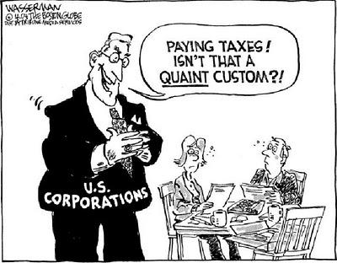
Changes in
Federal Income Tax Deduction
Changes apply to Corporate Income Tax and Financial Institutions Excise Tax
New rules apply to tax years beginning after August 29, 2016. See AL Rule 810-3-35-.01
Allocation of federal taxes paid by a federal consolidated group no longer based on IRC 1552 method. New method consistent with IRC 1552 (a)(1).
Alternative Minimum Tax (AMT) paid is deductible as federal taxes paid. Alternative Minimum Taxable Income is used to allocate the AMT paid to members of a federal consolidated group.
Notes:
Neal, You may wish to add as a refresher for next year when examiners will start seeing these returns.

Slide 52

The Multistate Tax Commission (MTC) is an intergovernmental state tax agency working on behalf of states and taxpayers to administer, equitably and efficiently, tax laws that apply to multistate and multinational enterprises. One of the responsibilities of MTC is to maintain the model of the Uniform Division of Income for Tax Purposes Act (UDITPA) and the model rules and regulations interpreting that model statute.
This year Revenue repealed their existing Code of AL, Chapter 27 of Title 40 (UDITPA) rules numbered AL Rules 810-27-1-4-.01 through 810-27-1-4-.19. The numbering system of these rules were not consistent with the numbering system of other rules and necessitated their repeal.
AL Rules 810-27-1-.01 through 810-27-1-.19 less 810-27-1-.03 have replaced the existing rules. Largely consistent with the repealed rules, but the material changes include:
  Business Income definition consistent with Code of AL, Section 40-27-1.1. Several rules were updated, but see primary changes in AL Rule 810-27-1-.01
  Compensation should include payments made for leased employees. See AL Rule 810-27-1-.13
  Special Rules for the allocation and apportionment of income for Telecommunications companies were added, See AL Rule 810-27-1-.18.07
  Process added for taxpayers requesting alternative allocation and apportionment. See AL Rule 810-27-1-.18
  Special Industry rules were separated from AL Rule 810-27-1-.18 and into new rules, see AL Rules 810-27-1-.18.01 through 810-27-1-.01.07

Slide 53
The MTC also maintains special rules for the allocation and apportionment of income from special industries. One such industry that has special rules is the banking industry who file Financial Institution Excise Tax (FIET) in AL.
This year revenue adopted new MTC rules that change how the apportionment factor is calculated for FIET taxpayers. See AL Rule 810-9-1-.05
Material changes include:
  Loan receivables excluded from the Property Factor. (SINAA no longer applies)
  Added definitions for terms debit card and merchant discount.
  Sourcing rules added for debit card fees and other fees associated with cards, merchant discounts and ATMs
  All other receipts should be sourced according to AL Rules 810-27-1-.16 and 810-27-1-.17
These rules, while effective in March 2016, will have a delayed application and will be applicable for operating years beginning January 1, 2017.

Slide 54

Electronic Filing Information

Slide 55

My Alabama Taxes
ADOR continues to offer a FREE electronic filing option to individual Alabama taxpayers filing a state tax return.
No income limitations or other qualifications must be met to take advantage of this free online filing system.
Go to www.myalabamataxes.alabama.gov to sign up and efile.
Notes:
55

Slide 56
Electronically Filed Returns
As of October 1, 2016-Individual Returns:
  1,583,040 returns have been filed electronically
  65% returns filed have been refund returns

Slide 57
Electronically Filed Business MeF Returns
Information as of October 1, 2016:
Form Type | Total Received | % e-filed
20C | 24,855 | 66.68%
20CC | 126 | 66.67%
CPT | 13,734 | 45.17%*
PPT | 77,924 | 45.17%*
20S | 51,364 | 81.56%
PTEC | 10,694 | 63.06%
65 | 47,958 | 81.37%
41 | 17,651 | 56.33%
*CPT and PPT information is reported together.

Slide 58
Modernized Electronic Filing (MeF)
Contacts
Tavares Mathews – Individual MeF (40 and 40NR)
tavares.mathews@revenue.alabama.go
334-353-9497
Missy Gillis – Business MeF (20S, 65, PTEC and 41)
melissa.gillis@revenue.alabama.gov
334-353-9178
Nicci Adams – Business MeF (20C, 20CC , CPT and PPT)
nicci.adams@revenue.alabama.gov
334-353-0685
Veronica Jennings – Mef Development and Web Service, Manager
veronica.jennings@revenue.alabama.gov
334-353-9440

Slide 59

2016 Forms

Slide 60
Mailed Forms
The Department will mail income tax booklets (40/40NR) to Libraries and TPSC’s this year.
E-file most tax forms from our website.
Download and print all tax forms from our website.
Order tax forms from our website.

Slide 61

Form Changes

Slide 62
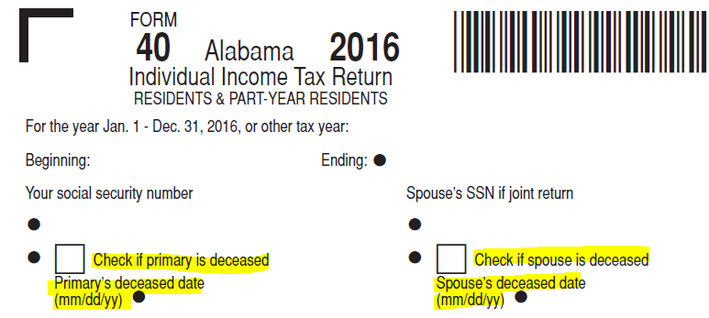
2016
Individual Income Tax Forms
Added deceased taxpayer information requirement to both paper and efile

Slide 63
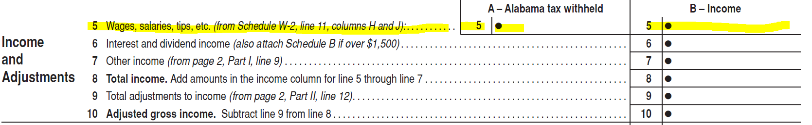
2016
Individual Income Tax Forms
New Schedule W2 for paper filed returns this year. Totals from the Schedule W2 will carry over to page 1, line 5 of the return.

Slide 64
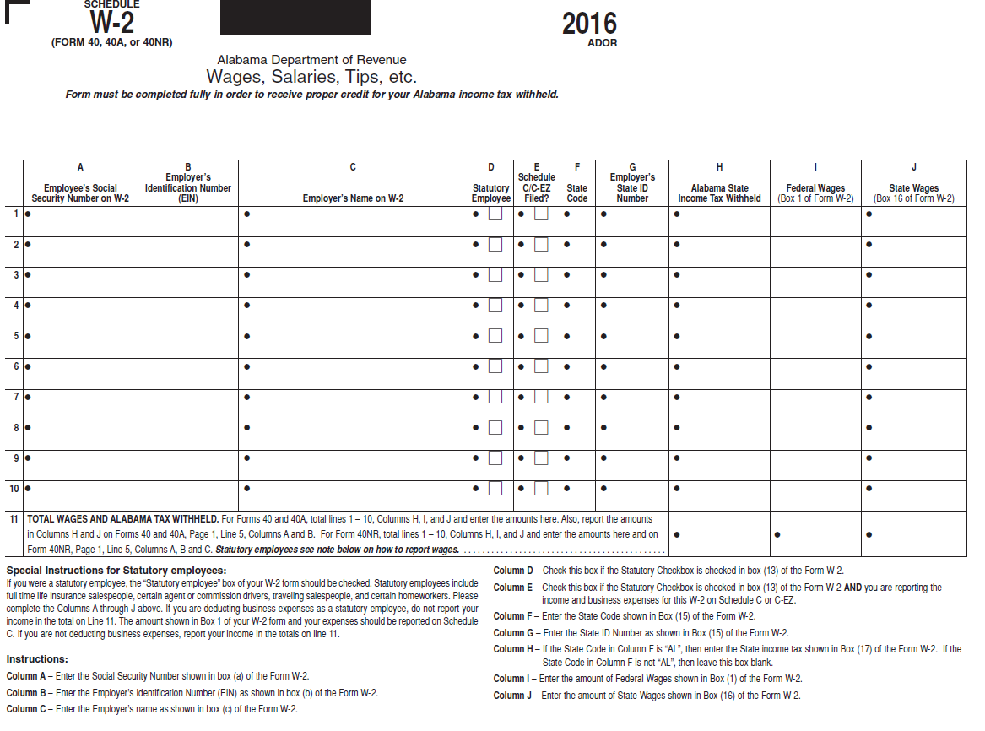
Schedule W2

Slide 65
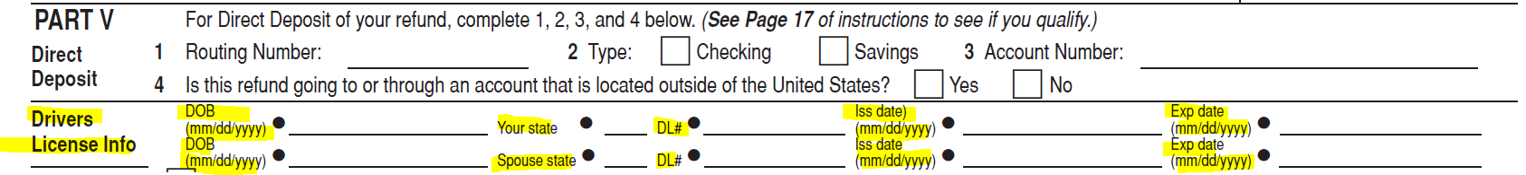
2016
Individual Income Tax Forms
Added drivers license information requirement to paper returns to include:
Date of birth, license number and state, license issue and expiration date

Slide 66
New Forms for 2016
Form 1310A - Statement of Person Claiming Refund Due a Deceased Taxpayer
For use when claiming a refund on behalf of a deceased taxpayer or if you need to reissue a joint named check in the name of spouse only.
Form PWR - Request for Penalty Waiver
For use by all Sections within the Department by a taxpayer requesting a penalty waiver.

Slide 68
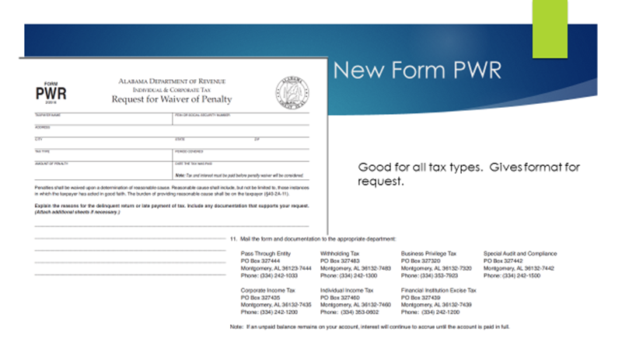
Form PWR – Request for Penalty Waiver

Slide 69
2016 Schedule Changes
The following schedules were updated to allow for a pro rata share of credit as requested by the business community.
AJA
DEC
HTC

Slide 70
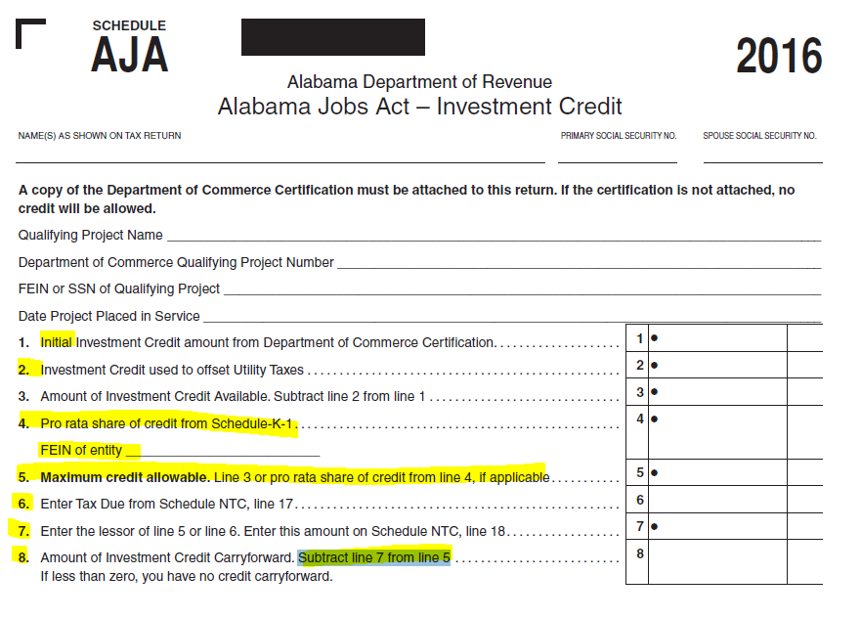

Slide 71
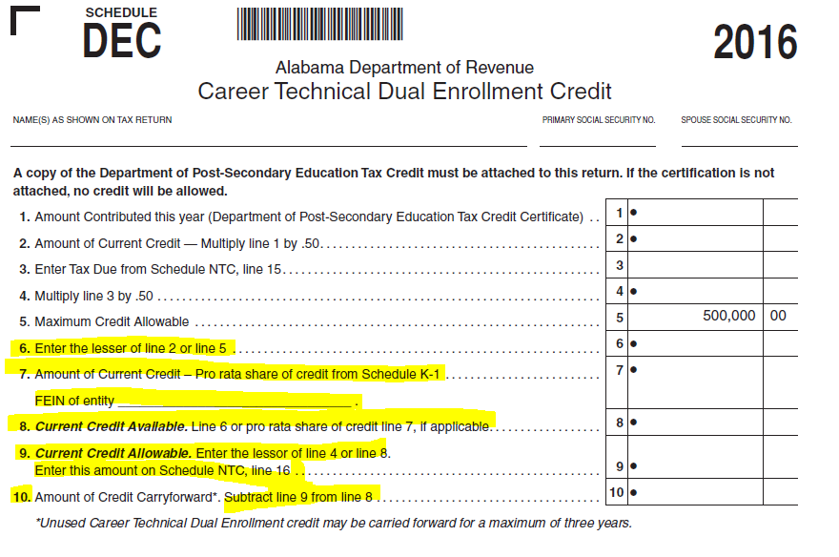

Slide 72
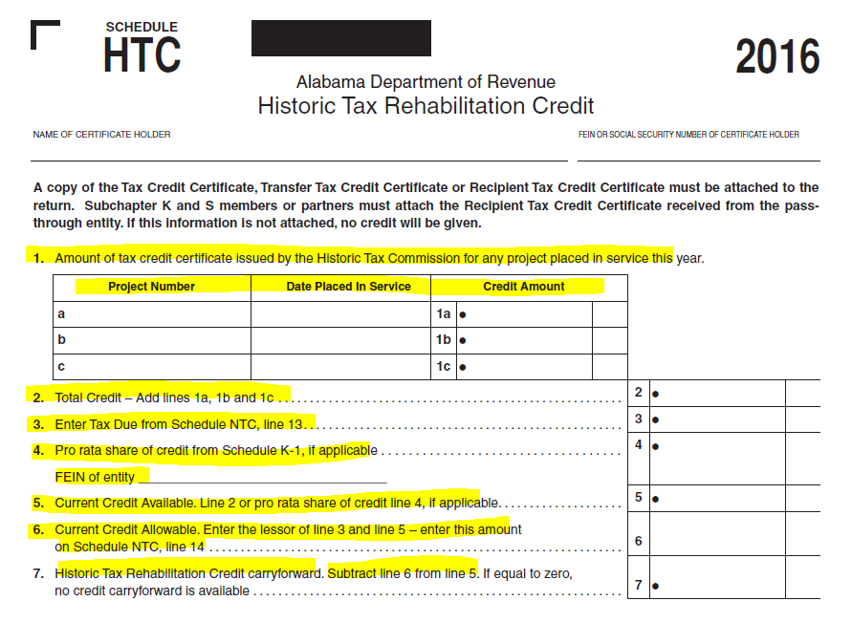

Slide 73
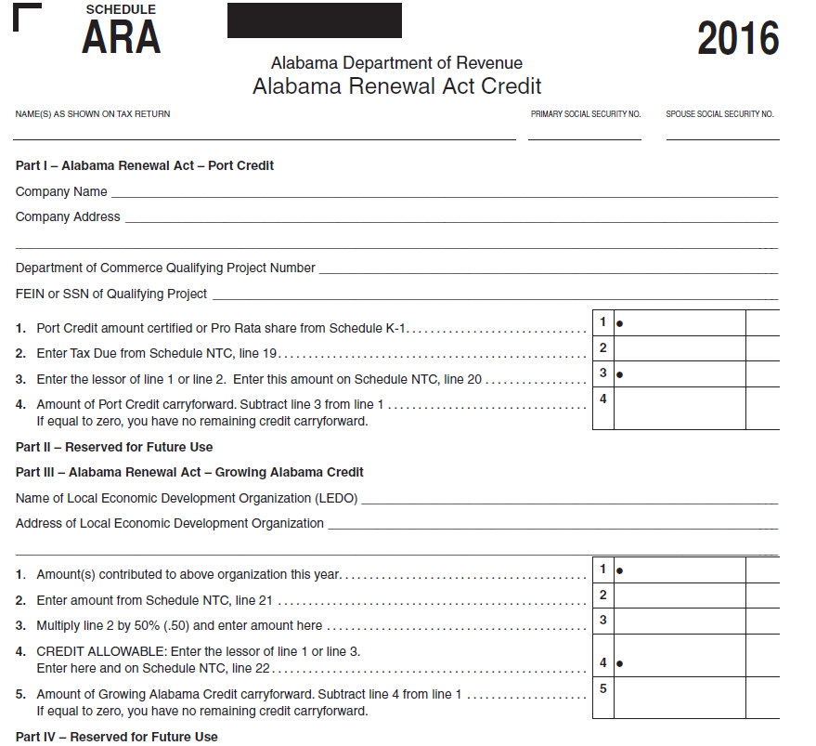
Schedule ARA New for 2016

Slide 74
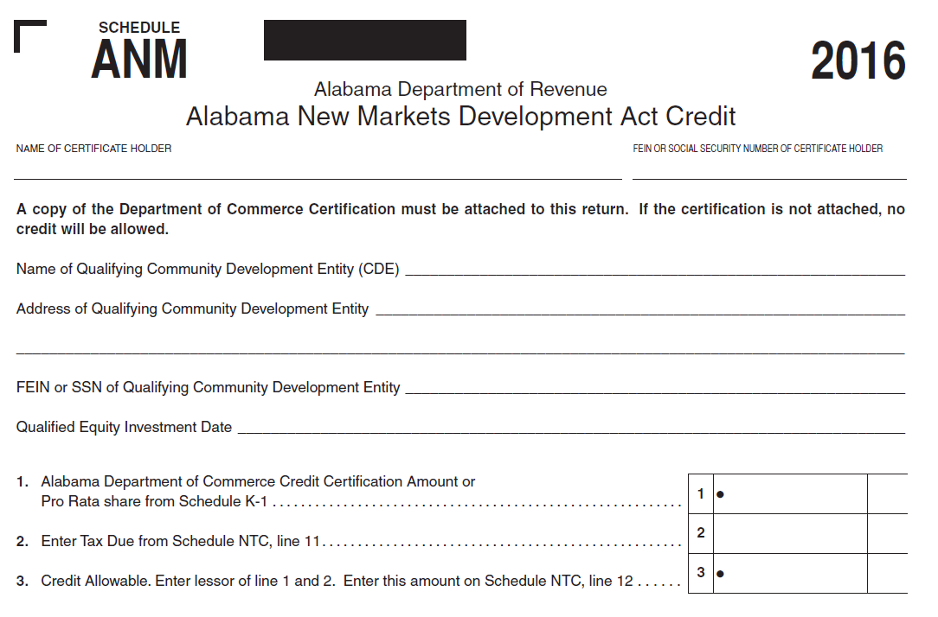
Schedule ANM New for 2016

Slide 75
Schedule OC Changes
Capital Credit moved to Schedule NTC
Tariff Credit expired and removed
Full Employment Act, Heroes for Hire Acts, Irrigation/Reservoir System Credit, and Neighborhood Infrastructure Credit changed to allow for a pro rata share of credit
Additional instructions given for the Irrigation/Reservoir System Credit to indicate it is a one time only credit, not multiple systems purchases.
Additional instructions given for the Neighborhood Infrastructure Credit to indicate this isn’t for your typical homeowner, condo, or neighborhood fees and that it is an actual assessment from an actual Neighborhood Infrastructure Authority District

Slide 76
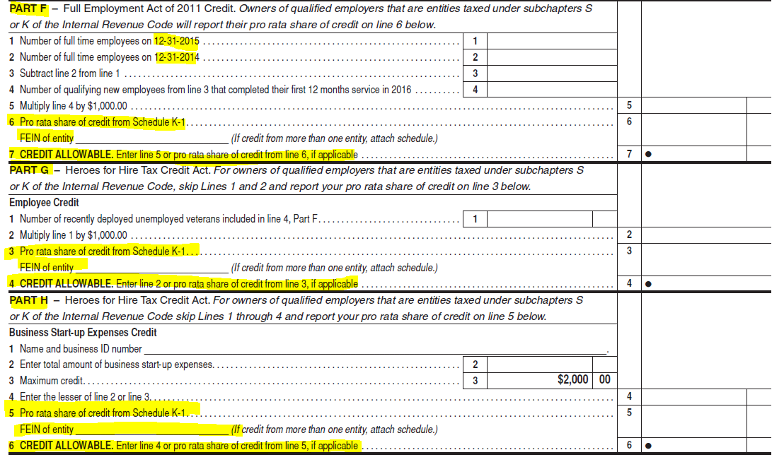
Schedule OC Changes

Slide 77
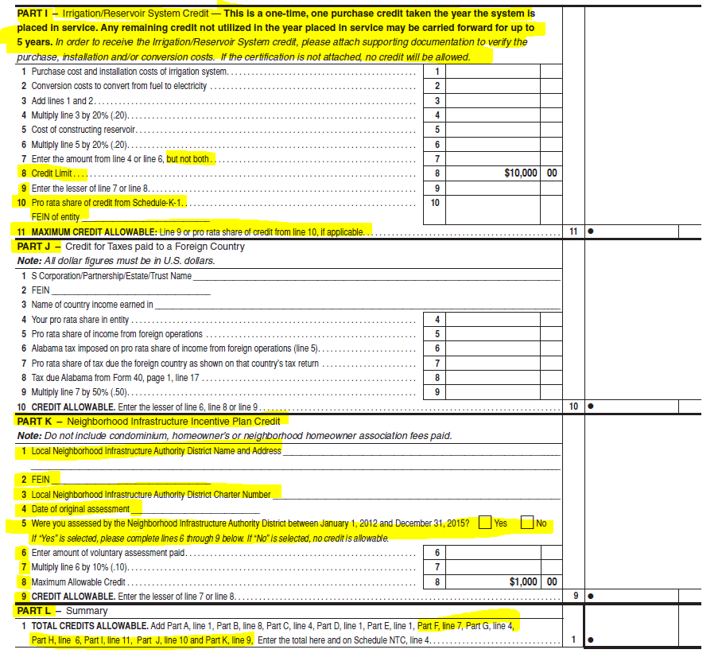
Schedule OC Changes cont.

Slide 78
Schedule AATC Changes
Part I - The amounts on lines 7, 16, 25, and 34 has changed to $3,794.00. This figure is 80% of the average annual cost of attendance for an Alabama public K-12 student. This will change yearly.
Part III – Added question “Do you have a Scholarship Contribution Credit carryforward from a prior year?” with Yes and No checkboxes for answer.
  Added new directions. If No, skip Lines 1 through 15 and complete lines 16 through 20. If Yes, compete the section below as needed. If no carryforward it prevents the taxpayer from having to complete unnecessary lines.

Slide 79
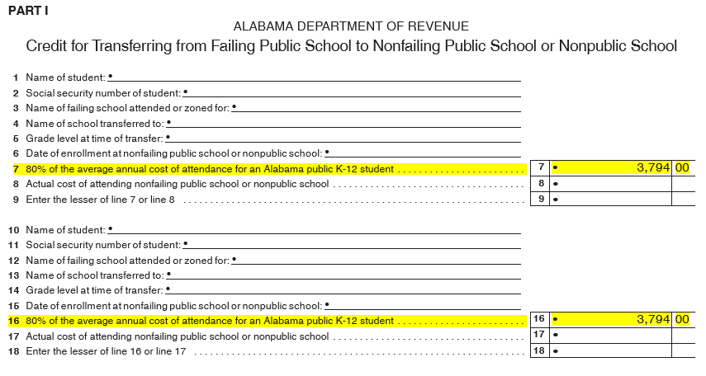
Schedule AATC Changes

Slide 80
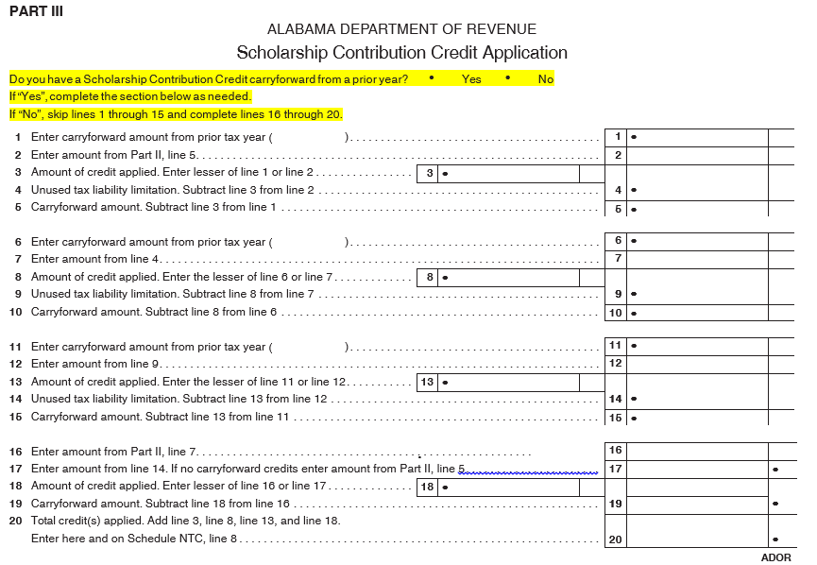
Schedule AATC Changes cont.

Slide 81
Schedule NTC changes
Updated to include the following items for 2016 and accompanying line number changes as a result
Added Schedule ANM - Alabama New Market
Added the Schedule ARA - Alabama Renewal Act
Capital Credit which was moved from the Schedule OC to here

Slide 82
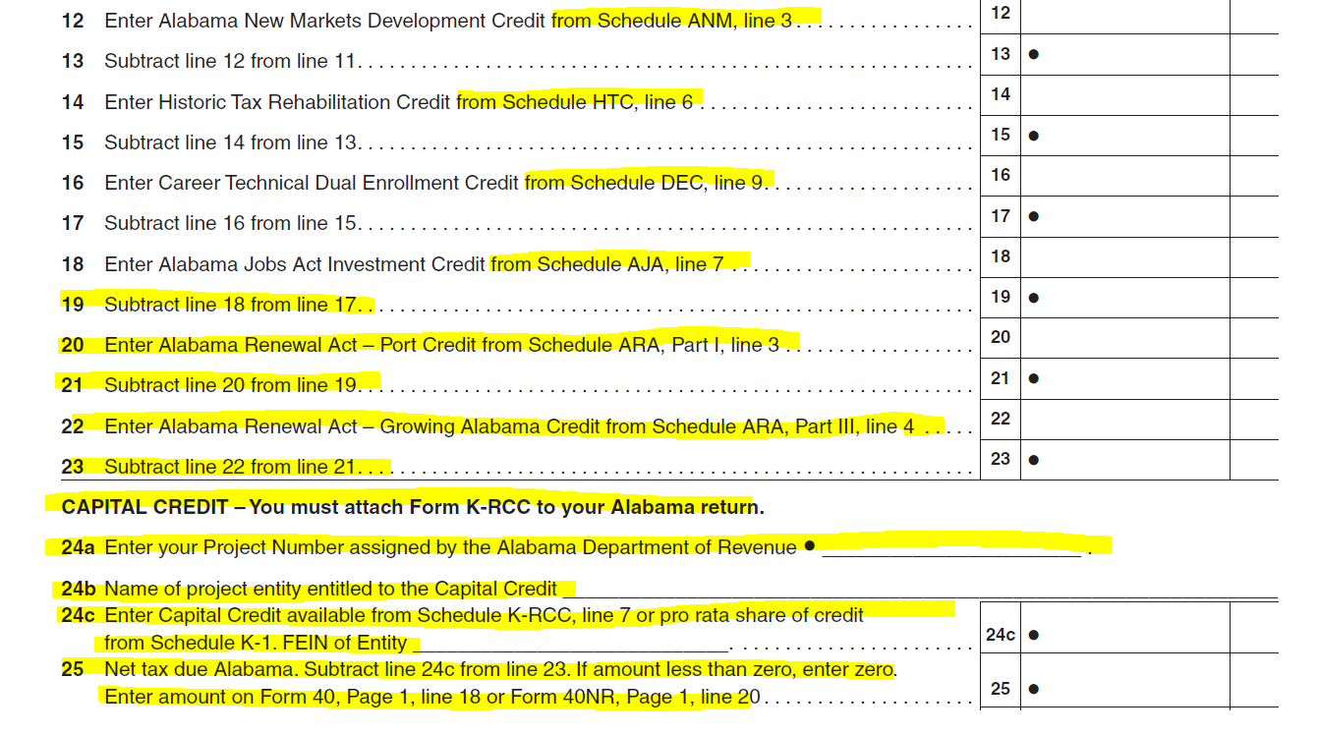
Schedule NTC changes

Slide 83
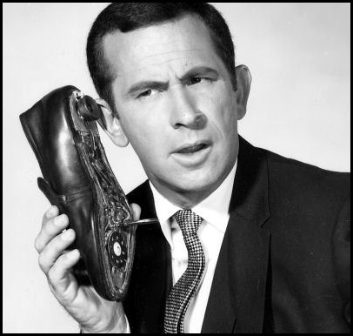
Refund Calls
ADOR Website: “Where’s My Refund”
Phone: 1-855-894-7391 (voice/ keyed response )
Call Center: (334)353-0944 or 1-800-535-9410

Slide 84
Pass Through Form changes
Form 65
Schedule K-1
Form 20S
Form 20S Schedule K
Form 20S Schedule K-1
Form 41

Slide 85
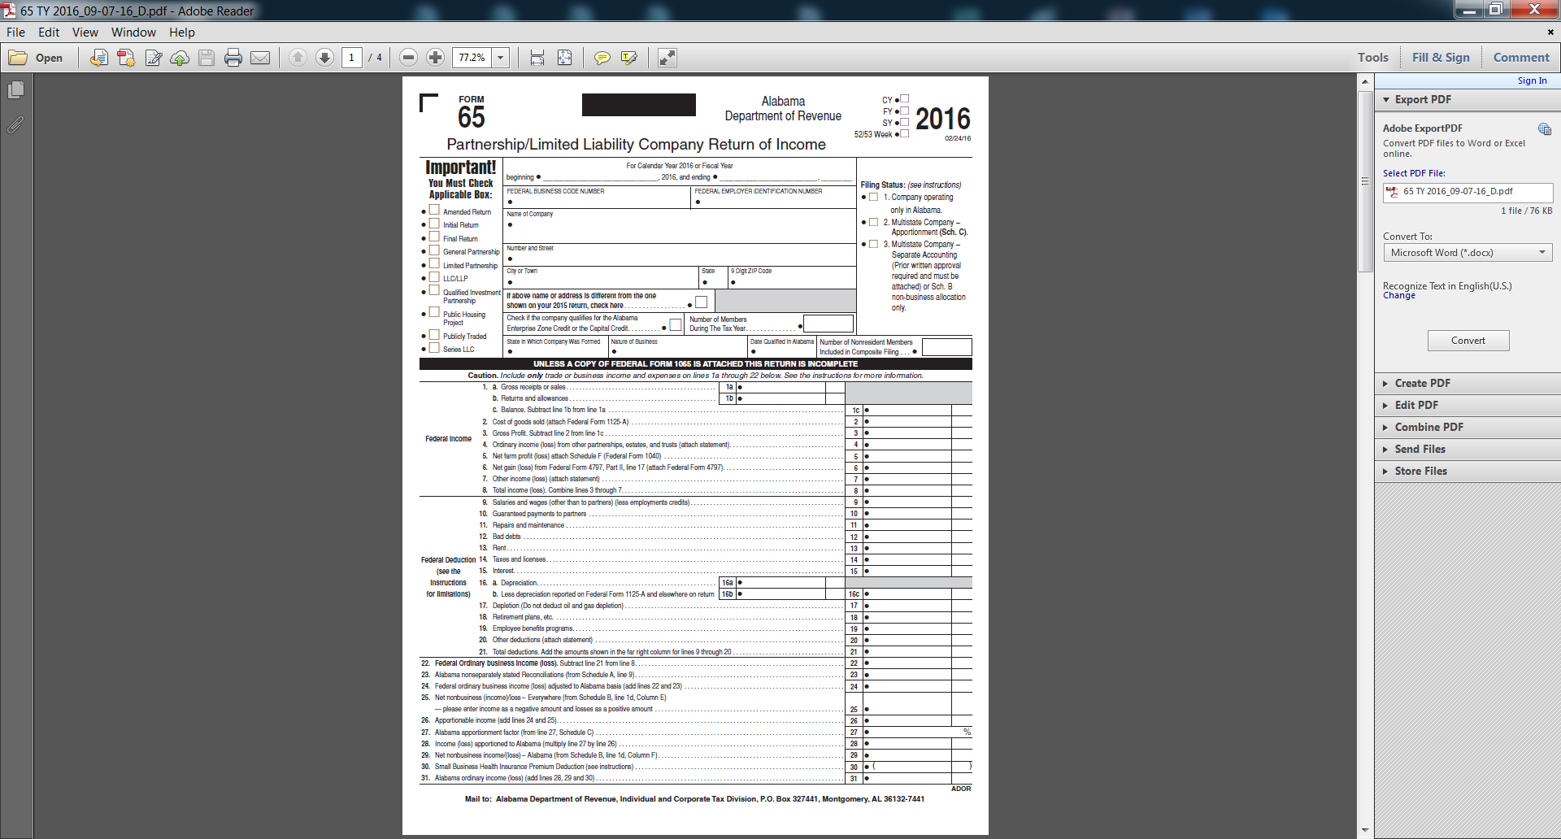
52-53 week filer
Filing status 3 added for companies that have only income to be allocated.
Series
LLC
This is where older returns started.

Slide 86
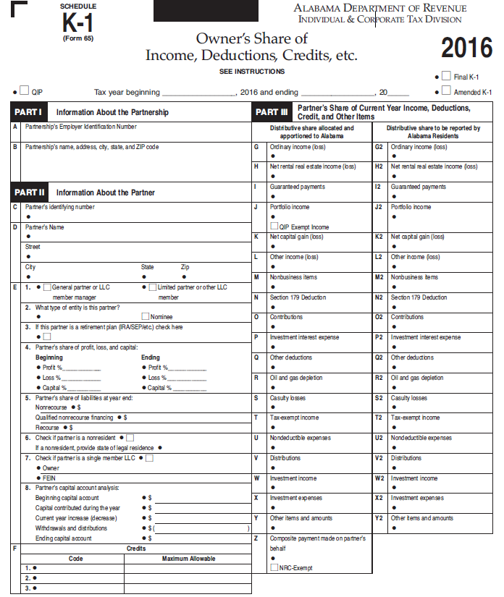
Separated K-1s for 65
And 20S.
More partner/
member detail
More inside basis information requested

Slide 87
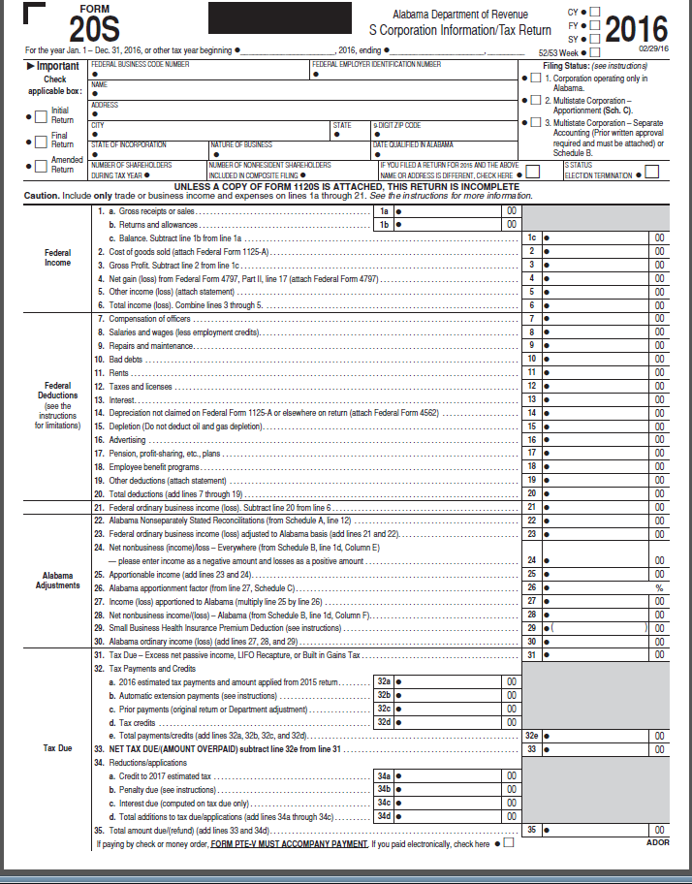
52-53 week filer
Filing status 3 added for companies that have only income to be allocated.
This is where older returns started.

Slide 88
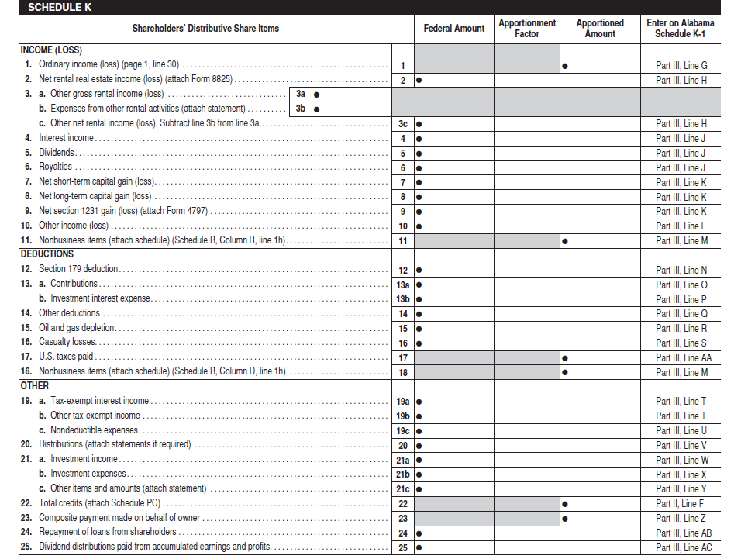
Expanded 20S
Schedule K

Slide 89
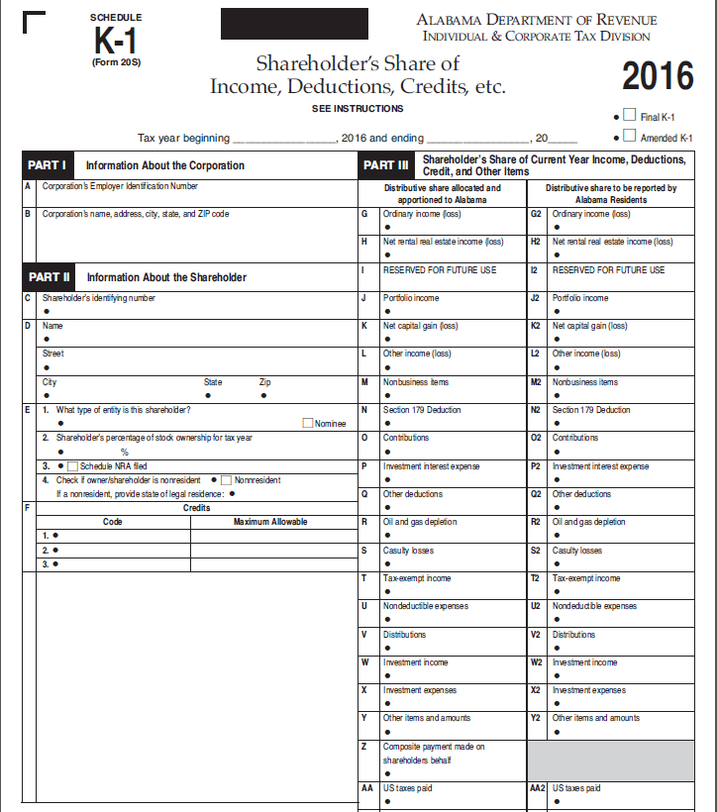
Separated 65 and 20S K-1s
some boxes on 20S K-1 were left as
reserved so that items would match
on the two K-1s

Slide 90
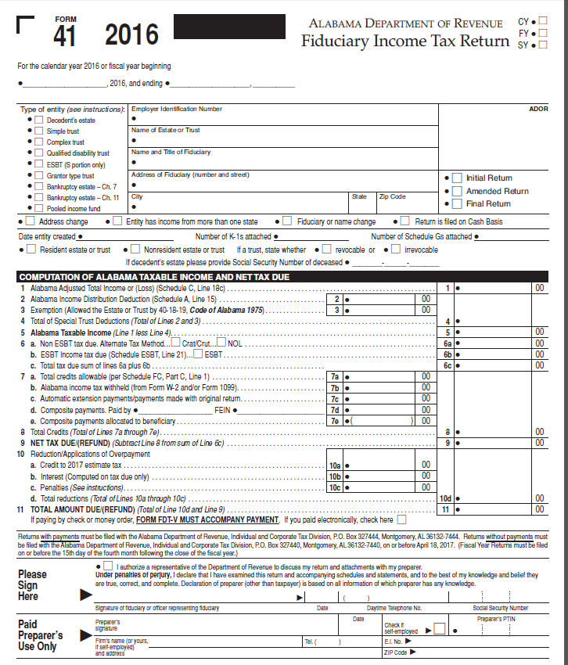
Resident/
nonresident
indicator
Other changes:
K-1 split columns like 65/20S
Charitable deduction Schedule B page 2
Schedules C & E estate/trust income separated
Schedule ESBT added non-esbt column
SSN of deceased if estate

Slide 91
Corporate Income Tax Forms
Revisions to the 20C on Schedule A and Schedule E
Revisions to Schedule BC for new credits
Revisions to the instructions and calculations on the 2220AL
Revisions to the ET-1 on Schedule M
Revisions to Schedule EC for new credits

Slide 92
Form 20C Changes
Removed line from Schedule A for Nondeductible Federal Depreciation (Economic Stimulus Act of 2008)
Added line on Schedule A for contributions not deductible on state income tax return due to an election to claim a state credit
Added checkbox for determining whether Alternative Minimum Tax is being used to calculate the Federal Income Tax Deduction on Schedule E

Slide 93
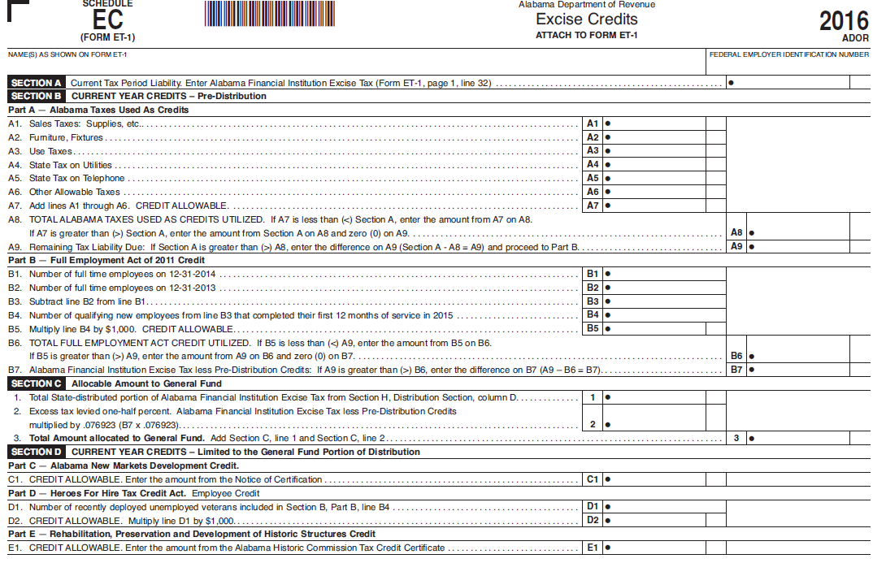
Notes:
ET-TC worksheet no longer utilized. Modified and Changed to Schedule EC.

Slide 94
Reminder
NEW WITHOLDING REQUIREMENTS
Departmental Business Rule 810-3-75-.03 require employers who electronically file their monthly and quarterly withholding tax returns and payments online during the year to also submit their end of year wage and tax information (W2’s/Form A3) electronically with the Department as well. The filing due date for the Form A3/W2’s is January 31st.

Slide 95

QUESTIONS
Business Privilege Tax 334-353-7923
Certificate of Compliance 334 -242-1189
Corporate Income Tax 334-353-7943
Individual Income Tax 334-353-0602
Pass Through Entity 334-242-1033
Special Audit and Compliance:
Non-Filer Group 334-242-1511
CP 2000 334-242-1940
Withholding Tax 334-242-1300

Slide 96

Comments?
Lynn Schoener
lynn.schoener@revenue.alabama.gov
(334) 353-8045
Andrea Wyatt
andrea.wyatt@revenue.alabama.gov
(334) 353-9447

