Slide 1

Alabama Department of Revenue
Individual & Corporate Tax Division
2017 CPE Training
February 01, 2018
Lynn Schoener, CPA, FAS II
(334) 353-8045
lynn.schoener@revenue.alabama.gov
Andrea Wyatt, Revenue Examiner III
(334) 353-9447
andrea.wyatt@revenue.alabama.gov
Notes:
1

Slide 2

What’s New in I.D. Theft Prevention
State partners with MorphoTrust USA to use a selfie to authenticate your identity when filing your income tax returns.
Steps to participate:
Users will download the free app to their smartphone.
Take a photo of the bar code on the rear of their drivers license.
Scan the front of their drivers license to authenticate it is actually issued by AL DMV.
Take a selfie and submit.
The information submitted is compared to the drivers license information on file and if there is a match, the user will be registered for the service.

Slide 3
What’s New in I.D. Theft Prevention
Each log in attempt or tax return submission requires a new selfie in lieu of a password to verify it is the actual taxpayer rather than a cyber criminal. Without an ID match the user cannot log in.
Now available for the Android for the 2017 filing season.
Previously only available to iPhone users.

Slide 4

What’s New from the 2017 Regular Session of the Alabama Legislature?

Slide 5
Act 2017-165 (HB263)
Financial Institutions

Slide 6
Act 2017-165 (HB263)
Financial Institutions
Act 2017-165 amends Code Section 40-16-4 relating to financial institutions with income taxed within and outside of the state:
To now include loans and credit card receivables as part of the calculation for the property factor of the finance institution excise tax apportionment formula.
To specify that the new apportionment formula would be applicable to all tax years beginning on or after January 1, 2017.

Slide 7
Act 2017-227 (HB87)
Identity Theft Related Refund Fraud

Slide 8
Act 2017-227 (HB87)
Identity Theft Related Refund Fraud
Act 2017-227 adds a new Article 7 to Chapter 29 of Title 40, Code of Alabama 1975 entitled “Identity Theft Related Refund Fraud”. See Code Section 40-29-130.
Allows the Department of Revenue, with assistance and support of other state agencies that participate in the income tax refund process, the authority to pursue all reasonable options available to it in order to reduce identity theft refund related fraud.
Allows partnering with other state, federal, and private sectors in various programs and projects designed to reduce refund fraud.
Allows the Department to reimburse the partners in these programs for the reasonable costs associated in carrying out these programs.

Slide 9
Act 2017-227 (HB87)
Dishonored EFT Payments

Slide 10
Act 2017-227 (HB87)
Dishonored EFT Payments
Act 2017-227 amends Code Section 40-29-70 relating to dishonored payments.
40-29-70 previously mentions only checks. This expands the code section to cover other forms of non-payment such as EFT and Money orders.
The verbiage “Dishonored Payment Penalty” has replaced “Bad Check Penalty” on RITS letters btL043 and btL050.
Provides penalties to taxpayers who present non-payable electronic funds or money orders to the Department in payment of tax liabilities.
Like checks, if unpaid within 10 days, the penalty is 10 percent of the amount of the dishonored payment, except that if the amount of the payment was less than $500, the penalty would be $10 or the amount of the payment, whichever is less.

Slide 11
Act 2017-227 (HB87)
Filing Standardization

Slide 12
Act 2017-227 (HB87)
Filing Standardization
  Act 2017-227 amends Code Section 40-30-7 relating to the filing of returns, license applications, and methods of payments.
  In order to standardize processes, Act 2017-227 authorizes the Department to prescribe by administrative rules the method of filing tax returns, license applications, and other information as well as the method of payment for such taxes and licenses.
  These rules shall be reviewed every five years in accordance with the Red Tape Reduction Act of 2013.

Slide 13
Act 2017-227 (HB87)
Overpayment of Tax

Slide 14
Act 2017-227 (HB87)
Overpayment of Tax
Act 2017-227 further amends Code Section 40-18-79 relating to overpayment of tax.
Allows the Department to reimburse a bank or financial institution for a taxpayer’s refund that was erroneously reversed by the Department but credited to the taxpayer by the bank or financial institution.
Any fees or costs associated with the reversal shall also be reimbursed to the bank or financial institution.

Slide 15
Act 2017-264 (HB193)
FTI Background Checks

Slide 16
Act 2017-264 (HB193)
FTI Background Checks
Act 2017-264 authorizes state departments and agencies that have access to federal tax information to perform background checks on their employees and any contract labor.
Each applicant for employment with such an agency shall state whether they have ever been convicted of a crime or whether they have current criminal charges pending against them.
Each applicant shall submit to fingerprinting and a state and national criminal history records check.
The Alabama Law Enforcement Agency (ALEA) will perform the fingerprinting and background check as requested by the Department and shall submit the fingerprints or other positive identifying information to the FBI for a national criminal history records check.
The results of the state and national criminal history records check shall be returned to the department or agency by ALEA.

Slide 17
Act 2017-294 (HB 75)
Wholesale to Retail Accountability Program

Slide 18
Act 2017-294 (HB 75)
Wholesale to Retail Accountability Program
Act 2017-294 Wholesale to Retail Accountability Program or “WRAP” was established to standardize reporting of sellers of tobacco products and distributors of beer and wine for sales tax purposes and 1099K reporting for income tax purposes as defined in IRC 6050W.
For Department purposes, the Act requires third party payment settlement entities (PSE’s/ think credit card processors) to electronically file duplicate form 1099Ks for those payees with an Alabama address. These forms must be filed within 30 days of filing the federal forms with the IRS.
Will require a new access point in MAT for the PSE’s to file these 1099K information returns.
Penalties up to $1,000 are provided for each month of non-compliance or failing to file these informational reports with the Department.

Slide 19
Act 2017-314 (HB574)
Alabama Jobs Act

Slide 20
Act 2017-314 (HB574)
Alabama Jobs Act
Act 2017-314 amends Code Sections 40-18-382 and 40-18-383 relating to the Alabama Jobs Act of 2015.
Code Section 40-18-382 is amended to extend the qualifying deadline date for project agreements from December 31, 2019 to December 31, 2020, unless extended further by an act of the legislature.
Code Section 40-18-383 is amended to revise the cap on outstanding job acts incentives from an aggregate amount of $850 million to an annual amount of $300 million.

Slide 21
Act 2017-349 (SB315)
AL National Guard Member Educational Benefits

Slide 22
Act 2017-349 (SB315)
AL National Guard Member Educational Benefits
  Amends code sections to set the tuition rate benefits for a member of the AL National Guard.
  In order to qualify for tuition benefits, the Department of Veterans Affairs must first determine the guard member’s residency.
  The Department of Veterans Affairs will request income tax return information from the Department of Revenue in order to determine residency if required.
  Can verify with the Department of Revenue for the past ten years whether the guard member filed an Alabama income tax return as a resident, the type of return they filed, and other return information as needed.
  The request for return information by the Department of Veterans Affairs shall be exempt from the confidentiality provisions of Code Section 40-2A-10, Code of Alabama 1975.
  Will possibly need to develop a request form to be used by the Department of Veterans Affairs.

Slide 23
Act 2017-352 (SB257)
Irrigation and Reservoir System Credit

Slide 24
Act 2017-352 (SB257)
Irrigation and Reservoir System Credit
Prior to Act 2017-352, Code Section 40-18-342 allowed qualifying taxpayers a one time purchase credit of 20% of their irrigation or reservoir system costs up to $10,000 with a 5 year carry forward of any credit remaining above their liability.
Amendment changes the current irrigation credit "beginning with tax year 2018 and ending with tax year 2022".

Slide 25
Act 2017-352 (SB257)
Irrigation and Reservoir System Credit
Beginning with the 2018 tax year, Code Section 40-18-342 will allow taxpayers who qualify for the credit a choice to take the greater of 20% of their irrigation system cost up to $10,000 or as an alternative 10% of their irrigation system cost up to $50,000, whichever is greater.
As before, the credit is taken in the year the system is placed in service and any unused credit may be carried forward for an additional 5 years.
Pro rata share of credit will be available to members of a pass through entity.
For tax years beginning after December 31, 2022, the credit will revert back to its original amount of 20% of the irrigation or reservoir system cost up to $10,000.

Slide 26
Act 2017-363 (HB46)
Alabama Taxpayer Protection and Assistance Act

Slide 27
Act 2017-363 (HB46) Alabama Taxpayer Protection and Assistance Act
Enacted to protect consumers by establishing a mechanism to ensure that only qualified individuals provide tax preparation services in Alabama.
Requires any person providing tax preparation services to provide their IRS issued PTIN (Preparer Tax Identification Number) when submitting a return and signing as a paid preparer.
Requires the Department to implement programs using the preparers PTIN as an oversight mechanism to assess returns, identify high error rates, patterns of fraud, and unsubstantiated basis for positions used by preparers.
Allows exchange of PTIN preparer information with the IRS and other agencies on preparers suspected of fraud or those that have been barred from filing with the IRS.

Slide 28
Act 2017-363 (HB46) Alabama Taxpayer Protection and Assistance Act
Preparers may be barred from filing returns with the Department for good cause, subject to the appeal rights under Chapter 2A of Title 40.
Provides a civil penalty of $50 per offense for failing to provide a PTIN unless the failure to provide a PTIN is due to reasonable cause and not willful neglect.
The total civil penalties shall not exceed $25,000 per calendar year per preparer.

Slide 29
Act 2017-363 (HB46)
Alabama Taxpayer Protection and Assistance Act
Bill changes the title of the "Taxpayer Advocate" to "Taxpayer Assistance Officer or Officers" possibly allowing for more than one officer or for others to approve assistance orders in the absence of the taxpayer advocate.
Further house cleaning with Act 2017-363:
Bill amends 40-14A-22 to ensure that returns for members of a financial institution group shall be due no later than the due date for the corresponding Alabama financial institution excise tax return.
Bill amends 40-14A-25 to ensure the BPT return due date is same as that of the corresponding federal income tax return as required to be filed as provided under federal law.

Slide 30
Act 2017-380 (HB345)
Historic Rehabilitation Tax Credit

Slide 31
Act 2017-380 (HB345)
Historic Rehabilitation Tax Credit
To provide an income tax credit for the rehabilitation, preservation, and development of historical structures. This is an entirely new credit to replace the original which sunset.
The original Historic Rehabilitation Tax credit sunset in 2015. There is a 10 year carry forward on any original unused credit amount which we will see for some time in the future.
The Historic Tax Commission issues a tax credit certificate to the qualifying property owner in an amount equal to the lesser of the amount of the tax credit reserved for the taxpayer or 25% of the actual rehabilitation expenditures.
The taxpayer must file this credit certificate with their Alabama state income tax return due under Chapter 18.

Slide 32
Act 2017-380 (HB345)
Historic Rehabilitation Tax Credit
The taxpayer must claim their credit in the year they place their historic structure in service. If the tax credit is larger than their tax liability for that year, the property owner will be entitled to a refund of the difference.
This historic tax credit is available to taxpayers who qualify between the tax years 2018 through 2022 only.
The Historic Tax Commission can reserve up to $20,000,000 a year in credits for the five calendar years.
The credit may be transferred once and the Department shall provide a form transfer statement to be filed by the transferor prior to the transfer. The transferor shall pay a fee of $1,000 per transferee listed on the transfer statement.

Slide 33
Act 2017-405 (HB346)
Individual Income Tax Simplified Short Form Filing Act

Slide 34
Act 2017-405 (HB346)
Individual Income Tax Simplified Short Form Filing Act
Adds a new section 40-18-15.7 to the Code of Alabama 1975 and begins with the 2018 tax filing year.
Allows for individual to report their income taxes using a simplified short form.
Taxpayers that choose to file using the optional increased standard deduction, must acknowledge that they are voluntarily foregoing other deductions, credits, and exemptions that may otherwise be available to them including their federal income tax deduction.
The personal exemption and the increased optional standard deduction are the only exemptions or deductions allowed by a person filing this return.

Slide 35
Act 2017-405 (HB346)
Individual Income Tax Simplified Short Form Filing Act
To qualify for the simplified short form, filers must be Alabama residents filing either single or married filing a joint return meeting the following requirements:
Alabama gross income of less than $100,000
Zero dollars of non-wage income (interest, dividends, retirement, pension, rents, royalties, gains, etc.)
No dependent deduction
No itemized deductions

Slide 36
Act 2017-405 (HB346)
Individual Income Tax Simplified Short Form Filing Act
Continued:
No adjustments to income
No federal income tax deduction
No income tax credits
Filer is not required to make estimated income tax payments
Not claiming any gains or losses

Slide 37
Act 2017-405 (HB346)
Individual Income Tax Simplified Short Form Filing Act
The only deductions allowed a taxpayer using the simplified short form will be the standard deduction and a personal exemption as follows:
The standard deduction allowed single filers will be the greater of $2,250 or the standard deduction allowed by 40-18-15.
The standard deduction allowed taxpayers filing married filing joint will be the greater of $4,500 or the standard deduction allowed by 40-18-15.
The personal exemption will be allowed in accordance with 40-18-19, $1500 for single filers and $3,000 for those filing married filing joint.

Slide 38
Prior Year Credits Affecting 2017
Returns
Act 2011-551 Full Employment Act of 2011
Act 2011-689 Neighborhood Infrastructure Incentive Plan Credit
Act 2012-168 Heroes for Hire Tax Credit
Act 2012-391 Irrigation /Reservoir System Tax Credit
Act 2013-64 School Transfer Credit – AAA Credit and SGO Donation Credit – Scholarship Granting Organization
Act 2013-241 Historic Rehabilitation Tax Credit
2014-147 Career Technical Dual Enrollment Credit

Slide 39
Prior Year Credits Affecting 2017
Returns
Act 2014-413 Adoption Credit
Act 2015-027 Alabama Jobs Act Credit
Act 2016-102 Alabama Renewal Act (Port Credit and Growing Alabama Act Credit)
Act 2016-188 Alabama Small Business and Agribusiness Jobs Act
Act 2016-314 Apprenticeship Tax Credit of 2016
Act 2016-321 Alabama Jobs Act Credit of 2015

Slide 40
Prior Year Acts Effective for 2018
Returns
Act 2016-345 Health Savings Account Contributions deductions (HSA’s)
Act 2017-352 Irrigation and Reservoir System Credit

Slide 41

Act 2013-088
Red Tape Reduction Act
Requires Business Rules be reviewed every 5 years
Steps currently underway to review all existing rules to bring the Department into compliance before the first deadline of July 2018.
Important: Managers should be reviewing all business rules which apply to them and making the appropriate response in Lotus Notes as to whether they need to be amended, repealed, or no change (reviewed).

Slide 42

Electronic Filing Information

Slide 43

My Alabama Taxes
ADOR continues to offer a FREE electronic filing option to individual Alabama taxpayers filing a state tax return.
No income limitations or other qualifications must be met to take advantage of this free online filing system.
Go to www.myalabamataxes.alabama.gov to sign up and efile.
Notes:
43

Slide 44
Electronically Filed Returns
As of January 1, 2018-Individual Income Tax Returns:
  1,685,717 returns have been filed electronically
  65.459% of returns filed have been refund returns

Slide 45
Electronically Filed Business MeF Returns
Information as of January 1, 2018:
Form Type | Total Received | % e-filed
20C | 24,081 | 62.3%
20CC | 91 | 59.48%
CPT | 15,755 | 43.73%
PPT | 90,276 | 43.73%
BPT | 100,885 | 43.73%
20S | 50,842 | 77.84%
PTEC | 11,619 | 60.91%
65 | 46,641 | 74.52%
41 | 19,146 | 65.34%
.

Slide 46
Modernized Electronic Filing (MeF) Contacts
Tavares Mathews – Individual MeF (40 and 40NR)
tavares.mathews@revenue.alabama.go
334-353-9497
Missy Gillis – Business MeF (20S, 65, PTEC and 41)
melissa.gillis@revenue.alabama.gov
334-353-9178
Nicci Adams – Business MeF (20C, 20CC , CPT and PPT)
nicci.adams@revenue.alabama.gov
334-353-0685
Veronica Jennings – Mef Development and Web Service, Manager
veronica.jennings@revenue.alabama.gov
334-353-9440

Slide 47
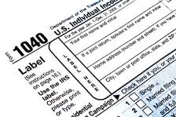
2017 Forms

Slide 48

Mailed Forms
The Department will mail income tax booklets (40/40NR) to Libraries and TPSC’s this year.
Download and print all tax forms from our website.
Order tax forms from our website.

Slide 49
New Forms for 2017
Schedule ATC - Apprenticeship Tax Credit as a result of Act 2016-314
Schedule SBA - Small Business and Agribusiness Jobs Credit as a result of Act 2016-188
Schedule IRC - Irrigation / Reservoir System Credit as a result of Act 2017-352. Removed from the Schedule OC.

Slide 50
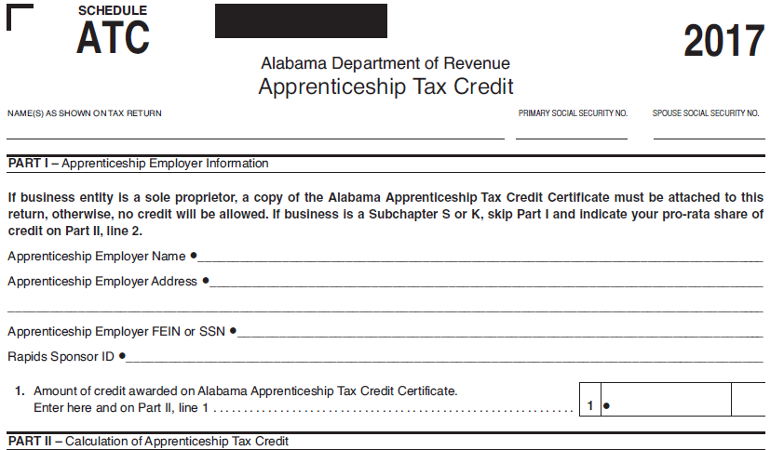
Schedule ATC
Apprenticeship Tax Credit

Slide 51
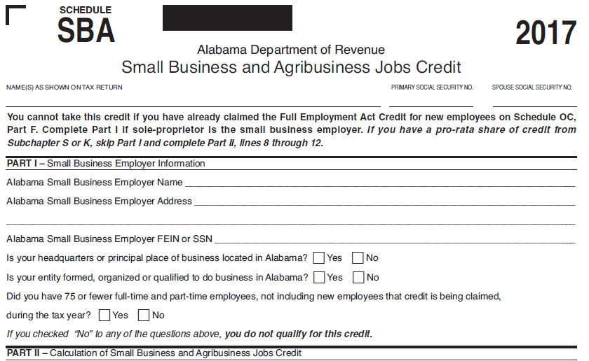
Schedule SBA
Small Business and Agribusiness Jobs Credit

Slide 52
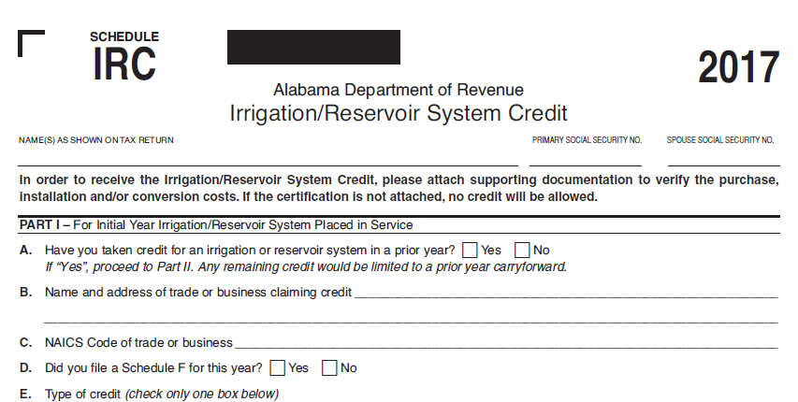
Schedule IRC
Irrigation / Reservoir System Credit

Slide 53
Schedule ANM
Alabama New Markets Development Credit
Schedule ANM - Alabama New Markets Development Act Credit has been retired. There were no longer any applicable taxpayers.
Also removed the ANM Credit line from Schedule NTC.

Slide 54

Form Changes

Slide 55
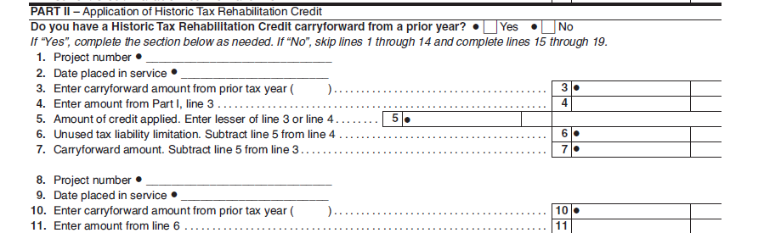
Schedule HTC
Historic Tax Credit
Added a carryforward section for 2017

Slide 56
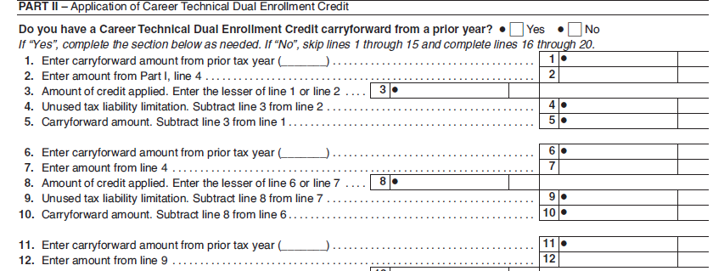
Schedule DEC
Dual Enrollment Credit
Added a carryforward section for 2017

Slide 57
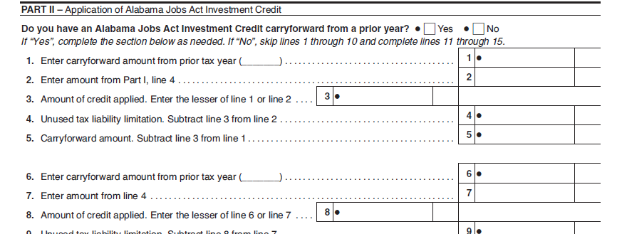
Schedule AJA
Alabama Jobs Act
Added a carryforward section for 2017

Slide 58
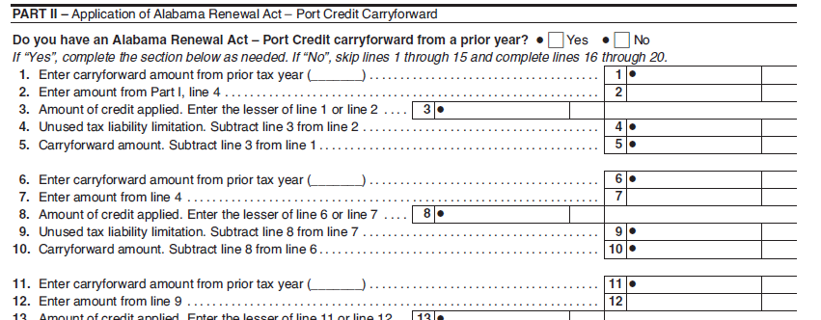
Schedule ARA
Alabama Renewal Act
Added new carry forward sections Part II and Part IV

Slide 59
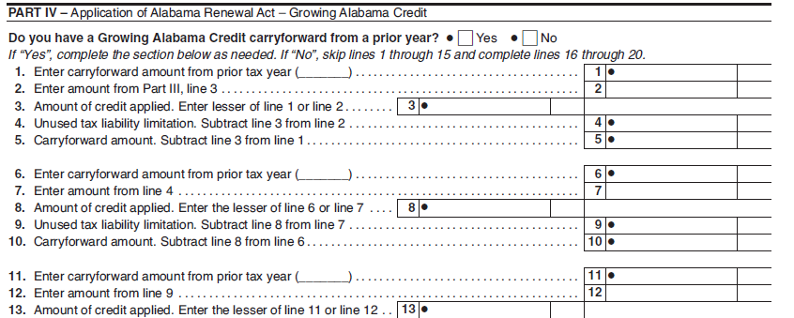
Schedule ARA
Alabama Renewal Act

Slide 60
Schedule NTC Changes
Updated to include the following items for 2017 and accompanying line number changes as a result
Added Schedule IRC, new Line 6 – Irrigation/Reservoir System Credit
Removed Schedule ANM, Line 12 – Alabama New Markets Development Credit since no longer applicable
Added Schedule ATC, new Line 24 – Apprenticeship Tax Credit
Added Schedule SBA, new Line 26 – Small Business and Agribusiness Jobs Credit

Slide 61
Schedule OC Changes
Removed Section I references to Irrigation/Reservoir System Credit. A new Schedule IRC has been created with credit amounts flowing from the Schedule IRC to the Schedule NTC.
Additional instructions given for Part F- Full Employment Act of 2011 Credit to clarify confusion as to whether an employer qualifies or not. Header question added: “Were you in business with 50 or fewer full and/or part-time employees on June 9, 2011? Yes No If “No”, you do not qualify for this credit.”

Slide 62
Pass Through Form changes
Form 65 Schedule P
Form PTE-C
Form 20S
Schedule PC
Form 41

Slide 63
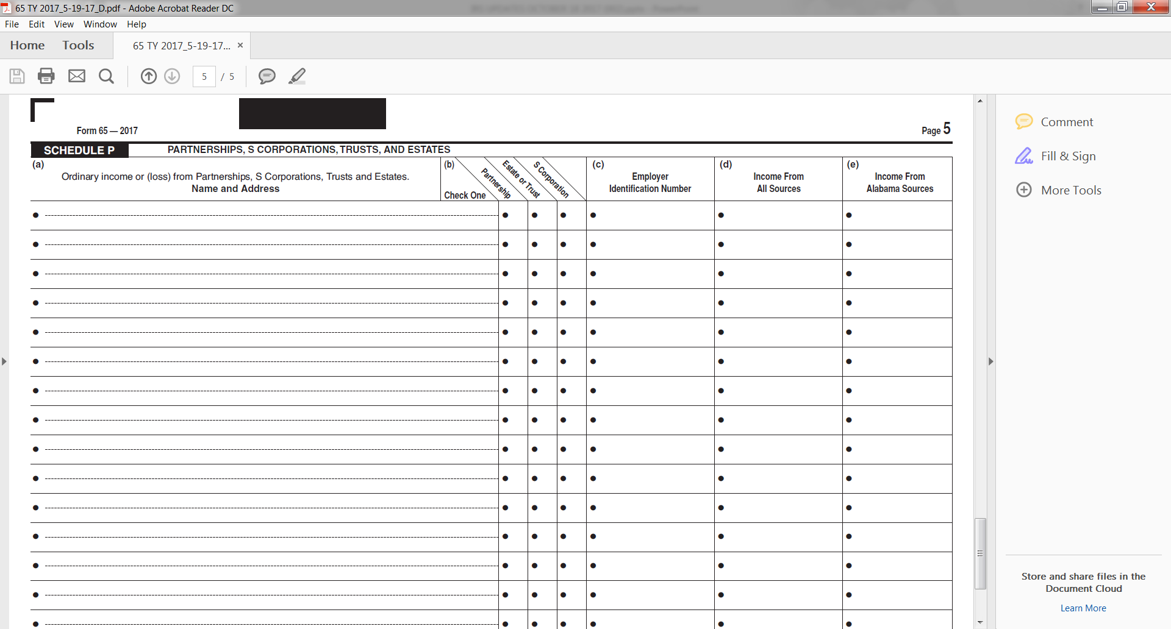
Form 65 Schedule P
Use Schedule P to report income received from partnerships, estates, trusts, and S Corporations.

Slide 64
Form PTE-C Changes
Additional instructions given on where to claim WNR-V tax payments (line 5b).
Schedule NRC-Exempt (Subchapter K only). Schedule NRC-Exempt is to be completed by a nonresident partners to certify exemption from AL Code §40-18-24.2. This form should be attached to Form PTE-C each year. Failure to attach form NRC-EXEMPT to the return shall cause the pass through entity to remit payment due as originally required.

Slide 65
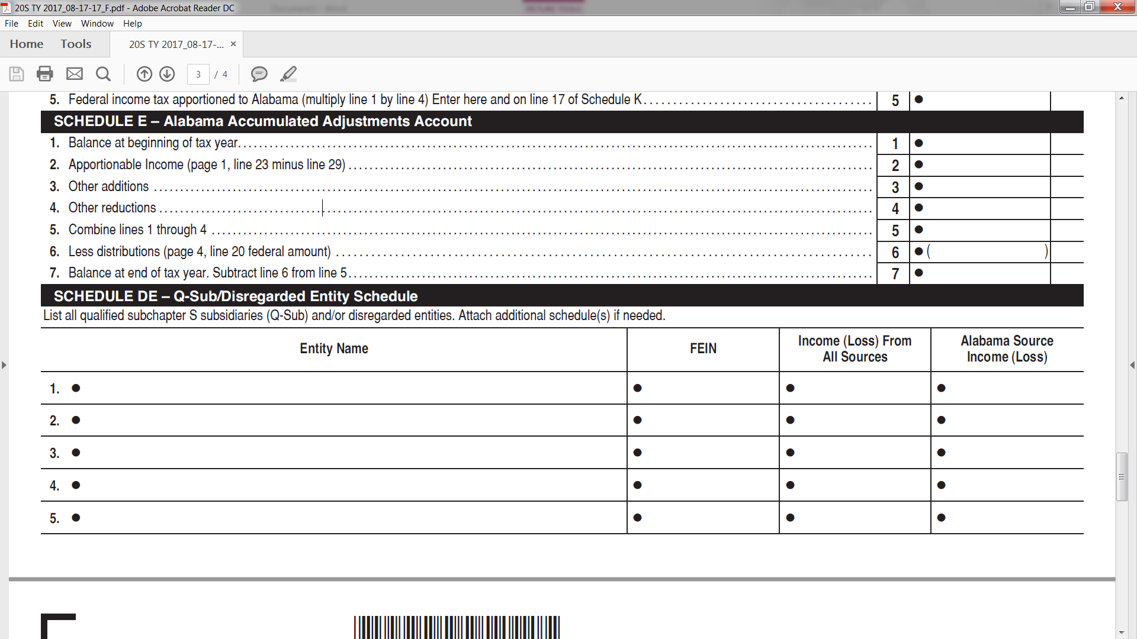
Form 20S Changes
Adjustments to the AAAA should include the entire earnings, profits, losses, gains and deductions of the S corporation.

Slide 66
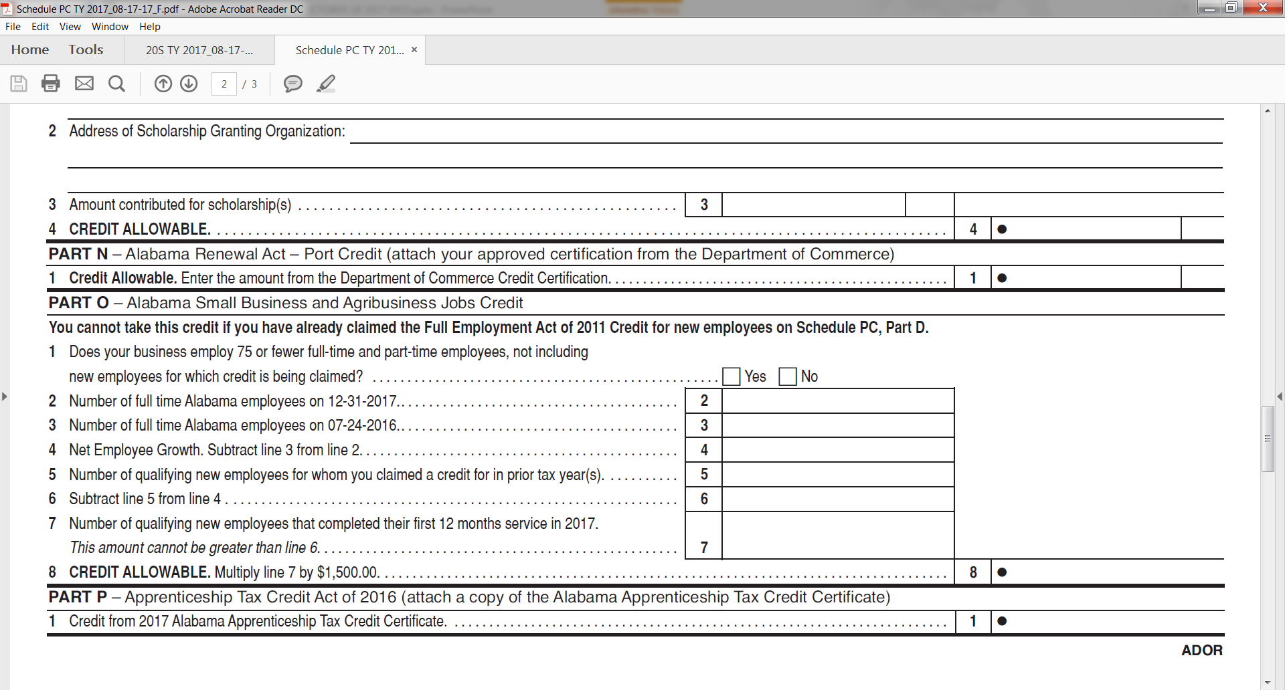
Schedule PC changes
Added Alabama Small Business and Agribusiness Jobs Credit and Apprenticeship Tax Credit Act of 2016.

Slide 67
Form 41 changes
Schedule G: added resident and nonresident checkboxes
Schedule FC: added additional lines for income tax paid to other states
Schedule K and K-1: added line for Non Alabama Source Income

Slide 68
Business Privilege Tax Form Changes
Act 2017-363
For the Form Year 2018-The due dates of the BPT Returns will correspond to the due dates of the corresponding federal return.

Slide 69
Business Privilege Tax Form Changes
AL-CAR, CPT, and PPT (C-Corporations)- taxpayers will need to make sure they check the box for change in officers(if applicable).

Slide 70
Corporate Income Tax Form Changes
Schedule BC and Schedule EC New Credits
Alabama Small Business and Agribusiness Jobs Credit
  This credit cannot be taken in conjunction with the Full
  Employment Credit.
Apprenticeship Tax Credit

Slide 71
Corporate Income Tax Form Changes
What’s New for Form ET-8
ONLINE ONLY
Taxpayers who request extension of time to file Alabama Form ET-1 or ET-1C are required to remit Alabama Form ET-8 electronically and any payments over $750 electronically through My Alabama Taxes (MAT).
  Visit the Department’s website at www.revenue.alabama.gov (click the MAT icon on the home page).

Slide 72
Corporate Income Tax Form Changes
Corporate Income Tax- Schedule E Financial Institution Excise Tax- Schedule M
Alabama Rule 810-3-35-.01 removes methods 1552(a)(2) and 1552(a)(3) in computing the FIT Deduction. For tax years beginning on or after August 29, 2016, corporate taxpayers must use the 1552(a)(1) method to determine the amount of applicable FIT Deduction. See Alabama Rule 810-3-35-.01 for additional information.
In computing the Federal Income Tax (FIT) Deduction, taxpayers must specify whether they paid Alternative Minimum Tax (AMT). If so, taxpayers must use Alternative Minimum Taxable Income (AMTI) to determine the corporation’s portion of federal income taxes accrued or paid.
  Financial Institution Excise taxpayers will only include the federal income taxes paid.

Slide 73
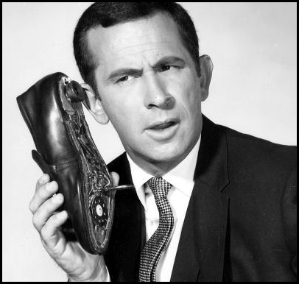
Refund Calls
ADOR Website: “Where’s My Refund”
Phone: 1-855-894-7391 (voice/ keyed response )
Call Center: (334)353-0944 or 1-800-535-9410

Slide 74

QUESTIONS
Business Privilege Tax 334-353-7923
Certificate of Compliance 334 -242-1189
Corporate Income Tax 334-353-7943
Individual Income Tax:
Examination Unit 334-353-0602
Compliance Unit 334-353-9770
Pass Through Entity 334-242-1033
Special Audit and Compliance:
Non-Filer Group 334-242-1511
CP 2000 334-242-1940
Withholding Tax 334-242-1300

Slide 75

Comments?
Lynn Schoener
lynn.schoener@revenue.alabama.gov
(334) 353-8045
Andrea Wyatt
andrea.wyatt@revenue.alabama.gov
(334) 353-9447

