Slide 1

Alabama Department of Revenue
Individual & Corporate Tax Division
2018 CPE Training
Lynn Schoener, CPA, FAS II
(334) 353-8045
lynn.schoener@revenue.alabama.gov
Andrea Wyatt, Revenue Examiner III
(334) 353-9447
andrea.wyatt@revenue.alabama.gov
Notes:
1

Slide 2
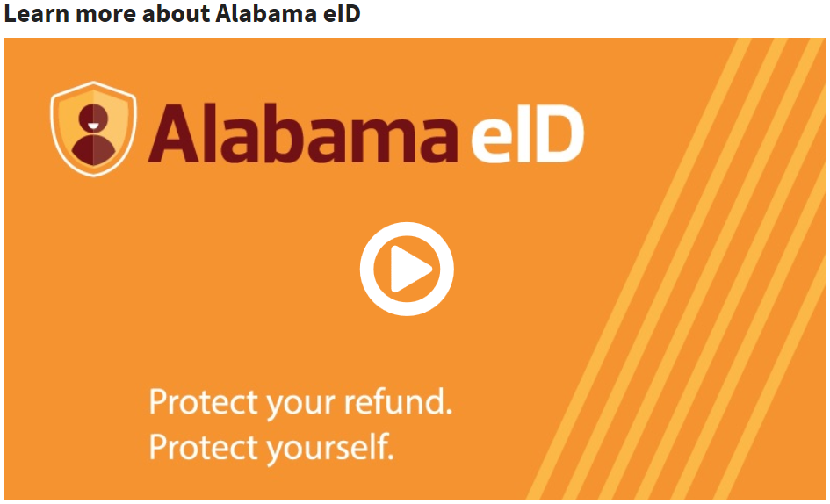
What’s New in I.D. Theft Prevention

Slide 3
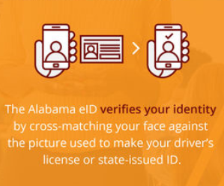
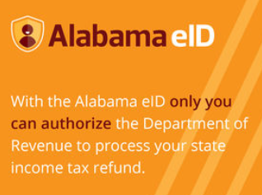
What’s New in I.D. Theft Prevention

Slide 4
What’s New in I.D. Theft Prevention
State partners with IDEMIA to create the ground breaking electronic ID app (Alabama eId). The app uses a selfie taken by the filer to authenticate their identity when filing their income tax returns. Below are the steps in order to participate:
Users will download the free Alabama eID app to their smartphone.
Users will take a photo of their drivers license.
Users will take a selfie with the app to activate your eID.
Users will register their eID with My Alabama Taxes and be provided a QR code which they scan with the Alabama eID app on their phone.
The information submitted is compared to the drivers license information on file and if there is a match, the user will be registered for the service.

Slide 5

What’s New in I.D. Theft Prevention
Each log in attempt or tax return submission requires a new selfie in lieu of a password to verify it is the actual taxpayer rather than a cyber criminal. Without an ID match the user cannot log in.
Available for both the iPhone and the Android.
Best of all, submitting your return using eID grants you priority return processing.

Slide 6
What’s New in I.D. Theft Prevention
eID statistics as of 10-16-2018:
There are currently 805 eID users. 1 eID users registered this week.
ADOR sent 7 alerts this week. Users responded affirmatively to 1 alerts this week.
ADOR has sent a total of 1787 eID alerts. This includes 861 return alerts sent to notify the user that a return was filed in their name.
ADOR has received a total of 1236 affirmative alert responses and 2 negative alert responses.
There are 7 alerts awaiting a response. 543 alerts have expired.
ADOR has received 458 affirmative return alert responses and 0 negative return alert responses.
There are 6 return alerts awaiting a response. 397 return alerts have expired.

Slide 7

What’s New from the 2018 Regular Session of the Alabama Legislature?

Slide 8
What’s New from the 2018 Regular Session of the Alabama Legislature?
To view any legislation passed by the Alabama Legislature, please visit the website for the Alabama Secretary of State at www.sos.alabama.gov .
Point to the “Records” tab at the top of the page with your mouse and select “Legislative Acts”.
Select whether you want to search by the Act Number or the Bill Number.
Enter either the Act Number or Bill Number and select view image to see a PDF version of the Act.

Slide 9
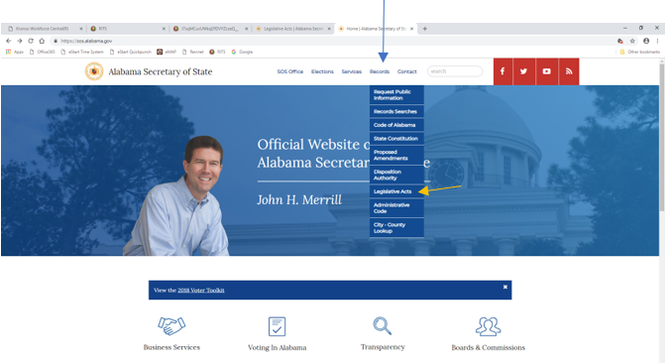
What’s New from the 2018 Regular Session of the Alabama Legislature?

Slide 10
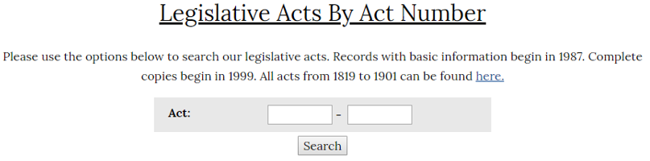
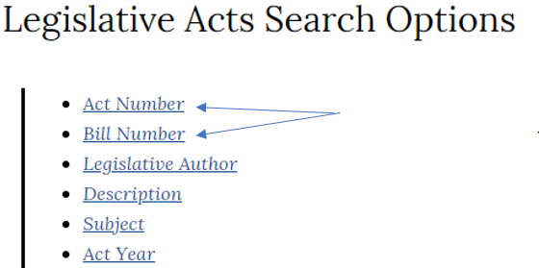
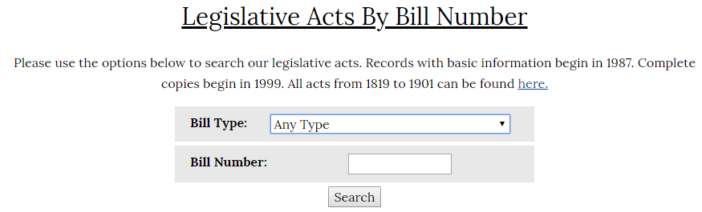
What’s New from the 2018 Regular Session of the Alabama Legislature?

Slide 11
Act 2018-153 (HB137)
Alabama Tax Delinquency Amnesty Act of 2018

Slide 12
Act 2018-153 (HB137)
Alabama Tax Delinquency Amnesty Act of 2018
Requires the Department of Revenue establish a Tax Amnesty Program.
The program was effective for the three month period beginning July 1, 2018 and ending September 30, 2018.
Amnesty applications were submitted electronically using the following link: https://www.alabamataxamnesty.com/
Program applied to ALL taxes administered by the Department EXCEPT for motor fuel, motor vehicle, and property taxes.
Notes:
Local sales, use, gross receipts, motor fuels taxes, utility taxes, personal property tax-generally taxes collected by others on behalf of the state or local governments

Slide 13
Act 2018-153 (HB137)
Alabama Tax Delinquency Amnesty Act of 2018
Eligible: Taxpayers that had not been contacted by the Department of Revenue within two years of submitting an initial amnesty application
Ineligible: 1) Taxpayers that had been contacted by the Department of Revenue or
2) Taxpayers who are parties to any criminal investigation or criminal litigations in any court of the United States or the State of Alabama.

Slide 14
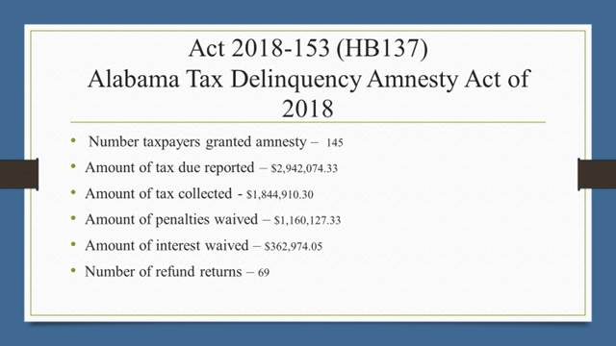

Slide 15
Act 2018-194 (HB83)
Veterans Employment Act

Slide 16
Act 2018-194 (HB83)
Veterans Employment Act
Act 2018-194 amends Code Section 40-18-320 to rename the Heroes for Hire Tax Credit Act of 2012 the Veterans Employment Act.
Act 2018-194 removes the requirement that the veteran have been discharged from active duty service within two years of the hire date to promote the hiring of unemployed veterans. This credit was previously only available to employers hiring a “recently deployed unemployed veteran” who was hired within two years of discharge from service.
The credit is $1,000 per qualifying employee hired if all the requirements of the Act are met.

Slide 17
Act 2018-194 (HB83)
Veterans Employment Act
In addition to meeting the requirements of either the Full Employment Act of 2011 or the Alabama Small Business and Agribusiness Jobs Act, Act 2018-194 added the following additional requirements for each new hire:
Employee must be an unemployed combat veteran with an honorable discharge or any unemployed veteran with a general or honorable discharge who was an Alabama resident upon entry into the service
Each qualifying new hire must be a full-time position paying at least $14 per hour
Job location and duties must be predominantly in Alabama
Employee must complete 12 months of consecutive employment

Slide 18
Act 2018-232 (SB76)
Standard Deduction Increase
Foreign Income Exclusion

Slide 19
Act 2018-232 (SB76)
Standard Deduction Increase
Foreign Income Exclusion
Act 2018-232 amends Code Section 40-18-15 to increase the maximum standard deduction income range and amends Code Section 40-18-19 to allow a foreign income exclusion.
For tax years 2019 and forward, the maximum optional standard deduction income range for each filing status shall be increased before the deduction tapers off as follows:
Married Filing Jointly – from $20,000 to $23,000 - $7500 less $175 per $500 of GI
Married Filing Separately – from $10,000 to $10,500 - $3750 less $88 per $250 of GI
Filing Head of Family - from $20,000 to $23,000 - $4700 less $135 per $500 of GI
Filing Single – from $20,000 to $23,000 - $2500 less $25 per $500 of GI

Slide 22
Act 2018-232 (SB76)
Standard Deduction Increase
Foreign Income Exclusion
Act 2018-232 amends Code Section 40-18-19 to now allow for a foreign income exclusion.
Exclusion is allowed on 2018 and forward tax returns.
Allows an exemption for foreign income to the extent such income is exempt from federal income tax pursuant to section 26 USC 911 – federal Form 2555 should be attached, and the amount per Form 2555 will be entered on Form 40, Page 2, Part I, line 8 as a negative amount. **negative amount is only entered if income is reported elsewhere on the return**

Slide 23
Act 2018-280 (HB251)
ABLE Savings Plan

Slide 24
Act 2018-280 (HB251)
ABLE Savings Plan
  Act 2018-280 amends Code Section 16-33C-5 relating to the Wallace-Folsom Savings Investment.
  Adds the new paragraph 16-33C-5(e) to the code section which states that contrary to any other laws, that for purposes under state law contributions to and investments in an ABLE Savings Account will continue to be allowed.
  As before, contributions to an ABLE Savings Plan are not deductible and distributions from an ABLE Savings Plan are not taxable if used by a conservator for the for qualified expenses of a designated beneficiary.

Slide 25
Act 2018-405 (SB150)
Donation Check-off Spanish Fort Veterans Cemetery

Slide 26
Act 2018-405 (SB150)
Donation Check-off Spanish Fort Veterans Cemetery
Act 2018-405 amends Code Section 40-18-140 to provide an income tax refund check-off for a contribution to the Alabama State Veterans Cemetery at Spanish Fort Foundation, Incorporated.
Effective for the 2018 and forward tax years.
Code Section 40-18-140(c) allows for a donation check-off to be dropped from the Alabama income tax return if it fails to achieve average annual gross collections of $7,500 for a three year period after adoption. This year the “Archives Services Fund” was removed for failing to meet this threshold.

Slide 27
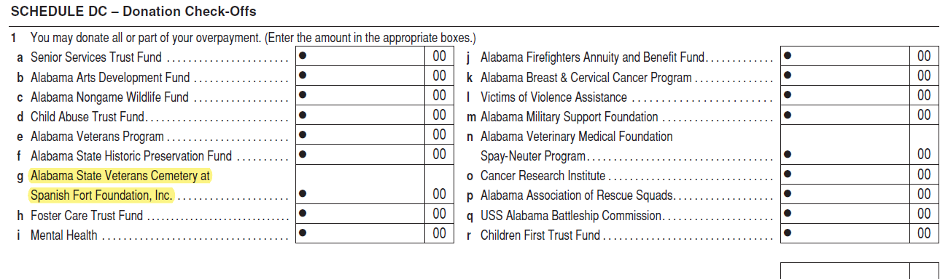
Act 2018-405 (SB150)
Donation Check-off Spanish Fort Veterans Cemetery

Slide 28
Act 2018-453 (HB320)
Filing Threshold Update

Slide 29
Act 2018-453 (HB320)
Filing Threshold Update
Act 2018-453 amends Code Section 40-18-27 to update the filing status threshold to reflect that a return is required by a taxpayer when their income exceeds the allowable optional standard deduction allowed in Code Section 40-18-15 and their personal exemption allowed in Code Section 40-18-19 for their filing status.
Although this Act now amends Code Section 40-18-27, the instructional booklets for the Forms 40, 40A, and 40NR previously reflected this information.
The next slide information is from the 2017 Form 40 instructions which reflects this was in practice before the code was updated this year.

Slide 30
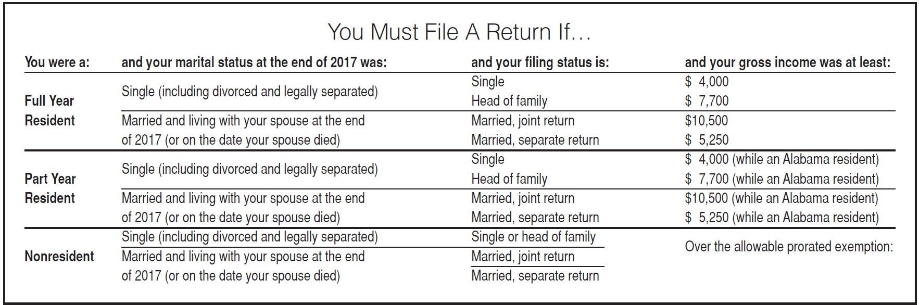
Act 2018-453 (HB320)
Filing Threshold Update

Slide 31
Act 2018-465 (HB 384)
Credit for Taxes Paid to Another State or Territory

Slide 32
Act 2018-465 (HB 384)
Credit for Taxes Paid to Another State or Territory
Act 2018-465 adds further clarification that an Alabama resident individual with gross income from sources outside of Alabama which is includible in Alabama Gross Income and that is also includible in the gross income of another state or territory of the United States is entitled to a credit against the income tax due Alabama on such income subject to limitation.
The credit for tax paid or incurred to other jurisdictions shall not be used to offset that portion of a taxpayer’s income tax liability which is attributable to Alabama sources. The credit for tax paid or incurred to other jurisdictions shall only be utilized against that portion of the taxpayer’s Alabama income tax liability which is attributable to income from other jurisdictions to which income taxes were paid with respect to that tax year.

Slide 33
Act 2018-465 (HB 384)
Credit for Taxes Paid to Another State or Territory
As a general rule, that portion of a taxpayer’s income tax liability which is attributable to non-Alabama sources shall be determined by multiplying the taxpayer’s Alabama income tax liability before consideration of any credit described in Code Section 40-18-21 by a fraction, the numerator of which is the taxpayer's Alabama adjusted gross income attributable to other states or territories to which income taxes were paid by or on behalf of an individual resident of Alabama, and the denominator of which is total Alabama adjusted gross income.

Slide 34
Act 2018-465 (HB 384)
Credit for Taxes Paid to Another State or Territory
  Example: Taxpayer reports $120,000 of adjusted gross income on his Alabama income tax return, of which $80,000 is attributable to another jurisdiction; his Alabama income tax liability before credits is $4,000. Taxpayer paid the other jurisdiction $4,000 of income tax on the $80,000 of income from the other jurisdiction.
Because one-third ($1,333) of Taxpayer’s liability is attributable to Alabama sources, it is not subject to the credit for tax paid to other jurisdictions. The maximum credit that Taxpayer may utilize is $2,667, which is the portion of his liability attributable to other jurisdictions.

Slide 35
Act 2018-467 (HB248)
Alabama First-Time and Second Chance Home Buyer Savings Account Act

Slide 36
Act 2018-467 (HB248)
Alabama First-Time and Second Chance Home Buyer Savings Account Act
  Act 2018-467 was created as an incentive to help first-time and second chance home buyers plan and save funds for a down payment and closing costs on the purchase of a first home in Alabama.
  Allows Alabama residents a tax deduction for contributions made to a first-time and second chance home buyer savings account. The earnings are not taxable if used for the purchase of a first home in Alabama.
  Qualifying individuals must be Alabama residents who have not owned or purchased individually or jointly a home ten years prior to the purchase of the first-time home in Alabama.
  Individuals must open an account with a financial institution which is designated as a first-time and second chance home buyer savings account on or after January 1, 2019.
  There is no limitation on the amount deposited into the account, but single taxpayers are limited to a $5,000 maximum annual deduction and joint filers are limited to a $10,000 annual maximum for a period not to exceed 5 years for an aggregate total of principal and earnings of $25,000 and $50,000 respectively during the 5 year period.

Slide 37
Act 2018-467 (HB248)
Alabama First-Time and Second Chance Home Buyer Savings Account Act
  Only the account holder(s) are eligible for a deduction. Individuals or organizations that contribute to an account on behalf of the taxpayer will not be eligible for any deductions for the contribution.
  The funds must be used by December 31st of the fifth year to purchase a home in Alabama or the entire funds balance must be included in the account holder’s income.
  Funds withdrawn for reasons other than to purchase a first-time home will require the taxpayer to include (1) the entire balance of the fund, including and accumulated earnings, in income in the year of withdrawal (2) a penalty equal to 10% of the amount withdrawn.
  Exceptions to the rule would be the death or disability of the account holder or if the account holder has exhausted his or her applicable unemployment benefits.
  Taxpayers must maintain and submit annually with their return any supporting documentation provided by the financial institution for the account.
  This Act sunsets 5 years after the effective date for new accounts on March 28, 2023.

Slide 38
Act 2018-468 (HB260)
Irrigation and Reservoir System Credit

Slide 39
Act 2018-468 (HB260)
Irrigation and Reservoir System Credit
Act 2018-468 adds clarifying language to Code Section 40-18-342 that the irrigation credit is limited to a one time purchase credit per taxpayer for each of the following series of years:
2012 - 2017
2018 - 2022
2023 and forward.
For years 2012 - 2017, Code Section 40-18-342 allowed qualifying taxpayers a one time purchase credit of 20% of their irrigation or reservoir system costs up to $10,000 with a 5 year carry forward of any credit remaining above their liability.

Slide 40
Act 2018-468 (HB260)
Irrigation and Reservoir System Credit
Last years Act 2017-352 amended Code Section 40-18-342 to allow taxpayers who qualify for the credit a choice to take 20% of their irrigation system cost up to $10,000 or as an alternative 10% of their irrigation system cost up to $50,000, whichever is greater. This is effective for tax years 2018-2022.
For tax years beginning after December 31, 2022, the credit will revert back to its original amount of 20% of the irrigation or reservoir system cost up to $10,000 per Act 2017-352.
For all years, the credit is taken in the year the system is placed in service and any unused credit may be carried forward for an additional 5 years.

Slide 41
Act 2018-468 (HB260)
Irrigation and Reservoir System Credit
Taxpayers must submit a copy of their credit certificate as issued from the Department of Agriculture and Industries when submitting their return reflecting an Irrigation Credit.
A pro rata share of credit will be available to members of a pass through entity.

Slide 42
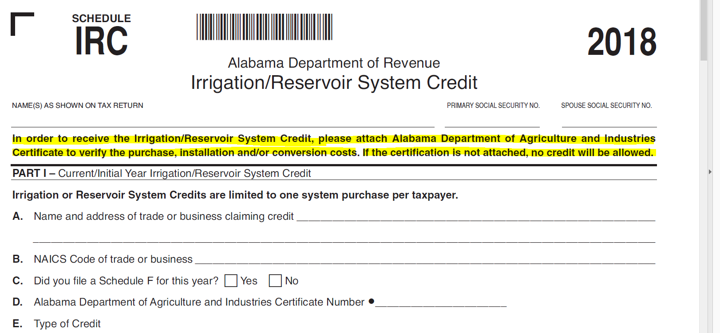
Act 2018-468 (HB260)
Irrigation and Reservoir System Credit

Slide 43
Act 2018-549 (SB209)
Adoption Credit

Slide 44
Act 2018-549
(SB209) Adoption Credit
Act 2018-549 amends Code Sections 40-18-360 and 40-18-361 to remove the wording “intrastate” from the code.
In removing the term “intrastate”, the Act now allows any private adoption to qualify for the $1,000 refundable credit as long as the adoptive parents are Alabama residents. The birth mother and child no longer have to reside in Alabama.
Effective for tax years 2019 and forward.
Adoptions, including foster children in the care of the Alabama Department of Human Resources, must go through a private adoption agency.
Adopting or housing a family member will not qualify for an adoption credit.

Slide 45
2017 Legislation
Effective 2018 and Later Tax Years

Slide 46
Act 2017-380 (HB345)
Historic Rehabilitation Tax Credit

Slide 47
Act 2017-380 (HB345)
Historic Rehabilitation Tax Credit
To provide an income tax credit for the rehabilitation, preservation, and development of historical structures. This was an entirely new credit to replace the original which sunset.
The original Historic Rehabilitation Tax credit sunset in 2015. There is a 10 year carry forward on any original unused credit amount which we will see for some time in the future.
The Historic Tax Commission issues a tax credit certificate to the qualifying property owner in an amount equal to the lesser of the amount of the tax credit reserved for the taxpayer or 25% of the actual rehabilitation expenditures.
The taxpayer must file this credit certificate with their Alabama state income tax return due under Chapter 18.

Slide 48
Act 2017-380 (HB345)
Historic Rehabilitation Tax Credit
The taxpayer must claim their credit in the year they place their historic structure in service. If the tax credit is larger than their tax liability for that year, the property owner will be entitled to a “refund” of the difference. See new Schedule RC.
This new historic tax credit is available to taxpayers who qualify between the tax years of 2018 through 2022 only.
The Historic Tax Commission can reserve up to $20,000,000 a year in credits for the five calendar years.
The credit may be transferred once and the Department shall provide a transfer statement to be filed by the transferor prior to the transfer. The transferor shall pay a fee of $1,000 per transferee listed on the transfer statement.

Slide 49
Act 2017-405 (HB346)
Individual Income Tax Simplified Short Form Filing Act

Slide 50
Act 2017-405 (HB346)
Individual Income Tax Simplified Short Form Filing Act
Act 2017-405 adds a new section “40-18-15.7” to the Code of Alabama 1975. This section provides for a new short form with an increased standard deduction starting with the 2018 tax year.
Allows for an individual to report their income taxes using a simplified short form in M.A.T.
Taxpayers that choose to file using the optional increased standard deduction, must acknowledge that they are voluntarily foregoing other deductions, credits, and exemptions that may otherwise be available to them including their federal income tax deduction.
The personal exemption and the increased optional standard deduction are the only exemptions or deductions allowed by a taxpayer filing this return. A taxpayer will input their W2 income and select a personal exemption of single or married filing jointly. The M.A.T. system will handle the rest of the calculations.

Slide 51
Act 2017-405 (HB346)
Individual Income Tax Simplified Short Form Filing Act
To qualify for the simplified short form, taxpayers must be Alabama residents with a filing status of either single or married filing a joint return meeting the following requirements:
Alabama gross income of less than $100,000
Zero dollars of non-wage income (interest, dividends, retirement, pension,
rents, royalties, gains, etc.)
No dependent deduction
No itemized deductions

Slide 52
Act 2017-405 (HB346)
Individual Income Tax Simplified Short Form Filing Act
Continued:
No adjustments to income
No federal income tax deduction
No income tax credits
Filer is not required to make estimated income tax payments
Not claiming any gains or losses

Slide 53
Act 2017-405 (HB346)
Individual Income Tax Simplified Short Form Filing Act
The only deductions allowed a taxpayer using the simplified short form will be the optional increased standard deduction and a personal exemption as follows:
The standard deduction allowed single filers will be the greater of $2,250 or the standard deduction allowed by 40-18-15.
The standard deduction allowed joint filers will be the greater of $4,500 or the standard deduction allowed by 40-18-15.
The personal exemption will be allowed in accordance with 40-18-19, $1500 for single filers and $3,000 for joint filers.

Slide 54
Prior Year Credits Affecting 2018
Returns
Act 2011-551 Full Employment Act of 2011
Act 2011-689 Neighborhood Infrastructure Incentive Plan Credit
Act 2012-168 Veterans Employment Act (Heroes for Hire Tax Credit)
Act 2012-391 Irrigation /Reservoir System Tax Credit
Act 2013-64 School Transfer Credit – AAA Credit and SGO Donation Credit – Scholarship Granting Organization
Act 2013-241 Historic Rehabilitation Tax Credit
2014-147 Career Technical Dual Enrollment Credit (there have been zero $ donations for 2018)

Slide 55
Prior Year Credits Affecting 2018
Returns
Act 2014-413 Adoption Credit
Act 2015-027 Alabama Jobs Act Credit
Act 2016-102 Alabama Renewal Act (Port Credit and Growing Alabama Act Credit)
Act 2016-188 Alabama Small Business and Agribusiness Jobs Act
Act 2016-314 Apprenticeship Tax Credit of 2016
Act 2016-321 Alabama Jobs Act Credit of 2015 (amended)

Slide 56
Prior Year Acts Effective for 2018
Returns
Act 2016-345 Health Savings Account Contributions deductions (HSA’s)
Act 2017-352 Irrigation and Reservoir System Credit
Act 2017-380 Historic Rehabilitation Tax Credit

Slide 57


Slide 58
Changes affecting Individual
For tax years 2018 and forward, moving expenses are no longer allowed for Alabama residents except for members of the Armed Forces of the United States per 26 USC 217(k). See Alabama Code Section 40-18-15(a)(18).
Mortgage interest deduction is now limited to interest on debt of up to $750,000 if filing joint or $375,000 if filing separately for purchases of a principal residence after December 31, 2017 per 26 USC 163(h)(3)(F). See Alabama Code Section 40-18-15(a)(2).
Home equity interest no longer deductible per 26 USC 163(h)(3)(F). See Alabama Code Section 40-18-15(a)(2). However, the interest is still deductible if used for improvements on a taxpayers main home and the total of both the home mortgage and the home equity loan does not exceed the $750,000 mortgage interest threshold. Can’t be used to pay off credit card, student loan debt, etc.

Slide 59
Alimony will not be reportable by the recipient or deductible by the payer for divorce agreements executed after December 31, 2018 per 26 USC 61 (a)(8), 71, 215, and 682. See Alabama Code Sections 40-18-14(1), 40-18-14.2(10), and 40-18-15(a)(17).
Personal casualty losses no longer deductible unless attributable to a federally declared disaster area per 26 USC 165(h)(5). See Alabama Code Section 40-18-15(a)(6).
529 college plan funds marked for higher education can now be used for attendance at an elementary or secondary public school, private, or religious school.
Occasional or recreational gambling losses will still be limited to the amount of gambling winnings for Alabama purposes. Expenses incurred by professional gamblers in carrying on a trade or business which are allowed up to the amount of gambling winnings for Federal purposes will also be recognized for Alabama purposes. See Alabama Business Rule 810-3-17-.01(a)(12).

Slide 60
Changes affecting corporations-
New Federal flat tax rate of 21%
AMT repealed
Section 199 (DPAD) repealed
Dividends received deduction reduced to 50% & 65% (pre TCJA 70% & 80%)
Federal NOL changes
  No carryback, indefinite carry forward, & 80% of Taxable Income limitation

Slide 61
Corporate continued
Business interest deductions
  For years beginning after 12/31/2017, every business, regardless of its form, is generally subject to a disallowance for net interest expense in excess of 30% of the business’s “adjusted taxable income”. Taxpayers with average gross receipts less than 25 million in the 3 previous tax years are exempt.
  Adjusted Taxable Income for years beginning after 12/31/2017 & before 1/1/2022 is computed without regard to depreciation, amortization, or depletion.
  The disallowance is determined at the tax filer level except for pass-through entities which are determined at the entity level not at the individual member level.

Slide 62

Act 2013-088
Red Tape Reduction Act
Requires Business Rules be reviewed every 5 years.
Completed first 5 year review on June 29th.
Important: Managers should follow up on all business rules that were identified as needing to be amended or repealed to make sure the appropriate changes were made or that the rule was repealed.
Next review is due in 2023

Slide 63

My Alabama Taxes
ADOR continues to offer a FREE electronic filing option to individual Alabama taxpayers filing a state tax return.
No income limitations or other qualifications must be met to take advantage of this free online filing system.
Go to www.myalabamataxes.alabama.gov to sign up and efile.
No registration required for the new simplified short form 40EZ now available for the 2018 filing season.
Notes:
63

Slide 64

2018 Forms

Slide 65
Corporate Income Tax Form Changes
Form 20C
Form 20C-C
Schedule BC (Form 20C)

Slide 66
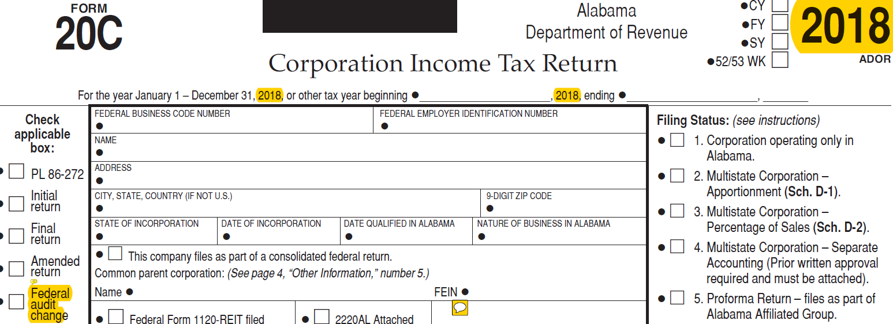
Form 20C changes
Replaced Address change check box with Federal audit change check box.

Slide 67
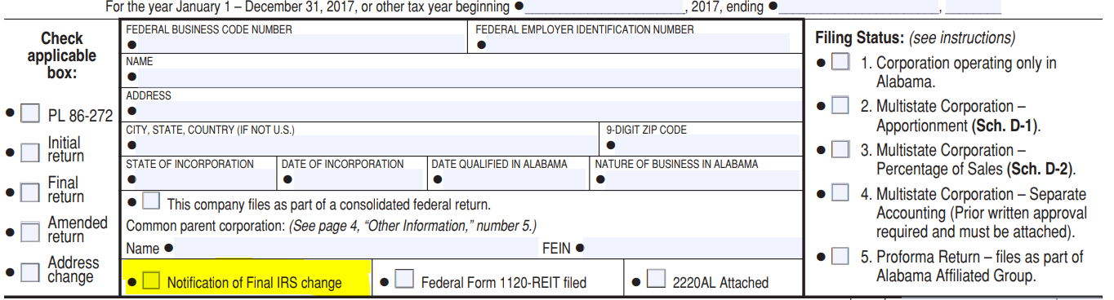
Form 20C changes
Removed Notification of Final IRS Change check box.

Slide 68
Form 20C changes
Moved line 16f Credits to line 16 renamed Nonrefundable Credits (from Schedule BC, Section E, line E3).
Moved line 16g LIFO Reserve Tax Deferral (see instructions) to line 17.
Added new Line 18 Net Tax Due Alabama (line 15 less lines 16 and 17).
Renumbered remaining line numbers.
“Paid preparer’s Use Only” information moved to page 4.

Slide 69
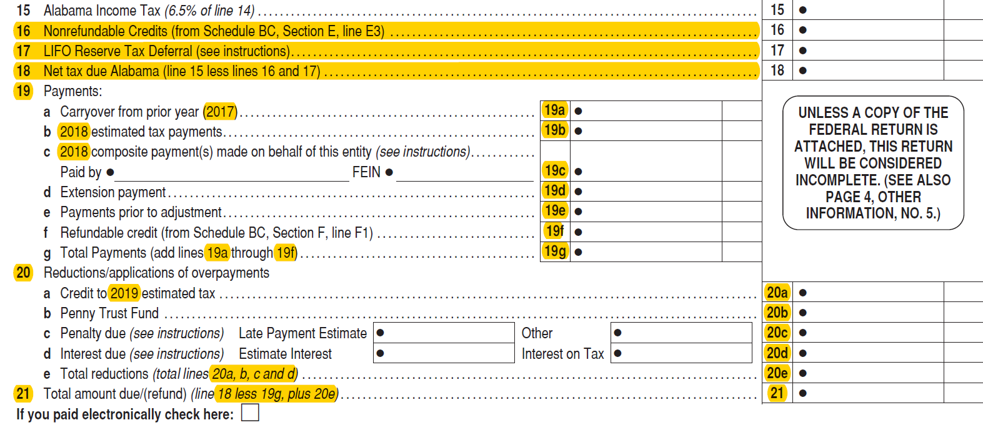
Form 20C changes

Slide 70
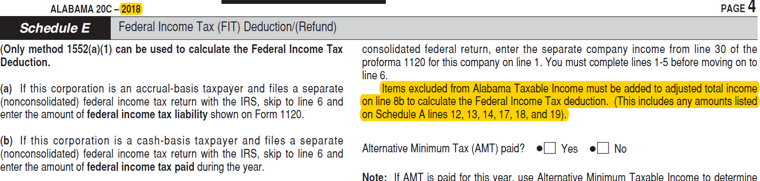
Form 20C changes
Schedule E - Added verbiage for items excluded from Alabama Taxable Income.

Slide 71
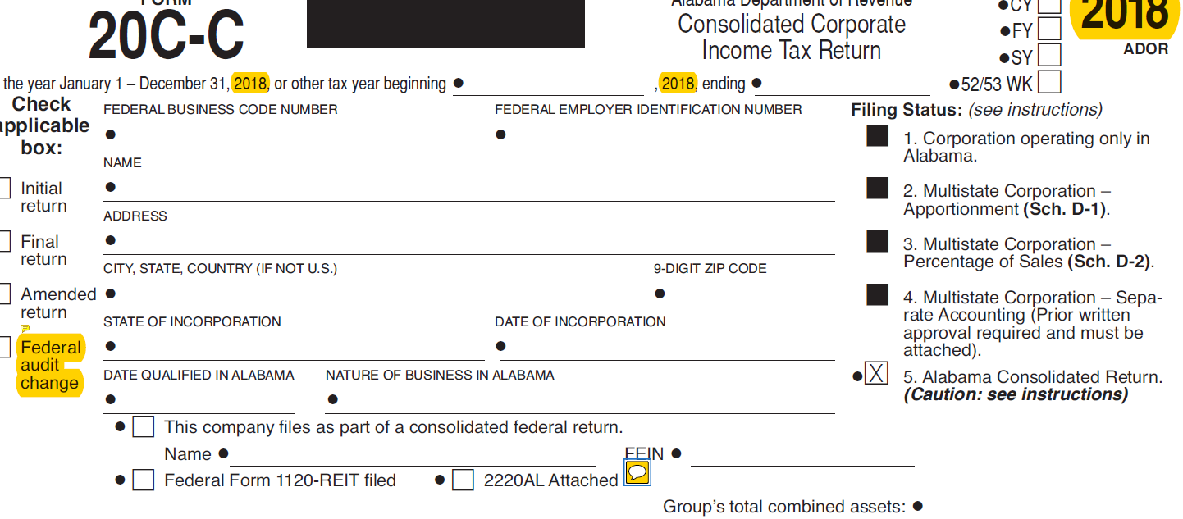
Form 20C-C changes
Replaced Address change with Federal audit change.
Deleted Notification of Final IRS change check box.

Slide 72
Form 20C-C changes
Moved line 3f Credits (sum of all proforma 20C(s), line 16) to line 3.
Moved line 3g LIFO Reserve Tax Deferral (sum of all proforma 20C(s), line 17) to line 4.
Line 5 added Net Tax Due Alabama.
Line 6 renamed to Payments/Updated line number and year.
Line 6f added Refundable Credit line.
Line 6g renamed Total Payments and line references 6a through 6f.
Updated line references for lines 7a through 7e.
Line 8 reference updated to line 5 less 6g, plus 7e.
Mailing Address moved to end of page 2 and added mailing address for Federal audit change returns.

Slide 73
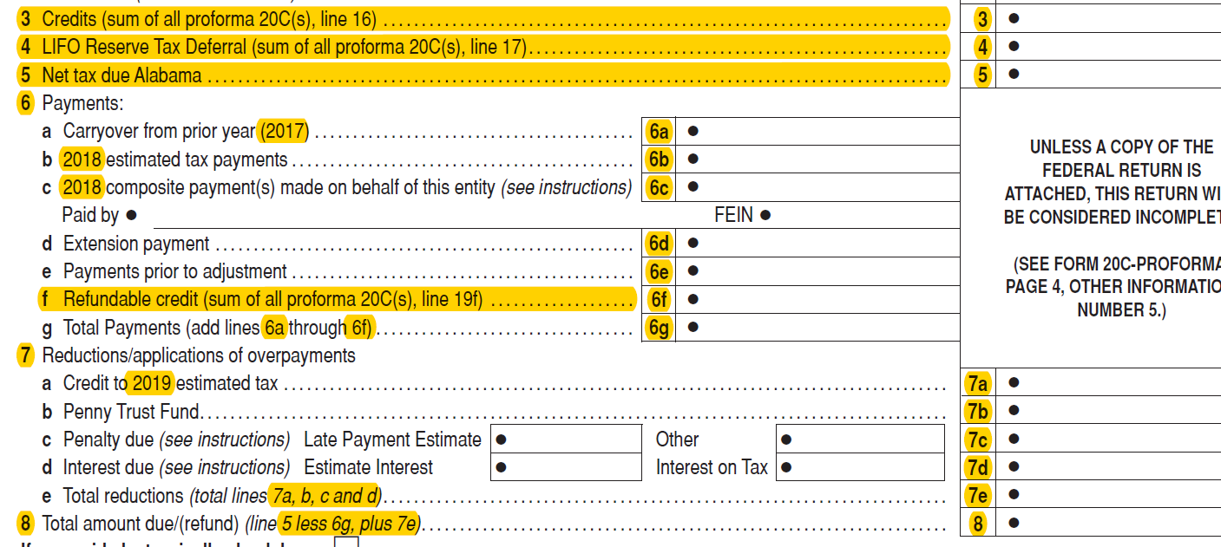
Form 20C-C changes

Slide 74
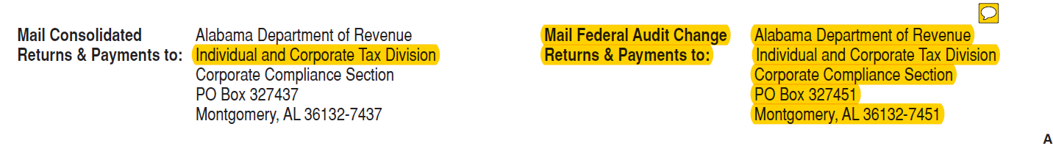
Form 20C-C changes

Slide 75
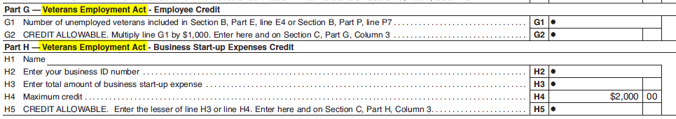
Schedule BC (Form 20C) changes
Parts G and H of Schedule BC updated to reflect the name change to the Veterans Employment Act which was formerly known as the Heroes for Hire Tax Credit Act.

Slide 76
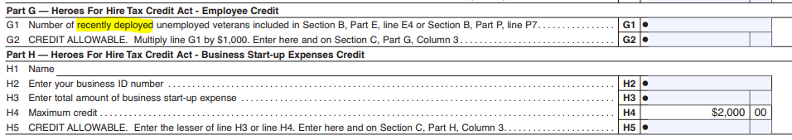
Schedule BC (Form 20C) changes
The requirement that the unemployed veteran be “Recently Deployed” removed from line G1. The Veterans Employment Act removed this requirement. This slide reflects the 2017 version of the form to show what verbiage will be removed. The previous slide reflects the updated 2018 version.

Slide 77
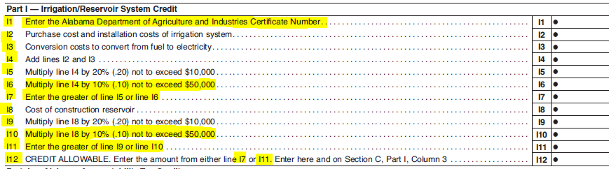
Schedule BC (Form 20C) changes
Part I of Schedule BC updated to reflect the new Irrigation Credit Act 2017-352 effective for the 2018 form year.

Slide 78
Schedule BC (Form 20C) changes
New Part R of Schedule BC updated to reflect the new Historic Tax Credit of 2017. Effective for the 2018 form year.

Slide 79
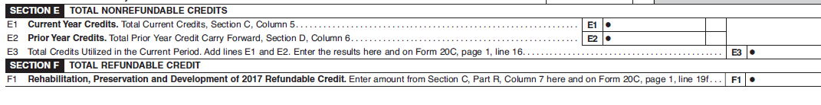
Schedule BC (Form 20C) changes
Section E has been renamed Total Nonrefundable Credits and a new section F has been added for Total Refundable Credits for the refundable portion of the Historic Tax Credit of 2017.

Slide 80
FIET Tax Form Changes
Form ET-1
Form ET-1C
Form FIE-V
Schedule EC

Slide 81
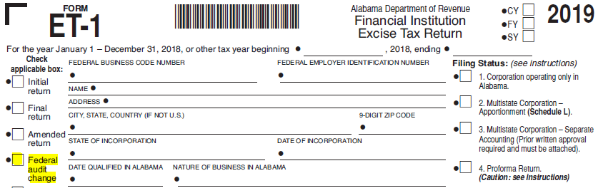
Form ET-1 changes
Replaced Address change check box with Federal audit change check box.

Slide 82
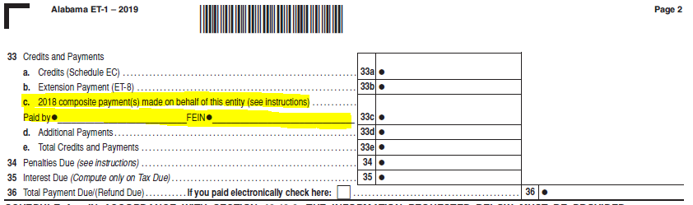
Form ET-1 changes
Added a new line 33C for Composite Payments and payer information.

Slide 83
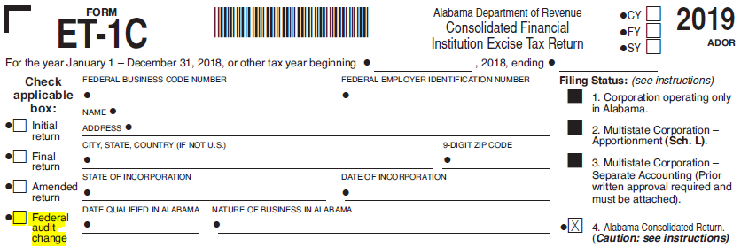
Form ET-1C changes
Replaced Address change check box with Federal audit change check box.

Slide 84
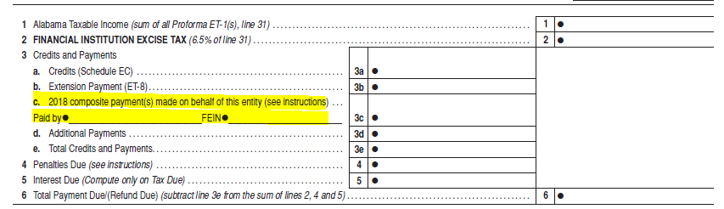
Form ET-1C changes
Added a new line 3C for Composite Payments and payer information.

Slide 85
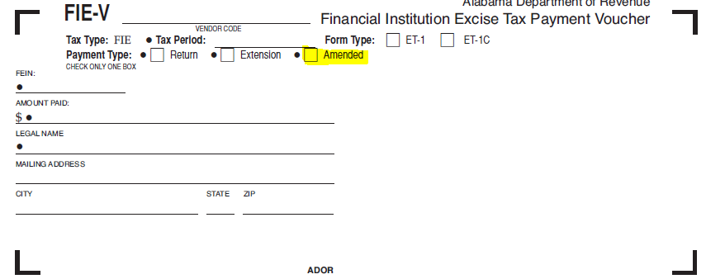
FIE-V changes
Added Amended payment type check box.

Slide 86

Schedule EC changes
Section D, Part D of Schedule EC updated to reflect the name change to the Veterans Employment Act which was formerly known as the Heroes for Hire Tax Credit Act.

Slide 87
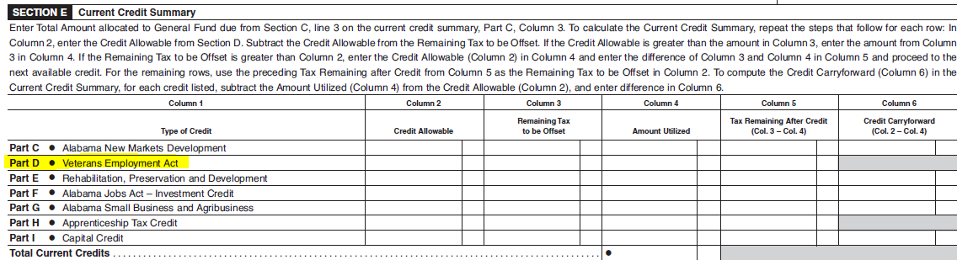
Schedule EC changes
Section E, Part D of Schedule EC updated to reflect the name change to the Veterans Employment Act which was formerly known as the Heroes for Hire Tax Credit Act.

Slide 88

Mailed Forms
The Department will mail income tax booklets (40/40NR) to Libraries and TPSC’s this year.
Taxpayers can download and print all tax forms from our website.
Taxpayers can order all tax forms from our website.

Slide 89
New IIT Forms for 2018
Form 40EZ - The new 40EZ simplified short form is an efile only option in M.A.T., no paper forms. Copies may be printed from M.A.T. for your records, but please do not mail to the Department.
Schedule DS - A new Schedule DS was created for the dependent deduction. Additional lines were needed on page 2, Part III of the return for the new Health Savings Account deduction and next year’s Alabama First-Time and Second Chance Home Buyers Savings Account deduction. These new deductions necessitated removal of the dependents calculation and the creation of the new dependent Schedule DS.
Schedule HOF – On the reverse side of the new Schedule DS will be the Head of Family Schedule HOF. Taxpayers can add requested information concerning their qualifying person.

Slide 90
New IIT Forms for 2018
Schedule RC - With no room on the face of the return for the new refundable Historic Rehabilitation Tax Credit, a new Schedule RC was created and all refundable credits were removed from page 1 of the return. Refundable credits that will now be reported on the new Schedule RC include the Alabama Accountability Act, the Alabama Adoption Credit, and the Historic Rehabilitation Tax Credit.

Slide 91
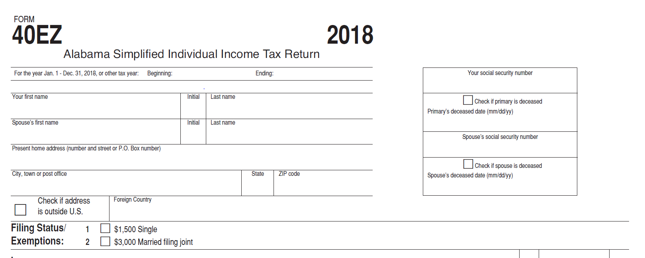
Form 40EZ
Simplified Individual Income Tax Return
Efile only in M.A.T.

Slide 92
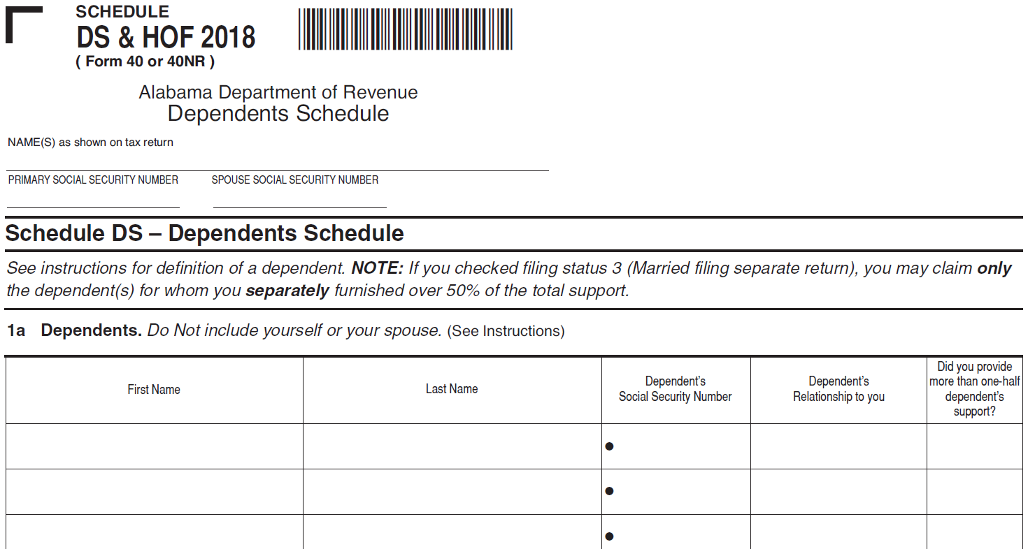
Schedule DS
Dependents Schedule

Slide 93
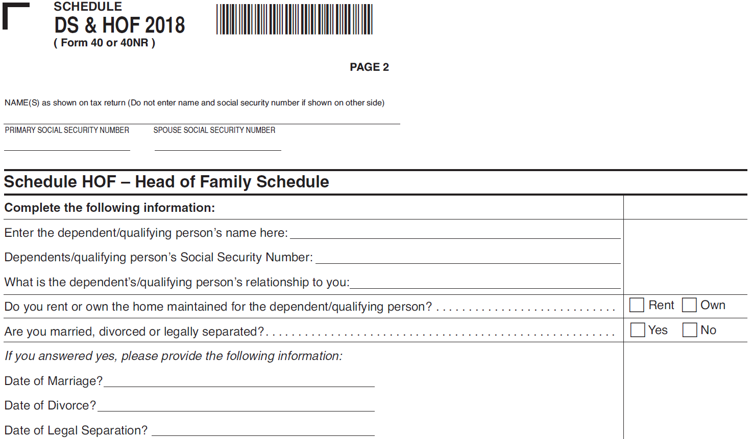
Schedule HOF
Head of Family Schedule

Slide 94
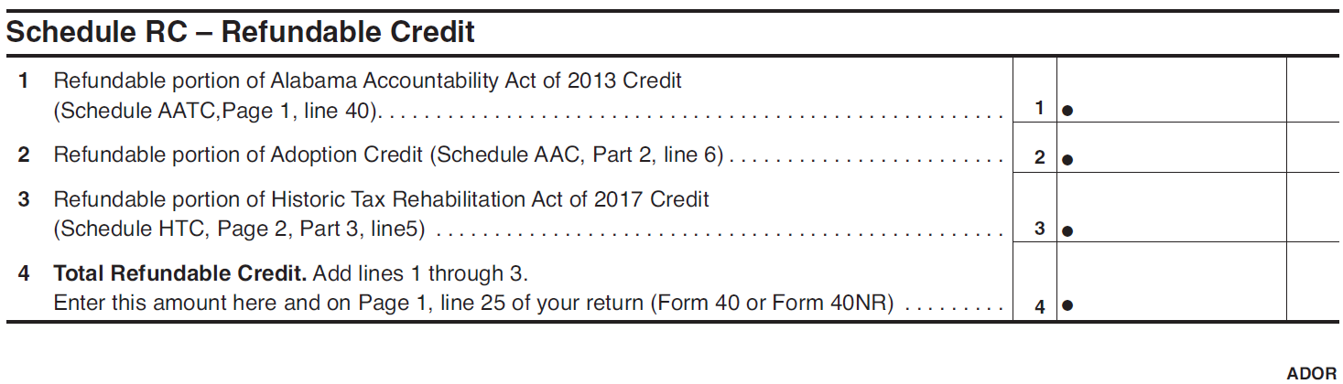
Schedule RC
Refundable Credits Schedule

Slide 95
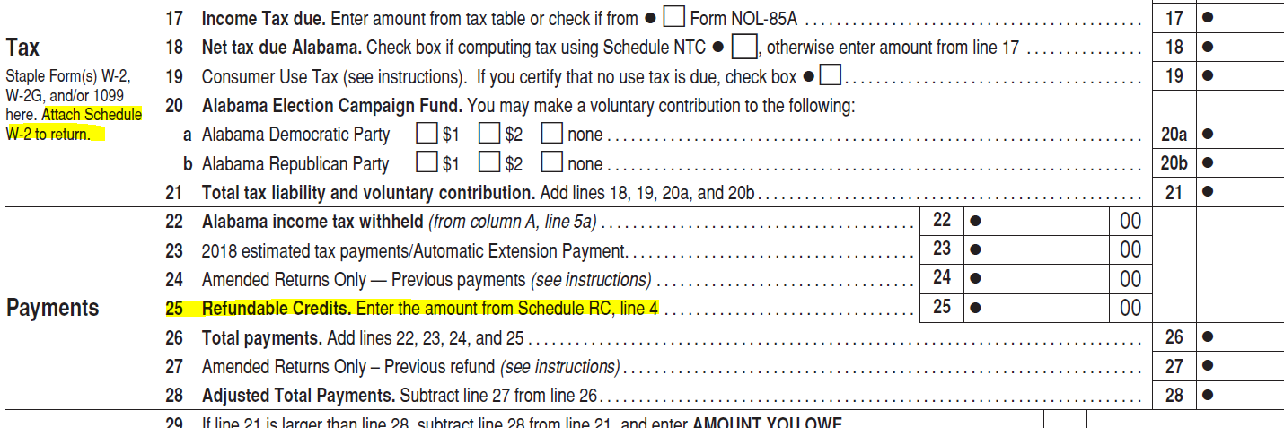
2018 IIT Form Changes
Form 40, 40A, 40NR – Added reminder to include Schedule W2 with return.

Slide 96
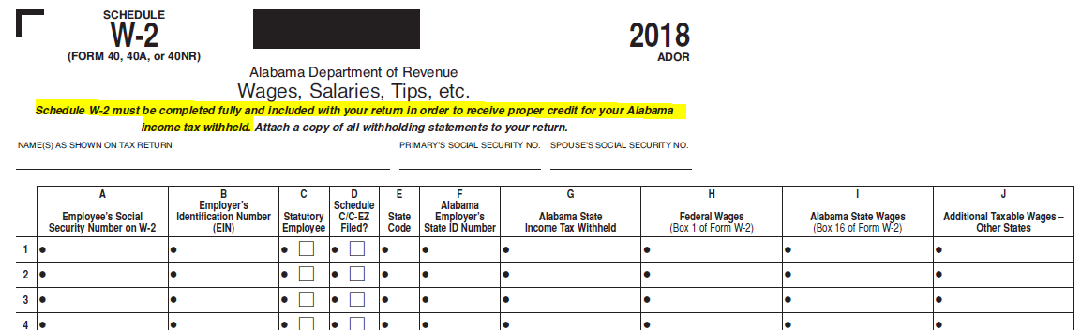
2018 IIT Form Changes
Schedule W2 was updated to remind taxpayers to submit this schedule with their return.
th updated verbage

Slide 97
2017 IIT Form Changes Effective for 2018
Schedule IRC – Updated for 2018 as a result of Act 2017-352. The irrigation or reservoir credit can now be up to 20% of the installation costs not to exceed $10,000 or 10% of the installation costs not to exceed $50,000, whichever is greater.
Schedule HTC – Updated for 2018 as a result of Act 2017-380. Taxpayers qualifying for the Historic Rehabilitation Tax Credit between the years of 2018-2022 will now be entitled to a refund for the excess credit above the taxpayers liability. A new part III has been added to the Schedule HTC for 2018. Amounts from Part III flow to the new Schedule RC for refund.

Slide 98
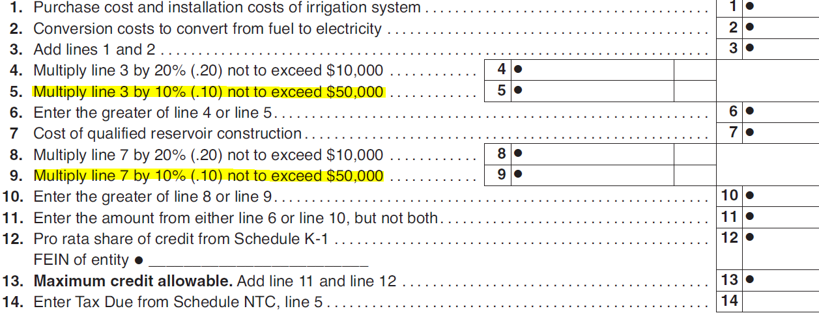
Schedule IRC
Irrigation/Reservoir System Credit

Slide 99
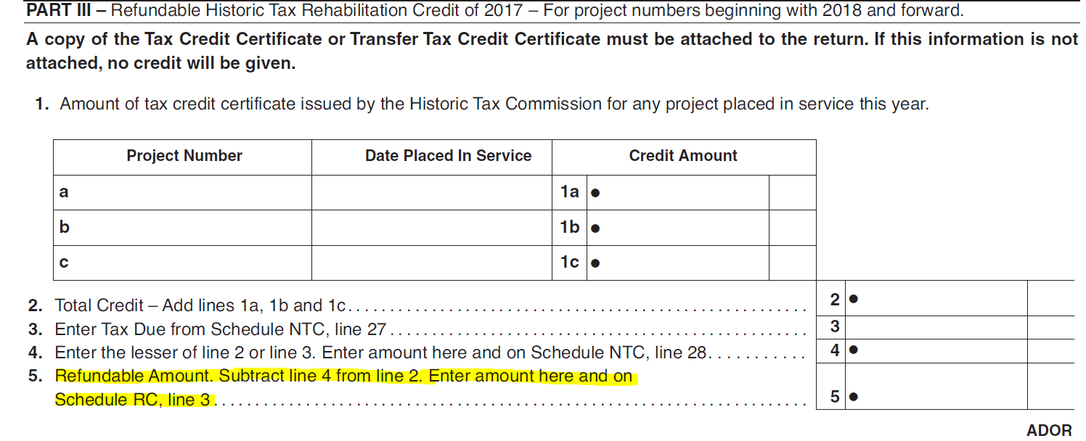
Schedule HTC
Historic Tax Credit

Slide 100
Schedule NTC Changes
Updated for 2018 as a result of Act 2017-380:
Added a new Line 28 – Historic Tax Rehabilitation Credit of 2017. Any portion of the credit which exceeds the taxpayers liability will be refunded to the taxpayer.

Slide 101
Schedule OC Changes
Removed Part A concerning credit for taxes paid to another state. Schedule CR has been updated with credit amounts now flowing from the Schedule CR directly to the Schedule NTC.
Parts F and G were renamed the Veterans Employment Act as a result of Act 2018-194. Act 2018-194 amends Code Section 40-18-320 to rename the Heroes for Hire Tax Credit Act of 2012 the Veterans Employment Act.
Additional instructions added for Part G concerning the Veterans Employment Act Business Expense Start Up Credit. Header question added:
“Did this business start up after April 2, 2012? Yes No If “No”, you do not
qualify for this credit.”

Slide 102
Schedule CR Changes
Updated Part 6 as a result of Act 2018-465 to reflect that income taxes from sources outside the state of Alabama only offset the portion of the taxpayers income tax liability attributable to income derived from non-Alabama sources.

Slide 103
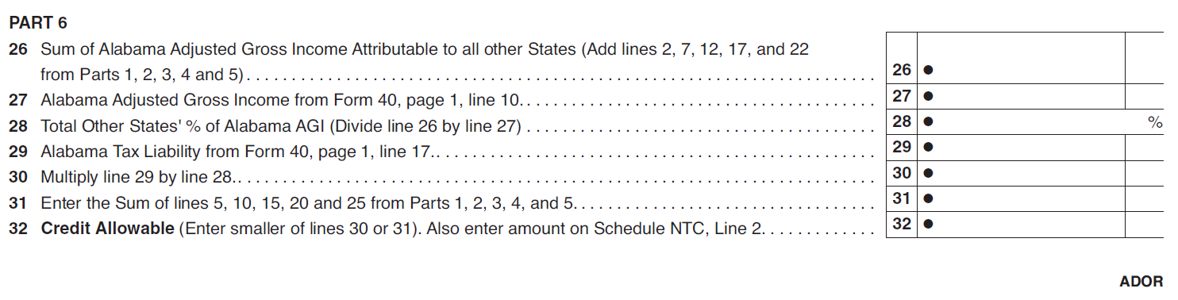
Schedule CR Changes

Slide 104
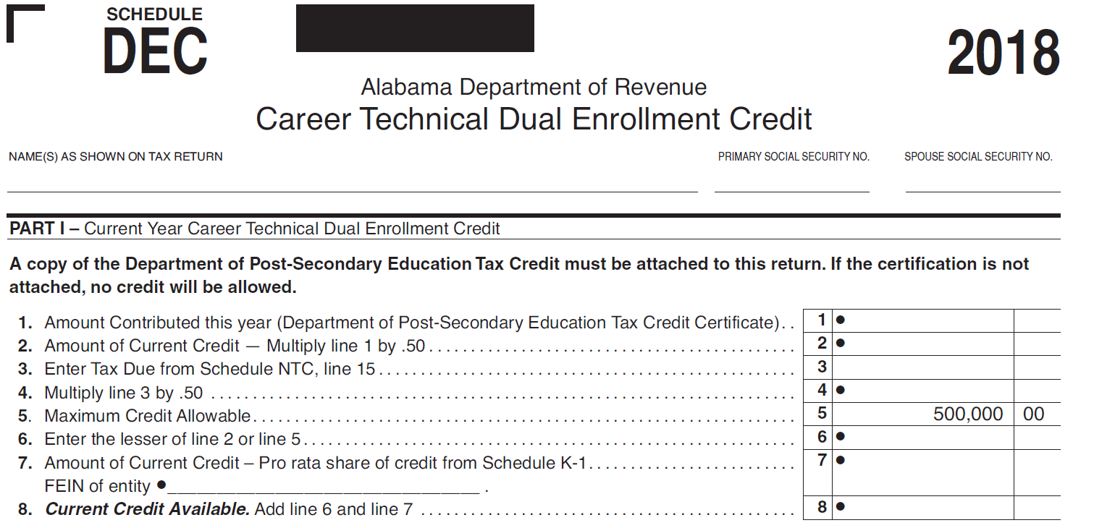
Schedule DEC
Dual Enrollment Credit
There have been no contributions. There should not be anyone taking this credit for 2018.

Slide 105
Schedule ANM
Alabama New Markets Development Credit
Schedule ANM - Alabama New Markets Development Act Credit has been retired. There were no longer any applicable taxpayers.
Also removed the ANM Credit line from Schedule NTC.

Slide 106
Fiduciary Form changes
Form 41
Schedule D (Form 41)
Schedule FC (Form 41)
Form NOL – F85
Form NOL – F85A
Schedule K-1 (Form 41)
Schedule G (Form 41)
Schedule ESBT (Form 41)

Slide 107
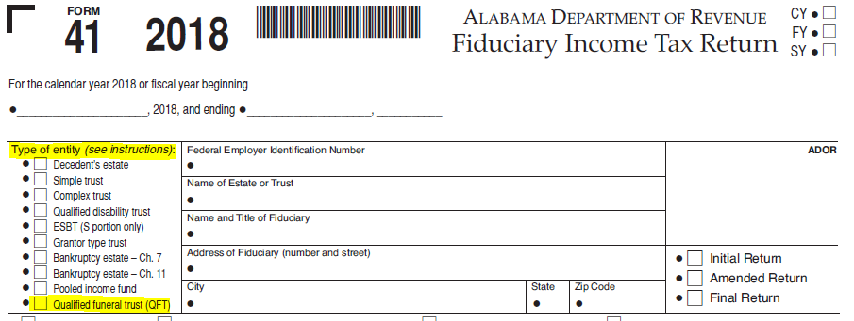
Form 41 changes
Added Qualified funeral trust checkbox as a type of entity option.

Slide 108
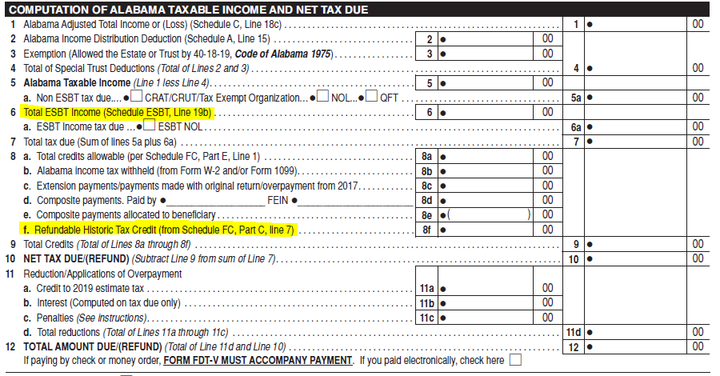
Form 41 changes
Return has been renumbered beginning with line 6 and the Refundable Historic Tax Credit of 2017 has been added on line 8f.

Slide 109
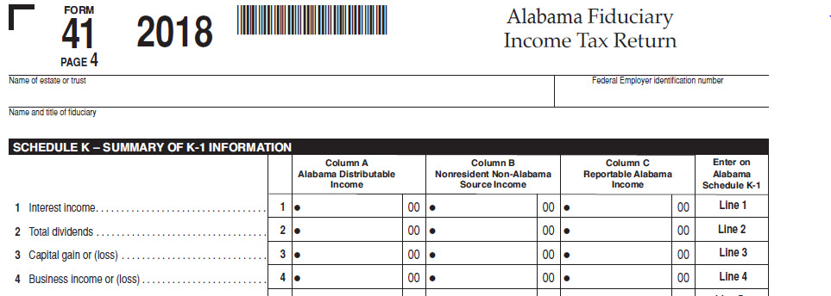
Form 41 changes
A completely new page 4 has been added to the Form 41 for Schedule K – Summary of K-1 Information.

Slide 110
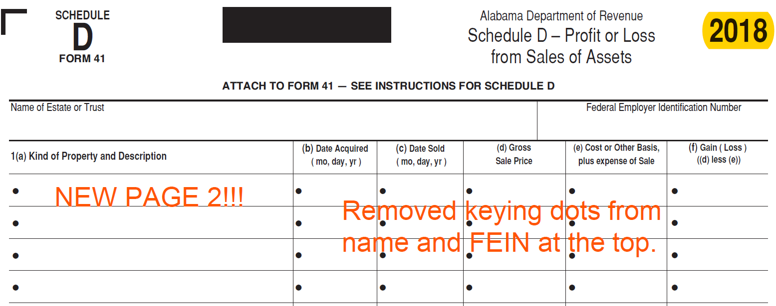
Schedule D (Form 41) changes
Schedule D (Form 41) has a new page 2 and additional changes as reflected below.

Slide 111
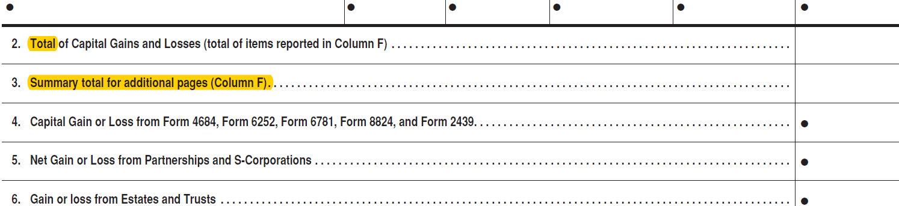
Schedule D (Form 41) changes
Schedule D (Form 41) has a new page 2 and additional changes as reflected below.

Slide 112
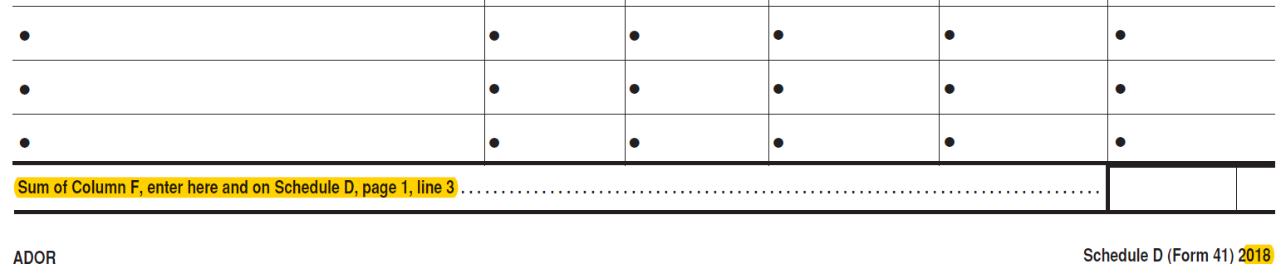
Schedule D (Form 41) changes
Schedule D (Form 41) has a new page 2 and additional changes as reflected below.

Slide 113
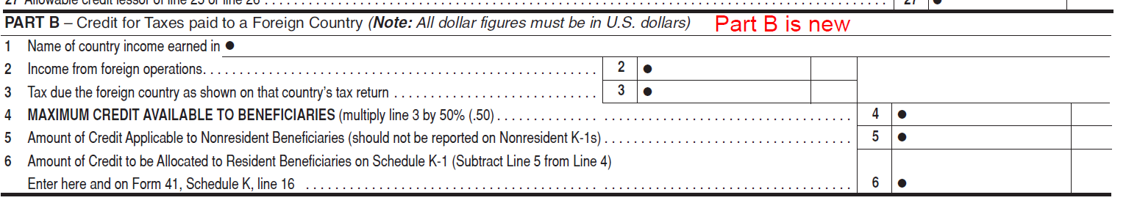
Schedule FC (Form 41) changes
New Parts B and C have been added to Schedule FC (Form 41) for 2018. The previous Part B is now Part D.

Slide 114
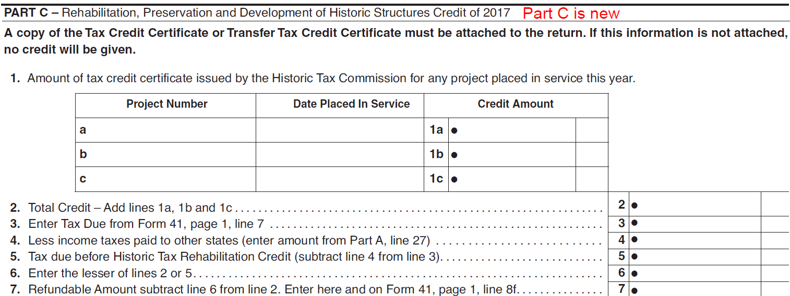
Schedule FC (Form 41) changes
New Parts B and C have been added to Schedule FC (Form 41) for 2018. The previous Part B is now Part D.
D.

Slide 115
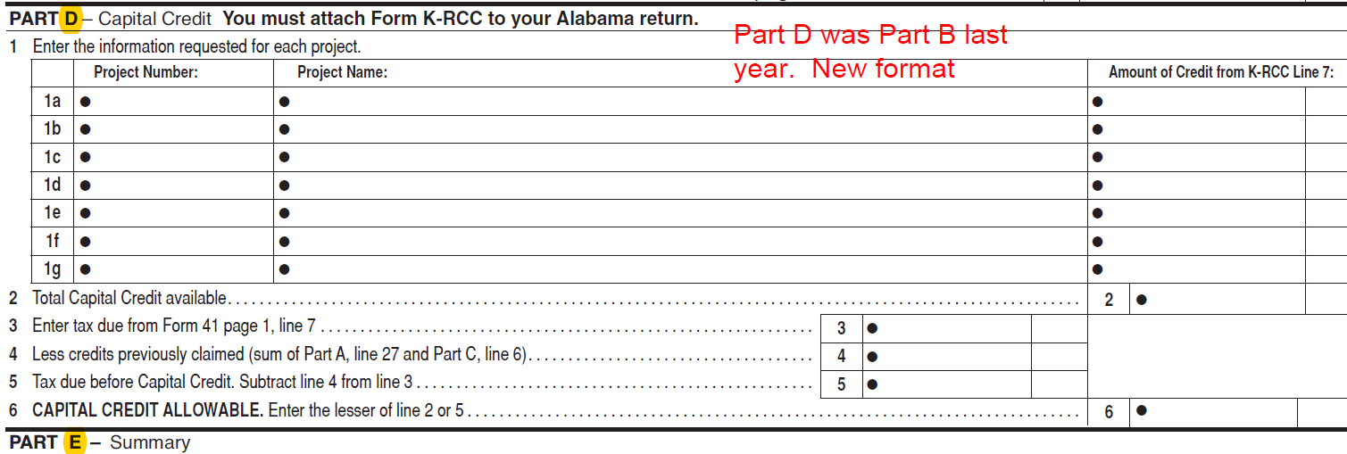
Schedule FC (Form 41) changes
Part D (previously Part B) has a new format.

Slide 116
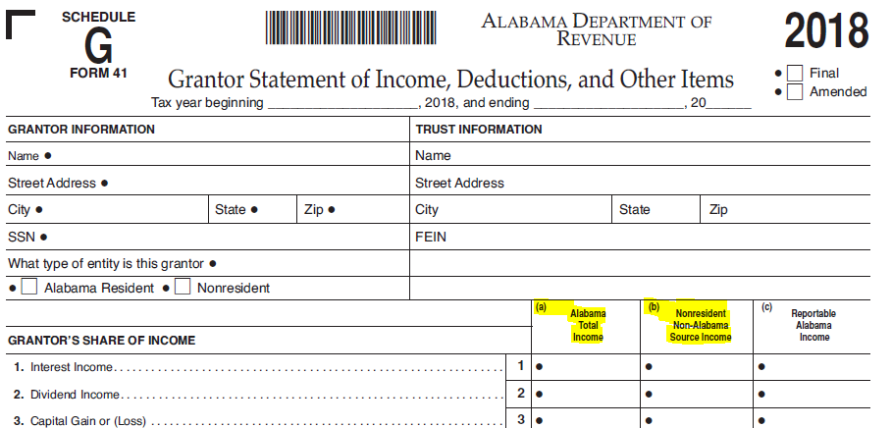
Schedule G (Form 41) changes
Schedule G (Form 41) has been reformatted and a new columns A and B added for Non-Resident Non-Alabama Source Income and Alabama Taxable Income.

Slide 117
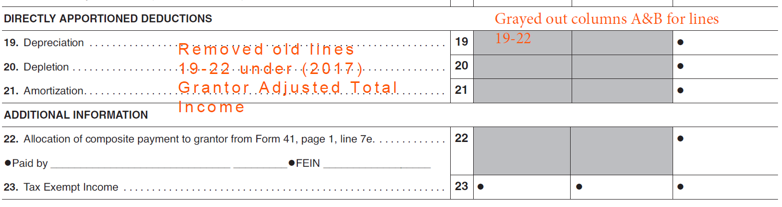
Schedule G (Form 41) changes
Additional instructions added to Schedule G (Form 41) for 2018.

Slide 118
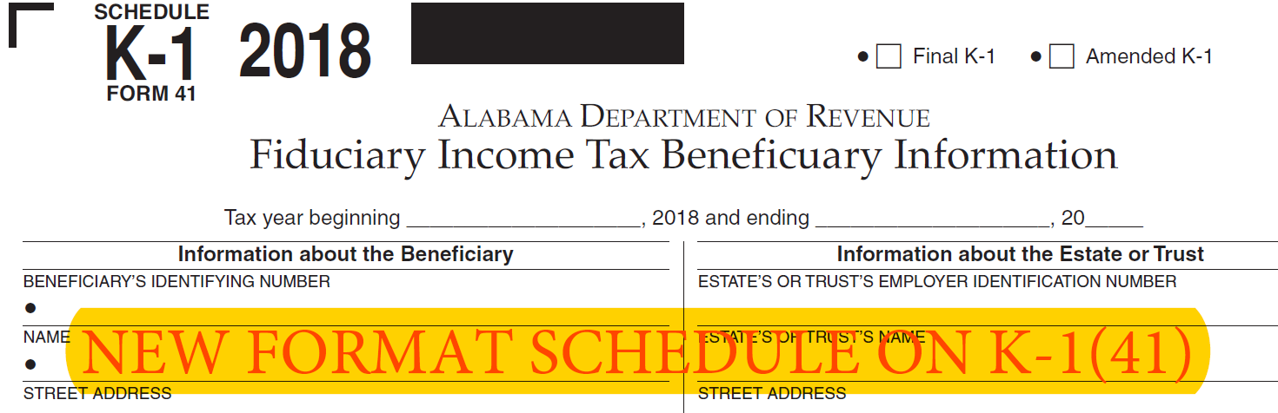
Schedule K-1 (Form 41) changes
Schedule K-1 (Form 41) has been reformatted and a new column added for Alabama Taxable Income.

Slide 119

Schedule K-1 (Form 41) changes
New format

Slide 120

Schedule ESBT (Form 41) changes
Beginning with lines 19a and below the form has been reformatted.

Slide 121

Form NOL – F85 changes
Additional instructions added to Part II of Form NOL – F85. Previously referenced line 20 of the Form 41.

Slide 122

Form NOL – F85A changes
Additional instructions added to Part I of Form NOL – F85A.

Slide 123
Pass Through Form changes
Form 65
Form PTE-C
Form 20S
Schedule PC
Schedule K-1 (Form 65)
Schedule K-1 (Form 20S)

Slide 124

Form 65 changes
Removed change of address check box and added Federal Audit Change check box.

Slide 125

Form 65 changes
Added Refundable Historic Tax Credit of 2017 to Form 65, line 32.

Slide 126

Form 65 changes
Added additional instructions to Form 65, Schedule B.

Slide 127

Form 65 changes
Added additional instructions to Form 65, Schedule E.

Slide 128

Form 65 changes
Removed S Corporation column from Form 65, Schedule P.

Slide 129

Form PTE-C changes
Removed change of address check box and added Federal Audit Change check box.

Slide 130

Form 20S changes
Removed change of address box and added Federal Audit Change box.

Slide 131

Form 20S changes

Slide 132

Form 20S changes

Slide 133

Form 20S changes
Added Refundable Historic Tax Credit of 2017 to Form 20S.

Slide 134

Form 20S changes

Slide 135

Form 20S changes
2017 version of Form 20S reflecting the information removed for the 2018 form year shown in previous slide.

Slide 136

Form 20S changes
Added additional Instructions and Keying Dots to Schedule K of Form 20S.

Slide 137

Schedule PC changes
Parts F and G of Schedule PC updated to reflect the name change to the Veterans Employment Act which was formerly known as the Heroes for Hire Tax Credit Act.

Slide 138

Schedule PC changes
On Part F, line 1, the requirement that the unemployed veteran be “Recently Deployed” will be removed for the 2018 version. The Veterans Employment Act removed this requirement. This slide reflects the 2017 version of the form to show what verbiage will be removed. The previous slide reflects the updated 2018 version.

Slide 139

Schedule PC changes
Part H of Schedule PC updated to reflect the new Irrigation Credit Act 2017-352 effective for the 2018 form year.

Slide 140

Schedule PC changes
Additional instructions added to Part J of Schedule PC.

Slide 141

Schedule PC changes
Additional instructions and Refundable Historic Tax Credit of 2017 added to Part R of Schedule PC.

Slide 142

Schedule K-1 (Form 65) changes
New check boxes have been added to the Schedule K-1 (Form 65) – Summary of K-1 if Nondeductible Section 179 Deduction.

Slide 143

Schedule K-1 (Form 20S) changes
New check boxes have been added to the Schedule K-1 (Form 20S) if Nondeductible Section 179 Deduction.

Slide 144
Business Privilege Tax Form Changes
Act 2017-363
For Form Years 2018 and forward-The due dates of the BPT Returns will correspond to the due dates of the corresponding federal return.

Slide 145
Business Privilege Tax Form Changes
AL-CAR, CPT, and PPT (C-Corporations)- taxpayers will need to make sure they check the box for change in officers (if applicable).

Slide 146

Refund Calls
ADOR Website: “Where’s My Refund”
Phone: 1-855-894-7391 (voice/ keyed response )
Call Center: (334)353-0944 or 1-800-535-9410

Slide 147

QUESTIONS
Business Privilege Tax 334-353-7923
Certificate of Compliance 334 -242-1189
Corporate Income Tax 334-353-7943
Individual Income Tax:
Examination Unit 334-353-0602
Compliance Unit 334-353-9770
Pass Through Entity 334-242-1033
Special Audit and Compliance:
Non-Filer Group 334-242-1511
CP 2000 334-242-1940
Withholding Tax 334-242-1300

Slide 148

Comments?
Lynn Schoener
lynn.schoener@revenue.alabama.gov
(334) 353-8045
Andrea Wyatt
andrea.wyatt@revenue.alabama.gov
(334) 353-9447

