Slide 1
2019 CPE Training
Lynn Schoener, CPA, FAS II
(334) 353-8045
lynn.schoener@revenue.alabama.gov
Andrea Wyatt, Revenue Examiner III
(334) 353-9447
andrea.wyatt@revenue.alabama.gov
Notes:
1

Slide 2
What’s New in I.D. Theft Prevention

Slide 3
What’s New in I.D. Theft Prevention

Slide 4
What’s New in I.D. Theft Prevention
NEW
submitting your return using eID grants you priority return processing.

Slide 5
What’s New from the 2019 Regular Session of the Alabama Legislature?

Slide 6
Act 2019-284 (HB419)
Financial Institution Excise Tax Reform Act of 2019

Slide 7
Act 2019-284 (HB419) Financial Institution Excise Tax Reform Act of 2019
Act 2019-284 updated the antiquated Financial Institution Excise Tax (FIET) statute which has not been substantially revised since being adopted in 1935.
The Federal Tax Cuts and Jobs Act and its effect on the calculation of the FIET was the catalyst for the change.
The act provides clarity, simplicity, and administrative ease for taxpayers and the Department of Revenue (DOR) while keeping the revenue collected for FIET neutral.
The new FIET reform act provides for the following enhancements:
For financial institutions other than credit unions, the act clarifies the calculation of net income by tying it to federal taxable income, with certain specified additions and subtractions prescribed by Section 40-16-1.2.

Slide 8
Act 2019-284 (HB419) Financial Institution Excise Tax Reform Act of 2019
For credit unions only, net income means financial statement income, which is the final net income amount calculated for financial statement purposes. Credit unions are afforded certain subtractions from net income in accordance with Section 40-16-1.3.
The act extends the net operating loss (NOL) carryforward period to fifteen years, while eliminating the ability to carry back NOLs to the prior two tax years in accordance with Section 40-16-10.
The Act implements an estimated payment system that will transition us from a post-payment to a pre-payment system allowing distributions to counties and municipalities on a quarterly basis as opposed to the current annual basis.

Slide 9
Act 2019-284 (HB419) Financial Institution Excise Tax Reform Act of 2019
Section 40-16-3 was amended to change the FIET due date to make it correspond to the federal income tax or federal information return due date.
Consolidated FIET return elections are now binding for 10 years unless there has been a termination or revoke of the federal consolidated return election.
The act phases out the (DRD) dividends received deduction over a five year period with no further deduction after 12-31-2024.
Eliminates the reporting of the financial institutions “location” beginning with the 2020 return.

Slide 10
Act 2019-361 (HB360)
Firefighter Exempt Benefits and Premium Deductions

Slide 11
Act 2019-361 (HB360) Firefighter Exempt Benefits and Premium Deductions
Requires paid fire departments to provide insurance coverage for career firefighters who have served 12 or more consecutive months. Coverage benefits for career firefighters who have been diagnosed with job related cancer must include both of the following:
Lump sum benefit payments to a firefighter as a result of a cancer diagnosis up to a lifetime benefit of $50,000.
Monthly benefit payments as a result of a specific injury or illness of $3,000 per month for 36 consecutive months to a career firefighter or certified volunteer firefighter or $1,500 per month to a non-certified volunteer firefighter otherwise not eligible for employment benefits.
Qualifying firefighters may exempt the above benefit payments from income to the extent the payments are included in their federal adjusted gross income.
Firefighters may take a deduction for 100% of the insurance premiums they paid with after tax dollars to the extent the premiums have not been deducted from their federal adjusted gross income.
Effective for tax years 2020 forward.

Slide 12
Act 2019-392 (HB540) Alabama Incentives Modernization Act

Slide 13
Act 2019-392 (HB540) Alabama Incentives Modernization Act
In an effort to attract and retain high-tech companies, especially in Alabama’s rural and low growth areas, Alabama’s legislature introduced the Alabama Incentives Modernization Act (AIM).
The Act focuses on enhancing current code sections as well as introducing multiple new code sections in an all out effort to attract and promote the expansion of high-tech industries within Alabama.
The Act was effective beginning 08-06-2019.

Slide 14
Act 2019-392 (HB540) Alabama Incentives Modernization Act
AIM amends the following code sections relating to the current Alabama Jobs Act (AJA): 40-18-376 and 40-18-376.1.
Code Section 40-18-376 was amended to allow the transfer of the Investment Credit between differing tax types. Previously, the Investment Credit was allowed to be transferred only if the transferee and transferor were both subject to the same tax type.
Code Section 40-18-376.1 was amended to add the new definition “jumpstart county” which is defined as a county that 1) has experienced negative population growth over the last five years 2) is not already a targeted county & 3) has no more than 2 opportunity zones.

Slide 15
Act 2019-392 (HB540) Alabama Incentives Modernization Act
Code Section 40-18-376.1 was amended further to increase the population size of a “targeted county” from 25,000 to 50,000 or less.
Projects locating in a “jumpstart” or “targeted county” will now qualify for the AJA incentives if employing at least 10 rather than 25 new employees, but will now require an investment of at least $2 million as well.

Slide 16
Act 2019-392 (HB540) Alabama Incentives Modernization Act
Under new Code Section 40-18-376.1, the following changes will now apply to projects locating in a ‘targeted’ or ‘jumpstart county’:
The Jobs Credit will be increased to 4% rather than the current 3%.
The Investment Credit availability will be increased to 15 years rather than the current 10 years.

Slide 17
Act 2019-392 (HB540) Alabama Incentives Modernization Act
AIM amends code section 40-18-410 relating to the Alabama Renewal Act’s “Growing Alabama Credit”.
State Economic Development Organizations will now be allowed to request funding along with Local Economic Development Organizations in order to enhance sites or ports for attracting industries and businesses. Both organizations will now simply be referred to as Economic Development Organizations.

Slide 18
Act 2019-392 (HB540) Alabama Incentives Modernization Act
Code Section 40-18-411 was amended to allow Economic Development Organizations to request funding for improvements in research or industrial parks, agricultural centers, inland ports, technology companies, and for encouraging persons with a STEM background to remain in Alabama.
Agricultural Centers defined under code section 40-18-411 are also eligible for the 1.5% Investment Credit allowed under the Alabama Jobs Act (40-18-376) for a period of up to 10 years per new code section 41-10-46.01.

Slide 19
Act 2019-392 (HB540) Alabama Incentives Modernization Act
New code section 40-18-376.3 has been added to the Alabama Jobs Act concerning “Technology Companies”. For qualifying tech companies, Alabama must be the companies headquarters, the place of residence of its top three executives, and the place of residence of 75 percent or more of its employees.
Qualifying Technology Companies will now qualify for the Alabama Jobs Act if employing at least 5 new employees.
Qualifying Technology Companies will also be entitled to an additional 2 percent of jobs credit above the current 3% allowed under the Alabama Jobs Act for a total of 5%. Those jobs located in a “targeted or jumpstart county” normally eligible for a 4% jobs credit will now be entitled to a 6% jobs credit under the AJA (40-18-376).

Slide 20
Act 2019-392 (HB540) Alabama Incentives Modernization Act
A new code section 40-18-8.1 has been added which allows taxpayers to exempt their gain from the sale of an ownership interest in a qualifying entity or “Technology Company” authorized under the new aforementioned Code Section 40-18-376.3.
Taxpayers may exempt the sale of their ownership interest in a “Technology Company” from income if meeting the following requirements:
the taxpayer’s primary residence was not Alabama on the effective date of this Act (08-06-2019),
for a period of at least three years prior to the disposition date and for a period of at least five years after the disposition date the taxpayers residence is Alabama,

Slide 21
Act 2019-392 (HB540) Alabama Incentives Modernization Act
Continued:
the taxpayer ceases employment with the technology company within three months of the deposition date and begins work at another “Technology Company” in Alabama within nine months of the disposition date,
the employee has a STEM degree based in science, technology, engineering, or mathematics,
Alabama was not the tech company’s headquarters, the place of residence of its top three executives, or the place of residence of at least 75 percent of its employees on the effective date of this Act,
the company has at least 100 employees on the disposition date of the ownership interest,

Slide 22
Act 2019-392 (HB540) Alabama Incentives Modernization Act
Continued:
and for a period of at least three years prior to the disposition and for a period of at least five years after the disposition date, Alabama is the company’s headquarters, the place of residence of its top three executives, and the place of residence of at least 75 percent of its employees.

Slide 23
Act 2019-392 (HB540) Alabama Incentives Modernization Act
A new code section 40-18-6.1 has been added which allows taxpayers to defer their investment gains by reinvesting these gains in “approved opportunity zone property” as allowed under IRC Section 26 USC 1400Z-2. These qualifying investments must be made in approved opportunity zone property located in Alabama.
40-18-6.1 allows a taxpayer to defer paying income taxes on their original investment gain up to December 31, 2026 or the disposition date, whichever comes first per IRC Section 26 USC 1400Z-2.
All taxes must be paid on the original investments by December 31, 2026 unless disposed of earlier. The next slides provide examples of the tax savings.

Slide 24
Act 2019-392 (HB540) Alabama Incentives Modernization Act
Investments held at least 5 years prior to the end of the deferral period 12-31-2026 are eligible for a 10 percent reduction on their “original gain” amount. For example: if the original gain investment of $100,000 is valued at $175,000 at year 5 of disposal, the amount of gain to be recognized would be $165,000. If not disposed of the taxpayer will only pay tax on the original investment less the 10%.
Investments held at least 7 years prior to the end of the deferral period 12-31-2026 are eligible for a 15 percent reduction on their “original gain” amount. For example: if the original gain investment of $100,000 is valued at $175,000 at year 7 of disposal, the amount of gain to be recognized would be $160,000. If not disposed of the taxpayer will only pay tax on the original investment less the 15%.

Slide 25
Act 2019-392 (HB540) Alabama Incentives Modernization Act
Investments held for 10 years are eligible for gain forgiveness on the increased value of the investment. For example: if a taxpayer paid tax on their “original gain” investment of $100,000 by December 31, 2026, any future potential gains on the investment is eliminated if the investment is held for at least 10 years. See next slide.
A new Schedule OZ and Schedule OZ instructions have been developed to report the deferred gains invested in approved opportunity zones.

Slide 26
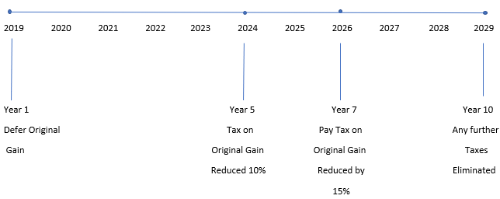
Investment Timeline

Slide 27
Act 2019-392 (HB540) Alabama Incentives Modernization Act
Additionally, new code section 40-18-6.1 allows investors in an approved opportunity fund an “impact investment tax credit” if the fund is not producing a guaranteed rate of return on their investment.
These “impact investment tax credits” shall be allocated annually, but not within the first 4 years of the existence of the fund. Credits may be issued in year 5 to provide for any inadequate returns on investment in the first 4 years of the fund and annually thereafter.
The cumulative amount of the “impact investment tax credits” allowed under this section cannot exceed $50 million.
ADECA shall certify the credit information and will provide this information to ADOR in order to allow these credits to be utilized by qualifying taxpayers.

Slide 28
Act 2019-459 (HB457) The Railroad Modernization Act of 2019

Slide 29
Act 2019-459 (HB457) The Railroad Modernization Act of 2019
Upon approval, qualifying taxpayers that own or lease railroad infrastructure in Alabama are now eligible for a tax credit to be used in offsetting qualified railroad rehabilitation and infrastructure improvement expenditures.
Rehabilitation applications for credit should include detailed plans and must be submitted to the Department of Commerce for approval.
If approved, the Department of Commerce will reserve a tax credit for the eligible taxpayer to be issued upon proof that the rehabilitation expenditures have been placed in service.
Once improvements are placed in service and approved by the Department of Commerce, a tax credit certificate shall be issued to the eligible taxpayer which may not exceed the original tax credit reservation. The tax credit certificate must be filed with the taxpayers return in which credit is claimed.

Slide 30
Act 2019-459 (HB457) The Railroad Modernization Act of 2019
Act is effective for tax years 2020, 2021 and 2022.
The credit will reported on the new Schedule “RMC – Railroad Modernization Act Credit” and any refundable amount will flow to the Schedule RC.
The total amount of all credits shall not exceed $3,700,000 in any one year for a cumulative total of $11,100,000 for the three tax years.
The credit is taken in the year infrastructure improvements are placed in service.
The credit shall be claimed at the entity level and shall not pass through to the partners, members, or owners.

Slide 31
Act 2019-459 (HB457) The Railroad Modernization Act of 2019
The credit is only transferable once and ADOR is responsible for creating and maintaining the transfer agreement forms.
The credit may be assigned or transferred to an individual.
The amount of credit in excess of an individual taxpayer’s liability is refundable and is reported on the “Schedule RC – Refundable Credit”.

Slide 32
Act 2019-506 (SB295) Alabama Industry Recognized and Registered Apprenticeship Program Act

Slide 33
Act 2019-506 (SB295) Alabama Industry Recognized and Registered Apprenticeship Program Act
Amendments to the existing apprenticeship tax credit are effective for tax years 2020 through 2025. The current apprenticeship tax credit is still effective through tax year 2019.
Beginning in 2020, the Act increases the current annual apprenticeship tax credit from $1,000 per qualifying apprentice to $1,250.
Employers who hire apprentices under the age of 18 will be allowed an additional tax credit of $500 for a total tax credit of $1,750.
The number of apprentices for which an employer can take a credit for has been increased from 5 apprentices in a tax year to 10.

Slide 34
Act 2019-506 (SB295) Alabama Industry Recognized and Registered Apprenticeship Program Act
The number of years that an employer may take credit for any one apprentice will remain at 4 years.
The cumulative amount of apprenticeship credit available each year has been increased from $3,000,000 to $7,500,000.

Slide 35
Beginning with the 2019 tax returns, certain tax credits are now required to be pre-approved through My Alabama Taxes (MAT) at www.myalabamataxes.alabama.gov
Please see the instructions in the tax guide or the instructions for a particular schedule or form being used for more information.

Slide 36
Beginning with the 2019 tax returns, certain tax credits are now required to be pre-approved through My Alabama Taxes (MAT) at www.myalabamataxes.alabama.gov
Please see the instructions in the tax guide or the instructions for a particular schedule or form being used for more information.

Slide 38
Prior Year Credits Affecting 2019 Returns

Slide 39
Prior Year Credits Affecting 2019 Returns
Act 2011-551 Full Employment Act of 2011
Act 2011-689 Neighborhood Infrastructure Incentive Plan Credit
Act 2012-168 Veterans Employment Act (Heroes for Hire Tax Credit)
Act 2012-391 Irrigation /Reservoir System Tax Credit
Act 2013-64 School Transfer Credit – AAA Credit and SGO Donation Credit – Scholarship Granting Organization
Act 2013-241 Historic Rehabilitation Tax Credit
Act 2014-147 Career Technical Dual Enrollment Credit (there have been zero donations for 2019) Code Sections 16-60-350 thru 16-60-354

Slide 40
Prior Year Credits Affecting 2019 Returns
Act 2014-413 Alabama Adoption Credit (Refundable on Schedule RC)
Act 2015-27 Alabama Jobs Act Investment Credit
Act 2016-102 Alabama Renewal Act Port Credit
Act 2016-102 Growing Alabama Credit (Contributions to an Economic Development Organization)
Act 2016-188 Small Business and Agribusiness Jobs Credit
Act 2016-314 Apprenticeship Tax Credit

Slide 41
Prior Year Acts Affecting 2019 Returns
Act 2016-345 Health Savings Account Contributions deduction (HSA’s)
Act 2017-352 Irrigation and Reservoir System Credit
Act 2017-380 Historic Rehabilitation Tax Credit
Act 2017-405 Individual Income Tax Simplified Short Form Filing Act
Act 2018-194 Veterans Employment Act (Heroes for Hire Tax Credit)
Act 2018-232 Optional Standard Deduction Increase
Act 2018-232 Foreign Income Exclusion

Slide 42
Prior Year Acts Affecting 2019 Returns
Act 2018-465 Credit For Taxes Paid To Another State or Territory
Act 2018-467 Alabama First-Time and Second Chance Home Buyer Savings Account
Act 2018-468 Irrigation and Reservoir System Credit
Act 2018-549 Adoption Credit

Slide 43
CPE on the Website
If looking for this CPE Presentation or prior year presentations, please visit the Department’s website at www.revenue.alabama.gov and follow these steps.
Click on any of the three links in the upper left-hand corner of the homepage: Individuals, Business, or Professionals
Click on the blue Individual & Corporate box
Scroll down and click on the CPE Presentations link under the Practitioners’ Links box.

Slide 44
CPE on the Website

Slide 45
Electronic Filing Information

Slide 46
My Alabama Taxes
ADOR continues to offer a FREE electronic filing option to individual Alabama taxpayers filing a state tax return.
No income limitations or other qualifications must be met to take advantage of this free online filing system.
Go to www.myalabamataxes.alabama.gov to sign up and efile.
No registration required for the new simplified short form 40EZ beginning with the 2018 filing season.
Notes:
46

Slide 47
Modernized Electronic Filing (MeF) Contacts
Tavares Mathews – Individual MeF (40 and 40NR) tavares.mathews@revenue.alabama.go
334-353-9497 Nicci Adams – Business MeF nicci.adams@revenue.alabama.gov
334-353-0685 Veronica Jennings – Mef Development and Web Service, Manager veronica.jennings@revenue.alabama.gov
334-353-9440

Slide 48
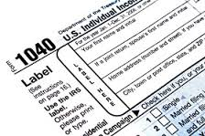
Forms

Slide 49
Mailed Forms
The Department HAS provided income tax booklets (40/40NR) to Libraries and TPSC’s this year.
Taxpayers can download and print all tax forms from our website.
Taxpayers can order (40/40NR/40ES) forms from our website.

Slide 50
New Forms for 2019
Schedule OZ to report deferred gains invested in Opportunity Zones

Slide 51
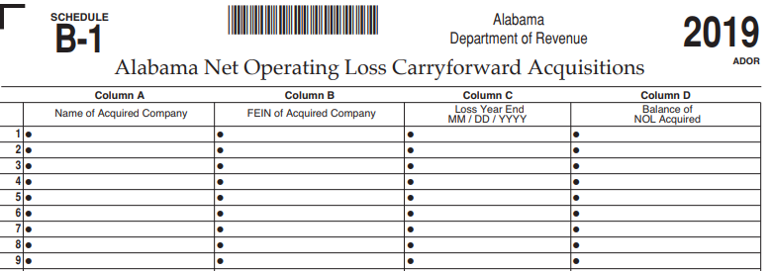
New Forms for 2019
New Schedule B-1 for 2019 to report NOL acquisitions. Attach to Forms 20-C, 20C-C or ET-1.

Slide 52
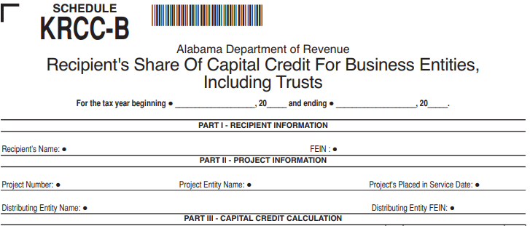
New Forms for 2019
New Schedule KRCC-B for 2019: to report the business entities share of capital credit.

Slide 53
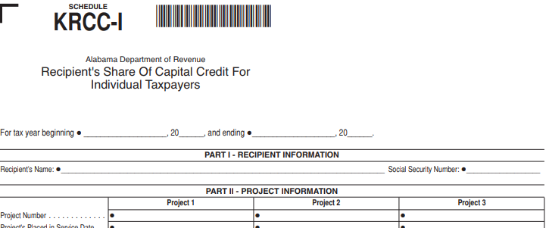
New Forms for 2019
New Schedule KRCC-I for 2019: to report the individuals share of capital credit.

Slide 54
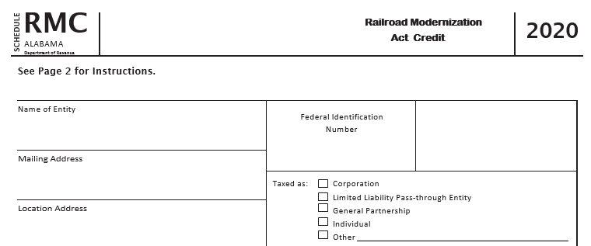
New Forms for 2020
Schedule RMC – Railroad Modernization Credit:
Any excess credit flows to Schedule RC for refund. Schedule RC will need updating for 2020 to add the RMC.

Slide 55
2019 IIT Form Changes
Form 40 – The First Time and Second Chance Home Buyer Savings Account has been added to the “Adjustments to Income” on Page 2, Part II. In 2020 there will be another new adjustment to income for the Firefighters Insurance Premium deduction per Act 2019-361.

Slide 56
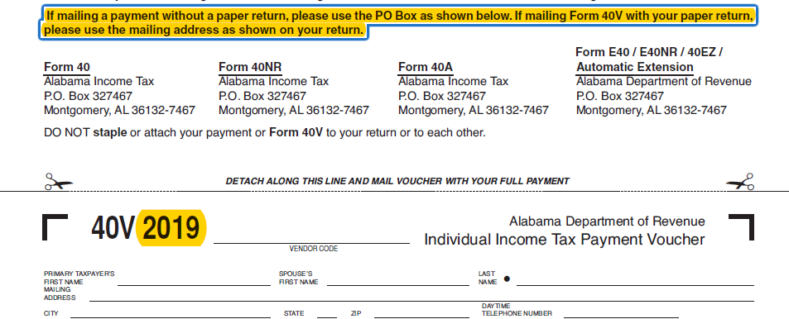
2019 IIT Form Changes
The 2019 Form 40V mailing instructions were updated.
Notes:
.

Slide 57
Schedule DEC Dual Enrollment Credit
There have been no contributions for 2019. There should not be anyone taking this credit on their 2019 return.

Slide 58
Fiduciary Form changes
Form 41
Schedule D (Form 41)
Schedule FC (Form 41)
Form FDT-V (Form 41)
Schedule G (Form 41)
Schedule K-1 (Form 41)

Slide 59
Form 41 changes
New line 17 on page 4 to report Capital Credits from Schedule FC .

Slide 60
Schedule D (Form 41) changes
New Line 10 and 11 to report the exemption of a gain from the sale of an ownership interest in a Tech Company per Act 2019-392 Alabama Incentives Modernization Act (40-18-8.1).

Slide 61
Schedule FC (Form 41) changes
New instructions Page 1, Part B, line 6.

Slide 62
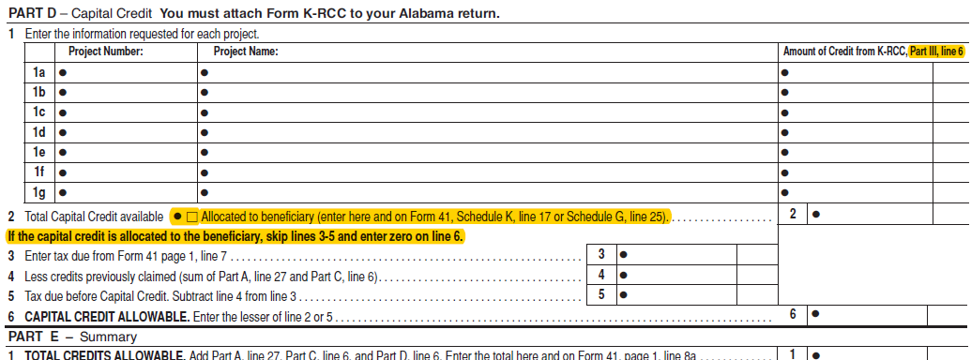
Schedule FC (Form 41) changes
New instructions Page 2, Part D, lines 1 and 2.

Slide 63
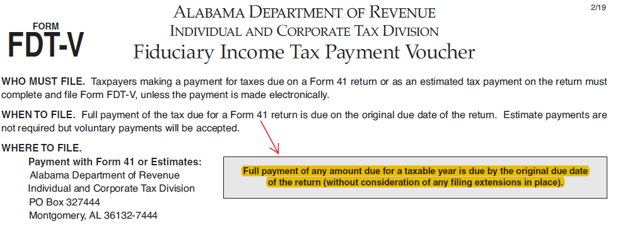
Form FDT-V (Form 41) changes
New instructions added to the FDT-V voucher.

Slide 64
Schedule G (Form 41) changes
New Lines 24 & 25 to report Taxes paid to a Foreign Country and available Capital Credits.

Slide 65
Schedule K-1 (Form 41) changes
New line 17 to report available Capital Credits.

Slide 66
Pass Through Form changes
Schedule PC (Form 20S or 65)
Form PTE-V
Schedule K-1 (Form 20S or 65)

Slide 67
Schedule PC changes Form 20S or 65
Page 1, Part D instructions updated.

Slide 68
Schedule PC changes Form 20S or 65
Page 2, Part G instructions added.

Slide 69
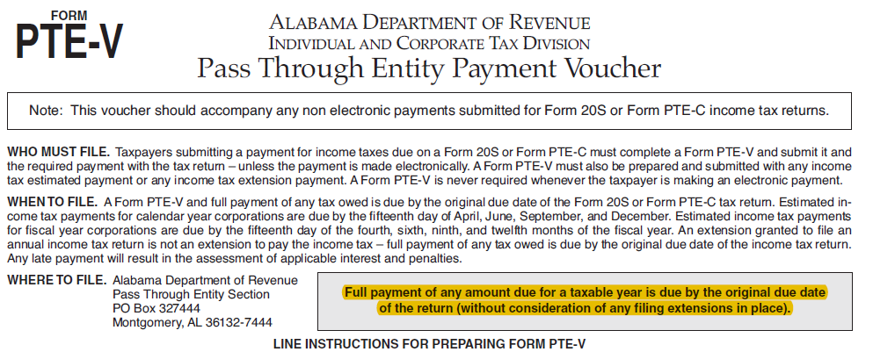
Form PTE-V
New instructions added to form PTE-V.

Slide 70
Schedule K-1 changes Form 20S or 65
Additional instructions added to Part II, Section F.

Slide 71
Corporate Income Tax Form Changes
Form 20C
Form 20C-C
Schedule BC (Form 20C)

Slide 72
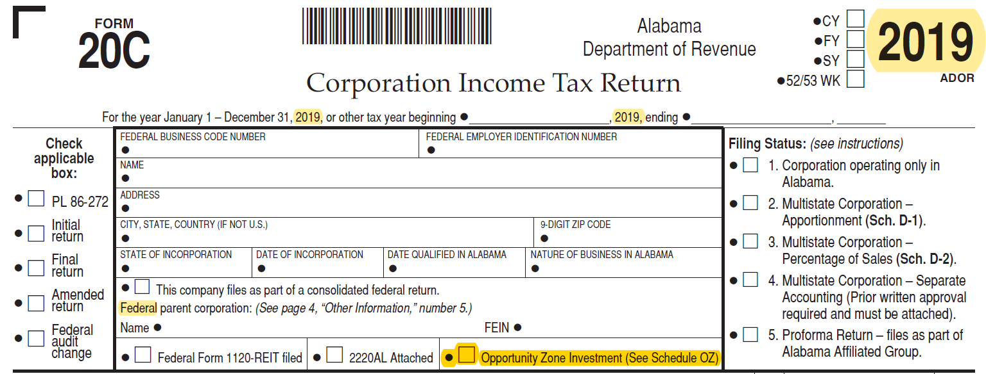
Form 20C changes
Check box added to report an investment in an opportunity zone. If this check box is checked, the Schedule OZ must be completed.

Slide 73
Form 20C changes
New Line 17 subtotal.

Slide 74
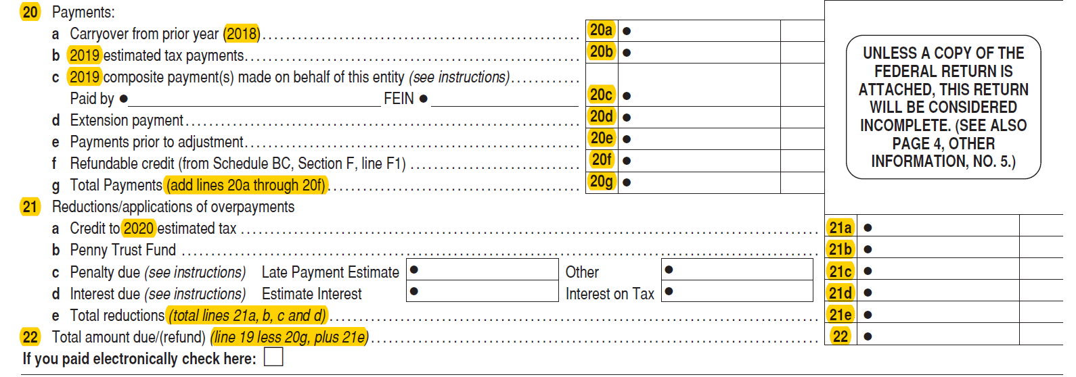
Form 20C changes
Line reference changes as a result of new line 17.

Slide 75
Form 20C changes
New line 23 on Schedule A of Form 20C to report the exemption of gain under new Section 40-18-8.1 (Act 2019-392).

Slide 76
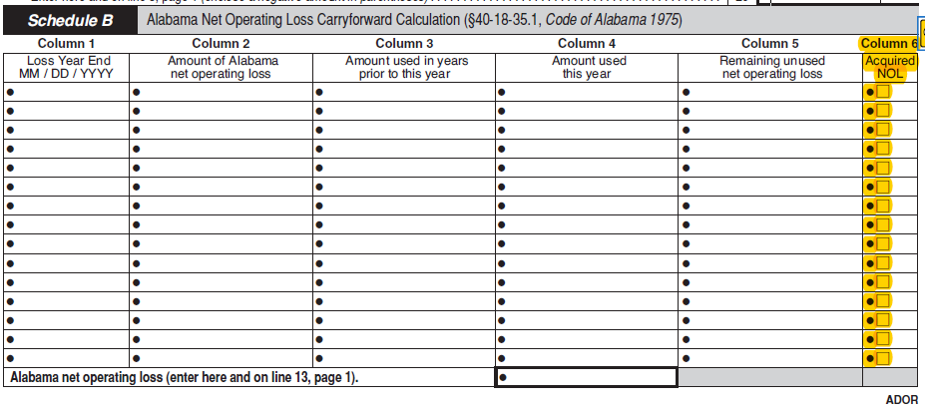
Form 20C changes
Schedule B of Form 20C has new Column 6 to indicate if taxpayer acquired any net operating loss from another entity previously filing in Alabama.

Slide 77
Form 20C changes
Removed Alternative Minimum Tax (AMT) paid

Slide 78
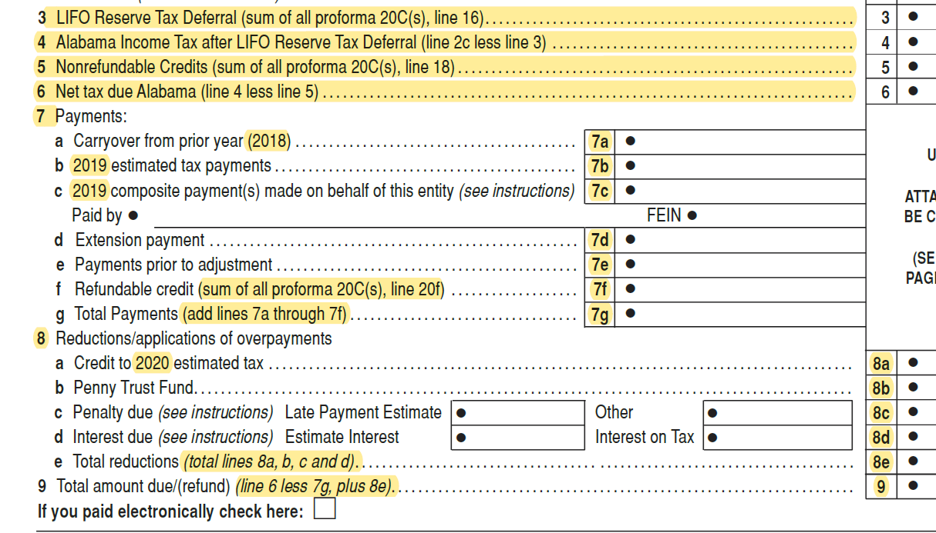
Form 20C-C changes
New Line 4 subtotal and line reference updates.

Slide 79
Schedule BC changes
Added information to inform taxpayer which credits are required to be filed through My Alabama Taxes (MAT)
Updated Section A, line number reference
Updated Section A line reference

Slide 80
Schedule BC (Form 20C) changes
Instructions updated for parts E and F of Section B
Amount increased from $1,000 to $2,000 for Veterans Employment Act-Employee Credit

Slide 81
Schedule BC Rehabilitation, Preservation and Development of Historic Structures Credit of 2013
Updated Part K to include project number, date placed in service, and amount of credit.

Slide 82
Schedule BC Rehabilitation, Preservation and Development of Historic Structures Credit of 2017 (Refundable Credit)
Updated Part R to include project number, date placed in service, and amount of credit

Slide 83
Schedule BC (Form 20C) changes
New check box added to Section B, Part S for corporations that received Form KRCC.

Slide 84
Schedule BC (Form 20C) changes
Additional line reference updates in Sections E and F due to Schedule 20C changes.

Slide 85
FIET Tax Form Changes
Form ET-1
Form ET-1C
Schedule EC

Slide 86
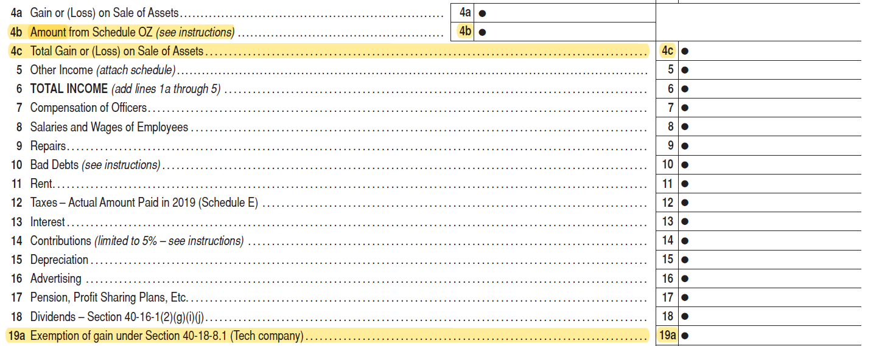
Form ET-1 changes
Added line 4b and 4c to report amount of gains invested in qualified opportunity zone funds reported on the Schedule OZ
Added line 19a to report amount of gain from Section 40-18-8.1

Slide 87
Form ET-1 changes

Slide 88
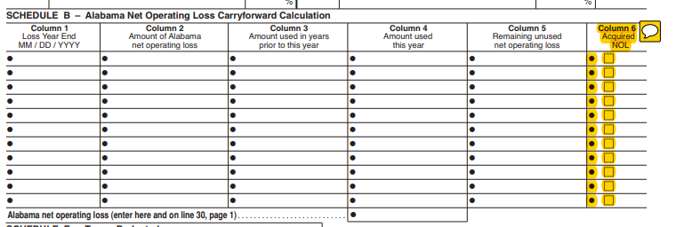
Form ET-1 Changes
Column 6 was added to Schedule B of the ET-1 to report NOL’s acquired from another entity previously filing in Alabama.

Slide 89
Form ET-1 Schedule M- Federal Income Tax (FIT) Deduction/(Refund)
Alternative Minimum Tax (AMT) information removed

Slide 90
ET-1C Consolidated Financial Institution Excise Tax Return

Slide 91
Schedule EC changes
Added information to inform taxpayer which credits are required to be filed through My Alabama Taxes (MAT)
Updated Section A, line number reference

Slide 92
Schedule EC (Form ET-1) changes
Instructions updated for part E of Section B for the Full Employment Act of 2011 Credit.

Slide 93
Schedule EC changes
Updated General fund calculation

Slide 94
Schedule EC Veterans Employment Act. Employee Credit

Slide 95
Schedule EC Rehabilitation, Preservation and Development of Historic Structures Credit
Updated Part E to include project number, date placed in service, and amount of credit.

Slide 96
Distribution Schedule
Removed Schedule A from ET-1 and ET-1C
Removed Section H- Distribution Schedule from Schedule EC (pgs. 4-6)

Slide 97
Refund Calls
ADOR Website: “Where’s My Refund”
Phone: 1-855-894-7391 (voice/ keyed response )
Call Center: (334)353-0944 or 1-800-535-9410

Slide 98
QUESTIONS
Business Privilege Tax 334-353-7923
Certificate of Compliance 334 -242-1189
Corporate Income Tax 334-353-7943
Individual Income Tax:
Examination Unit 334-353-0602
Compliance Unit 334-353-9770
Pass Through Entity 334-242-1033
Special Audit and Compliance:
Non-Filer Group 334-242-1511
CP 2000 334-242-1940
Withholding Tax 334-242-1300

