Slide 1
Income Tax Updates
2020 CPE Training
Lynn Schoener, CPA, FAS II
(334) 353-8045
lynn.schoener@revenue.alabama.gov
Andrea Wyatt, Revenue Examiner III
(334) 353-9447
andrea.wyatt@revenue.alabama.gov
Notes:
1

Slide 2
I.D. Theft Prevention

Slide 3
I.D. Theft Prevention
Each log in attempt or tax return submission requires a new selfie in lieu of a password to verify it is the actual taxpayer rather than a cyber criminal. Without an ID match the user cannot log in.
Only the registered user can authorize the Department of Revenue to process their state income tax refund.
Alabama eID verifies a user’s identity by cross-matching their face with their state issued driver license.
Available for both the iPhone and the Android.
Best of all, submitting your return using eID grants you priority return processing.

Slide 4
What’s New from the 2020 Regular Session of the Alabama Legislature?

Slide 5
Alabama’s Legislature
Legislators are concerned how their constituents feel on certain issues. Without contacting them to voice your support or disapproval concerning legislation they won’t know.
Below is the mailing address and phone numbers for your legislators:
Mailing Address for your legislator: [Name of your Legislator], Alabama State House, Montgomery, AL 36130
Phone number for the House: (334) 242-7600 / Phone number for the Senate: (334) 242-7800
Legislative website: http://www.legislature.state.al.us
Look-up your legislator: https://www.sos.alabama.gov/alabama-votes/elected-official-map

Slide 6
What’s New from the 2020 Regular Session of the Alabama Legislature?
To view any legislation passed by the Alabama Legislature, please visit the website for the Alabama Secretary of State at www.sos.alabama.gov .
Point to the “Records” tab at the top of the page with your mouse and select “Legislative Acts”.
Select whether you want to search by the Act Number or the Bill Number.
Enter either the Act Number or Bill Number and select view image to see a PDF version of the Act.

Slide 7
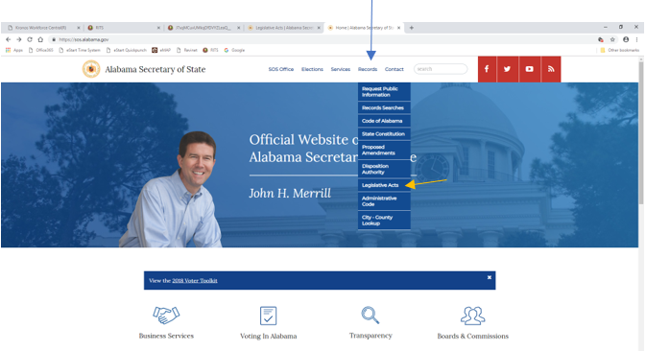
What’s New from the 2020 Regular Session of the Alabama Legislature?

Slide 8
What’s New from the 2020 Regular Session of the Alabama Legislature?

Slide 9
What’s New from the 2020 Regular Session of the Alabama Legislature?
Due to the coronavirus pandemic, the 2020 regular session of the legislature ended after a two month break on May 18, 2020 with the passage of only a few bills.

Slide 10
Governor’s Proclamation December 11, 2020
CARES Act direct benefits-The Stimulus Checks are exempt from taxation at the federal level by Congress. Additionally,
The State of Alabama is excluding the Stimulus Checks from Alabama income taxation and from all calculations in determining the federal income-tax deduction.
CARES Act loan forgiveness-Cancellation of indebtedness income resulting from loans forgiven pursuant to §1106 of the CARES Act is excluded from Alabama Income tax and Financial Institution Excise Tax to the extent that it is exempted from federal income taxes.

Slide 11
Governor’s Proclamation December 11, 2020
Extension of the following Credits
Alabama Jobs Act
Growing Alabama Tax Credit
Both were set to sunset on December 31, 2020. They were extended by Governor Ivey to the earlier of (i) the enactment of a bill to extend each credit or (ii) the last day of the first regular session of the Legislature following the issuance of the proclamation

Slide 12
Act 2020-31 (HB 158)
Act 2020-31 added new code section 40-29-20.1 which prohibits a private third-party auditing or collection firm from charging or collecting any of the following expenses from a taxpayer effective March 11, 2020:
Professional service fees to include, but not be limited to, attorney fees and charges for accountant services.
Travel costs.
Salary or personnel-related expenses of the firm.
Auditing or collecting related costs.

Slide 13
Act 2020-72 (HB66)
Economic Development

Slide 14
Act 2020-72 (HB66) Economic Development
Act 2020-72 concerning economic development authorizes the creation of local redevelopment authorities by municipalities and counties for the purpose of revitalization and redevelopment of land contiguous to Active United States military installations throughout the State of Alabama.
The Act exempts such local redevelopment authorities, a co-op of which a member, private users and related parties from any taxation in the state, city or county, as well as any fees charged by probate judges for 20 years.
Empowers authority to issue bonds for purposes of the authority to be repaid from any revenues and receipts generated by the authority and from payments in lieu of taxes.
Act is effective beginning 03-31-2020.

Slide 15
For more information on Income Tax Credits, Abatements, and other Incentives available please visit the Office of Economic Development located on the Department’s website at
https://revenue.alabama.gov/tax-incentives/

Slide 16
Prior Year Credits and Incentives

Slide 17
Prior Year Credits Affecting 2020 Returns
Act 1987-573 Alabama Enterprise Zone Act (41-23-20)
Act 1993-313 Rural Physician Credit (40-18-130)
Act 1993-907 Basic Skills Education Credit (40-18-136)
Act 1995-239 Coal Credit (40-18-220)
Act 2011-551 Full Employment Act of 2011 (40-18-290)
Act 2011-689 Neighborhood Infrastructure Incentive Plan Credit (11-71-3)
Act 2012-168 Veterans Employment Act (Heroes for Hire Tax Credit) (40-18-320)
Act 2012-391 Irrigation /Reservoir System Tax Credit (40-18-340)

Slide 18
Prior Year Credits Affecting 2020 Returns
Act 2013-64 School Transfer Credit – AAA Credit and SGO Donation Credit – Scholarship Granting Organization (16-6D-1)
Act 2013-241 Historic Rehabilitation Tax Credit (40-9F-4)
Act 2014-147 Career Technical Dual Enrollment Credit (there have been zero donations for 2020) (16-60-350)
Act 2014-413 Alabama Adoption Credit (Refundable on Schedule OC) (40-18-360)
Act 2015-27 Alabama Jobs Act Investment Credit (40-18-376)
Act 2016-102 Alabama Renewal Act Port Credit (40-18-400)
Act 2016-102 Growing Alabama Credit (Contributions to an Economic Development Organization) (40-18-410)

Slide 19
Prior Year Credits Affecting 2020 Returns
Act 2016-188 Small Business and Agribusiness Jobs Credit (40-18-390)
Act 2016-314 Apprenticeship Tax Credit (40-18-240)
Act 2018-465 Credit for taxes paid to other states and foreign income credit (40-18-21)
Act 2019-459 Railroad Modernization Act of 2019 (37-11C-4)

Slide 20
Electronic Filing Information

Slide 21
My Alabama Taxes
ADOR continues to offer a FREE electronic filing option to individual Alabama taxpayers filing a state tax return.
No income limitations or other qualifications must be met to take advantage of this free online filing system.
Go to www.myalabamataxes.alabama.gov to sign up and efile.
No registration required for the new simplified short form 40EZ
Notes:
21

Slide 22
Electronically Filed Returns
2019 Individual Income Tax Returns:
As of November 17, 2020
1,835,734 returns have been filed electronically
61% of returns filed have been refund returns

Slide 23
Modernized Electronic Filing (MeF) Contacts
Tavares Mathews – Individual MeF (40 and 40NR) tavares.mathews@revenue.alabama.go
334-353-9497
Demetria Gordon – Business MeF (20C, 20CC , CPT and PPT) demetria.gordon@revenue.alabama.gov
334-353-9129 Nicci Adams – Business MeF (20S, 65, PTEC and 41 ) nicci.adams@revenue.alabama.gov
334-353-0685 Veronica Jennings – Mef Development and Web Service, Manager veronica.jennings@revenue.alabama.gov
334-353-9440

Slide 24
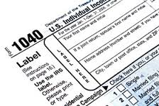
Forms

Slide 25
Corporate Income Tax Form Changes
Schedule BC Business Credits
Schedule CP-B (New) Composite Payments from PTEs
Schedule FTI (New) Federal Taxable Income reconciliation

Slide 26
Schedule BC
Schedule BC updated to remove the Small Business and Agribusiness Jobs Act Credit which expired January 1, 2019 and to add the Railroad Modernization Act of 2019.

Slide 27
Schedule CP-B
Schedule CP-B use this schedule with the 20C and ET-1

Slide 28
Schedule FTI
Schedule FTI
The purpose of this schedule is to reconcile any difference between the federal taxable income and line 1 of the Form 20C or Form ET-1.

Slide 29
FIET Form Changes
Schedule PCL (Form ET-1) (New) parent company loss
Form ET-1 Form completely updated as a result of the Financial Institution Excise Tax Reform Act of 2019
Form EC Excise credits
Form ET-C Excise Tax Election to file Consolidated
Form 2220E Excise Underpayment penalty & interest
Form ET-1C Excise Tax-Consolidated return

Slide 30
Schedule PCL (Form ET-1) (New Form)
Consolidated Parent Company Loss Allocation Schedule added for 2020.

Slide 31
Form ET-1(Revamped)
Form ET-1 and instructions completely updated to begin with the federal taxable income as a result of the Financial Institution Excise Tax Reform Act of 2019.

Slide 32
Schedule EC
Schedule EC updated to remove the Small Business and Agribusiness Jobs Act Credit which expired January 1, 2019.

Slide 33
Form ET-C
Form ET-C was updated to remove the $6,000 privilege to file a consolidated FIET return as a result of the Financial Institution Excise Tax Reform Act of 2019. No fee required now.
The election is now a 10-year election. Previously the election had to be made annually and was in effect for 1 year only.

Slide 34
Form 2220E
New form for 2020 to compute FIET underpayment penalty and interest.

Slide 35
Form ET-1C
Added checkbox for the new Form 2220E.

Slide 36
Individual Income Tax Form Changes
Form 40 Alabama Individual Income Tax Return Residents and Part-Year Residents (Adjustment to Income)
Form 40NR Alabama Individual Income Tax Return Nonresidents Only (Adjustment to Income)
Schedule OC Other Available Credits
Schedule CP (New) Composite Payments

Slide 37
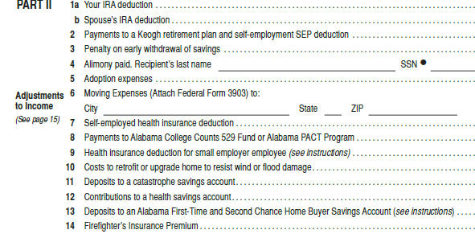
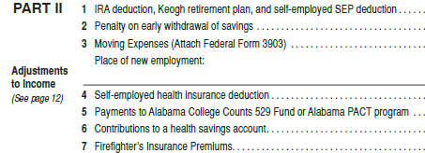
New Adjustment to Income- Firefighter’s Insurance Premium
Form 40, Page 2, Part 2, Line 14
Form 40NR, Page 2, Part 2, Line 7

Slide 38
Form Changes for 2020
Nine schedules will be eliminated for the 2020 filing season and combined within the new Schedule OC:
Schedule IRC
Schedule HTC
Schedule DEC
Schedule AJA
Schedule ARA
Schedule ATC
Schedule NTC
Schedule RC

Slide 39
New Forms for 2020
The biggest change for 2020 forms is the updated Schedule OC which was changed to replace multiple credit and carry forward schedules with one concise Schedule.
Credits will now flow in the order of passage and current year carryforwards will be applied before prior year carryforwards per regulations.
The following credit schedules have been retired and are now integrated within the new Schedule OC:
Schedule IRC – Irrigation/Reservoir System Credit
Schedule HTC – Historic Rehabilitation Tax Credit

Slide 40
New Forms for 2020
Schedule OC changes continued:
Schedule DEC – Dual Enrollment Credit
Schedule AJA – Alabama Jobs Act (Investment Credit)
Schedule ARA – Alabama Renewal Act (Port Credit and Growing Alabama Credit)
Schedule ATC – Apprenticeship Tax Credit
Schedule NTC – Net Tax Calculation
Schedule RC – Refundable Credits
Schedule SBA has sunset. However, taxpayers may still have a carryforward from this credit.

Slide 41
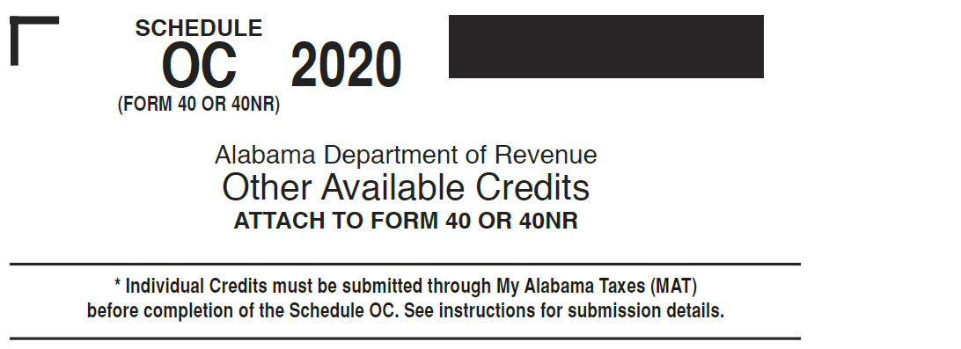
New Forms for 2020

Slide 42
Schedule OC
Schedule IRC – Irrigation/Reservoir System Tax Credit has been moved to Part J of the new Schedule OC for 2020.

Slide 43
Schedule OC
Schedule HTC – Historic Tax Rehabilitation Credit for projects prior to 2018 has been moved to Part N of the new Schedule OC for 2020.

Slide 44
Schedule OC
Schedule HTC – Historic Tax Rehabilitation Credit for projects 2018 and on has been moved to Part T of the new Schedule OC for 2020.

Slide 45
Schedule OC
Schedule DEC – Dual Enrollment Credit has been moved to Part O of the new Schedule OC for 2020.

Slide 46
Schedule OC
Schedule AJA – Alabama Jobs Act - Investment Credit has been moved to Part P of the new Schedule OC for 2020.

Slide 47
Schedule OC
Schedule ARA – Alabama Renewal Act (Port Credit) has been moved to Part Q of the new Schedule OC for 2020.

Slide 48
Schedule OC
Schedule ARA – Alabama Renewal Act (Growing Alabama Credit) has been moved to Part R of the new Schedule OC for 2020.

Slide 49
Schedule OC
Schedule ATC has been moved to Part S of the new Schedule OC for 2020.

Slide 50
Schedule OC
Schedule RC has been moved to Section F of the new Schedule OC for 2020.

Slide 51
Schedule CP
Schedule CP - To report composite payments made on behalf of a partner, member, beneficiary, etc.

Slide 52
Mailed Forms
The Department will provide income tax booklets (40/40NR) to Libraries and TPSC’s this year.
Taxpayers can download and print all tax forms from our website.
Taxpayers can mail order all tax forms from our website.

Slide 53
Pass Through Form changes
Schedule PTE-CK1
Schedule PC (Form 20S or 65) Pass-Through Credits
Schedule NRA-IC (New) Alabama Investment Credit Non Resident Agreement
Form 20S S Corporation Information/Tax Return
Form 65 Partnership/Limited Liability Company Return of Information

Slide 54
Schedule PTE-CK1
Updated to include Guaranteed Payments and Shareholders tax due.

Slide 55
Schedule PC Form 20S or 65
Form and Instructions have been updated to remove the Small Business and Agribusiness Jobs Credit which has expired and to add the Railroad Modernization Act of 2019 Refundable Credit.

Slide 56
Schedule NRA-IC (New)
New Schedule NRA-IC and Instructions have been added to report non-resident owners share of investment credit on composite return rather than PTE-C.

Slide 57
Form 20S
Form 20S was updated to add the Railroad Modernization Act of 2019 refundable credit.

Slide 58
Form 65
Form 65 was updated to add the Railroad Modernization Act of 2019.

Slide 59
Fiduciary Form changes
Schedule FC (Form 41) Fiduciary Credits
Form 41 Fiduciary Income Tax Return
Schedule K-1 (Form 41) Fiduciary Income Tax Beneficiary Information

Slide 60
Schedule FC
Schedule FC (Form 41) has been completely redone.

Slide 61
Form 41
Form 41 has been updated to add the Railroad Modernization Act of 2019 refundable credit.

Slide 62
Schedule K-1 (Form 41)
Schedule K-1 (Form 41) has been updated for the Sch FC addition

Slide 63
CPE on the Website
If looking for this CPE Presentation or prior year presentations, please visit the Department’s website at www.revenue.alabama.gov and follow these steps.
Click on any of the three links in the upper left-hand corner of the homepage: Individuals, Business, or Professionals
Click on the blue Income Tax box
Scroll down and click on the CPE Presentations link under the Practitioners’ Links box.

Slide 64
CPE on the Website

Slide 65
QUESTIONS
Business Privilege Tax: 334-353-7923
Certificate of Compliance: 334 -242-1189
Corporate Income Tax : 334-353-7943
Individual Income Tax:
Examination Unit 334-353-0602
Compliance Unit 334-353-9770
Return Integrity & Assurance Unit 334-353-0759
Correspondence & Assessments 334-353-0775
Pass-Through Entity Unit: 334-343-1033
Special Audit and Compliance:
Non-Filer Group 334-242-1511
CP 2000 334-242-1940
Withholding Tax : 334-242-1300

Slide 66
This Photo by Unknown Author is licensed under CC BY-NC

