Slide 1
Alabama Department of Revenue Income Tax Administration
Division

Slide 2
Alabama Department of Revenue Income Tax Administration Division
2023 CPE Training
Lynn Schoener, CPA, FAS II
(334) 353-8045
lynn.schoener@revenue.alabama.gov
Andrea Wyatt, Revenue Tax Accountant/Auditor III
(334) 353-9447
andrea.wyatt@revenue.alabama.gov

Slide 3
What’s New from the 2023 Regular Session of the Alabama Legislature?

Slide 4
Prior year legislation effective for the 2023 return.
Act 2022-294 - Lynn Greer Retirement Income Tax Cut Act of 2022
Act 2022-298 - Volunteer Emergency Responders Tax Credit
Act 2022-299 - Adoption Credit

Slide 5
Act 2022-294 (HB 162) Lynn Greer Retirement Income Tax Cut Act of 2022
This act amends code section 40-18-19 relating to exemptions from income tax.
Beginning January 1, 2023, the first six thousand dollars ($6,000) of taxable retirement income is exempt from taxation for a taxpayer 65 years of age or older.
The 2023 Form 40 instructions have been updated for the exemption.
New Schedule RS

Slide 6
Act 2022-298 (HB 253) Volunteer Emergency Responders Tax Credit
This act provides an income tax credit for certain firefighters and paramedics beginning on or after January 1, 2023 and ending December 31, 2027. Credit is based on qualifying individuals providing proof of 30 hours or more of qualifying training during the tax year.
A credit in the amount of $300 annually is available to an active certified volunteer firefighter, licensed EMT-Basic, or a qualified rescue squad member who is a licensed EMT-Basic who submits signed certificate of completion of training from their supervisor.
A credit in the amount of $600 annually is available to an active certified volunteer firefighter as a Firefighter II, licensed Advanced EMT or EMT-Paramedic, or a qualified rescue squad member who is a licensed Advanced EMT or EMT- Paramedic who submits signed certificate of completion of training from their supervisor.
Requires registration of credit in My Alabama Taxes.

Slide 7
Act 2022-299 (HB 487) Adoption Credit
This act amends code sections 40-18-360 and 40-18-361 to expand the income tax credit available to individuals who adopt a child.
Provides for a one-time, refundable credit in the amount of $1,000 per child adopted through an out-of-state adoption or if the child is not a resident of Alabama.
Provides for a one-time, refundable credit in the amount of $2,000 per child adopted through a private adoption or a qualified foster child adopted provided the qualifying children are residents of Alabama.
The credit is available January 1, 2023, through December 31, 2027. After that period, the credit will revert back to $1,000 per child regardless of residency.
Adopting the child of one's spouse will not qualify for credit under this act.
The 2023 Sch AAC, Sch OC, and Forms 40, 40NR, and Instructions have updated for this amendment.

Slide 8
What’s New from the 2023 Regular Session of the Alabama Legislature?
To view any legislation passed by the Alabama Legislature, please visit the website for the Alabama Secretary of State at www.sos.alabama.gov . New Secretary of State Wes Allen
Point to the “Records” tab at the top of the page with your mouse and select “Legislative Acts”.
Select whether you want to search by the Act Number or the Bill Number.
Enter either the Act Number or Bill Number and select view image to see a PDF version of the Act.

Slide 9
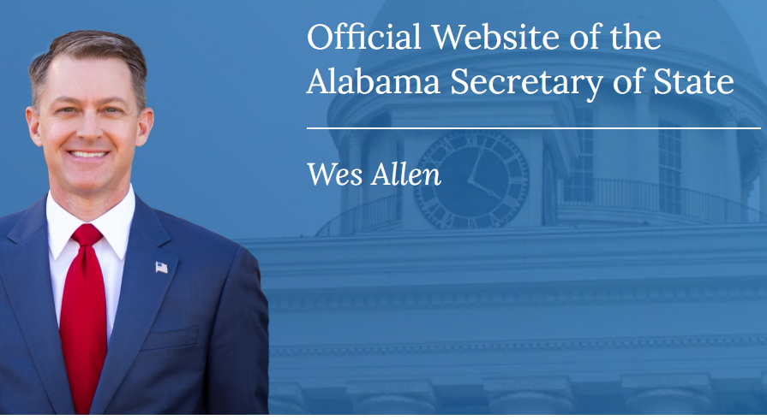
What’s New from the 2023 Regular Session of the Alabama Legislature?

Slide 10
What’s New from the 2023 Regular Session of the Alabama Legislature?

Slide 11
Act 2023-33 (HB 247) Innovating Alabama Tax Credit Program
Act 2023-33 establishes the Innovating Alabama Tax Credit Program. Reference 41-10-840 of Title 41.
The program is designed to allow taxpayers a credit for contributions made to an economic development organization using an online system administered by the Department of Revenue (My Alabama Taxes). Contributions to an economic development organization shall not exceed the amounts approved by the Alabama Innovative Corporation aka Innovate Alabama.
The Innovating tax credit will be available for tax years beginning January 1, 2023, and sunset July 31, 2028.
The cumulative calendar year cap for this credit is twenty-five million dollars ($25,000,000) and may be used to offset income taxes, financial institution excise tax, insurance premium tax, and state license tax.
The tax credit can not lower a taxpayer's liability by more than 50%.
The credit is not refundable or transferable, but it may be carried forward for no more than five years.
A donating taxpayer includes a shareholder of an Alabama S corporation or a partner or member of a subchapter K entity that makes a contribution to an economic development organization approved by Innovate Alabama.

Slide 12
Act 2023-34 (HB 241) Enhancing Economic Progress Act
Act 2023-34 establishes the Enhancing Economic Progress Act which extends and amends existing economic development programs such as the Alabama Jobs Act, the Growing Alabama Credit Act, and creates the new Sweet Home Alabama Tourism Investment Act.
The Act extends both the Alabama Jobs Act / Investment Credit and the Growing Alabama Credit Act through July 1, 2028.
Beginning with the 2023 calendar year the Alabama Jobs Act / Investment Credit cap will increase by $25,000,000 annually from its current cap of $350,000,000 to a maximum cap of $475,000,000 in 2027.
The Alabama Jobs Act / Investment Credit changes the transfer period to 5-year period rather than the original 3-year period if approved to do so.
The Growing Alabama Credit will increase at an incremental rate of $3,000,000 per year from $20,000,000 to $35,000,000 for tax years 2024-2028.
Certain programs from the Growing Alabama Credit will now be covered under the new Innovate Alabama Program.

Slide 13
Act 2023-34 (HB 241) Enhancing Economic Progress Act
The Enhancing Economic Progress Act will also establish the Sweet Home Alabama Tourism Investment Act which will provide tax rebates to companies with certain tourism destination projects to offset state and local sales and use taxes, lodgings taxes, and any other transactional taxes generated by or arising within the tourism destination project. Reference 40-18-470 of Title 40.
The rebates are capped at $1,000,000 for a company annually with no more than $5,000,000 in total rebates over the 10-year rebate period for a single company.
The effective beginning date for the Enhancing Economic Progress Act is August 1, 2023, with a sunset date of July 31, 2028.
The cap for total rebates under the Act is set at $10,000,000 per year.

Slide 14
Act 2023-36 (SB 151) Legislative Advisory Committee on Economic Development
Act 2023-36 updates reporting and publishing requirements concerning economic incentive performance data on all projects incentivized under this article.
The Department of Commerce, the Department of Revenue, and the Department of Finance shall collectively report no later than January 1 of each year, the aggregate amount of incentives committed by tax source on executed project agreements during the past fiscal year.
The Department of Commerce shall be required to publish the following information on its website for each incentivized project:
a. The name of the incentivized company.
b. The county of the qualifying project.
c. The estimated capital investment.
d. The estimated number of new jobs.
e . The estimated average hourly wage.
f . The estimated value of the jobs credit.
g. The estimated value of the investment credit.
h. The projected 10-year and 20-year return on incentives.
i. The value of any cash incentive that was committed.

Slide 15
Act 2023-313 (HB 439) Growing Alabama Credit
Act 2023-313 allows a Growing Alabama Act Credit issued to a parent or holding company may be claimed by the subsidiary, provided that both the parent or holding company and subsidiary are filing as part of an Alabama consolidated return (20C-C). This is effective retroactively for tax years beginning on or after January 1, 2021.

Slide 16
Act 2023-327 (SB 207) Refund Check-Offs
This act provides an income tax refund check-off for making contributions to the State Parks Division of the Department of Conservation and Natural Resources, the Department of Mental Health, or the Alabama Medicaid Agency.
Each Alabama resident individual income taxpayer desiring to contribute to any of the programs listed above may designate an amount of his or her refund rounded off in whole dollars in an appropriate box on the state income tax return form to be credited to the program.
Effective beginning with the 2024 calendar year.

Slide 17
Act 2023-377 (SB 86) Income Tax Rebate
Act 2023-377 provides for a one-time, non-taxable rebate for qualified Alabama residents of $150 if filing single, married filing separate, or head of household. The Act provides a $300 rebate for qualified taxpayers who are filing jointly.
Taxpayers who timely filed their 2021 return by October 17, 2022, will qualify for the rebate.
The rebates will be issued on or after November 30, 2023.
Duplicate of Act 2023-511.

Slide 18
Act 2023-418 (SB263) Alabama Accountability Act Updates
Act 2023-418 provides updates to the Alabama Accountability Act.
The Act will now provide expenses for qualifying students with special or unique needs.
The terms “failing or non-failing school" will be changed to “priority or qualifying school” respectively.
The Department of Revenue may bar a qualifying school or educational service provider from the program if the department discovers the school or provider are doing any of the following: - Routinely fails to comply with the accountability standards established in the Act. - Fails to provide the eligible student with the education services funded by the program.
If ALDOR makes the decision to bar a school or provider, they must notify the eligible student and their parents of this decision.
The cumulative amount of tax credits has been increased to $40,000,000 annually, based on the calendar year. If the cumulative amount of tax credits issued exceeds 90 percent of the cap for three out of four consecutive years, there will be an automatic increase of $10,000,000 until the cumulative amount of tax credits issues reaches $60,000,000.
Effective September 1, 2023.

Slide 19
Act 2023-419 (HB 293) Port Credit
Act 2023-419 revises the calculation of the port credit amount. The new calculation is the cargo volume calculated multiplied by the appropriate amount shown in the following chart:

Slide 20
Act 2023-421 (HB 217) Overtime Exemption
Act 2023-421 provides that compensation for overtime wages paid to a full-time hourly employee will be exempt from gross income beginning January 1, 2024, through June 30, 2025.
Alabama employers will be required to report the following to ALDOR: - For tax year 2023 the total amount of overtime received by a full-time hourly employee for wages earned in excess of 40 hours a week. This historical overtime data is due no later than January 31, 2024. - For tax year 2024 the total amount of overtime received by a full-time hourly employee for wages earned in excess of 40 hours a week. To be reported monthly or quarterly to the department no later than the due date of the corresponding withholding monthly or quarterly return.
The ALDOR will report to Legislative Services Agency (LSA) the data collected no later than 30 days after the due date of the information.
The Department’s website has been updated with FAQ’s and filing specifications in a section on the overtime exemption.
Website overtime exemption link: https://www.revenue.alabama.gov/individual-corporate/overtime-exemption

Slide 21
Act 2023-510 (HB 23) Mileage Credit for First Responders
Act 2023-510 provides for an income tax credit to reimburse volunteer first responders for use of their private vehicle when responding to a fire, emergency or rescue call.
The tax credit is effective beginning January 1, 2024.
The tax credit is allowed up to the amount of the tax liability of the taxpayer.
The tax credit is not refundable, transferable, and may not be carried forward.
The credit amount is equal to the total unreimbursed annual mileage at the standard mileage currently allowed for state employees.
The head of the department of the first responder will maintain mileage records for each call responded to and will provide the volunteer responder a signed certificate indicating the total mileage for the year.

Slide 22
Act 2023-511 (HB 175) Income Tax Rebate
Act 2023-377 provides for a one-time, non-taxable rebate for qualified Alabama residents of $150 if filing single, married filing separate, or head of household. The Act provides a $300 rebate for qualified taxpayers who are filing jointly.
Taxpayers who timely filed their 2021 return by October 17, 2022, will qualify for the rebate.
The rebates will be issued on or after November 30, 2023.
This is a duplicate of Act 2023-377.

Slide 23
Act 2023-512 (HB 445) Sweet Home Alabama Tourism Investment Act
Act 2023-512 amends the new Sweet Home Alabama Tourism Investment Act created by Act 2023-34 by incorporating the following changes: - Removes the grant 5-year carryforward. - Ensure that the rebate incentive is only available to projects that occur after the
effective date of the act. - Updates max target county population to 12,000 but less than 60,000 (was
previously 50,000).
Tax rebates granted to a certified tourism destination consists of state and local sales and use taxes, lodging taxes, other transactional taxes or a combination of generated by or arising from the project.

Slide 24
Act 2023-519 (HB 133) Preceptor Tax Incentive Program
Act 2023-519 establishes the Preceptor Tax Incentive Program to provide an income tax credit to preceptors who train in a rural area in Alabama in a clinical preceptorship in the following programs: medical allopathic, osteopathic, dental, optometric, physician assistant, anesthesia assistant, certified registered nurse practitioner, certified nurse midwife, certified registered nurse anesthetist.
The Preceptor income tax credit will begin with the 2024 calendar year and the credit amounts per preceptor rotation are as follows: 1. Community-based Physician, Dentist, or Optometrist - $500 per rotation, annual limit of $6,000. 2. Community-based Assistant to Physician - $425 per rotation, annual limit of $5,100. 3. Community-based Advanced Practice Nurse - $425 per rotation, annual limit of $5,100.
An individual may not accrue more than 12 clinical preceptorships in any combination of the
above categories in one calendar year.

Slide 25
Act 2023-519 (HB 133) Preceptor Tax Incentive Program
The program will be administered by The Alabama Statewide Area Health Education Center Program Office who shall annually certify no later than January 31 to the Department of Revenue a list of preceptors registered with the Alabama Statewide Area Health Education Center Program who are eligible to claim the credit.
The certificate issued to the preceptor will include information to verify the credit amount.
Credit is limited to and shall not exceed the taxpayer’s liability. There is no transfer, refund or carryforward of any unused credit.
The act is repealed September 29, 2031, unless extended by an act of the Legislature.

Slide 26
Act 2023-522 (HB 253) Alabama Historic Rehabilitation Credit
Act 2023-522 makes the following changes to the existing Alabama Historic Rehabilitation Credit:
- Extends the program through 2027.
- For a structure to qualify for the credit after June 1, 2023, the property must be 75
years of age.
- For tax years 2024-2027 an additional $5,000,000 may be used to reduce the backlog
of qualified applicants. The annual cap remains at $20,000,000.
- Any unreserved credits may be allocated in subsequent years as long as the total amount
allocated from 2017-2027 does not exceed $200,000,000.

Slide 27
Act 2023-539 (SB 175) ReEngage Alabama Grant program and the Alabama Short-Term Credential Scholarship Program
Act 2023-539 establishes the ReEngage Alabama Grant program and the Alabama Short-Term Credential Scholarship Program to assist adult learners in Alabama.
The ReEngage Alabama Grant program will be administered by the Alabama Commission on Higher Education.
The Alabama Short-Term Credential Scholarship Program will be administered by the Alabama Community College System.
Act 2023-539 also provides for the repeal of the Apprenticeship Tax Credit Program, Chapter 18 of Title 40, commencing with Section 40-18-422 as of December 31, 2024, unless extended by an act of the legislature.

Slide 28
Act 2023-546 (SB 299) Coal Production Tax Credit
Act 2023-546 amends Section 40-18-220 relating to the current Coal Production Credit as follows:
- now allows an offset to the income taxes found in Chapter18 or as an estimated tax payment for income
taxes.
- now allows an offset to the taxes imposed by Sections 40-21-82 and 40-21-102 (Public Utility Taxes).
- now allows an offset of a combination of income taxes and utilities taxes as long as the credit is only
used once.
- any unused credit can now be carried forward for 5 years.
- if the owner is a pass-through entity the credit will be allocated on a pro-rata share basis.
- the coal production tax credit will now subject to the reporting requirements under Section 40-1-50.

Slide 29
Act 2023-546 (SB 299) Coal Production Tax Credit
Act 2023-546 also provides for a sunset date of December 31, 2028, for the following credits and exemptions unless extended by an act of the legislature prior to that date for no more than 5 additional years: 1. Brownfield Development Tax Abatement 2. Rural Physician Tax Credit 3. Coal Production Tax Credit 4. The Reemployment Act of 2010 5. The Full Employment Act of 2011 6. The Veterans Employment Act 7. The Irrigation Equipment Tax Credit 8. The Entertainment Industry Incentive Act of 2009 9. The Alabama Enterprise Zone Act

Slide 30
Act 2023-546 (SB 299) Coal Production Tax Credit
Act 2023-546 further provides that for every bill enacting a new tax credit, a tax credit performance statement is required.
All new credits will have a sunset date five years from the effective date of the credit.
Each new credit bill must state a monetary limit on the amount of credits allowed, a limit on the transfer or sale of the tax credit and a limit on the carryforward of unused credits to no more than five years.
The term tax credit applies to Income Taxes and Financial Institution Excise Tax.

Slide 31
Act 2023-557 (SB 197) Recipient Benefit Fraud
Act 2023-557 requires state agencies to take certain measures to prevent fraud before making a payment of public funds to a recipients.
Each agency making a payment of a benefit shall consult with the Department of Examiners of Public Accounts to determine if there is a system or service in place which could aid the agency, or commission in detecting, defraying, or preventing fraudulent payments.

Slide 32
Beginning with the 2019 tax returns, certain tax credits are now required to be pre-approved through My Alabama Taxes (MAT) at www.myalabamataxes.alabama.gov
Please see the instructions in the tax guide or the instructions for a particular schedule or form being used for more information.

Slide 33
For more information on Income Tax Credits, Abatements, and other Incentives available please visit the Office of Economic Development located on the Department’s website at
https://revenue.alabama.gov/tax-incentives/

Slide 34
Electronic Filing Information

Slide 35
My Alabama Taxes
ADOR continues to offer a FREE electronic filing option to individual Alabama taxpayers filing a state tax return.
No income limitations or other qualifications must be met to take advantage of this free online filing system.
Go to www.myalabamataxes.alabama.gov to sign up and efile.
No registration required for the simplified short form 40EZ beginning with the 2018 filing season.

Slide 36
Electronically Filed Returns
Tax Year 2022 Individual Income Tax Returns
E-filed as of December 31, 2023
2,006,621 returns have been filed electronically
72% of returns filed have been refund returns

Slide 37
Information from January 1, 2023 – December 31, 2023
Form Type | Total Returns Received* | % e-filed
20C-Corporate | 35,866 | 94.79%
20CC-Consolidated Corporate | 206 | 63.11%
BPT, CPT, PPT Privilege Tax | 171,600 | 93.33%
EPT-Electing Pass Through | 7,468 | 93.68%
20S-Sub Chapter S Corporation | 70,622 | 98.03%
65-Partnership | 72,021 | 96.73%
PTEC-Pass Through Entity Composite | 20,535 | 93.46%
41-Estates and Trust | 26,266 | 96.75%

Slide 38
Modernized Electronic Filing (MeF) Contacts
Tavares Mathews – Individual MeF (40 and 40NR) tavares.mathews@revenue.alabama.go
334-353-9497
Demetria Gordon – Business MeF (20C, 20CC , CPT and PPT) demetria.gordon@revenue.alabama.gov
334-353-9129 Tymecca Pearson– Business MeF (20S, 65, PTEC and 41 ) tymecca.pearson@revenue.alabama.gov
334-353-0685 Veronica Jennings – Mef Development and Web Service, Manager veronica.jennings@revenue.alabama.gov
334-353-9440

Slide 39
Forms

Slide 40
Mailed Forms
The Department will provide income tax booklets (40/40NR) to Libraries and TPSC’s this year.
Taxpayers can download and print all tax forms from our website.

Slide 41
Form Changes for 2023
Individual Income Tax changes:
Act 2018-468 (HB 260) Irrigation and Reservoir System Credit reverts to its original amount 20% of the irrigation or reservoir system cost up to $10,000 per Act 2017-352 (Schedule OC, Section B, Part J).
Act 2022-298 (HB 253) Firefighters/EMT Credit is based on qualifying individuals providing proof of 30 hours or more of qualifying training during the tax year. (Schedule OC, Section B, Part W).
Act 2023 – 33 (Innovate Alabama Credit) authorizes a tax credit to corporations/Individuals that make cash contributions to economic development organizations (EDO) approved by Innovate Alabama. (Schedule OC, Section B, Part X).
New Retirement Schedule (Schedule RS) for the Form 40 and Form 40NR.

Slide 42
Form Changes for 2023
Individual Income Tax changes:
New format for the Schedule AAC, to allow the correct deduction for eligible “child/children” who are adopted through a private adoption in which the adoptee or qualifying foster child is an Alabama resident, and the adoptive parents reside.
($2,000) per eligible “child/children” who are adopted reside in Alabama.
($1,000) per eligible “child/children” who are adopted but are not residents of Alabama.

Slide 43
Form Changes for 2023
Corporate Tax changes:
Form 20C
Page 2, Schedule A, Line 9-Added text.
Line 23-Added text.
Page 4, NEW Schedule F-Balance Sheet.
Other Information, Line 5-New text online and removed (a)-(e) under line.
Paid Preparer’s Use Only- (3rd line)- Renamed line “Firm’s address.
(3rd line)-Removed keying dot online.
ZIP Code-removed keying dot from line.

Slide 44
Form Changes for 2023
Corporate Tax changes:
Form 20C-C
Page 1, Paid Preparer’s Use Only (3rd line)-Renamed line “Firm’s address”.
(3rd line)-Removed keying dot from line.
ZIP Code-removed keying dot from line.

Slide 45
Form Changes for 2023
Corporate Tax changes:
Schedule BC
Page1, Section B, Part C -NEW Lines C4 -C6.
Page 2, Section B, Part G-Qualified Irrigation System/Reservoir System Tax Credit-multiple updates made to this credit.
Page 4, Section B, Part M-Growing Alabama Credit-multiple updates made to this credit.
Page 5, Section B, Part Q-Innovate Alabama Tax Credit-NEW credit for 2023.

Slide 46
Form Changes for 2023
Fiduciary Tax changes:
Form 41
Page 1, Paid Preparer’s Use Only(2nd line)-Added keying dot to line.
Paid Preparer’s Use Only(3rd line)-Renamed Line “Firm’s address”.

Slide 47
Form Changes for 2023
Fiduciary Tax changes:
Schedule FC
Page 1, Section B, Part B -NEW credit for 2023 for Schedule FC “Coal Credit.”
Page 2, Section B, Part F-Qualified Irrigation System/Reservoir System Tax Credit-multiple updates made to this credit.
Page 4, Section B, Part Q-Innovate Alabama Tax Credit-NEW credit for 2023.

Slide 48
Form Changes for 2023
Financial Institution Excise Tax changes:
Form ET-1
Page 1, Line 21 – Removed if you paid electronically check here.
Page 4, Line 8b updated wording.
Pages 4 and 5, Added Schedule F.
Page 5, Other information – moved to page 5.
Page 5, Line 5 – Updated years.
Page 5, Paid Preparer’s section – Updated format and removed keying dots for Firm’s
Address and Zip Code.

Slide 49
Form Changes for 2023
Financial Institution Excise Tax changes:
Form EC
Section B, Part B – Updated years on lines B1, B2 and B4.
Section D, Part G – Added prorate share to Growing Alabama credit. Lines were renumbered.
Section D, Part H – Added new Innovate Alabama Credit.
Section D, Part I – Changed from Part H to Part I. Lines were renumbered for this change.
Section E – Added Part H, Innovate Alabama Credit and changed Part H to Part I and renumbered Parts.

Slide 50
Form Changes for 2023
Financial Institution Excise Tax changes:
Form ET-1C
Page 1, Footer – Removed if you paid electronically check here.
Page 5, Paid Preparer’s section – Updated format and removed keying dots for Firm’s Address and Zip Code.

Slide 51
Form Changes for 2023
Pass-Through Tax changes:
Form PTE-C
Multiple keying dots were moved and/or deleted on pages 1 and 2.
Page 1, Paid Preparer’s Use Only-(4th line)-Removed keying dot from line and renamed line “Firm’s Address.”
Page 3, Schedule PTE-CK1- Moved keying dots in column (A) and deleted keying dots in columns (B) –(I).
Schedule PTE-AJA
Part I, Line 1-Removed keying dots from “Amount of Credit allocated to Income Tax” column.
New lines 4-6.
Part II-Removed multiple lines. Part II now has a total of 16 lines.

Slide 52
Form Changes for 2023
Pass-Through Tax changes:
Form EPT
Paid Preparer’s Use Only- (4th line) Removed keying dot and renamed line “Firm’s Address”.
Form 20S
Page 2, Paid Preparer’s Use Only-(3rd line)-Removed keying dot from line and renamed line “Firm’s Address.”
Page 5-NEW Schedule L-Balance Sheet.
Form 65
Page 2, Paid Preparer’s Use Only-(3rd line)-Removed keying dot from line and renamed line “Firm’s Address.”
Page 5-NEW Schedule L-Balance Sheet.

Slide 53
Form Changes for 2023
Pass-Through Tax changes:
Schedule PC
Page 1,
Part C-NEW Line 5
Part D-NEW Lines 6 & 7
Part E-NEW Lines 3 & 4
Part F-NEW Lines 5 - 7
Part G-Multiple updates made to this credit
Page 2,
Part L- NEW Lines 4 & 5
Part N-NEW Lines 2 & 4
Part O -NEW Line 2 -4
Page 3,
Part R-Innovate Alabama Tax Credit-NEW credit for 2023.

Slide 54
Form Changes for 2023
Business Privilege Tax changes:
Form BPT-IN
The No Alabama Factor Presence Nexus moved up on the Form BPT-IN to Line 2b.
BPT-NWI - Balance Sheet - Net Worth Computation is now required form for the Form BPT-IN.
Alabama Act 2022-252 amends Section 40-14(A)-22. For taxable year 2024, taxpayers who would be subject to the minimum tax of one hundred dollars ($100), do not have a filing requirement.
Act 2015-505 establishes a factor presence nexus standard for nonresident business activity. Substantial
nexus in Alabama is established if any of the following thresholds are exceeded during the tax period:
$64,000 of property, $64,000 of payroll, $635,000 of sales, or 25% of total property, total payroll or total sales.
Schedule AL-CAR has been removed and no longer required for the BPT Forms.

Slide 55
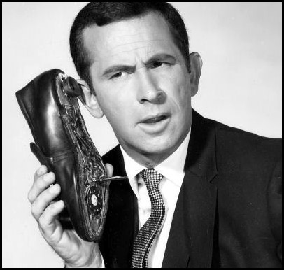
Refund Calls
ADOR Website: “Where’s My Refund”
Phone: 1-855-894-7391 (voice/ keyed response )

Slide 56
QUESTIONS
Business Privilege Tax 334-353-7923
Certificate of Compliance 334 -242-1189
Corporate Income Tax 334-242-1200
Financial Institution Excise Tax 334-242-1200
Individual Income Tax:
Examination Unit 334-353-0602
Return Integrity & Assurance 334-353-0709
Compliance 334-353-9770
Return Audit and Review 334-353-2170
Pass Through Entity 334-242-1033
Special Audit and Compliance:
Non-Filer Group 334-242-1511
CP 2000 334-242-1940
Withholding Tax 334-242-1300

Slide 57
CPE Presentations on the Website
If looking for this CPE Presentation or prior year presentations, please visit the Department’s website at www.revenue.alabama.gov and follow these steps.
Click on the Services link in the upper right-hand corner of the homepage.
Click on the Income Tax link from the drop-down menu.
Click on the Professionals link.
Click on CPE Presentations in the drop-down box.
Click on the CPE Presentation of your choice.

Slide 58
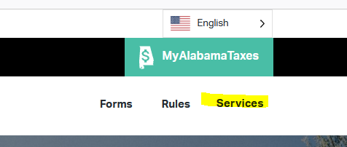
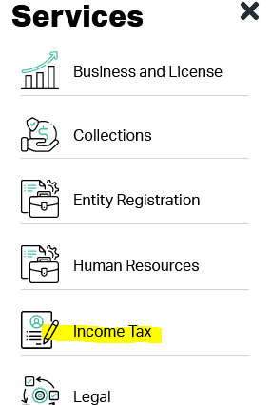
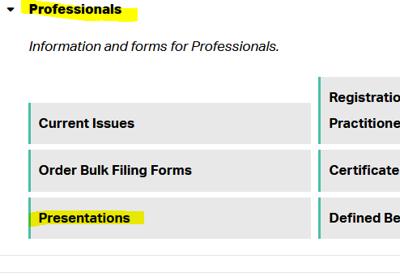
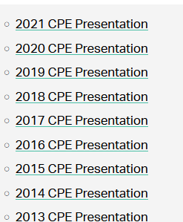
CPE Presentations on the Website

Slide 59
Lynn Schoener
lynn.schoener@revenue.alabama.gov
(334) 353-8045
Andrea Wyatt
andrea.wyatt@revenue.alabama.gov
(334) 353-9447
This Photo by Unknown Author is licensed under CC BY-SA
This Photo by Unknown Author is licensed under CC BY

