Slide 1
Alabama Department of Revenue Income Tax Administration
Division

Slide 2
Alabama Department of Revenue Income Tax Administration Division
2024 CPE Training
Lynn Schoener, CPA, FAS II
(334) 353-8045
lynn.schoener@revenue.alabama.gov
Andrea Wyatt, Revenue Tax Accountant/Auditor III
(334) 353-9447
andrea.wyatt@revenue.alabama.gov

Slide 3
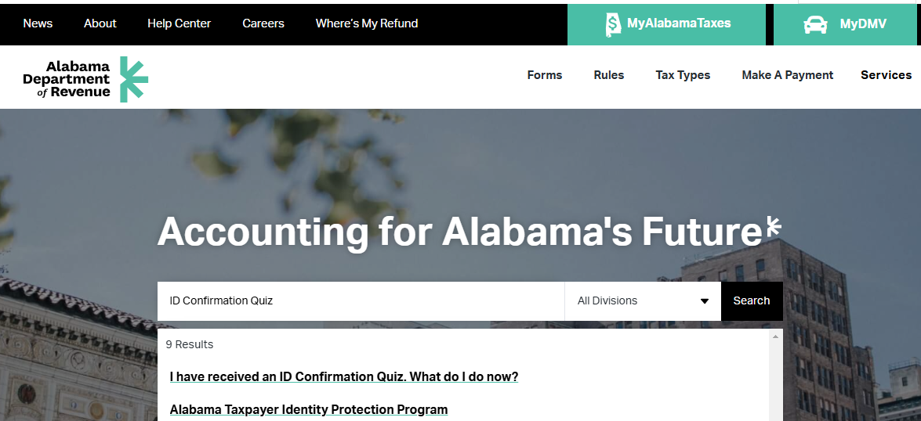
What’s New in I.D. Theft Prevention
Alabama will continue with the ID Confirmation Quiz letter mailed to taxpayers as done in previous years.
If you have received a call asking if this is real, please direct them to the ID Confirmation Quiz on our website.
Revenue.alabama.gov
Type ID confirmation quiz in the search line then
select Alabama Taxpayer Identity Protection Program

Slide 4
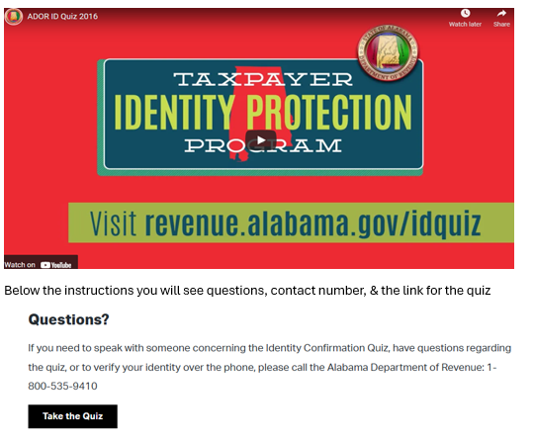
ID Confirmation Quiz
You can watch the video
or click Take the Quiz
Contact phone number is provided for additional questions

Slide 5
ID Confirmation Quiz
Before You Take the Quiz:
The quiz is based on information associated with the name first listed on the letter you received regarding this quiz. This person is considered the primary taxpayer related to the tax return filed.
You will need
Social Security Number (SSN) or Individual Taxpayer Identification Number (ITIN) of the primary taxpayer
Letter ID number from the top right corner of your letter
Current email address
Just 4 Easy Steps:
Read the instructions on this website.
Enter the Letter ID from the top right corner of your letter. Enter the last four digits of your SSN/ITIN and your date of birth. Select that you’re READY TO BEGIN THE QUIZ and click NEXT.
Answer the questions. Select that you’re READY TO SCORE YOUR QUIZ and click SUBMIT.
Enter your EMAIL ADDRESS to be notified of your results and click YES.
At the end of the quiz, you will see a confirmation screen.

Slide 6
What’s New from the 2024 Regular Session of the Alabama Legislature?

Slide 7
Alabama’s Legislature
Legislators are concerned how their constituents feel on certain issues. Without contacting them to voice your support or disapproval concerning legislation they won’t know.
Below is the mailing address and phone numbers for your legislators:
Mailing Address for your legislator: [Name of your Legislator], Alabama State House, Montgomery, AL 36130
Phone number for the House: (334) 242-7600 / Phone number for the Senate: (334) 242-7800
Legislative website: http://www.legislature.state.al.us
Look-up your legislator: https://www.sos.alabama.gov/alabama-votes/elected-official-map

Slide 8
What’s New from the 2024 Regular Session of the Alabama Legislature?
To view any legislation passed by the Alabama Legislature, please visit the website for the Alabama Secretary of State at www.sos.alabama.gov .
Point to the “Records” tab at the top of the page with your mouse and select “Legislative Acts”.
Select whether you want to search by the Act Number or the Bill Number.
Enter either the Act Number or Bill Number and select view image to see a PDF version of the Act.

Slide 9
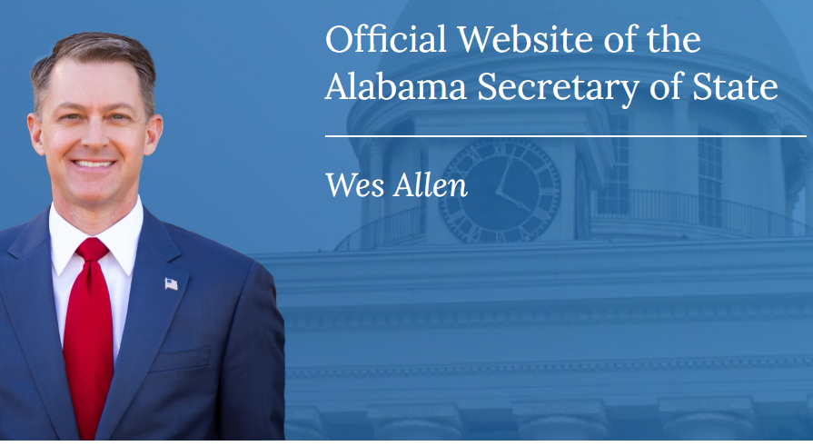
What’s New from the 2024 Regular Session of the Alabama Legislature?

Slide 10
What’s New from the 2024 Regular Session of the Alabama Legislature?

Slide 11
Prior year legislation effective for the 2024 return.
Act 2023-327 – Refund Check Offs
Act 2023-421 – Overtime Exemption
Act 2023-510 – Mileage Credit for First Responders
Act 2023-519 – Preceptor Tax Incentive Program
Please review the prior presentations for more detailed information about these and Other Acts.

Slide 12
Act 2024-21 (HB 129) The CHOOSE Act
Act 2024-21 establishes the Creating Hope and Opportunity for Our Students' Education Act of 2024, otherwise known as the CHOOSE Act.
The program shall be administered by the Tax Policy and Governmental Affairs Division of the Alabama Department of Revenue.
ADOR will set up an Education Savings Account or ESA in which funds are deposited by the department for the parent of a participating student to pay qualifying expenses to an education service provider.
The Educational Savings Account shall be available to parents of eligible students beginning with the 2025-2026 academic year.
AAA recipients are not eligible for Choose.

Slide 13
Act 2024-21 (HB 129) The CHOOSE Act
Although the CHOOSE Act is administered by the Tax Policy and Governmental Affairs Division of the Alabama Department of Revenue, ALDOR has contracted with ClassWallet to assist in programmatic support and customer service for the Act.
For additional information concerning the CHOOSE Act, CHOOSE Act Alabama, the school choice program, or the school choice income tax credit please feel free to reach out to us through one of the following contacts:
Website: chooseact.alabama.gov
Email: help@classwallet.com
Phone: 877-969-5536

Slide 14
Act 2024-113 (HB 187) PTE Due Date Extension
Act 2024-113 amends the Alabama Electing Pass-Through Entity Act passed under Act 2021-1.
The Alabama Electing Pass-Through Entity Tax Act provides that for tax years beginning on or after January 1, 2021, any Alabama S-Corporation or Subchapter K entity may elect to be taxed as an Electing Pass-Through Entity. Act 2024-113 makes the following changes to the original Act.
For tax years beginning on or after January 1, 2021, through December 31, 2023, an electing pass-through entity shall submit the appropriate form to the Department of Revenue at any time during the tax year or on or before the fifteenth day of the third month (due date) following the close of that tax year for which the entity elects to be taxed as an electing pass-through entity.
For tax years beginning on or after January 1, 2024, an electing pass-through entity shall submit the appropriate form to the Department of Revenue on or before the due date for filing the applicable income tax return, including any extensions which have been granted following the close of that tax year for which the entity elects to be taxed as an electing pass-through entity.
For tax years beginning on or after January 1, 2025, the election or revocation shall be made on the timely filed return including any extensions which have been granted.

Slide 15
Act 2024-213 (HB 230) Filing of Annual Report with the Secretary of State
Act 2024-213 is filed as an informational only bill which does not affect the operations ALDOR.
The Act removes the requirement and any reference to a requirement that corporations must file an annual report with the Secretary of State.
Effective October 1, 2024.

Slide 16
Act 2024-223 (HB 380) Storm Shelter Credit - Extended
Act 2024-223 extends the sunset date on the existing storm shelter tax credit. The bill proposes to extend the tax credit through calendar year 2028 rather than ending in 2025, unless continued by an act of the legislature.

Slide 17
Act 2024-302 (HB 346) Alabama Workforce Housing Tax Credit Act
Act 2024-302 establishes the Alabama Workforce Housing Tax Credit Act which allows for the issuance of income tax credits to developers who build affordable multi-family rental housing in areas where there is a shortage of low-income housing.
The Alabama Housing Finance Authority is charged with administering the provisions of the Act.
The legislation gives the Alabama Housing Finance Authority discretion to award this credit to any project that applies to the Authority and is currently receiving a federal low-income housing credit under 26 USC Section 42.
The Authority shall issue an eligibility certificate to the owner(s) of the qualified project reflecting the tax credit awarded and the eligible credit period. A copy shall also be provided to the Alabama Department of Revenue.
The Alabama Workforce Housing Tax Credit may be claimed for 10 years against the tax liability of the project owner(s). A tax credit not used in a taxable year may be carried forward for the succeeding 5 years but is non-refundable or transferable.
Credit may be applied against taxes due under chapters 16 and 18 of the Code of Alabama 1975, but only the state portion if used to offset the financial institution excise tax.

Slide 18
Act 2024-302 (HB 346) Alabama Workforce Housing Tax Credit Act
The credit amount awarded annually by the authority shall not exceed $5 million dollars for each year of the designated 10-year credit period.
An annual credit awarded to any one qualified project shall not exceed $2 million dollars.
Pass-through entities may allocate the tax credit to some or all of its partners, members, or shareholders, including any not-for-profit entity that is a partner, member, or shareholder in any manner agreed to by such persons, regardless of whether the person is allocated or allowed any portion of any federal low-income housing tax credit with respect to the qualified project.
20% to 25% of the annual cap will be awarded to rural properties, with the remainder awarded to qualified projects without geographic limitation.
The credit will be effective January 1, 2025.
The final date to apply for a low-income housing tax credit is September 30, 2027.

Slide 19
Act 2024-303 (HB 358) Employer and Facility Childcare Tax Credits
Act 2024-303 provides for an employer provided childcare tax credit, a childcare facility tax credit, and a nonprofit childcare provider grant.
The income tax credit for employers and facilities that provide childcare assistance for eligible employees was engineered to help employees reenter the workforce through access to affordable high-quality childcare while increasing workforce participation throughout the state.
ALDOR is charged with administering the tax credits while the Department of Human Resources (DHR) is responsible for administering the nonprofit childcare provider grants.
The tax credits may be applied against chapter 16 excise tax, 18 income tax, chapter 21 utility gross receipts, or Title 27 Insurance Premiums Tax.
An employer providing childcare, or a childcare facility may make application to the Department of Revenue for a tax credit beginning on or after January 1, 2025, and ending on December 31, 2027, unless extended by an act of the legislature.
Employer tax credits and facility tax credits are awarded in the order of the application receipt.
Employers must be able to demonstrate that EIC recipient employees are prioritized to qualify for the tax credit.

Slide 20
Act 2024-303 (HB 358) Employer and Facility Childcare Tax Credits
Employer tax credit is for employers who support their employees’ childcare needs by offering financial assistance for childcare expenses (this can be direct payment to the childcare facility on behalf of the employee or a reimbursement of qualifying childcare expenses to the employee) or establishing and/or operating childcare facilities for their employees with children five years old or younger. For employers who operate a childcare facility, the eligible expenses include construction, renovation, expansion, or repair of a childcare facility, or for the maintenance and operation of such facility. The credit is nonrefundable, nontransferable, and cannot be carried forward*.
Facility tax credit is for childcare providers who own and operate a qualified childcare facility licensed by the Alabama Department of Human Resources and participate in the Quality Rating and Improvement System and Child Care Subsidy Program. The credit is refundable. The facility credit is based on the average monthly number of eligible children enrolled and the facility’s quality rating under the Alabama Quality STARS program: A five-star rating = $2,000 per child. A four-star rating = $1,750 per child. A three-star rating = $1,500 per child. A two-star rating = $1,250 per child. A one-star rating = $1,000 per child.
*In cases where a childcare provider (#2 above) also meets the criteria for an employer credit(#1), they shall receive a refund on their state income tax return if the credit exceeds their tax liability.

Slide 21
Act 2024-303 (HB 358) Employer and Facility Childcare Tax Credits
25% of the credits awarded shall be to both small employers and childcare facilities located in rural targeted areas. A rural area is described in Alabama code Section 40-18-376.1(a)(2).
The annual cap for the total employer provided childcare tax credit is $15 million which shall be increased by $2.5 million dollars each year for the years 2026 and 2027. The maximum tax credit for a qualifying employer is $600,000.
The annual cap for the total childcare facility tax credit is $5 million. The maximum tax credit for a qualifying childcare facility tax credit is $25,000.
The employer provided childcare tax credit shall equal 75 percent of eligible expenses as defined in the act. In the case of a small employer with fewer than 25 employees the amount of the credit shall equal 100 percent of eligible expenses.
Employees earning more than $80K per annum are not employees for the purposes of this act. (excludes overtime & bonuses)

Slide 22
Act 2024-303 (HB 358) Employer and Facility Childcare Tax Credits
ALDOR is charged with the following before awarding an employer tax credit:
1. Provide a standardized certificate to be signed by the employer certifying all expenses incurred
were eligible expenses as defined in the Act. 2. Require & verify documentation to substantiate the credit amount & the eligibility of the expenses
claimed. 3. Require the identity and pro-rata share of ownership for pass-throughs. ALDOR is charged with the following before awarding a facility childcare tax credit:
1. Provide a standardized certificate to be signed by the childcare facility certifying each childcare
provider’s ownership of the applicable childcare facilities, the quality rating of each facility, and the
average number of eligible children attending each facility monthly. 2. Require & verify documentation supporting the amount of facility tax credit applied for.
3. Require identity and pro-rata share of ownership for pass-throughs

Slide 23
Act 2024-303 (HB 358) Employer and Facility Childcare Tax Credits
New Rules for use in administering Act 2024-303:
810-3-135-.05
Employer Tax Credit – General Guidelines
810-3-135-.06
Facility Tax Credit – General Guidelines

Slide 24
Act 2024-437 (HB 407) Overtime Exemption
Act 2024 - 437 Amends code section 40-18-14 to reflect that the amounts exempt from gross income for overtime wages will now be computed in accordance with the U.S. Fair Labor Standards Act.
The effective date of this change was October 01, 2024.
The ALDOR will report to LSA the data collected no later than 30 days after the due date of the information.
The Department’s website has been updated with a section on the overtime exemption which includes FAQ’s and filing specifications.
Website overtime exemption link: https://www.revenue.alabama.gov/individual-corporate/overtime-exemption/

Slide 25
Act 2024-441(HB 441) New Market Credit Program
Act 2024-441 is an informational only bill which does not affect the operations of the Revenue Department
Act 2024-441 amends the Growing Alabama Act, the Innovating Alabama Act, the Alabama Jobs Act, and Innovate Alabama to allow communities currently eligible for incentives to continue to receive incentives after the federal map of census tracts changes on September 01, 2024.
Communities that were eligible for the federal New Markets Tax Credit program under 26 U.S.C. §45 as of January 01, 2015 shall continue to be identified as such despite the census tract map changes.
Some communities would otherwise lose eligibility under the old census tracts and this amendment will grandfather them in.

Slide 26
Act 2024-170 (SB 209) Military Income Exemption
Act 2024-170 amends code section 40-18-13 to expand the exemption for compensation of members of the National Guard and Reserve. The current combat pay exemption is expanded to include:
income when deployed to locations outside of the United States
or when activated by the Governor of Alabama or the President of the United
States in response to emergencies within or outside of the United States.
Effective January 01, 2025.

Slide 27
Act 2024-451 (SB 219) Agriculture Exhibition Center Corporation
Act 2024-451 proposes the creation of the Agriculture Exhibition Center Corporation (an economic development organization under the Growing Alabama Act) for the operation of the Alabama Farm Center.
The Agriculture Exhibition Center Corporation shall be considered a governmental entity and as such is exempt from the payment of certain state, county, and municipal noneducational taxes.
The act clarifies the broad tax exemption does not include educational taxes.

Slide 28
Act 2024-406 (SB 286) Alabama Film Office
Act 2024-406 is as an informational only bill.
Act 2024-406 amends code sections 41-7A-1, 41-7A-42, and 41-7A-43.
The management powers of the Alabama Film Office shall now be managed by a director appointed by the secretary of the department rather than the governor.
The department has been changed to reflect “Commerce” rather than “Revenue”.

Slide 29
Act 2024-340 (SB 231) Economic Incentives and Labor Organizations
Act 2024-340 institutes legislation to prevent any employer from receiving economic incentives or requires them to repay economic incentives for certain labor violations outlined in the bill.
Requires enforcement by ADOR.
Effective January 01, 2025 and does not apply to economic incentives executed prior to this date.
An employer that engages in any activity prohibited by this legislation which has received an economic development incentive for any project shall be required to repay all economic development incentives received over the life of the project.
Labor violations that will prevent an employer from receiving economic incentives or require recapture of economic benefits by the State of Alabama include:
- disclosing an employee’s personal contact information to a third party without the employee’s consent
- allowing a voluntary union membership based on authorization cards rather than a required secret ballot.
- requiring a subcontractor to engage in any of the above two activities.

Slide 30
Act 2024-447 (SB 297) Sound Money Tax Neutrality Act
Act 2024-447 amends code section 40-18-14 to exclude any net capital gains derived from the exchange of precious metal bullion from state income taxes.
Precious metal bullion is described as coins, bars, or rounds containing primarily refined gold, silver, platinum, or palladium that is marked and valued primarily by its weight, purity, and content.
Effective beginning with the 2025 tax year.

Slide 31
Beginning with the 2019 tax returns, certain tax credits are now required to be pre-approved through My Alabama Taxes (MAT) at www.myalabamataxes.alabama.gov
Please see the instructions in the tax guide or the instructions for a particular schedule or form being used for more information.

Slide 32
For more information on Income Tax Credits, Abatements, and other Incentives available please visit the Office of Economic Development located on the Department’s website at
https://revenue.alabama.gov/tax-incentives/

Slide 33
Electronic Filing Information

Slide 34
My Alabama Taxes
ADOR continues to offer a FREE electronic filing option to individual Alabama taxpayers filing a state tax return.
No income limitations or other qualifications must be met to take advantage of this free online filing system.
Go to www.myalabamataxes.alabama.gov to sign up and efile.
No registration required for the new simplified short form 40EZ beginning with the 2018 filing season.

Slide 35
Electronically Filed Returns
Tax Year 2023 Individual Income Tax Returns
E-filed as of December 31, 2024
1,969,371 returns have been filed electronically
64 % of returns filed have been refund returns

Slide 36
*Information from January 1, 2024 – December 30, 2024
Form Type | Total Returns Received* | % e-filed
20C-Corporate | 34,923 | 75%
20CC-Consolidated Corporate | 145 | 68%
BPT, CPT, PPT Privilege Tax | 114,445 | 49%
EPT-Electing Pass Through | 9,631 | 94%
20S-Sub Chapter S Corporation | 73,357 | 98%
65-Partnership | 75,923 | 96%
PTEC-Pass Through Entity Composite | 20,878 | 94%
41-Estates and Trust | 26,685 | 97%

Slide 37
Modernized Electronic Filing (MeF) Contacts
Tavares Mathews – Individual MeF (40 and 40NR) tavares.mathews@revenue.alabama.go
334-353-9497
Demetria Gordon – Business MeF (20C, 20CC , CPT and PPT) demetria.gordon@revenue.alabama.gov
334-353-9129 Tymecca Pearson– Business MeF (20S, 65, PTEC and 41 ) tymecca.pearson@revenue.alabama.gov
334-353-0685 Veronica Jennings – Mef Development and Web Service, Manager veronica.jennings@revenue.alabama.gov
334-353-9440

Slide 38
Forms

Slide 39
Mailed Forms
The Department will provide income tax booklets (40/40NR) to Libraries and TPSC’s this year.
Taxpayers can download and print all tax forms from our website.
Taxpayers can mail order all tax forms from our website.

Slide 40
Form Changes for 2024
Unchanged Forms (other than year/date edits):
Corporate Income Tax:
Form 20C-C
Form 20C-CRE
Schedule FTI
Schedule B-1
Schedule KRCC-B
Schedule OZ
Financial Institution Excise Tax:
Schedule FTI
Schedule KRCC-B
Schedule B-1
Schedule OZ
Schedule ET-1 and ET-1C
Pass-Through and Fiduciary Forms:
NRA
NMC
PTE-R/NRA-R
NRC-Exempt
QIP-C
Schedule OZ
Schedule CP-B
EST-1
KRCC-B
NOL-F85
NOL-F85A

Slide 41
Form Changes for 2024
Individual Income Tax changes:
Act 2023-327 New Donation Check-Offs - State Parks Division of the Department of Conservation and Natural Resources; Department of Mental Health – 2023; and Alabama Medicaid Agency.
Act 2023 – 33 (Innovate Alabama Credit) authorizes a tax credit to corporations/Individuals that make cash contributions to economic development organizations (EDO) approved by Innovate Alabama. (Schedule OC, Section B, Part X) New allowable prior year credit carryforward.
Act 2023-510 provides that an individual who is a member of a volunteer fire department or a volunteer rescue squad shall be entitled to a state income tax credit as reimbursement to the volunteer first responder for use of their private vehicle when responding to a fire, emergency, or rescue call. (Schedule OC, Section B, Part Y).

Slide 42
Form Changes for 2024
Individual Income Tax changes:
Act 2023-519 established the Preceptor Tax Incentive Program to provide an income tax credit to individuals in Alabama who provide clinical preceptorships in a rural area (Schedule OC, Section B, Part Z).
AL8453
New Part II- Estimated Payments.
AL8453OL
New Part II- Estimated Payments.

Slide 43
Form Changes for 2024
Corporate Tax changes:
Form 20C
Line 12b added to Schedule AB. Non-Exempt amount of Disallowed IRC 163(j).
Schedule BC
Page 5, Section B, Part Q, Lines Q7 & Q8 added new Lines and Credit Carryforward section to Innovate Alabama Tax Credit.
Page 7, Section D-instructions - Updated text information in instructions for the Career-Technical Dual Enrollment Credit, Growing Alabama Credit, and Innovate Alabama Tax Credit in Column 4 of Section B, Part J, line J8, Section B, Part M, line M8 and Section B, Part Q, line Q8 respectively.
AL8453-C
New Part II- Estimated Payments.

Slide 44
Form Changes for 2024
Fiduciary Tax changes:
Form 41
Page 1, Header-Increased field length for both name fields to 75 characters.
Added New Field “COUNTRY”.

Slide 45
Form Changes for 2024
Fiduciary Tax changes:
Schedule FC
Page 4, Part Q-Innovate Alabama Tax Credit-Added lines 9-10d.
Page 6, Section E Instructions-Text updated.
AL8453-FDT
New Part II- Estimated Payments.

Slide 46
Form Changes for 2024
Financial Institution Excise Tax changes:
Form EC
Page 4, Part H-Innovate Alabama Credit- Line H7 new line added
Line H8 – H8f new lines added.
AL8453-FIE
New Part II- Estimated Payments.

Slide 47
Form Changes for 2024
Pass-Through Tax changes:
Form PTE-C
Page 1, Header-Increased field length for name field to 75 characters.
Added New Field “COUNTRY”.
Form EPT
Page 1, Header-Increased field length for name field to 75 characters.
Added New Field “COUNTRY”.

Slide 48
Form Changes for 2024
Pass-Through Tax changes:
Form 20S
Page 1, Header-Increased field length for name field to 75 characters.
Added New Field “COUNTRY”.
New box-TOTAL ASSETS AS SHOWN ON FORM 1120S.
Moved box-DATE QUALIFIED IN ALABAMA.
Removed box-S Status Election Termination.
New Line 19- Energy efficient commercial buildings deduction (attach Form 7205). Renumbered lines 20-37.
Page 4, Schedule G-New Line 9-S Status Election Termination.
Schedule K, Line 1-Updated line reference.

Slide 49
Form Changes for 2024
Pass-Through Tax changes:
Schedule K-1(20S)
New Part F-Entity Apportionment Percentage.
Re-lettered G-AD2.
Form 65
Page 1, Header-Increased field length for name field to 75 characters.
Added New Field “COUNTRY”.
New Line 20-Energy efficient commercial buildings deduction (attach Form 7205). Renumbered lines 21-34.
Page 4, Schedule K, Line 1-Updated line reference.

Slide 50
Form Changes for 2024
Pass-Through Tax changes:
Schedule K-1(65)
New Part F-Entity Apportionment.
Re-lettered G-AA.
Schedule PAB
New Line 12b-Non-Exempt amount of Disallowed IRC 163 (j) (Line 12 minus Line 12a).
New Form-8948-AL-Pass Through Entity
Preparer Explanation for Not Filing Electronically.

Slide 51
Form Changes for 2024
Business Privilege Tax changes:
Form CPT
Page 1, Header, New field/line “COUNTRY”.
Form BPT
Page 1, Header, New field/line “COUNTRY”.
Form BPT-IN
Page 1, Header, New field/line “COUNTRY”.

Slide 52
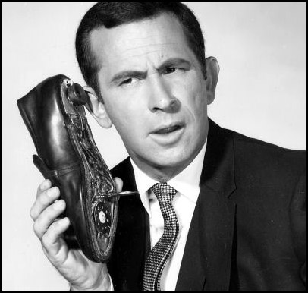
Refund Calls
ADOR Website: “Where’s My Refund”
Phone: 1-855-894-7391 (voice/ keyed response )
Call Center: (334)353-0944 or 1-800-535-9410

Slide 53
QUESTIONS
Business Privilege Tax 334-353-7923
Certificate of Compliance 334 -242-1189
Corporate Income Tax 334-353-7943
Individual Income Tax:
Examination Unit 334-353-0602
Compliance Unit 334-353-9770
Return Audit and Review-334-353-2170
Pass Through Entity 334-242-1033
Special Audit and Compliance:
Non-Filer Group 334-242-1511
CP 2000 334-242-1940
Withholding Tax 334-242-1300

Slide 54
CPE Presentations on the Website
If looking for this CPE Presentation or prior year presentations, please visit the Department’s website at www.revenue.alabama.gov and follow these steps.
Click on the Services link in the upper right-hand corner of the homepage.
Click on the Income Tax link from the drop-down menu.
Click on the Professionals link.
Click on CPE Presentations in the drop-down box.
Click on the CPE Presentation of your choice.

Slide 55
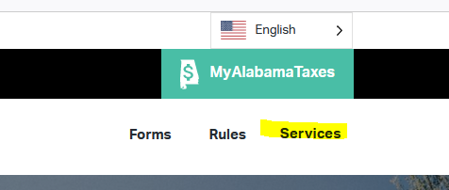
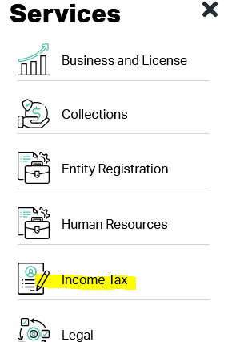
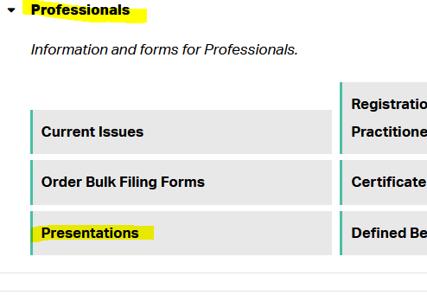
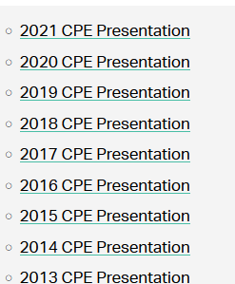
CPE Presentations on the Website

Slide 56
Comments?
Lynn Schoener
lynn.schoener@revenue.alabama.gov
(334) 353-8045
Andrea Wyatt
andrea.wyatt@revenue.alabama.gov
(334) 353-9447

