Slide 1


Licensing Conference
January 15-16, 2020
Notes:
Welcome and Introductions. Presentation will be available on MVD webpage

Slide 2
Legislative & Regulatory Review

Slide 3
2020 Legislative Session
Begins February 4th
MVD legislation tracking
  https://revenue.alabama.gov/motor-vehicle/reference-statistics/legislative-tracking/

Slide 4
Gas Tax
Act 2019-2 (Effective: January 1, 2020)
Rebuild Alabama Act Memo (October 1, 2019)
Annual additional registration fee:
  Battery electric vehicle $200
  Plug in hybrid electric vehicle $100
2.5% commission retained by official
Fees may be prorated like other license fees
Uniform Vehicle Valuation Manual includes fuel types:
  E (electric) $200 due
  P (plug-in hybrid) $100 due
  H (hybrid) ask registrant if plug-in
Notes:
Question H (hybrid) due to differences among manufacturers to determine if should reflect “P” and fees collected.
I’ve got a slide coming up where I will discuss the changes to the fuel type within the MVD file format in more detail

Slide 5
Gas Tax
Attorney General Opinion 2020-005:
  State portion of fees shall be deposited in the State General Fund until the total annual registrations of battery electric and plug-in hybrids exceed four percent of the total annual registrations.
    Comptroller memo dated 12/23/19 says hold funds until receive further instruction from their offices.
  Treasurer may not distribute proceeds to counties or cities.
  Fees must be prorated in same manner as license fees for other motor vehicles that may be acquired or first brought into the state (40-12-259).
  If prorated amount collected, it shall be distributed proportionally to state, counties and cities with any remainder to the Rebuild AL Fund.
Notes:
Fees may not be refunded.

Slide 6
Gas Tax Amendment
The proceeds of the annual license taxes and registration fees to be distributed to counties and municipalities pursuant to subsection (f) of Section 40-12-242, as amended by Act 2019-2, shall be distributed by the same entity responsible for the distribution under subdivisions (2) and (3) of subsection (c) of Section 40-17-371, as created by Act 2019-2.
This act shall become effective immediately, following its passage and approval by the Governor, or upon its otherwise becoming law.
Notes:
Section 7 of Act 2019-2 codified under 40-17-371
(1) 66.67% to ALDOT
(2) 25% to counties – 45% equally & 55% based on population
(3) 8.33% to cities – 25% equally & 75% based on population

Slide 7
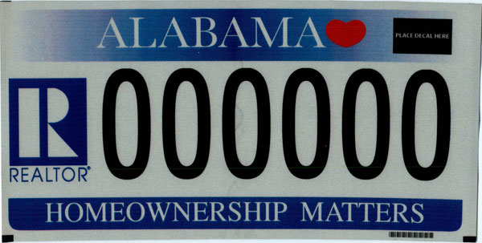
Realtor License Plate
Act 2019-138
Effective: January 1, 2020
Redirects proceeds from sale of the Alabama Association of Realtors distinctive license plates from the Alabama Children's Trust Fund to the Alabama Realtors Foundation

Slide 8
EMS License Plate
Act 2019-418 (Effective: January 1, 2020)
Creates Emergency Medical Services Provider distinctive license plate
  Additional fee of $50
Issued to licensed EMSP
  Verified through ADPH Office of EMS website
    Link to the site provided on the MVD plate page
    Law specifies to use ADPH site to verify
Notes:
EMPS = paramedic, emergency medical technician licensed with AL Dept of Public Health office of Emergency Medical Services
Use on privately owned passenger vehicles including station wagons and pick-up trucks (up to 12,000 and not more than 2 axles per definition under 32-8-2)

Slide 9
EMS License Plate

Slide 10
Fleet Online Registration & Tax (FORT) Portal
Act 2019-129 (Effective: May 8, 2019)
Establish Advisory Committee – met 11/20 will meet again on 1/22
DOR portal to allow registration and renewal of fleet vehicles (January 1, 2022)
Fleet – 50 or more vehicles less than 12,000 lbs.
DOR will calculate ad valorem tax and issue “fleet” license plate
DOR rule making authority to expand to other vehicles (i.e. IRP)

Slide 11
Mandatory Liability Insurance
Act 2019-446 (Effective: January 1, 2020)
Eliminate 4 mo. suspension period
Reduce lookback period for 2nd and subsequent violations to 3 years
Increase licensing official’s commission on reinstatement fee from 10% to 15%
Change distribution date to 20th of the month
Increase annual amount retained by licensing official’s office from $10K to $25K

Slide 12
Mandatory Liability Insurance
Tag must be surrendered to official when claiming stored/inoperable exemption
  Voluntarily Surrender prior to insurance lapse (Poster)
  Within 30 calendar days from receipt of MLI Verification Notice
  Use Form MV 32-7A-5 Request for Registration Revocation to surrender tag upload to MLI system
County registration record will be updated to “revoked” county should update their records
Exempt response can only be claimed once per year per vehicle
Notes:
Rule 810-5-8-.06 being repealed and replaced labeled as MLI Reg. Suspension, Reinstatement and Revocation Procedures.
Do we want them uploading all documents to MLI system for VR as well as good cause? I would think if we are telling them to do one then they should do for all.

Slide 13
Mandatory Liability Insurance
Exempt response cannot be claimed if vehicle was involved in crash or citation (MLI system links)
  Vehicle cannot be operated on insurance verification date and during time period exemption was claimed
Rule 810-5-8-.06 establishes “good cause” exceptions
  Use Form MV 32-7A-11 Mandatory Liability Insurance Affidavit
Good cause documentation and completed forms should be uploaded to MLI system

Slide 14
Mandatory Liability Insurance
Notice of Suspension
  Mailed and emailed by DOR if MLI case is not resolved within 30 days
  Notifies vehicle owner that registration is suspended as of the date of the notice of suspension (i.e. immediately)
  Vehicle owner still has 30 days to appeal
Notes:
Updated from current process of notice of suspension explaining that registration will be suspended in 30 days

Slide 15
Mandatory Liability Insurance
Collecting Reinstatement Fees
  Only at a local licensing office (32-7A-12)
  Department, including Taxpayer Service Centers, can no longer accept payments

Slide 16
Abandoned Vehicles
Act 2019-245 (Effective: January 1, 2020)
Only affects vehicles reported unclaimed on or after January 1, 2020
Increases title hold from 45 to 60 days
  Unless vehicle is redeemed or sold as abandoned
Purchaser must post title surety bond if vehicle is not sold by a bonded agent
  Towing companies are designated agents
Purchaser has one year to apply for title without posting bond if vehicle is purchased from bonded agent

Slide 17
Manufactured Homes
Act 2019-239 (Effective: January 1, 2020)
Exempts year models 1999 & older
Expands titling of MH to MH’s older than 20 model years
Clarifies additional $5 MH title fee shall be collected for each unit (side) of a MH subject to titling

Slide 18
Temporary Tag for Transporters
No bill number or sponsor yet
Drive out operations (i.e. transporters) may issue temporary (20-day) tags
Transporters must be bonded
Add house trailer definition to 32-8-2 – includes travel trailer
Add self-propelled camper or house car definition to 32-8-2 – includes motor homes and RVs
Effective – October 1, 2020
Notes:
House trailer and self-propelled camper/house car as defined in 10-12-240

Slide 19
Disabled Veteran Tag
No bill number or sponsor yet
Exempts DVs from $1.25 issuance fee
Effective – January 1, 2021
Notes:
Relabel for Expected 202 Legislation?

Slide 20
Disability Access Placards
SB11
Sponsor – Whatley
Removable windshield placards shall include photo of individual with disability
Photo of DL or non-driver ID on file with DOT
Effective – 1st day of 3rd month following passage and approval by governor
Notes:
DPPA – personal information, including photo is protected
ALVerify doesn’t include photos
ALDOT not responsible for DL (ALEA)
Throw away existing placards and reissue?

Slide 21
Distinctive Tags
No bill number or sponsor
All distinctive tags required to go through LOC for reissuance/redesign
College and military tags exempt
Fee for distinctive tag applications
May require military members to recertify at tag reissuance
County indicator prescribed by DOR
Effective – 1st day of 3rd month

Slide 22
Dealer License
No bill number or sponsor yet
Eliminates temporary 7-day auction transit tag
Eliminates temporary 7-day dealer transit tag
Creates auction tag for licensed auctions
Changes number of title applications to 500 to qualify for more dealer tags
Effective – October 1, 2020
Notes:
Currently 1,200. 300 in October. Lisa will talk about dealer license and tag law changes effective 10/1/2020

Slide 23
Non-interstate Tag (Rule)
Amend rule 810-5-1-.238
Issue non-interstate tags to LSVs
Issued to LSVs that meet FMVSS or federal definition of LSV
Notes:
Relabel for Expected 2020 Legislation?

Slide 24
Administrative Rules
Sign up on DOR website to receive rule hearing notices
Sunset provision – must review rules every 5 years
Rules on MVD website
Notes:
Makes sense to me to mention one time here and let each Section mention specifics related to rules they are working on – amended, repealed….

Slide 25
MVTRIP Notifications
Must have MVTRIP account
Each user should have their own email address
Pilot county calls
Webinars?

Slide 26
Contact Us
Telephone number: (334) 242-9000
Licensing Offices select option 5
Provide name, county and reason for call
MVD staff should identify themselves
email: MVD@revenue.alabama.gov
Report any issues to MVD management
Notes:
No voicemail on this number 2-9008. If no one answers call back or use one of the other options. If operator is unable to transfer call, please leave a message with the operator. No one is perfect and we don’t always have an immediate answer; however, we will no tolerate rude or unprofessional behavior.

Slide 27
MVD Customer Service
Calls received – 179,317
Calls answered – 138,475
Average hold time – 4.33 minutes
Emails – 65,872
Walk in customers – 17,534
Notes:
2019 calendar year

Slide 28
Title Updates

Slide 29
Title Section
Managers/Supervisors
  Jonathan Lawrence, Section Manager
  Kevin Long, Title Customer Service Manager
  Allyson Ward, Title Examination Unit Supervisor
Units
  Title Examination (16 employees)
  Title Customer Service (9 employees)
Notes:
Title Examination (16 employees)
Auditing title apps for accuracy (1.8 million apps in 2019)
New employee training (6 months)
Title Customer Service (9 employees)
Assist taxpayers
Phone (81K)
Emails (25K)
Walk-Ins (12K)

Slide 30
Manufactured Homes
Act 2019-239 (Effective: January 1, 2020)
Requires titles for year models 2000 and newer
System changes
  Updated edits in ALTS & Surety Bond Portal

Slide 31
Abandoned Vehicles
Act 2019-239 changes only affects vehicles reported unclaimed on or after January 1, 2020
60 Day Title Hold
  ALTS only allows applications using Abandoned Bill of Sale
Bonded Agents
  Amended Rule 810-5-75-.52 to include towing companies
  Non-Dealer Application for Designated Agents (MVT 4-2)
    https://revenue.alabama.gov/motor-vehicle/motor-vehicle-license-information/designated-agent-information/
Notes:
1st bullet point
Emphasize “Only”. LO’s have been turning away taxpayers with abandoned sales under the old law.
They should start seeing the new BOS beginning late February.
2nd bullet point
Mention how ALTS will work. Error on pre-qualifier screen
3rd bullet point
- Make sure they know under the new law bonded agents can process their own paperwork. Only sales under bond should be processed by their offices.

Slide 32
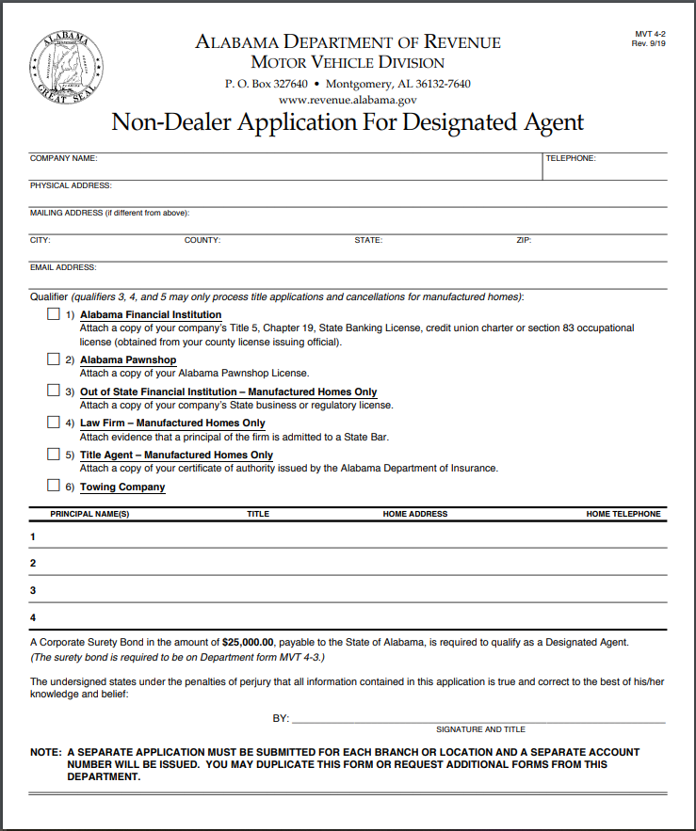
  Non-Dealer Application for Designated Agents (MVT 4-2)

Slide 33
Abandoned Vehicles
Purchaser must post title surety bond if vehicle is not sold by a bonded agent
  Revised Abandoned Bill of Sale
  Message on ALTS Pre-qualifier Screen
Purchaser has one year to apply for title without posting bond if vehicle is purchased from bonded agent
Notes:
1st bullet point
- Make sure they understand the 2 ways to recognize a purchaser must bond. The new BOS and also the system error message.

Slide 34
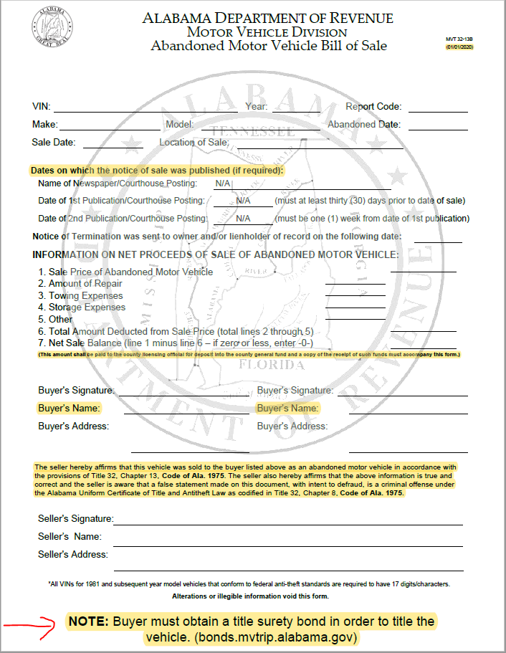
Abandoned Vehicle Bill of Sale

Slide 35
ALTS Updates
ETAPS API service no longer available (Dec. 2, 2019)
DA Lockout Feature
  Apps must be received by ADOR within thirty (30) days from creation
  Apps may be placed on “HOLD” for an additional thirty (30) days
  Live February 5, 2020
Adding a lienholder question in ALTS
  Must be answered prior to completing application
  Update to the API service
Adding a field to ALTS for “Vehicle Trim Packages”
  Update to the API service
Notes:
2nd bullet point
- Emphasize the Feb. 5th implementation date.

Slide 36
ALTS Updates
Public Title Portal (https://title.mvtrip.alabama.gov/)
  Apply for Replacement Title
  Check Application Status
  Check Undeliverable Titles
  Applications Coming Soon (Add lien, Salvage, Rebuilt Owner Retention)
Document Upload Feature
NMVTIS Webservice Integration
  Validate OOS Title Information
  Lien Verification
  Check for Brands (i.e. Junk, Salvage, Rebuilt, etc.)
  Stolen Vehicle Check
Notes:
1st bullet point
Ask them to stop handing out the old paper form and remove links from their websites.
2nd bullet point
Just mention the benefits of uploading docs (processing time reduction, cost savings, etc.)
3rd bullet point
- Mention the ongoing bi-weekly meetings with AAMVA and explain how this will work in our systems and the benefits of each.

Slide 37
Federal Odometer Law
National Highway Traffic Safety Administration (NHTSA)
  Issued Rule RIN 2127-AL39 (October 2019)
Odometer Certifications
  Allow for electronic signatures
  Extends certifications from 10 to 20 years beginning Jan. 1, 2021
  Only affects vehicles year model 2011 and forward
Benefits
  Deter odometer fraud, tax fraud, & skips in title transfers
  Consumer cost savings up to $7.5 million annually

Slide 38
Electronic Lien & Title (ELT)
Objectives:
  Issue electronic titles
  Record and release liens electronically
  Eliminate paper titles & allow electronic transfers among dealers
Goals to accomplish:
  NMVTIS webservice integration
  Document upload feature
  Implement Federal law changes (i.e. electronic signatures)
Notes:
Just explain the objectives of ELT and point out the goals to accomplish. This slide ties back to the previous slides

Slide 39
Title Admin Rule Updates
New
  810-5-75-.52.01 (Title Service Provider)
Repealed
  810-5-75-.49
  810-5-75-.54
  810-5-75-.62
  810-5-75-.67
  810-5-75-.68
Notes:
Just mention that all these rules were amended/repealed during 2019

Slide 40
Title Admin Rule Updates
Amended
  810-5-75-.03
  810-5-75-.14
  810.5-75-.15
  810-5-75-.17
  810-5-75-.21
  810-5-75-.24
  810-5-75-.29
  810-5-75-.31.02
  810-5-75-.34
  810-5-75-.36
  810-5-75-.39
  810-5-75-.40
  810-5-75-.48
  810-5-75-.52
  810-5-75-.53
  810-5-75-.55
  810-5-75-.57
  810-5-75-.58
  810-5-75-.60
  810-5-75-.61
  810-5-75-.63
  810-5-75-.64
  810-5-75-.66

Slide 41
Compliance & Licensing

Slide 42
Compliance & Licensing Section
Managers/supervisors
  Lisa Blankenship, Section Manager
  Maria Chamnong, Dealer License Supervisor
  Renee’ Kyser, Audit Unit Manager
  Vacant, Inspections Unit
Units
  Dealer License (5 employees)
  Audit (14 employees)
  Inspections (12 employees)
Notes:
Lisa is directly responsible for Inspections Unit until we get someone for that position

Slide 43
Title Service Provider
Act 2019-238 (Effective: October 1, 2019)
Allows a title service provider to perform designated agent duties for a licensed dealer
  Application package available online
Title service provider
  Any person who acts as an agent for a licensed dealer
  Must be bonded like a designated agent
  Designated agent cannot do work for another designated agent
Admin Rule 810-5-75-.52.01
Notify MVD of anyone in your county acting as an unregistered title service provider
Notes:
We will contact unregistered title service providers to instruct them on how to get registered with us.

Slide 44
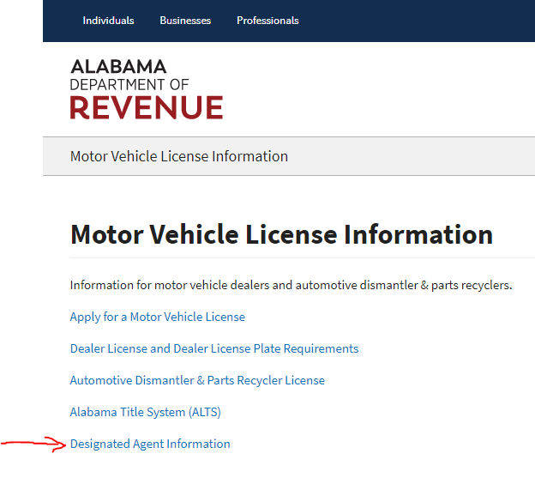
Title Service Provider

Slide 45
Dealer License & Tags
Act 2019-244 (Effective: October 1, 2020)
Result of HJR14 (2018) to research and draft recommendations to combat curbstoning and abandoned vehicle fraud
DOR responsible for issuing dealer tags
Dealer must have state regulatory license and county license before tag is issued

Slide 46
Dealer License & Tags
Metal DT tag replaced by temporary 7-day DT tag issued by DOR
Temporary DT/Auction tag - $5
Manufacturer tags issued by DOR
Penalty for first violation of dealer tag law increased from $100 to $200

Slide 47
Dealer License & Tags
Local official cannot collect ad valorem or sales tax on vehicle in dealer inventory when “standard” plate is issued
  Must provide MSO or reassigned title as evidence of vehicle inventory

Slide 48
Dealer License & Tags
Creates master dealer license – eliminates separate wholesale and rebuilder license
Penalty for delinquent dealer license - 15% of license fee after grace period (Oct)
Increases bond from $25K to $50K
Allows DOR to adjust license fee

Slide 49
Dealer License & Tags
Penalty for failure to obtain license
  $500 for first offense
  $1,000 for second or subsequent offense
No person, other than licensed dealer, may sell vehicle without title reflecting person as owner
Local licensing official or law enforcement may impound vehicle

Slide 50
Dealer License & Tags
Creates “facilitator” license for off-site sales - $25
Facilitator is any person who facilitates an off-site sale, including the property owner
Must apply for license 10 days before sale
Facilitator must provide names of participating licensed dealers who must also obtain an off-site license prior to sale
Penalties: 1st - $500 2nd - $1,000

Slide 51
Dealer License & Tags
Creates motor vehicle wholesale auction license issued by DOR
Any person in the business of buying, selling, exchanging or facilitating the sale of vehicles at wholesale to licensed dealers
Licensed and bonded similar to dealer
DOR may establish electronic reporting requirements regarding sale of vehicles
Notes:
40-12-240(21): Person is every individual, firm, partnership, association, estate, trust or corporation and the receiver, assignee, agent, administrator, or other representative of any of them

Slide 52
Licensing System
Allows dealer or dismantler to apply for license online
  Check system before privilege license is issued
Displays status of license - should be checked before privilege license and dealer tags are issued
Changes effective October 1st :
  Applicant must upload privilege license to receive dealer tags from the MVD

Slide 53
Compliance & Enforcement
Training manual
Report violations
Law enforcement bulletin/memo
(MVD will issue before October 1, 2020)
  ALEA Fusion Center
  AL Sheriff’s Association
  AL Chief’s of Police
  Local licensing offices
Notes:
Jay questioned what is plan to include locals – I think asking if we send separate memo or the LE bulletin, but verify with him

Slide 54
Temporary Tags for Dealers
Law enforcement bulletin/memo
(issued once dealers using POD tag material)
  ALEA Fusion Center
  AL Sheriff’s Association
  AL Chief’s of Police
  Licensing offices
Notify roadside law enforcement about temporary tag requirements
Notes:
Currently dealers still using blue and yellow temp tags we issue from our offices but they will be using the POD material as your offices are and we will coordinate sending the bulletin for that notification.

Slide 55
SCRAP System
Used to report junk vehicles
Different from scrap metal portal (ALEA)
Licensed dismantlers & parts recyclers
Crushers
Junk brand added to title record – no title issued

Slide 56
Online Training
Designated agents
Licensing Offices
IRP/IFTA registrants
AAMVA fraud training
Use MVTRIP login
Notes:
Jay says talk about DA training (current and proposed-online).
Explain that anytime a new user is added for a dealer, must complete training and we also plan to provide refresher courses
Jay has note – AAMVA fraud training is a maybe (discuss with him to see if just remove for now or not)
He says planned beside the “User MVTRIP login”- my question – will they have MVTRIP account to be able to complete training? I thought that would come after the fact.

Slide 57
Registration Updates

Slide 58
Registration Section
Managers/supervisors
  David Baxley, Section Manager
  Troy Thigpen, Registration Unit Manager
  Vacant, Warehouse
  Trishawn Bell, Motor Carrier Services Supervisor
Units
  Registration (MLI, Government Tags, Temporary Tags, Record Request) (15 employees)
  Warehouse (5 employees)
  Motor Carrier Services (11 employees)
Notes:
Explain Troy responsible for warehouse if they need to reach out to us with issues
Verify unit number of employees
Tell what each unit responsible for – I provided reg. unit but explain warehouse – what they do and they are responsible for Dept. records retention center as well

Slide 59
File Format & Error Report Updates
Changes pushed out to production on 12/9/19
Updated fuel codes in file format (E- Electric, P- Plug-in hybrid, H-Hybrid (need to ask registrant if plug-in or not, G – Gas, D – Diesel, etc.)
  Uniform Vehicle Valuation Manual includes fuel type
Changes to registration validation edits to resolve previous issues reported related to the registration error report (ex. out of state driver license)
  If still see issues or have questions, let us know
Notes:
David picks up from this slide
Explain (from Mike’s memo) how property tax valuation file providing fuel codes as provided from manufacturer mention will need to change to P if registrant states the vehicle does plug-in so the extra fees are collected properly
Mention that changes were pushed out previously and pulled back due to some issues but those should be resolved with what pushed out Monday night. Let us know if see any issues.
On file format the fuel field has gone from 10 to 1 character and the other 9 are filler now. Will see on error report if fuel code not one of the detailed one digit codes now.
Error report issues resolved - (One item know reported was related to the driver license field???)

Slide 60
Proration of Re-Registration Fees
Motor Homes
  Allowed for proration under 40-12-258
Electric & Plug-In Hybrid Vehicles
  Not allowed for proration
  Treated as additional registration fee

Slide 61
Inventory Management
System Rewrite
  Edits based on previous years statistics
Ordering inventory
  Stats on ADOR website
  Access to ordering inventory
  Limitations
Notes:
Jay states he thinks there is more info to provide here – need to discuss and decide

Slide 62
Disposal of Unused Tags and Tag Receipts
Per the Examiners of Public Accounts, Print on Demand (POD) excess materials may be destroyed in the same manner as any damaged/misprinted POD materials, as long as adequately documented for audit purposes.
Disposal of surrendered and unissued tags once audited
  Contact MVD
    Schedule pick-up with ACI
Notes:
Memo 2016-23 – Vehicle Document Retention Requirements
Memo 2017-15 – Print on Demand Reg. Receipt/Decal Project Update

Slide 63
Generic Tag Runs
Current Process
  Manual process to ensure no duplicate numbers
Proposed Process
  AIMS System Pulls Next Available Plate
  Eliminates Manually Assigning Tag Schemes (ex: # of characters on plate)
Notes:
Provide full explanation of the current process (Right now Beverly has to manually keep track of all tag schemes from years past to ensure that no duplicate numbers are out there) versus the proposed new process. He has note on number of characters on tags – need to discuss where want to go with information provided here

Slide 64
Reports
Temporary Tag and MLI Reinstatement Reports (Separate reports to MVD discontinued)
  Reinstatement report (MLI system)
  20-day Temporary Tag report (PROS system)
  Remitted to Comptroller’s Office
  Remit on 20th of each month – same as other fees (Ex. Dec. MLI reinstatement report on Jan. 20th)
Upload Comptroller report (40-12-270) to secure FTP folder
  Separate DOT report discontinued
Notes:
(see jay’s notes to make sure I cover everything here)
Explain MLI reports and how changing to reflect changes as they see on the comptroller report (they break down the 85% going to the dept/general fund from the 15% going to the peace officers annuity fund. Previously the licensing officials did not see this breakdown on their reports because our financial operations division handled the split of the funds received from their offices after the amount they retained. So know the 15% reflected on the comptroller report is NOT the amount they are retaining as of 1/1/2020. We are updating the MLI system reinstatement reports to show the split of the fees for these 3 amounts.
Reminder: December report they are submitting to comptroller by January 20, 2020 still reflects their commission at 10%
January report as submitting in February will be updated to reflect the 15% they are to retain effective 1/1/2020.
Address that they are to remit the state portion of the Temp. Tag fees (report from PROS) now in the same manner to the comptroller
For last bullet point- explain how the process changed – they used to mail in reports to comptroller, MVD, and DOT. We worked to verify DOT could get to information as provided to comptroller and that served their purpose for the information they needed and had provided update to no longer send DOT information separately and to provide the Comptroller reports to them electronically instead of mailing in. ?Find memo where we explained to give reference(I would add it to the slide)

Slide 65
Reports
10% reinstatement fees on Dec. report
15% reinstatement fees on Jan. report and moving forward
Comptroller report breakdown
  85% to general fund
  15% to POAF (this is not the 15% to be retained for reinstatement fees)
  Updating MLI system to show breakdown of each fee

Slide 66
Law Enforcement Bulletin
Dated 12/13/19
Trailer Tag
  ALEA Fusion Center
  AL Sheriff’s Association
  AL Chief’s of Police
Reminds roadside law enforcement that most trailers should be registered

Slide 67
Federal Heavy Vehicle Use Tax
Annual audit
Webservice
IRS Form 2290 filing requirements:
  Vehicles with declared (registered) GVW of 55K and higher – X5 weight range issue
  Vehicles registered with 60 days of purchase date are exempt

Slide 68
IRP & IFTA
What is it?
Assigned renewal month
Reminder to send “AP” records to state in nightly upload – not reflected on registration database until IRP tag is issued
  MVD uses to verify ad valorem paid (registrant not required to provide copy)
Trip permit module
Notes:
Explain how using their AP records – MVD Motor Carrier system updates to reflect ad valorem paid based on their records so registrant does not have to provide a copy of that document/receipt. This saves some time in getting their credentials issued and we are working to further streamline the process for them by getting additional documents verified electronically (not sure how much want to go into 2290 project)

Slide 69
Records Requests
New public portal
  Law Enforcement not charged for requests
Title records
Registration records
Abandoned vehicle records (title & registration)
Title histories
Alabama Interactive subscribers (ex. private investigators
Reminder - licensing offices can provide current registration record to law enforcement
Notes:
Explain we want law enforcement directed to the site to obtain registration information as well so they would no longer need to provide. LE not charged and our process is pretty quick so we suggest they make LE aware if they are still coming into their offices requesting registration information.

Slide 70
Government Tag Portal
New portal for state agencies, cities, counties and VFD to register vehicles
Integrated with ALTS
Electronic payment
Tags shipped by MVD, if needed

Slide 71
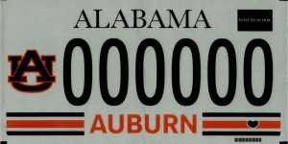
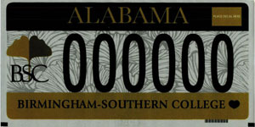
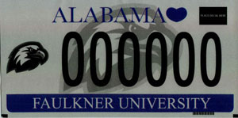
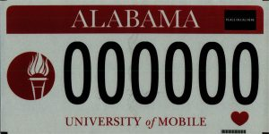
Tag Redesigns
Auburn University-1/1/2020
Birmingham Southern College-11/1/19
Faulkner University-11/1/19
University of Mobile-1/1/2020
Notes:
As Jay mentioned in the Legislative Updates this morning, there is a new EMS plate that began being issued 1/1/2020 and you saw a picture of it there.

Slide 72
Tag Designs Remaining The Same: 2020
AG Tag
Alabama Sons of Confederate Veteran
Breast Cancer Research
Huntingdon College
Save the Cahaba
University of Alabama

Slide 73
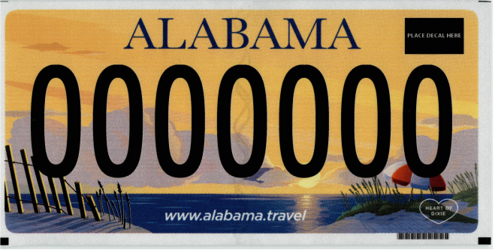
Standard License Plate
Issuance beginning 2022
Notes:
This design will be reflected on the disability access plate

Slide 74
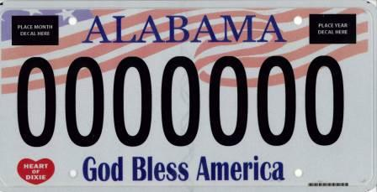
God Bless License Plate
Next redesign in 2023
Notes:
? Not sure if slide needed – I think we told them previously that senator chose to keep design – tell when next redesign due if include slide

Slide 75
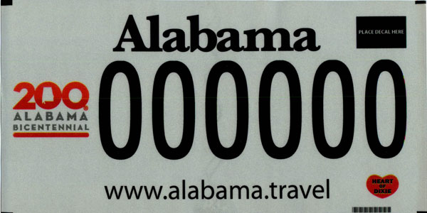
Bicentennial License Plate
Plate can be renewed through 12/31/2020

Slide 76
Alverify
Section 32-7A-17, Code of Ala. 1975
Administrative rule 810-5-8-.09 entitled Identification Documentation for Registration
Driver license validation for each registrant needed for:
  Initial registration (no renewals)
  Transferring registration
  ALTS title applications (optional)
Notes:
32-7A-17 – requires ID to be presented, if a registrant must provide ID, the administrative rule details other identifying documents you can take when person does not have a driver license.
ALVERIFY can be used to verify the legal name of vehicle owner related to title transactions, etc. as needed

Slide 77
AGO Opinion – Credit Card Fees
Authorized under Section 11-103-1 to withhold fees
Attorney General Opinion 2018-012:
  When a County Commission authorizes the use of credit cards to pay the additional annual registration fees required for distinctive plates (under Section 32-6-68) and elects not to impose a convenience fee, the county may not withhold a percentage of the cost of the fee charged by the credit card issuer from entities entitled to the proceeds from the payment.
Notes:
Jay suggests to provide the code section that allows counties to withhold fees

Slide 78
Address Verification
PROS (Verify address prior to shipping print on demand tags to registrants)
Titles
MLI
County offices

Slide 79
Administrative Rules
810-5-75-.31.02 – Abandoned MV Record Request
  Repealed rule
810-5-1-.485 – Implementation of DPPA (Records Rule)
  Repealed and replaced with updated language due to implementation of the records portal
810-5-1-.240 – Trailer License Plates
810-5-1-.211 – Penalty & Interest
  Recent ADOR Legal Opinion for penalty on trailers
  Assessed under 40-2-10, not 32-6-65
Notes:
Removed 810-5-1-.238 that Jay covers already
Is rule .485 referenced as the Records Rule now – see if slide needs updating

Slide 80
MLI Updates

Slide 81
Mandatory Liability Insurance
Tag must be surrendered to official when claiming stored/inoperable exemption
  Voluntarily Surrender prior to insurance lapse (Poster)
  Within 30 calendar days from receipt of MLI Verification Notice
  Use Form MV 32-7A-5 Request for Registration Revocation to surrender tag
County registration record must be updated to “revoked” and uploaded to DOR
Exempt response can only be claimed once per year per vehicle
Notes:
Rule 810-5-8-.06 being repealed and replaced labeled as MLI Reg. Suspension, Reinstatement and Revocation Procedures
Explain what to do if reg. doesn’t have tag to provide and our intentions to update the form and system (see Jay’s notes to see how/where to best address between the two slides)

Slide 82
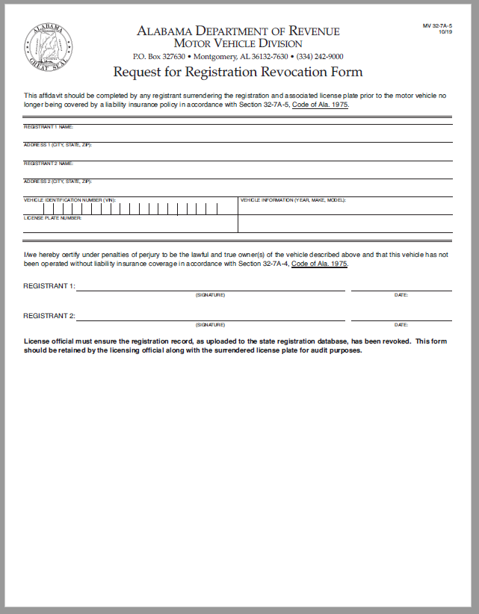
Notes:
Updating form for documents when tag not available to surrender. We will update the MLI manual as well

Slide 83
Mandatory Liability Insurance
Exempt response cannot be claimed if vehicle was involved in crash or citation (MLI system links)
  Vehicle cannot be operated on or after insurance verification date
Rule 810-5-8-.06 establishes “good cause” exceptions
  Use Form MV 32-7A-11 Mandatory Liability Insurance Affidavit
Good cause documentation and completed forms should be uploaded to MLI system
Revocation notice may be printed by licensing office from MLI system
Notes:
Explain they are looking to determine ability to claim the exempt response (ticket or crash) during the time period the registrant is claiming exemption – INCLUDING insurance verification date

Slide 84
MLI Exempt Situations
Exempt Responses: Correspondences dated prior to 12/18/19:
  Manually update the record to VR, and plate does not have to be surrendered.
Exempt Responses: Tag Not Available to Surrender
  Due to being stolen, transferred to another vehicle, left on sold vehicle, moved out of state, vehicle totaled, etc.
  Have Registrant Provide Documentation (bill of sale, police report, total loss payoff from insurer, etc.) and manually update record to VR.
  Form MV 32-7A-5 Request for Registration Revocation Form and system being updated to include documentation submitted instead of plate, when plate cannot be surrendered.
Notes:
See Jay’s note to inform them we will update the manual, system and document to address how to log responses as outlined here (manually update to VR and how to address under current law when tag not available)

Slide 85
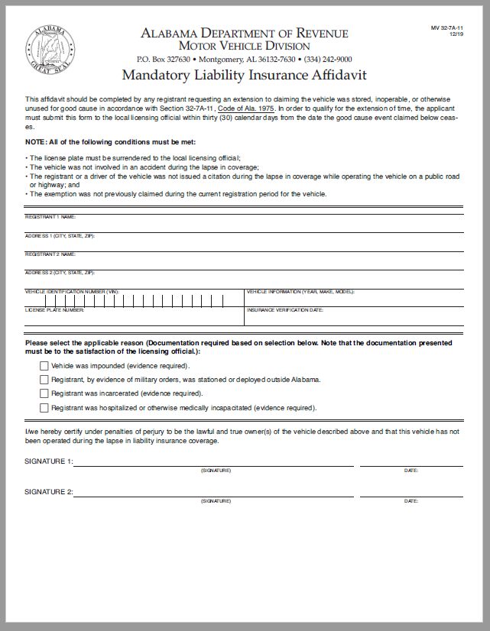
Notes:
These new and updated forms available from our website

Slide 86
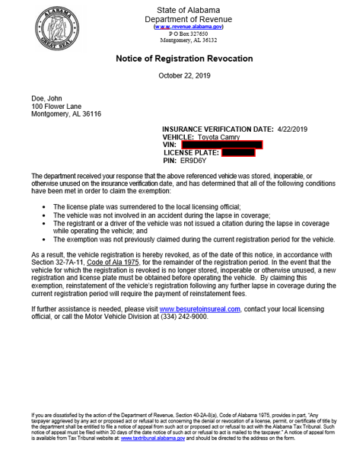

Slide 87
Mandatory Liability Insurance
Insurance Verification Notice (letter format)
  Mailed or emailed by DOR when MLI case is created
  Notifies vehicle owner that registration will be suspended in 30 days if not resolved.
  Replaces postcard questionnaires
    Old postcard responses still to be processed until phased out
Notes:
See Jay’s note – verifying if old postcard responses processed in accordance with old law (process)- you explained previously how to manually update records for prior to 12/18/19, so…

Slide 88
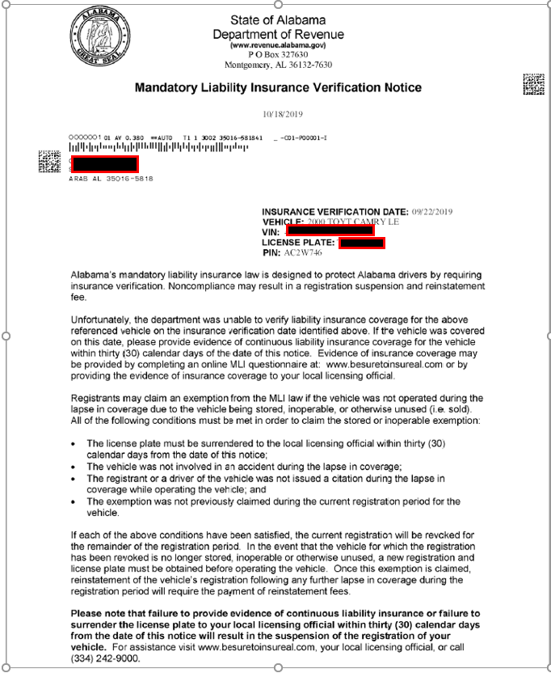

Slide 89
Mandatory Liability Insurance
Notice of Suspension
  Mailed and emailed by DOR if MLI case is not resolved within 30 days of date of notice
  Notifies vehicle owner that registration is suspended as of the date of the notice of suspension.
    Suspension is effective immediately
    Vehicle owner still has 30 days to appeal
Notes:
Jay asks to verify with Jack if the MLI suspension file includes only suspensions now and explain this to them

Slide 90
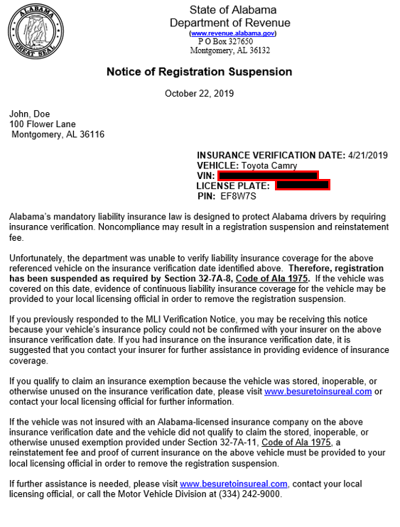

Slide 91
Mandatory Liability Insurance
Registrant Response System (www.besuretoinsureal.com) allows registrant to respond once:
Responses
  Yes (insurance confirmed) – updates to CL status
  Yes (insurance unconfirmed) – remains OP until due to suspend
  No (not insured)
    System instructs registrant to go to licensing official’s office to pay reinstatement fees
  No (exempt) – will suspend if tag not surrendered to licensing official timely
Notes:
Remind them that personnel with proper access (MLI Senior Users) have the ability to change a response after the fact but proper notation is required in the MLI system.

Slide 92

Mandatory Liability Insurance
Registrant Response System Yes Response-Insurance Confirmed.
Notes:
Staff will see same messages from the MLI system

Slide 93
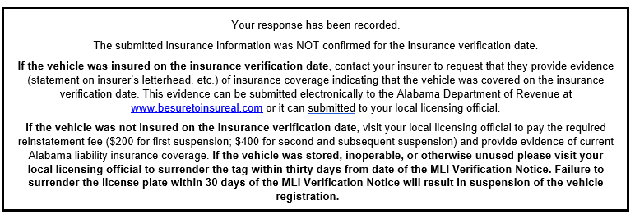
Mandatory Liability Insurance
Registrant Response System Yes Response-Insurance Unconfirmed.

Slide 94
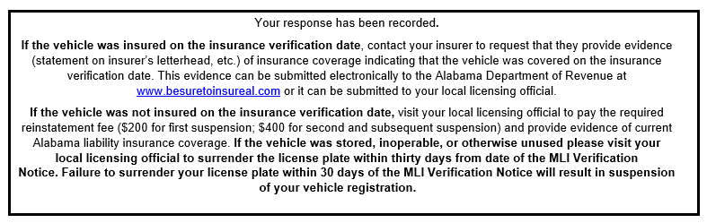
Mandatory Liability Insurance
Registrant Response System No Response

Slide 95
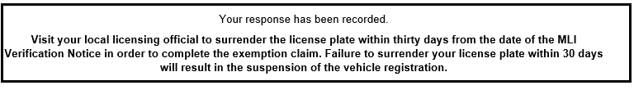
Mandatory Liability Insurance
Registrant Response System No (Exempt) Response

Slide 96
Mandatory Liability Insurance
Collecting Reinstatement Fees
  Only at a local licensing office (32-7A-12)
  Department, including Taxpayer Service Centers, can no longer accept payments
  Reinstatement notice may be printed by licensing office from MLI system

Slide 97
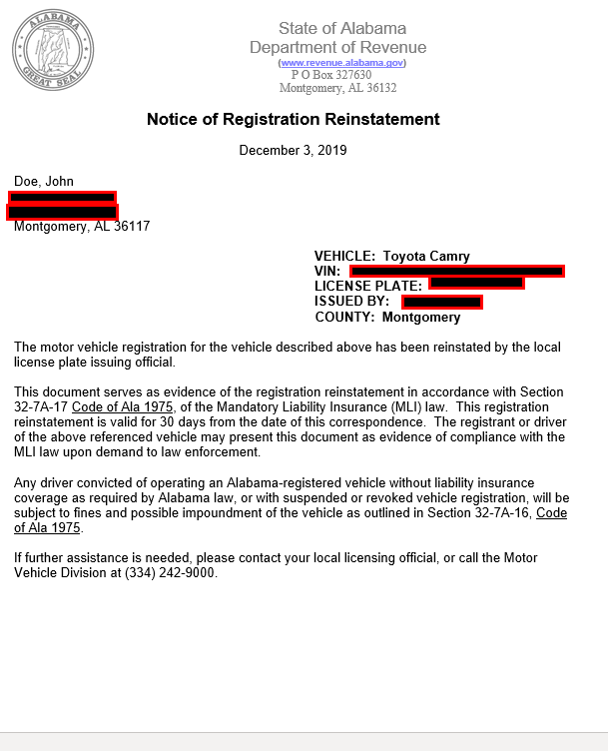

Slide 98
MLI System Updates
Updated MLI Manual
  MVTRIP/MLI Application Screen
  From within MLI Record
Elimination of Codes
  DS – same as open (OP)
  ID – same as open (OP)
  R3 – same as closed (CL)
Notes:
If asked what to do if still see record in below statuses: do we want them contacting us to determine how to update record?
DS= open unless response time expired
ID = depends on previous status, right? Stays open or reverts to suspended
Nothing to do with R3 code see, that basically equals closed record

Slide 99
Vehicles Exempt from OIVS
Vintage
IRP
Taxis
Notes:
Only exempting from OIVS reverification process not exempt from MLI law- must provide proof of insurance and verify to register
Give reminder that registration fees for RV and Farm vehicles can be prorated if vehicle requiring reregistration within same registration year

Slide 100
OIVS Statistics
Total OIVS Requests:
  2019 CY: 62 Million
  2018 CY: 62 Million
Total Correspondence Sent:
  2019 CY: 847,111 (Questionnaires and NOS)
  2018 CY: 818,525 (Questionnaires and NOS)
Total Reinstatement Fees Collected:
  2019 FY: 5.7 Million
  2018 FY: 8.1 Million
Notes:
Jay has note on explaining why reg fees collected lower based on the number of VRs – may need to verify with him if we want to wait to get asked before going into details on why lower

Slide 101
NAIC Information
NAICs Writing Alabama Personal Policies (OIVS): 193
NAICs Writing Alabama Commercial Policies (not OIVS): 3,121
NAICs Exempt from OIVS (less than 500 policies)(manually verified): 14
Lists provided on MVD Advisory Council Page
Notes:
Reminder on commercial policies that they are viewing the insurance document when registering but vehicles insured under commercial policies are not subject to OIVS. They might ask about a personal automobile – question goes back to how is it covered under their insurance policy – if commercial, then mark policy type to reflect that (not subject to OIVS)
Explain how the 14 insurance companies not subject to OIVS but writing personal auto lines must login to verify insurance policy information provided by registrants

Slide 102
MLI Administrative Rules
Updating all MLI rules from recent law changes
  Amended
    810-5-8-.01 – Certificate of MV Liability Bond, Cert. of Cash Bond and Satisfaction of Judgements
    810-5-8-.07
  Repeal and Replace
    810-5-8-.06 New Rule entitled – MLI Registration Suspension, Reinstatement, and Revocation Procedures
  Repeals – language in law or other rules
    810-5-8-.02
    810-5-8-.03
    810-5-8-.04
    810-5-8-.05
    810-5-8-.08
    810-5-8-.10
Notes:
Rule hearing held Dec. 10th
David picks up on next screen

