Slide 1
AATA Licensing Officials Conference
December 4, 2025

Slide 2
MVD Org Structure
MVD Admin
  David Baxley, Director
Registration Admin
  • Troy Thigpen, Section Manager
  Trishawn Bell, Registration Manager
  • Amanda Fleming, Registration/Warehouse Supervisor

Slide 3
MVD Org Structure
Dealer License/Compliance Section
  • Leslie Mackey, Section Manager
  Alicia Hart, Dealer License/Compliance Manager
Title Section
  Lisa Blankenship, Section Manager
  Allyson Ward, Title Supervisor

Slide 4
Contact Us
Admin Phone Line
  334-242-9008
  Admin line is used for immediate needs only
All emails are first name.last name@revenue.alabama.gov
  i.e. david.baxley@revenue.alabama.gov
  Note: Troy Thigpen email is termaine.thigpen@alabama.gov

Slide 5

Contact Us
Financial Related issues should be directed to ticketing
  Title Work Summary/Remittance
  MLI Reinstatements
  Other financial related issues

Slide 6
Contact Us – What’s Coming?
Beginning soon we will implement voice access assistance
Help keep phone lines clear for more detailed questions
AI Chatbot

Slide 7

Act 2024-346
Replaces the International Disability Access Symbol with the Dynamic Disability Access Symbol
Impacts to placards/decals
Effective: January 1, 2026

Slide 8
Act 2024-190
Defines and requires titling of off-road vehicles, as well as adding licensing requirements of dealers of off-road vehicles
Beginning January 1, 2026 for every off-road vehicle with a year model of 2026 and beyond
  Exempt if more than 10 model years old
Effective: October 1, 2024*

Slide 9
Definition of Off-Road Vehicle
Motorized vehicle 60 inches or less in width, weight of 1,500 pounds or less, 3 or more non-highway tires, single operator or not more than one passenger
Motorized vehicle 80 inches or less in width, weight of 3,500 pounds or less, 4 or more non-highway tires, operator and number of passengers as provided by manufacturer

Slide 10
Exceptions
Electric bicycles
Golf carts
LSVs
Mini-trucks
Vehicles used for military, fire, emergency, or law enforcement purposes
Vehicles used exclusively on airport property
Vehicles used primarily for agricultural purposes
Self-propelled lawnmowers
Snowblowers
Garden or lawn tractors

Slide 11
Requests to Void Tile Applications
Requests to Void (attached email with example and screenshots)
  Instance: Title App is in Pending Docs stage and the LO requests to void the app by either calling MVD or emailing management
  How to handle:
    The LO Manager can reverse the source service transaction if they need to withdraw a title review case in the Pending Documents stage.
    To do this, the Manager can generate the Title Work Summary Report they have access to in the Licensing Official manager, which contains the transaction ID and link to the transaction for every application they submit. When they select the appropriate transaction, they can then reverse their transaction which would withdraw the app.

Slide 12
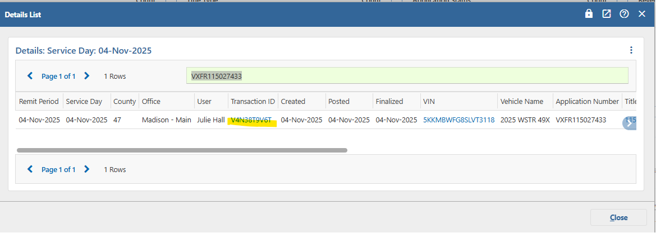
Requests to Void Title Applications

Slide 13
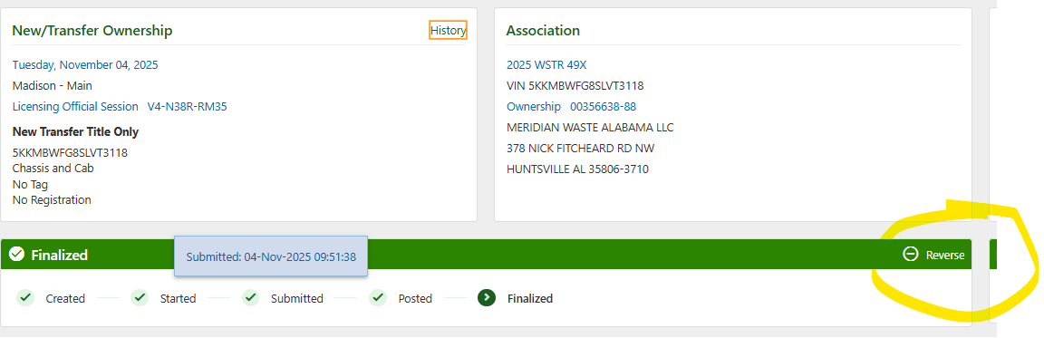
Requests to Void Title Applications

Slide 14
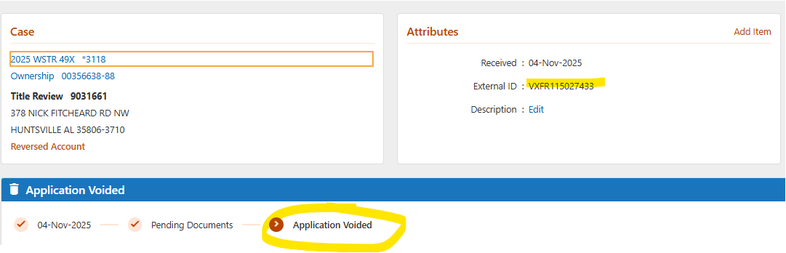
Requests to Void Title Applications

Slide 15
Lien Release vs Replacement
Lien Release (Free) vs Replacement
  Lien Management features the lien release action which will not charge for a lien release
    Use this when you HAVE the current AL title
  Replacement Apps allow for lien release but will charge the replacement fee
    DO NOT use this when you HAVE the current AL title with the lien released

Slide 16
POD Registration Decals
Yellow Decals
1st order of yellow decals will be auto shipped during December
If you have any overstock of red decals, please notify the MVD

Slide 17
Peeling License Plates
Please continue to notify the MVD if you have any peeling license plates
Believe the problem was related to material used in 2020/2021

Slide 18
License Plates
Production of new God Bless America plates on hold until December due to material shortage at Alabama Correctional Industries
Update! Material has arrived and orders are being filled

Slide 19
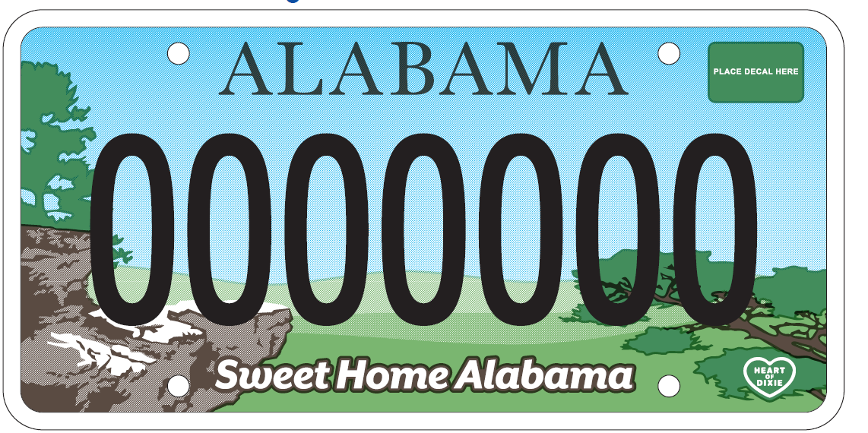
2027 Standard License Plate

Slide 20
Reissued and Redesigned Plates – Memo 2025-006
Prince Hall Grand Lodge
Alabama State University
Athens State University
Jacksonville State University

Slide 21
Reissued and Redesigned Plates – Memo 2025-006
Oakwood University
University of Alabama at Birmingham
University of Alabama at Huntsville
Lurleen B Wallace Community College
National Wild Turkey Federation

Slide 22
Federal Heavy Vehicle Use Tax
Rule 810-5-1-.233 provides the following evidence may be submitted:
  IRS stamped schedule 1 form 2290
  Schedule 1 with eFile watermark
  Schedule 1 and one of the following:
    Photocopy of both sides of cancelled check
    Bank statement indicating amount of tax paid
    Electronic acknowledgment of payment
    IRS printout of the taxpayer’s account showing the amount of tax paid

Slide 23

Questions

