Slide 1

Alabama Department of Revenue Income Tax Administration
Division

Slide 2
Alabama Department of Revenue Income Tax Administration Division
2025 CPE Training
Lynn Schoener, CPA, FAS II
(334) 353-8045
lynn.schoener@revenue.alabama.gov
Andrea Wyatt, Revenue Examiner III
(334) 353-9447
andrea.wyatt@revenue.alabama.gov

Slide 3
What’s New in I.D. Theft Prevention
Alabama will continue with the ID Confirmation Quiz letter mailed to taxpayers as done in previous years.
If you have received a notice asking you to complete an ID Confirmation Quiz, you’re in the right place. This 5-minute ID Confirmation Quiz is part of an effort designed to protect your identity and your tax refund. Once you have completed the quiz and your identity has been confirmed, we will continue processing your tax return.

Slide 4
ID Confirmation Quiz
Before You Take the Quiz:
The quiz is based on information associated with the name first listed on the letter you received regarding this quiz. This person is considered the primary taxpayer related to the tax return filed.
You will need
Social Security Number (SSN) or Individual Taxpayer Identification Number (ITIN) of the primary taxpayer
Letter ID number from the top right corner of your letter
Current email address
Just 4 Easy Steps:
Read the instructions on this website.
Enter the Letter ID from the top right corner of your letter. Enter the last four digits of your SSN/ITIN and your date of birth. Select that you’re READY TO BEGIN THE QUIZ and click NEXT.
Answer the questions. Select that you’re READY TO SCORE YOUR QUIZ and click SUBMIT.
Enter your EMAIL ADDRESS to be notified of your results and click YES.
At the end of the quiz, you will see a confirmation screen.

Slide 5

ID Confirmation Quiz
YouTube Video available for additional instructions.

Slide 6

What’s New from the 2025 Regular Session of the Alabama Legislature?

Slide 7
Alabama’s Legislature
Legislators are concerned how their constituents feel on certain issues. Without contacting them to voice your support or disapproval concerning legislation they won’t know.
Below is the mailing address and phone numbers for your legislators:
Mailing Address for your legislator: [Name of your Legislator], Alabama State House, Montgomery, AL 36130
Phone number for the House: (334) 242-7600 / Phone number for the Senate: (334) 242-7800
Legislative website: http://www.legislature.state.al.us
Look-up your legislator: https://www.sos.alabama.gov/alabama-votes/elected-official-map

Slide 8
Prior year legislation effective for the 2025 return.
Act 2024-113 - PTE Due Date Extension
Act 2024-170 - Military Income Exemption
Act 2024-297 - Sound Money Tax Neutrality Act
Act 2024-302 - Alabama Workforce Housing Tax Credit Act
Act 2024-303 - Employer and Facility Childcare Tax Credits

Slide 9
Act 2024-113 (HB 187) PTE Due Date Extension
Act 2024-113 amends the Alabama Electing Pass-Through Entity Act passed under Act 2021-1.
The Alabama Electing Pass-Through Entity Tax Act provides that for tax years beginning on or after January 1, 2021, any Alabama S-Corporation or Subchapter K entity may elect to be taxed as an Electing Pass-Through Entity. Act 2024-113 makes the following changes to the original Act.
For tax years beginning on or after January 1, 2021, through December 31, 2023, an electing pass-through entity shall submit the appropriate form to the Department of Revenue at any time during the tax year or on or before the fifteenth day of the third month following the close of that tax year for which the entity elects to be taxed as an electing pass-through entity.
For tax years beginning on or after January 1, 2024, an electing pass-through entity shall submit the appropriate form to the Department of Revenue on or before the due date for filing the applicable income tax return, including any extensions which have been granted following the close of that tax year for which the entity elects to be taxed as an electing pass-through entity.
For tax years beginning on or after January 1, 2025, the election or revocation shall be made on the timely filed return. including any extensions which have been granted.

Slide 10
Act 2024-170 (SB 209) Military Income Exemption
Act 2024-170 amends code section 40-18-13 to expand the exemption for compensation to members of the National Guard and Reserve. The current combat pay exemption is expanded to include:
income when deployed to locations outside of the United States
or when activated by the Governor of Alabama or the President of the United
States in response to emergencies within or outside of the United States.
Effective January 01, 2025.

Slide 11
Act 2024-447 (SB 297) Sound Money Tax Neutrality Act
Act 2024-447 amends code section 40-18-14 to exclude any net capital gains derived from the exchange of precious metal bullion from state income taxes.
Precious metal bullion is described as coins, bars, or rounds containing primarily refined gold, silver, platinum, or palladium that is marked and valued primarily by its weight, purity, and content.
Effective beginning with the 2025 tax year.

Slide 12
Act 2024-302 (HB 346) Alabama Workforce Housing Tax Credit Act
Act 2024-302 establishes the Alabama Workforce Housing Tax Credit Act which allows for the issuance of income tax credits to developers who build affordable multi-family rental housing in areas where there is a shortage of low-income housing.
The Alabama Housing Finance Authority is charged with administering the provisions of the Act.
The legislation gives the Alabama Housing Finance Authority discretion to award this credit to any project that applies to the Authority and is currently receiving a federal low-income housing credit under 26 USC Section 42.
The Authority shall issue an eligibility certificate to the owner (s) of the qualified project reflecting the tax credit awarded and the eligible credit period. A copy shall also be provided to the Alabama Department of Revenue.
The Alabama Workforce Housing Tax Credit may be claimed for 10 years against the tax liability of the project owner(s). A tax credit not used in a taxable year may be carried forward for the succeeding 5 years but is non-refundable or transferable.
Credit may be applied against taxes due under chapters 16 and 18 of the Code of Alabama 1975, but only the state portion if used to offset the financial institution excise tax.

Slide 13
Act 2024-302 (HB 346) Alabama Workforce Housing Tax Credit Act
The credit amount awarded annually by the authority shall not exceed $5 million dollars for each year of the designated 10-year credit period.
An annual credit awarded to any one qualified project shall not exceed $2 million dollars.
The tax credit may be allocated by pass-through entities to some or all of its partners, members, or shareholders, including any not-for-profit entity that is a partner, member, or shareholder in any manner agreed to by such persons, regardless of whether the person is allocated or allowed any portion of any federal low-income housing tax credit with respect to the qualified project.
20% to 25% of the annual cap will be awarded to rural properties, with the remainder awarded to qualified projects without geographic limitation.
The credit will be effective January 1, 2025.
The final date to apply for a low-income housing tax credit is September 30, 2027.

Slide 14
Act 2024-303 (HB 358) Employer and Facility Childcare Tax Credits
Act 2024-303 provides for an employer provided childcare tax credit, a childcare facility tax credit, and a nonprofit childcare provider grant.
The income tax credit for employers and facilities that provide childcare assistance for eligible employees was engineered to help employees reenter the workforce through access to affordable high-quality childcare while increasing workforce participation throughout the state.
ADOR is charged with administering the tax credits. The tax credits may be applied against chapter 16 or 18 taxes, chapter 21 utility gross receipts, or Title 27 Insurance Premiums Tax. The Department of Human Resources is responsible for administering the nonprofit childcare provider grants.
An employer providing childcare, or a childcare facility may make application to the Department of Revenue for a tax credit. The application period for the tax credits begin on or after January 1, 2025, and end on December 31, 2027, unless extended by an act of the legislature.
Employer tax credits and facility tax credits are awarded in the order of application receipt.
Employer tax credits cannot be awarded to employers who cannot prove they prioritize EIC recipient employees.

Slide 15
Act 2024-303 (HB 358) Employer and Facility Childcare Tax Credits
25% of the credits awarded shall be to both small employers in a rural targeted areas and childcare facilities in rural targeted areas. A rural area is described in Alabama code Section 40-18-376.1(a)(2).
The annual cap for the total employer provided childcare tax credit is $15 million and shall be increased $2.5 million dollars each year for the following years 2026 and 2027. The maximum tax credit for a qualifying employer is $600,000.
The annual cap for the total childcare facility tax credit is $5 million. The maximum tax credit for a qualifying childcare facility tax credit is $25,000.
The employer provided childcare tax credit shall equal 75 percent of eligible expenses as defined in the act. In the case of a small employer with fewer than 25 employees the amount of the credit shall equal 100 percent of eligible expenses.
Employees earning more than $80K per annum are not employees for the purposes of this act.

Slide 16
Act 2024-303 (HB 358) Employer and Facility Childcare Tax Credits
Employer tax credit is for employers who support their employees’ childcare needs by offering financial assistance for childcare expenses (this can be direct payment to the childcare facility on behalf of the employee or a reimbursement of qualifying childcare expenses to the employee) or establishing and/or operating childcare facilities for their employees with children five years old or younger. For employers who operate a childcare facility, the eligible expenses include construction, renovation, expansion, or repair of a childcare facility, or for the maintenance and operation of such facility. The credit is non-refundable and cannot be carried forward.
Facility tax credit is for childcare providers who own and operate a qualified childcare facility licensed by the Alabama Department of Human Resources and participate in the Quality Rating and Improvement System and Child Care Subsidy Program. The credit is refundable. The facility credit is based on the average monthly number of eligible children enrolled and the facility’s quality rating under the Alabama Quality STARS program: A five-star rating = $2,000 per child. A four-star rating = $1,750 per child. A three-star rating = $1,500 per child. A two-star rating = $1,250 per child. A one-star rating = $1,000 per child.
In cases where a childcare provider (#2 above) also meets the criteria for an employer credit(#1), they shall receive a refund on their state income tax return if the credit exceeds their tax liability.

Slide 17
Act 2024-303 (HB 358) Employer and Facility Childcare Tax Credits
ADOR is charged with the following before awarding an employer tax credit:
1. Provide a standardized certificate to be signed by the employer verifying all expenses
incurred were eligible expenses as defined in the Act. 2. Provide documentation to verify the eligible expenses. 3. Provide pro-rata share of ownership for pass-throughs. ADOR is charged with the following before awarding a facility childcare tax credit: 1. Provide a standardized certificate to be signed by the childcare facility verifying all
expenses incurred were eligible expenses i.e. rating score, number average number of
children, ownership proof. 2. Provide documentation to verify the eligible expenses. 3. Provide pro-rata share of ownership for pass-throughs.

Slide 18
Act 2024-303 (HB 358) Employer and Facility Childcare Tax Credits
New Rules for use in administering Act 2024-303:
810-3-135-.05
Employer Tax Credit – General Guidelines
810-3-135-.06
Facility Tax Credit – General Guidelines

Slide 19
What’s New from the 2025 Regular Session of the Alabama Legislature?
To view any legislation passed by the Alabama Legislature, please visit the website for the Alabama Secretary of State at www.sos.alabama.gov .
Point to the “Records” tab at the top of the page with your mouse and select “Legislative Acts”.
Select whether you want to search by the Act Number or the Bill Number.
Enter either the Act Number or Bill Number and select view image to see a PDF version of the Act.

Slide 20
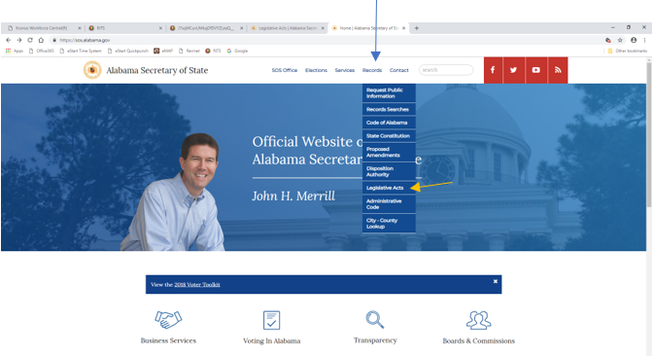
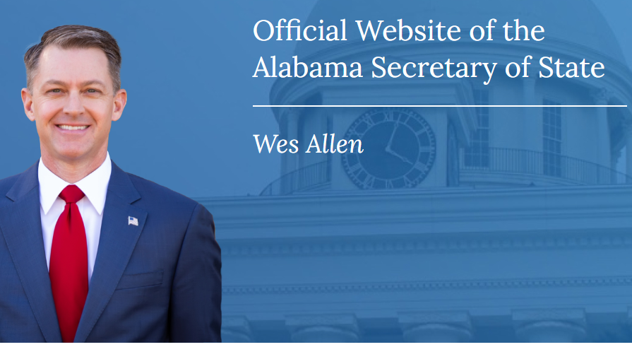
What’s New from the 2025 Regular Session of the Alabama Legislature?

Slide 21
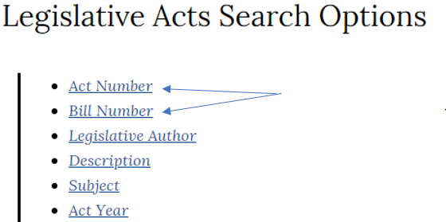
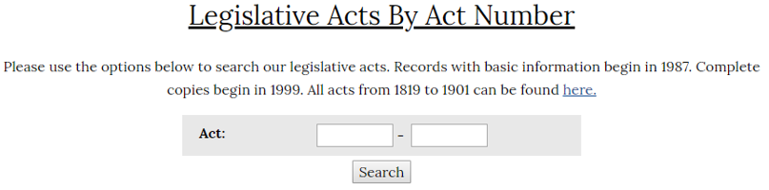
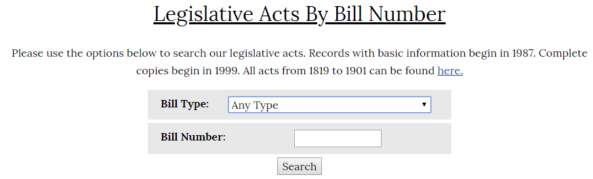
What’s New from the 2025 Regular Session of the Alabama Legislature?

Slide 22
Act 2025-119 (SB 86) The Portable Benefits Act
Act 2025-119 establishes the “Portable Benefits Act” (PBA).
The PBA allows the creation of portable benefit accounts for independent contractors for use in funding their health care plans, life insurance plans, retirement plans, etc.
Hiring parties can deduct as a business expense 100% of any contributions made on behalf of the independent contractor to their PBA.
Independent contractors may deduct as an adjustment to income on their individual income tax contributions they made to their PBA as well as 100% of contributions made on their behalf to their PBA by a hiring party.
Primarily used in the “gig economy”.
Effective for tax year 2026.

Slide 23
Act 2025-123 (SB 130) The Alabama Legal Tender Act
2024’s Act 2024-447 removed barriers in using gold and silver as money rather than commodities. Prior to doing so, the primary use of precious metals was investing rather than as legal tender. Removing the gains tax on the exchange treats the metals more as money than a commodity. This Act removed the inherit penalty for exchanging items of value.
Act 2025-123 continues this grass roots movement by proposing to recognize these precious metals as legal tender. In doing so, precious metals can be used as currency as an alternative to federal reserve notes.
Effective October 01, 2025.

Slide 24
Act 2025-334 (HB 379) Nonresident Remote Workers (Withholding Tax)
Act 2025-334 adds new Section 40-18-2.2 to the Code of Alabama 1975 to exempt Alabama income from taxation for certain nonresident individuals if all of the following conditions apply:
The individual's employment duties in Alabama were 30 or fewer days during the calendar year.
The individual worked in more than one state during the calendar year.
The individual is not a high-profile public figure, professional athlete or entertainer.
The individual’s state has a similar exclusion, does not have an income
tax, or the income is exempt for federal purposes.
Employers are not required to withhold tax if the nonresident employee meets the above stated conditions.
Effective beginning January 01, 2026.

Slide 25
Act 2025-343 (HB 505) Taxpayers’ Bill of Rights
Act 2025-343 amends Section 40-2A-7, Code of Alabama 1975 to lengthen the time a taxpayer may appeal from a Final assessment from 30 days to 60 days.
Amendment will become effective October 01, 2025.

Slide 26
Act 2025-400 (HB 163) Tax Cuts and Jobs Act (TCJA)
Effective immediately for tax years beginning on or after January 1, 2024, research and experimental expenditures for Alabama tax purposes under Chapter 16 and Chapter 18 of Title 40, Code of Alabama 1975, shall not follow the provisions of 26 U.S.C § 174, as amended by the Tax Cuts and Jobs Act (TCJA), P.L. 115-97.
Taxpayers shall now have the option to currently deduct research and experimental expenditures or treat the expenditures as deferred expenses in the same manner as provided in 26 U.S.C § 174 prior to tax year 2022.

Slide 27
Act 2025-402 (HB 52) Alabama Achieving a Better Life Experience
Act 2025-402 amends Code Section 40-18-15.8 to extend the Alabama Able Savings Account deduction until December 31, 2030.
Deduction was previously set to expire December 31, 2025.
Effective immediately.

Slide 28
Act 2025-404 (HB 86) Rural Hospital Investment Act of 2025
Act 2025-404 establishes the Rural Hospital Investment Act of 2025. The Act is designed to generate funds for rural hospitals and strengthen their financial stability by offering income tax credits in exchange for monetary donations to qualifying rural hospitals.
Effective for tax years beginning January 01, 2026 through December 31, 2028.
Applicable taxes to offset include income, financial institution excise tax, insurance premium tax, and utility tax.
Each December the Rural Hospital Investment Act Program Board will provide a list of eligible rural hospitals approved to receive monetary donations to ADOR’s website.
An eligible rural hospital shall report all donations received to ADOR within 30 days of receiving the donation.

Slide 29
Act 2025-404 (HB 86) Rural Hospital Investment Act of 2025
Eligible taxpayers may claim a credit to offset qualified donations for the tax year as follows:
A single, head of household, or married filing separate filer may claim 100 percent of their donation up to $15,000.00.
A married filing jointly filer may claim 100 percent of their donation up to $30,000.00.
A corporation shall be entitled to 100 percent of their donation or 75 percent of their liability, whichever is less, up to $500,000.
An electing pass-through entity may claim 100 percent of their donation up to $450,000.
Owners of non-electing pass-through entities may claim 100 percent of their donation on a pro rata basis according to their percentage of ownership not to exceed the above limitations.

Slide 30
Act 2025-404 (HB 86) Rural Hospital Investment Act of 2025
Unused credits may be carried forward for up to three years but may not be transferred or refunded.
Total donations are capped at $20 million for tax year 2026, $25 million for tax year 2027, and $30 million for tax year 2028.
Individual rural hospitals may not receive more than $750,000 in total donations for the tax year 2026, $1,000,000 for the tax year 2027, and $1,250,000 for tax year 2028.

Slide 31
One Big Beautiful Bill Act New Vehicle Loan Interest Deduction
Section 40-18-15 allows a deduction for vehicle loan interest paid on new qualified personal use vehicles effective for tax years 2025 through 2028 meeting certain requirements. Lease payments will not qualify.
The tax deduction phases out for single taxpayers with modified adjusted gross income which exceeds $100,000 (or $200,000 for married taxpayers filing jointly).
Final assembly of the automobile must have been completed in the United States.
The interest must be paid on a loan that originated after December 31, 2024, was used to purchase a vehicle originally used by the taxpayer and secured by a lien on the vehicle.

Slide 32
Beginning with the 2019 tax returns, certain tax credits are now required to be pre-approved through My Alabama Taxes (MAT) at www.myalabamataxes.alabama.gov
Please see the instructions in the tax guide or the instructions for a particular schedule or form being used for more information.

Slide 33
For more information on Income Tax Credits, Abatements, and other Incentives available please visit the Office of Economic Development located on the Department’s website at
https://revenue.alabama.gov/tax-incentives/

Slide 34

Electronic Filing Information

Slide 35

My Alabama Taxes
ADOR continues to offer a FREE electronic filing option to individual Alabama taxpayers filing a state tax return.
No income limitations or other qualifications must be met to take advantage of this free online filing system.
Go to www.myalabamataxes.alabama.gov to sign up and efile.
No registration required for the new simplified short form 40EZ beginning with the 2018 filing season.

Slide 36
Electronically Filed Returns
Tax Year 2024 Individual Income Tax Returns
E-filed as of December 03, 2025
1,957,123 returns have been filed electronically
65% of returns filed have been refund returns

Slide 37
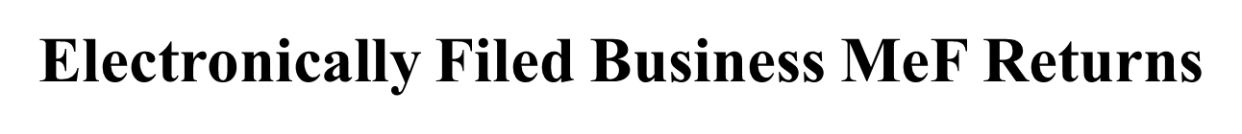
*Information from January 1, 2025 – December 03, 2025
Form Type | Total Returns Received* | % e-filed
20C-Corporate | 49,804 | 74%
20CC-Consolidated Corporate | 200 | 79%
BPT, CPT, PPT Privilege Tax | 78,007 | 64%
EPT-Electing Pass Through | 12,342 | 89%
20S-Sub Chapter S Corporation | 77,552 | 95%
65-Partnership | 82,589 | 94%
PTEC-Pass Through Entity Composite | 24,681 | 86%
41-Estates and Trust | 29,442 | 91%

Slide 38
Modernized Electronic Filing (MeF) Contacts
Tavares Mathews – Individual MeF (40 and 40NR) tavares.mathews@revenue.alabama.go
334-353-9497
Demetria Gordon – Business MeF (20C, 20CC , CPT and PPT) demetria.gordon@revenue.alabama.gov
334-353-9129 Tymecca Pearson– Business MeF (20S, 65, PTEC and 41 ) tymecca.pearson@revenue.alabama.gov
334-353-0685 Veronica Jennings – Mef Development and Web Service, Manager veronica.jennings@revenue.alabama.gov
334-353-9440

Slide 39
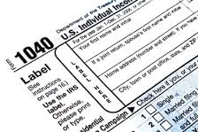
Forms

Slide 40

Mailed Forms
The Department will provide income tax booklets (40/40NR) to Libraries and TPSC’s this year.
Taxpayers can download and print all tax forms from our website.
Taxpayers can mail order all tax forms from our website.

Slide 41
Unchanged Forms for 2025
Unchanged Forms (other than year/date edits):
Corporate Income Tax:
Form 20C-CRE
Schedule B-1
Schedule KRCC-B
Schedule AB
Form 20C-C
Financial Institution Excise Tax:
Schedule KRCC-B
Schedule B-1
Schedule CP-B
Schedule ET-C
Schedule PCL
Pass-Through and Fiduciary Forms:
NRA
NMC
PTE-R/NRA-R
NRC-Exempt
QIP-C
EST-1
Schedule CP-B
Business Privilege Tax:
Form BPT- IN
Form BPT
Form CPT
Form PPT

Slide 42
Individual Income Tax Form Changes for 2025
Individual Income Tax changes:
Removed Donation Check-Oﬀs - Alabama State Veterans Cemetery at Spanish Fort
Foundation, Incorporated.
Removed Apprenticeship Tax Credit from Schedule OC.
Act 2024-302 and Section 40-18-533(Alabama Workforce Housing Tax Credit) provide a
workforce housing project tax credit to cover the construction, rehabilitation, or both, of
multifamily housing units located in Alabama for tax years beginning on or after January 1,
2025. (Schedule OC, Section B, Part Z).
Act 2024-303 and Section 40-18-542(Employer Tax Credit) provide a tax incentive to Alabama employers who support their employees’ childcare needs by offering financial assistance for the provision of childcare or for employers who incur eligible expenses for the operation, maintenance, and/or updates of a qualified childcare facility for tax years beginning on or after January 1, 2025. (Schedule OC, Section B, Part AA).

Slide 43
Individual Income Tax Form Changes for 2025
Individual Income Tax changes:
Act 2024-303 and Section 40-18-543(Childcare Facility Tax Credit) provide a tax incentive for
Alabama childcare providers who own and operate a qualified childcare facility. (Schedule OC,
Section B, Part AB).
The Employer Provider Credit is the Employer tax credit for qualifying childcare providers. Only
those childcare providers who meet the eligibility criteria for the employer tax credit are eligible
to receive a refund if their credit amount exceeds their tax liability. (Schedule OC, Section B, Part
AC).
Income Tax Capital Credit moved to Schedule OC, Section B, Part AD.
Schedule OC, Section C can only be submitted and/or printed via landscape.
Schedule OC, Section F have two new refundable credits (Childcare Facility Tax Credit and
Employer Provider Credit).
The Alabama Accountability Tax Credit annual cost of attendance when up to $5,198.00.
There were grammar and year changes for all Forms/Schedules.

Slide 44
Corporate Income Tax Form Changes for 2025
Corporate Tax changes:
New Form 8948AL-C-Corporate Preparer Explanation for Not Filing Electronically
Form 20C
Page 1, 2, 3, 4, and 5, Headers, Year updates.
Page 1, Line 20F - Updated text information in the parenthesis (Section F, line F3 to F5).
Page 4, Other Information, Line 6-Year updates made.
Schedule FTI
Line 3 removed.
Caused lines 4, 5 and 6 to be renumbered.
Schedule OZ
Line 4 – the line instructions updated to show correct line from Schedule FTI.

Slide 45
Corporate Income Tax Form Changes for 2025
Corporate Tax changes:
Schedule BC
2025 Schedule BC, Page 1, Section B, Part D, Lines D1, D2 and D4 – Year updates.
Removed old Schedule BC, Section B, Part N – Apprenticeship Credit.
Renumbered Schedule BC, Section B, Part O to N - Alabama Historic Rehabilitation Tax Credit.
Renumbered Schedule BC, Section B, Part P to O - Railroad Modernization.
Renumbered Schedule BC, Section B, Part Q to P - Innovate Alabama Tax Credit.
Added New Credit Alabama Workforce Housing Tax Credit to Schedule BC, Section B, Part Q.
Added New Credit Employer Tax Credit to Schedule BC, Section B, Part R.
Added New Credit Childcare Facility Tax Credit to Schedule BC, Section B, Part S.
Added New Credit Employer Provider Credit to Schedule BC, Section B, Part T.

Slide 46
Corporate Income Tax Form Changes for 2025
Corporate Tax changes:
Schedule BC continued
Renumbered Schedule BC, Section B, Part R to U - Income Tax Capital Credit.
2025 Schedule BC Page 6, Column 8 Part A Alabama Enterprise Zone - Credit Carryforward.
Unshaded Schedule BC, Section C, Part A, Column 8 - Alabama Enterprise Zone - Credit Carryforward.
Removed old Schedule BC, Section C, Part N – Apprenticeship Credit.
Renumbered Schedule BC, Section C, Part O to N - Alabama Historic Rehabilitation Tax Credit.
Renumbered Schedule BC, Section C, Part P to O - Railroad Modernization.
Renumbered Schedule BC, Section C, Part Q to P - Innovate Alabama Tax Credit.

Slide 47
Corporate Income Tax Form Changes for 2025
Corporate Tax changes:
Schedule BC continued
Added New Credit Alabama Workforce Housing Tax Credit to Schedule BC, Section C, Part Q.
Added New Credit Employer Tax Credit to Schedule BC, Section C, Part R.
Added New Credit Childcare Facility Tax Credit to Schedule BC, Section C, Part S.
Added New Credit Employer Provider Credit to Schedule BC, Section C, Part T.
Renumbered Schedule BC, Section C, Part R to U - Income Tax Capital Credit.
Updated Schedule BC, Page 7, Section D, Instructions.
Added new refundable Childcare Facility Tax Credit on Schedule BC, Page 7 Section F, Line F3.
Added new refundable Employer Provider Credit on 2025 Schedule BC, Page 7 Section F, Line F4.
2025 Schedule BC, Page 7 Section F, Line F3 to Line F5.

Slide 48
Fiduciary Tax Form Changes for 2025
Fiduciary Tax changes:
New Form 8948AL-FDT-Fiduciary Preparer Explanation for Not Filing Electronically
Form 41
Page 1, New lines 8j & 8k.
Removed 3 lines from the bottom of page.
Schedule K-1 Form 41
New lines 16d & 16e.

Slide 49
Fiduciary Tax Form Changes for 2025
Fiduciary Tax changes:
Schedule G Form 41
Keying dots on schedule have moved.
New lines 24d & 24e.
Schedule FC
Some keying dots on schedule have moved.
Page 3-Removed Apprenticeship Tax Credit.
Page 4-New Credits (4), Part Q-Part T.
Page 6-Section C, New Part Q-Part T.
Section D, Line 1-updated text info online.
Page 7-Section G, New lines 3 & 4.

Slide 50
Financial Institution Excise Tax Form Changes for 2025
Financial Institution Excise Tax changes:
Schedule ET-1
Line 17, updated wording.
Line 19f, new line.
Line 19g, updated.
Line 21, numbering updated.
Page 5, Other information, Line 5, year updated.
Page 6, Section G, Heading updated.
Page 6, Section H, New.

Slide 51
Financial Institution Excise Tax Form Changes for 2025
Financial Institution Excise Tax changes:
Schedule EC
Page 1, Part B, Line B1, year updated.
Page 1, Part B, Line B2, year updated.
Page 1, Part B, Line B4, year updated.
Page 2 & 3, Part F, Updated.
Page 3, Part G, Updated.
Page 3, Part H, New.
Page 4, Part I, New.
Page 4, Part J, New.
Page 4, Part K, New.
Page 4, Part L, Updated.
Page 5, Section E, Added new lines.
Page 6 has been added.

Slide 52
Financial Institution Excise Tax Form Changes for 2025
Financial Institution Excise Tax changes:
Schedule FTI
Line 3 removed.
Caused lines 4, 5 and 6 to be renumbered.
Form 2220E
Page 1, Part 2, Line 2, year updated.
Page 2, line numbers, odd, 23 – 37, year updated.
Page 4, Schedule B, lines 1a-c, line 2, lines 3a-c, year updated.

Slide 53
Financial Institution Excise Tax Form Changes for 2025
Financial Institution Excise Tax changes:
Schedule OZ
Updated line instructions on line 4 to update line reference for Schedule FTI.
Form ET-1C
Line 3, wording changed to Nonrefundable.
Line 5f, wording changed to Refundable.
Line 5g, new line for Total Payments.
Form 2220E
Page 1, Part 2, Line 2, year updated.
Page 2, line numbers, odd, 23 – 37, year updated.
Page 4, Schedule B, lines 1a-c, line 2, lines 3a-c, year updated.

Slide 54
Pass Through Tax Form Changes for 2025
Pass-Through Tax changes:
Form 8948AL-PTE
Formerly Form 8948AL-Form was renamed.
Form 20S
Many keying dots on form have moved.
Page 1, Header-Added new checkbox for Revoking PTE.
Line 33- updated Part reference in the parenthesis from Schedule PC.
Line 35d- updated Part reference in the parenthesis from Schedule PC.
Schedule K-1 (20S)
Part II, Section G-New Lines 4 &5.

Slide 55
Pass Through Tax Form Changes for 2025
Pass-Through Tax changes:
Form 65
Many keying dots on form have moved.
Page 1, Header-Added new checkbox for Revoking PTE.
Line 33-updated Part reference in ( ) from Schedule PC.
Line 34-updated Part reference in ( ) from Schedule PC.
Form K-1(65)
Part II, Section G-New Lines 4 &5.

Slide 56
Pass Through Tax Form Changes for 2025
Pass-Through Tax changes:
Schedule PC
Many keying dots on schedule have moved.
Page 2-Removed Apprenticeship Tax Credit.
Page 3-New Credits (4), Part R-Part U.
Page 4-New lines 3j-3m.
Line 6-Updated multiple part references online Line 7-Updated multiple part references
online.

Slide 57
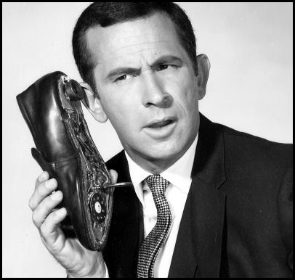
Refund Calls
ADOR Website: “Where’s My Refund”
Phone: 1-855-894-7391 (voice/ keyed response )
Call Center: (334)353-0944 or 1-800-535-9410

Slide 58

QUESTIONS
Business Privilege Tax 334-353-7923
Certificate of Compliance 334 -242-1189
Corporate Income Tax 334-353-7943
Individual Income Tax:
Examination Unit 334-353-0602
Compliance Unit 334-353-9770
Pass Through Entity 334-242-1033
Special Audit and Compliance:
Non-Filer Group 334-242-1511
CP 2000 334-242-1940
Withholding Tax 334-242-1300

Slide 59
CPE Presentations on the Website
If looking for this CPE Presentation or prior year presentations, please visit the Department’s website at www.revenue.alabama.gov and follow these steps.
Click on the Services link in the upper right-hand corner of the homepage.
Click on the Income Tax link from the drop-down menu.
Click on the Professionals link.
Click on CPE Presentations in the drop-down box.
Click on the CPE Presentation of your choice.

Slide 60
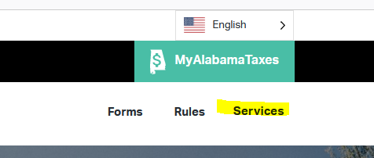
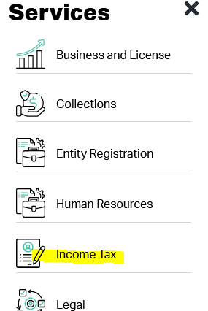
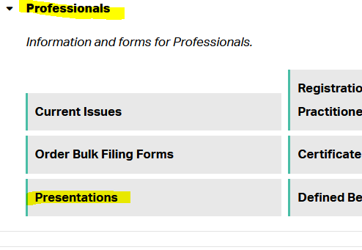
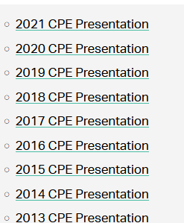
CPE Presentations on the Website

Slide 61

Comments?
Lynn Schoener
lynn.schoener@revenue.alabama.gov
(334) 353-8045
Andrea Wyatt
andrea.wyatt@revenue.alabama.gov
(334) 353-9447

